Slide 1
MolSim WS 23/24
Sheet X
Task1, Task2, Task3 …
Group C [Manuel, Tobias, Daniel]
10/31/2023

Slide 2
Topic 1
Chapter 1
Point 1
Point 2
Chapter 2
Point 1

Slide 3
Topic 2
Chapter 1
Point 1
Point 2
Chapter 2
Point 1

Slide 4
Topic 3
Chapter 1
Point 1
Point 2
Chapter 2
Point 1

Slide 5
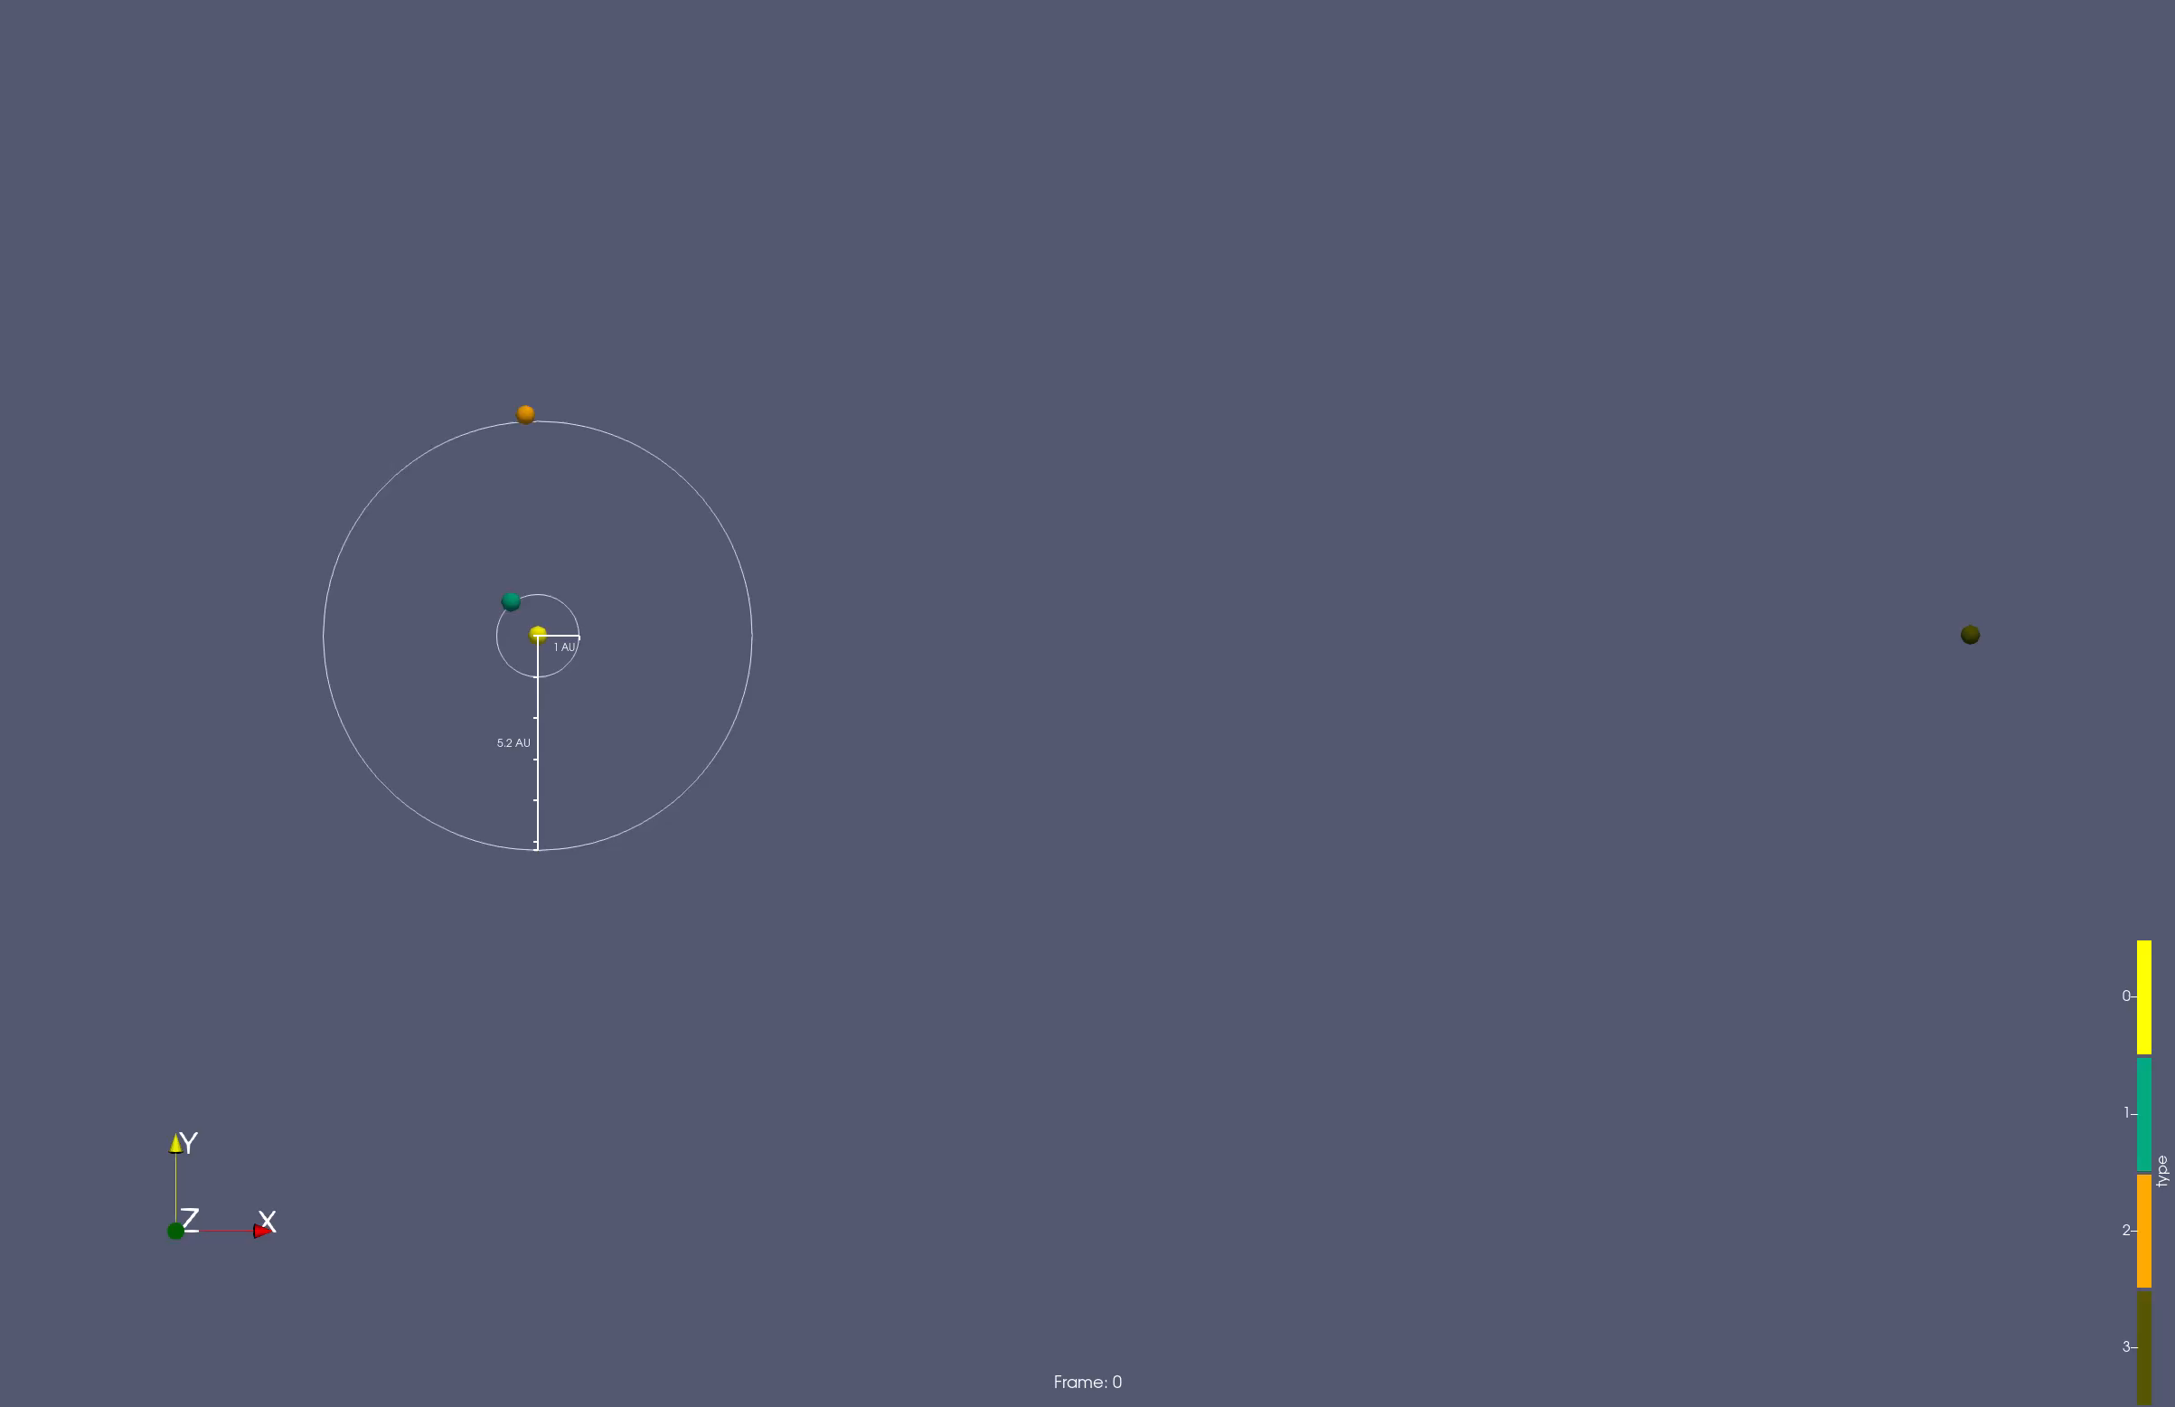
Pretty Picture

Slide 6
Summary of cool things
Cool thing 1
Cool thing 2
…

Slide 7
References
Source1: https://source1
Source2: https://source2

