Slide 1
MolSim WS 23/24
Sheet 1
Project Setup, Planetary Simulation
Group C [Manuel, Tobias, Daniel]
28.10.2023

Slide 2
N Body Simulation
TODO

Slide 3
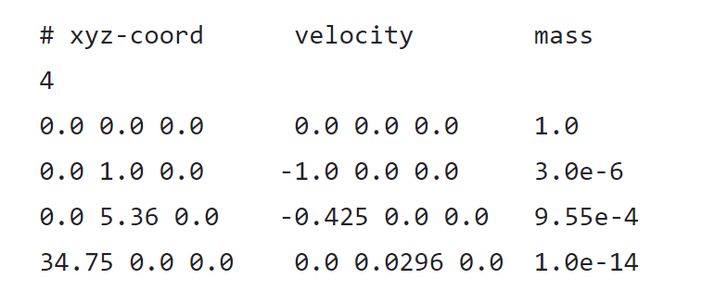
Input File Reverse Engineering
Input File isn’t labeled
⇒ Reverse engineer each body
Observation
Position in AUs
Mass normalized to sun
Therefore
Sun, Earth, Jupiter, Halley's Comet

Slide 4
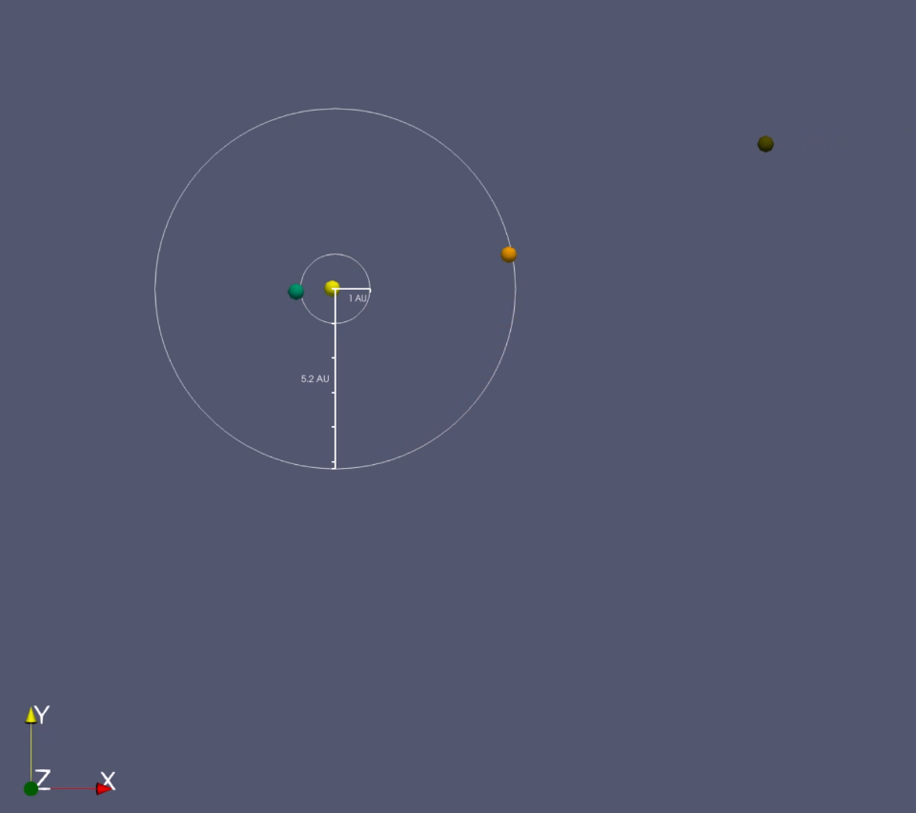
Visualization
Added some visuals to the simulation
Color represents planet type
Average orbit radius
Looks very cool!

Slide 5
Code Refactoring
TODO

Slide 6
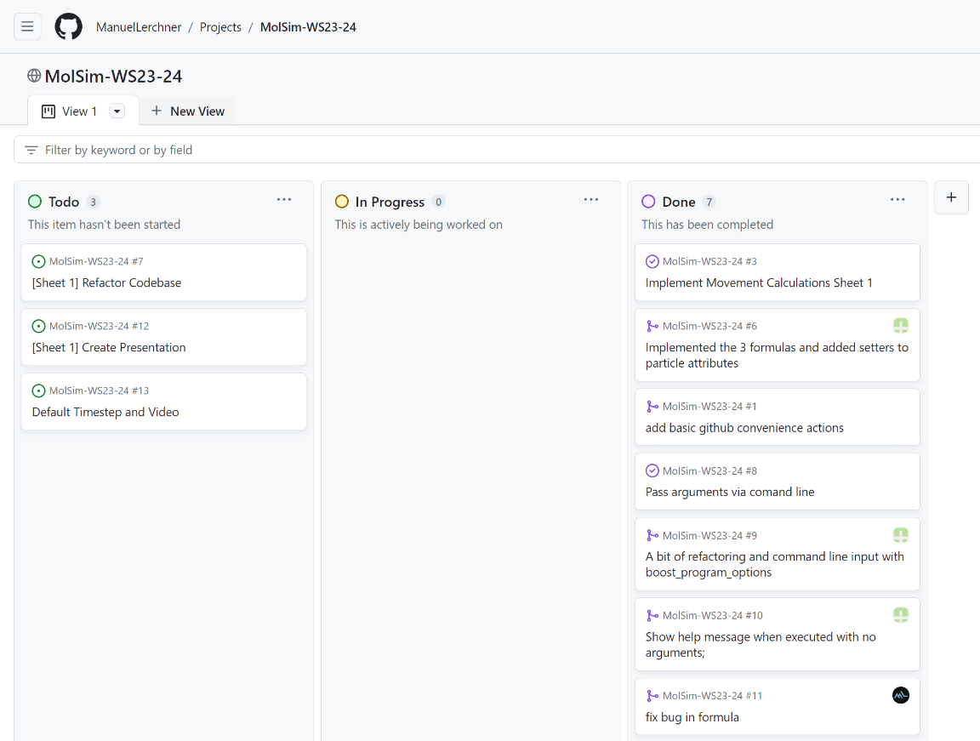
Github Project Management
Task Planning via Github
Kanban Board View
Easy way to see open issues

Slide 7
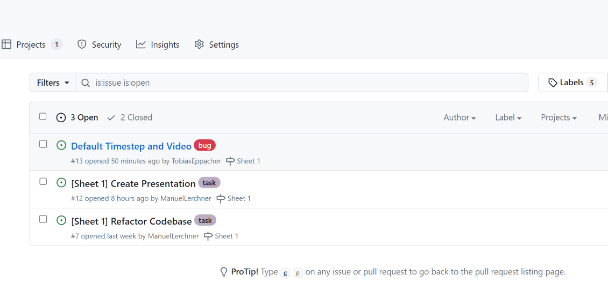
Github Issues
We organize open tasks in issues
Issues can be assigned to persons
Everyone can work in parallel
Hopefully not many merge conflicts

Slide 8
References

