Slide 1
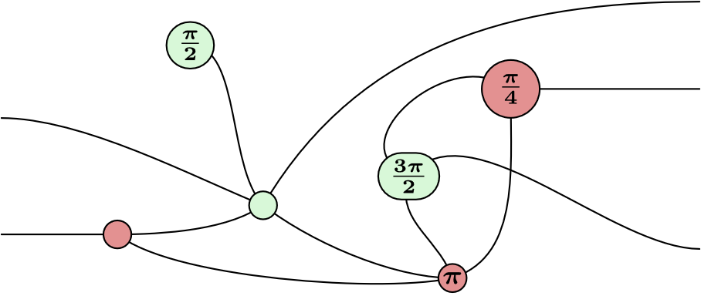
ZX-Calculus
Manuel Lerchner
21.05.2023

Slide 2
What is ZX-Calculus?
A way to represent Quantum Circuits
Graphical language
Rules for simplifying the Diagram

Slide 3
Applications
Quantum Circuit Optimization
T-Count Optimization
Circuit Compilation

Slide 4
Quantum Circuit Optimization
Idea: Transform circuits into equivalent circuits:
Goal: Fewer or simpler Gates
But why use ZX-Calculus for this?

Slide 5
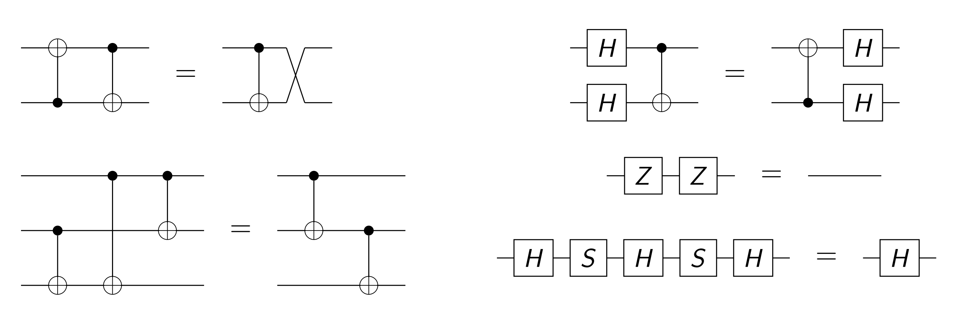
Classical Optimization
Fig. 2: Circuit Identities

Slide 6
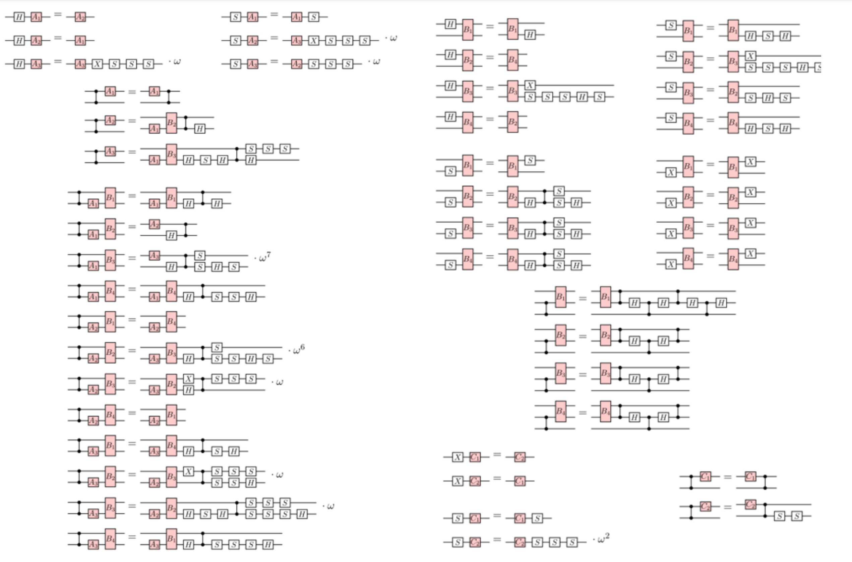
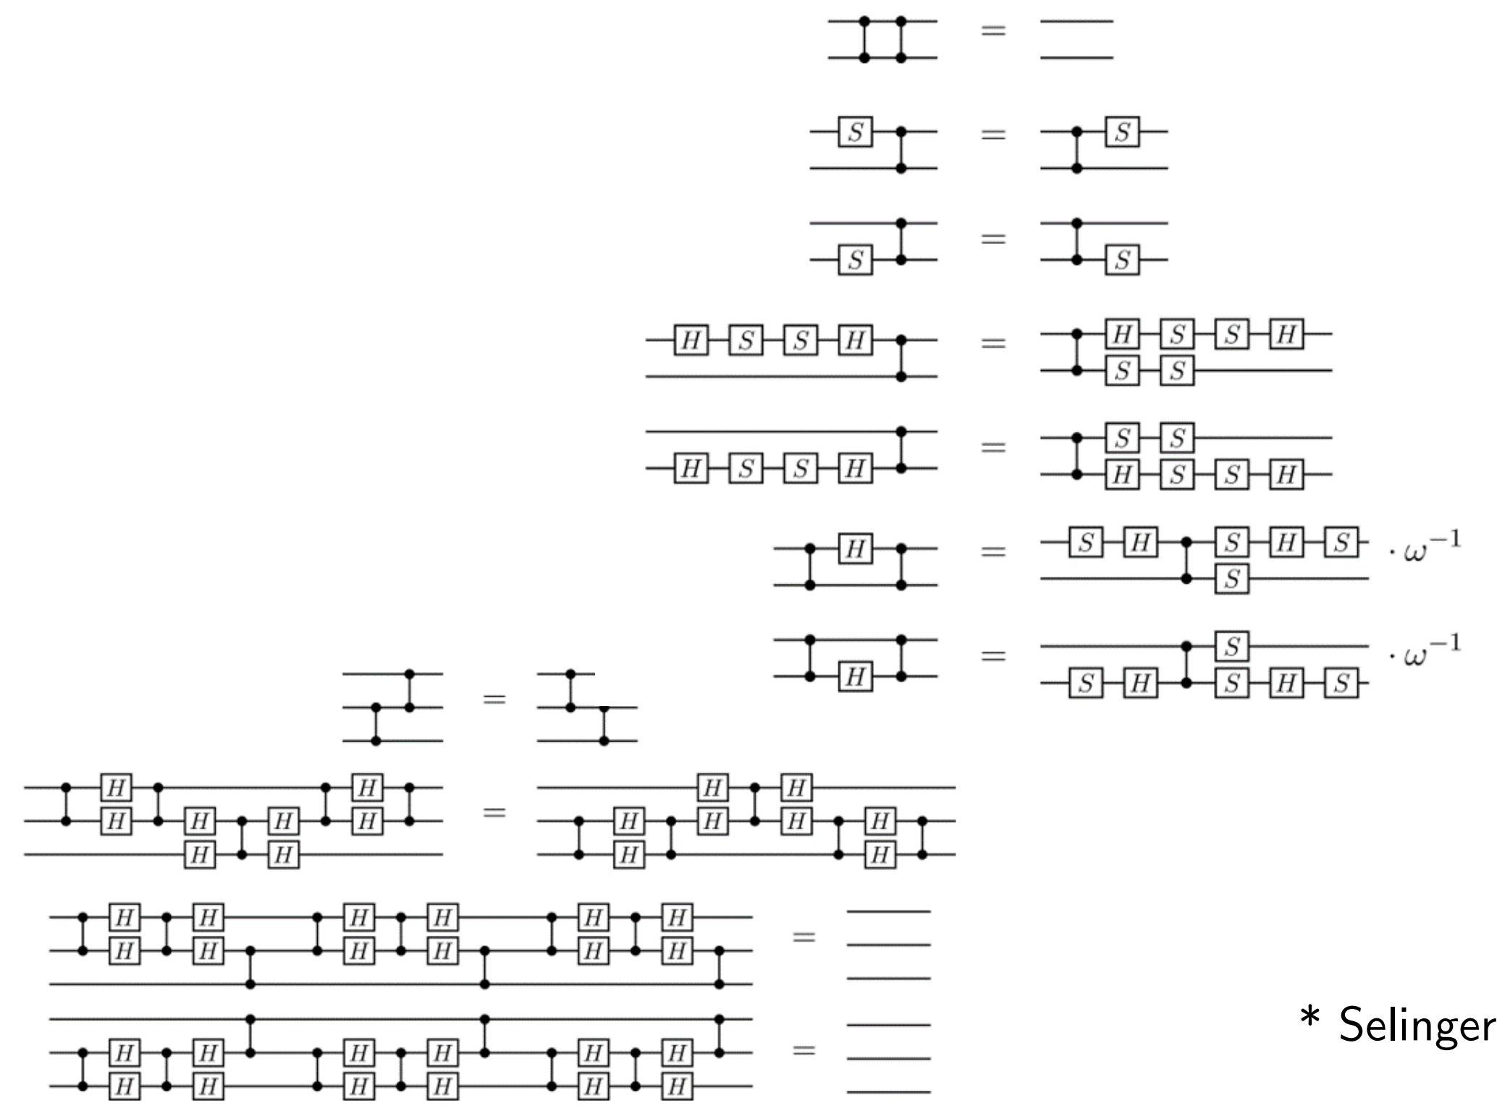
Classical Optimization
Fig. 2: Circuit Identities

Slide 7
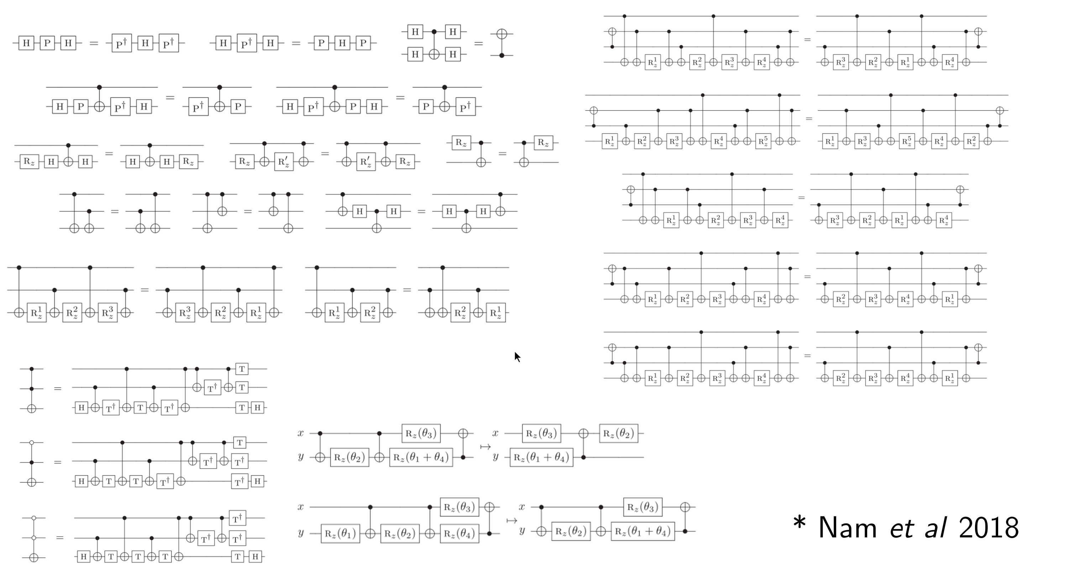
Classical Optimization
Fig. 2: Circuit Identities

Slide 8
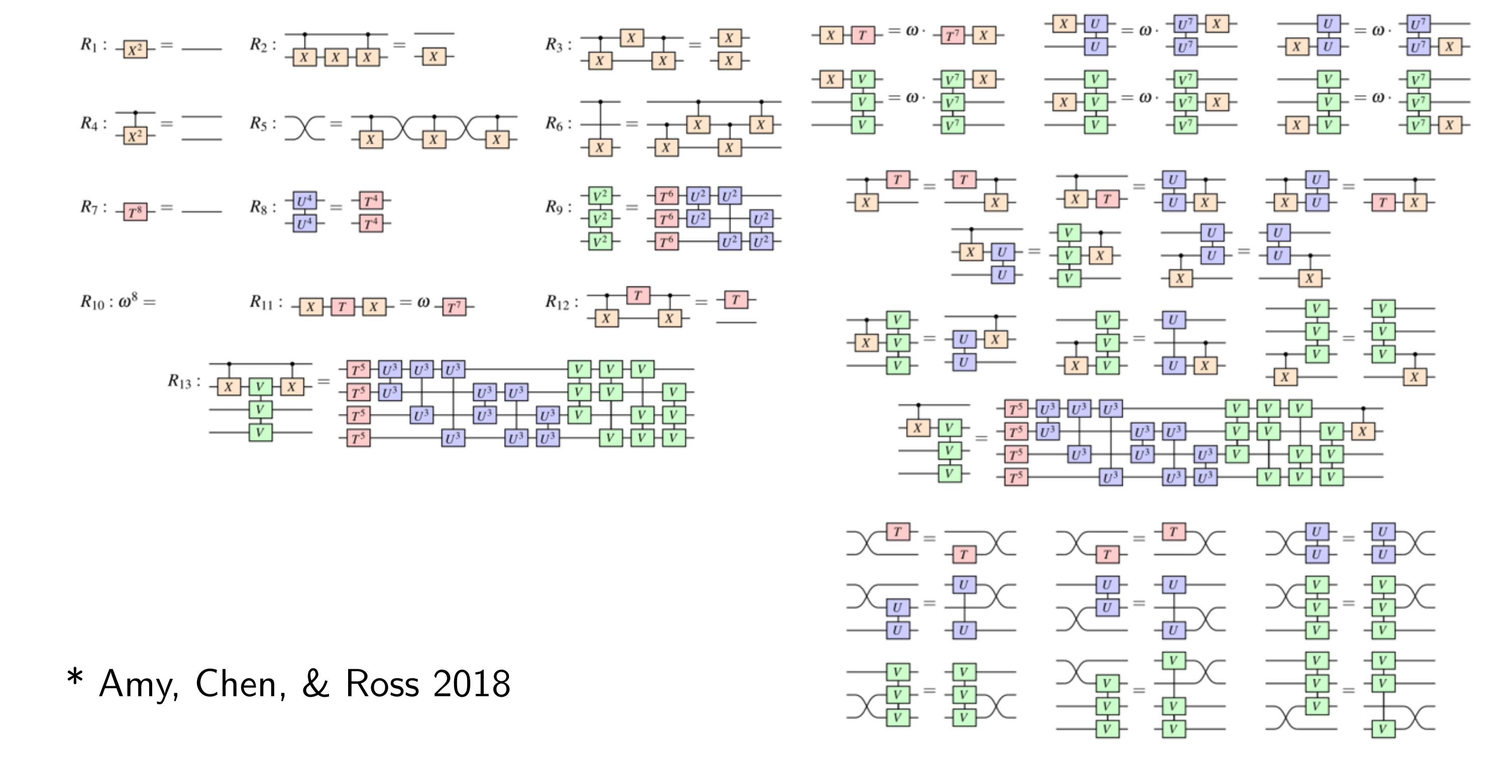
Classical Optimization
Fig. 2: Circuit Identities

Slide 9
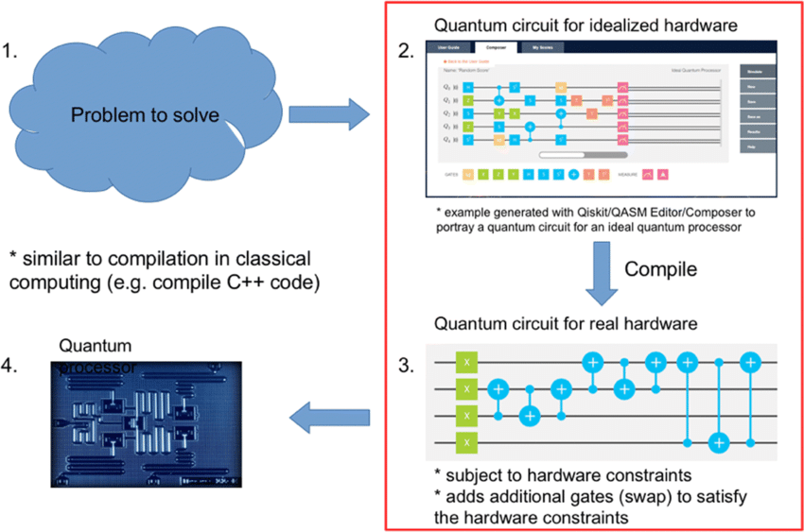
Compilation of quantum circuits
Circuits use many abstract gates
Problems of real quantum computers:
Limited set of gates
Limited connectivity between qubits
Fig. 3: Quantum Compilation

Slide 10
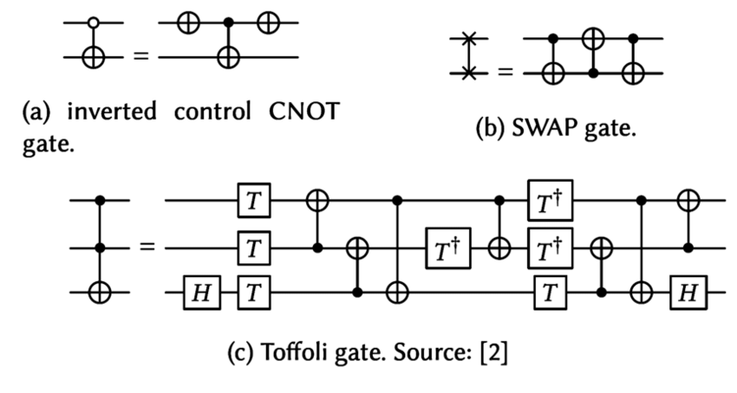
T-Count Optimization
Quantum computers are affected by noise
Clifford+T Circuits can be made tolerant to noise
Idea: Introduce Error Correcting Codes
Problem: Many new T-Gates need to be introduced
Difficult to simulate (Hardware Limits)
ZX-Calculus can simplify such circuits
Fig. 4: Fault tolerant Toffoli Gate

Slide 11
Mathematical Background
abc

Slide 12
Image Sources
Fig. 1: ZX-Circuit https://upload.wikimedia.org/wikipedia/commons/5/50/Zx-diagram-example.svg
Fig. 2: Circuit Identities https://www.cs.ox.ac.uk/people/aleks.kissinger/slides/qnlp-40mins.pdf
Fig. 3: Quantum Compilation https://www.researchgate.net/figure/Quantum-circuit-compilation-47_fig15_348930917
Fig. 4: Fault tolerant Toffoli Gate https://www.researchgate.net/figure/The-fault-tolerant-Clifford-T-implementations-of-quantum-logic-gates-used-in-this-work_fig1_322049116

