Slide 1
Whitespace & Cross-Sell
Opportunity Analyzer
User Guide for Sales & Sales Management
Q3 2026
Jeff Dillon, Helen Lan
SAP Confidential

Slide 2
What Is This Tool?
Whitespace & Cross-Sell Opportunity Analyzer
Looks at every account you own and asks: "Which SAP Solution Areas do they NOT have yet?"
Ranks those gaps by outside-in dollar potential (how much budget likely exists, based on peers in the same industry and revenue tier)
Tells you which accounts to call first, which products to propose, and how much opportunity is at stake
"Find the money you're leaving on the table — before your competitor does."
SAP Confidential

Slide 3
How the Tool Works
"Three inputs → one prioritized opportunity list"
SAP Adoption
Monitor
TAO
Estimated Wallet
TAO
Sales Priority
What do customers
own and are they using it?
What is the outside-in
budget estimate?
What solutions fit
their industry?
→
Prioritized Whitespace
SAP Confidential
Notes:
What do they own and how is it being used?
What is their estimated budget?

Slide 4
Key Concepts
Estimated Wallet Data Inputs
Average 2025 Total SAP Revenue per solution area for top k% companies in each Global Ultimate Revenue Band cluster.
CRO alignment and market intelligence informed additional assumptions on total opportunity sizing.
TAO Estimated Wallet
Approximates how much budget exists for a specific solution area
(L1, L2).
Gap to Estimated Wallet
Estimated Wallet - Exit ACV - CY & CY+1 Pipeline
SAP Confidential

Slide 5
Key Concepts
TAO Priority
SPS Model Data Inputs
Super Score (intent data)
BTP Recommender (usage data)
Propensity Model (opportunity data)
Customer Journey (purchase history)
Crystal Record (CRM master data)
The likelihood that a sales opportunity will open for this account in a specific solution area (L1,L2) within the next year, based on historical patterns.
Priority | Account coverage | Future opps
1 Very High | Top 5% | ~40%
2 High
3 Medium | Next 20% | ~40%
4 Medium Low | Bottom 75% | ~20%
5 Low
SAP Confidential

Slide 6
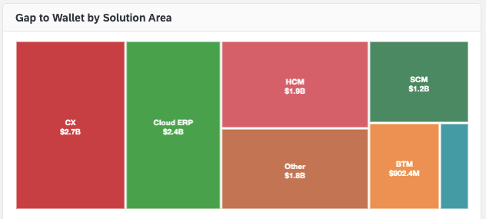
Overview: Gap to Wallet by Solution Area
"Where is the biggest money hiding?"
The largest boxes tell you exactly where the team should be focused.
SAP Confidential
Notes:
"Every quarter we ask the same question: where should we focus? This tool answers it with data, not gut feel."
"We're going to walk from the territory view down to a single account — following the questions a real selling team asks every day."
"Three roles, three questions: the RVP and VP looking for where to direct the team, the AE looking at one account, and the demand manager building a campaign."

Slide 7
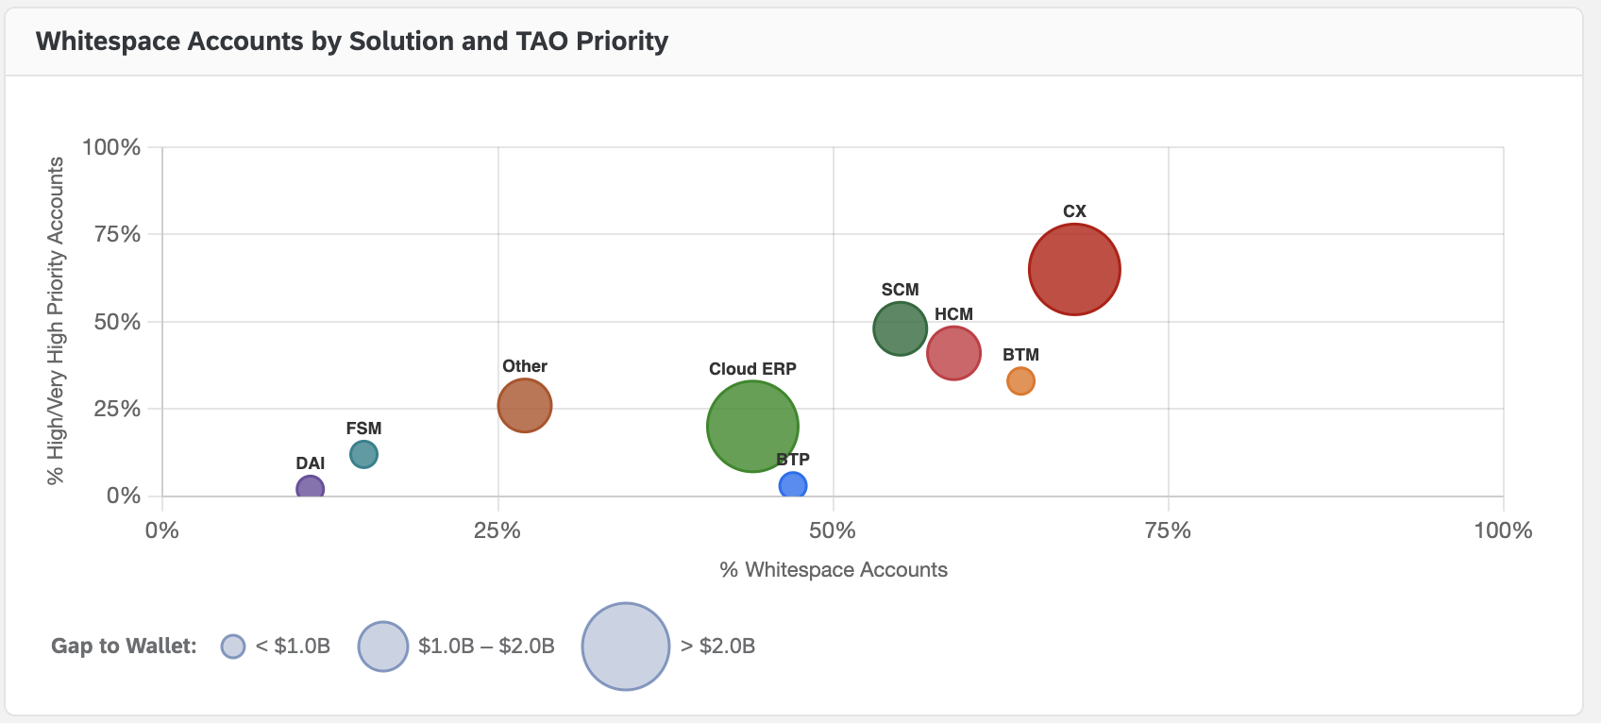
Whitespace Accounts by Solution and TAO Priority
"Which Solution Areas have both volume AND urgency?"
Bubbles in the upper-right corner have both volume AND urgency — call those accounts this week.
SAP Confidential

Slide 8
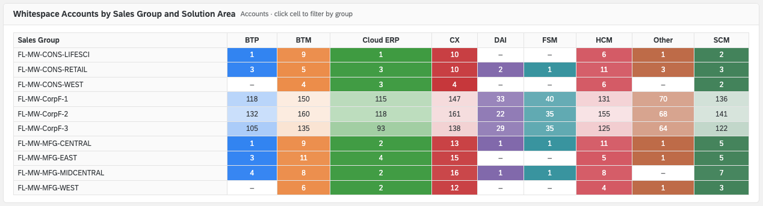
Whitespace by Sales Group and Solution Area
"How is opportunity distributed across your team?"
Scan the row for your team. The lightest cells show where the most accounts are missing a solution.
SAP Confidential

Slide 9
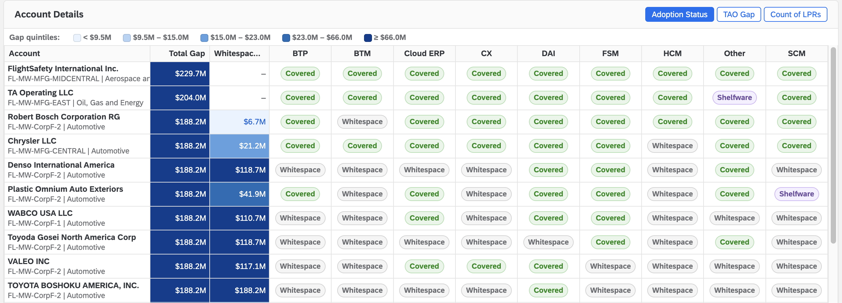
Account Details Table
"Your ranked account list — sortable, filterable, actionable"
Filter to your Sales Group. Sort by Whitespace Gap.
SAP Confidential

Slide 10
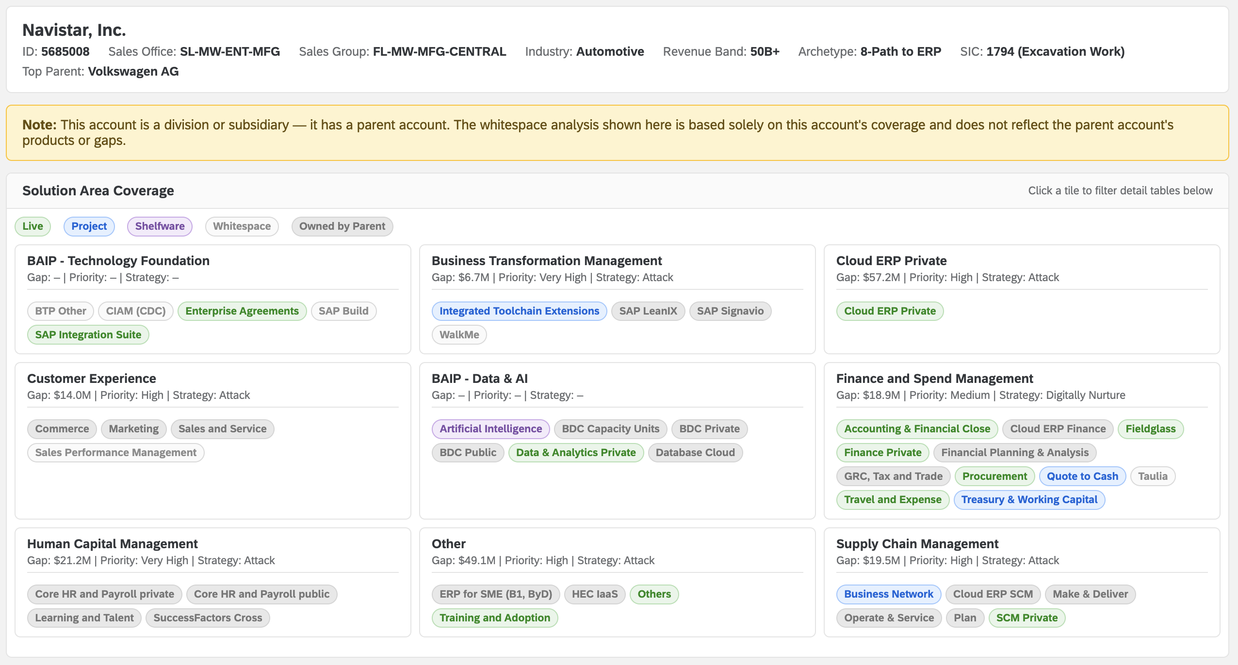
Account Detail Page
"Everything you need to prepare a cross-sell conversation — in one view"
Before your next discovery call: note the top 2–3 whitespace Solution Areas by Gap, check the Recommended Solutions, and go in with a hypothesis.
SAP Confidential

Slide 11
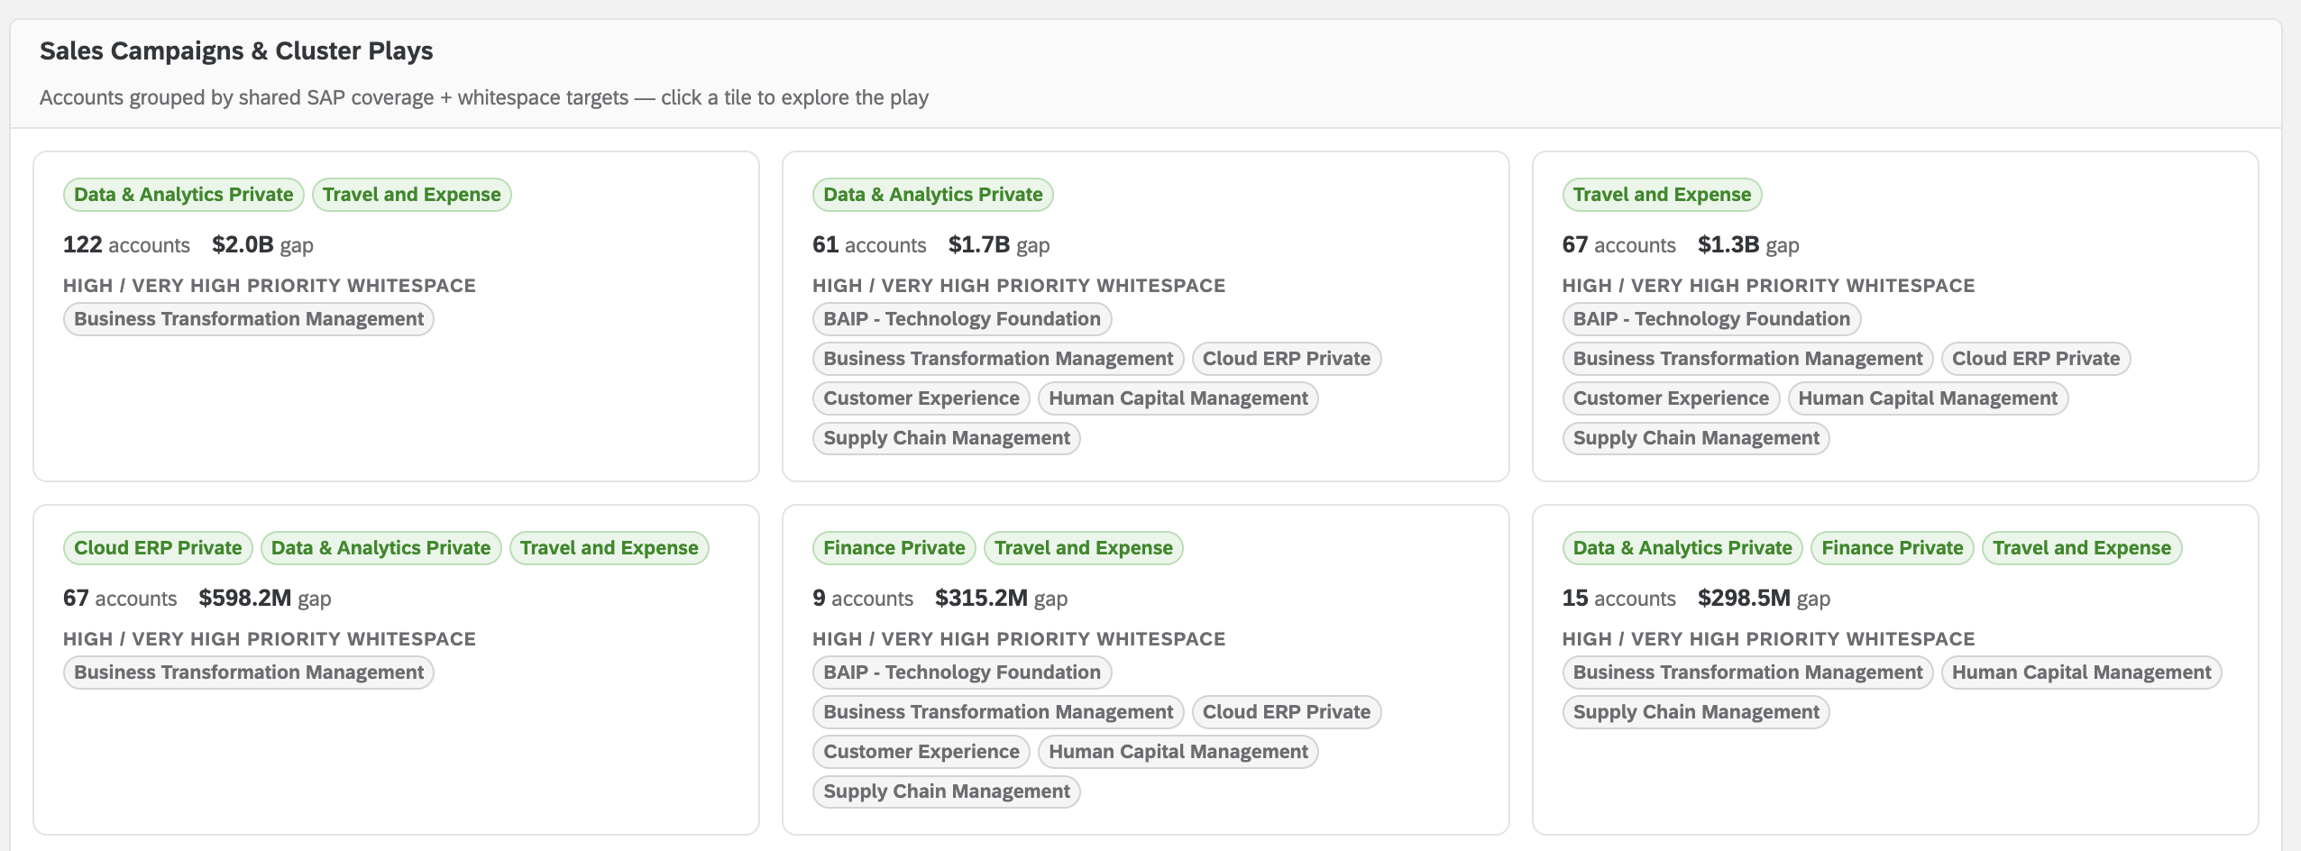
Cluster Analysis
"Run the same play on dozens of accounts at once"
Portfolio leads: use clusters to build focused campaigns. Sales managers: coordinate multi-AE outreach across a shared play.
SAP Confidential

Slide 12
Tips & Gotchas
Filters are global — Sales Office, Sales Group, Solution Area, Industry, RISE, Strategy, and Priority filters apply everywhere.
Scope mode — "Planning Entity + Top Parent" nulls out whitespace for L1s already covered by the parent. Avoids proposing what the parent owns.
Heatmap shading is intentionally inverted for accounts — lighter = more accounts (more opportunity volume).
Accounts with no SAP products are filtered out (tool is for cross-sell, not new logo).
Shelfware ≠ whitespace — if they have a license they’re not using, it’s covered. Consider a re-adoption conversation.
Data is at Planning Entity level — always check Top Parent. Switch to PE + Top Parent scope to factor in parent ownership.
Account search (top right) lets you jump directly to any account by name.
SAP Confidential

Slide 13
Next Steps
Access the tool here:
https://pages.github.tools.sap/ai-spotlight/mw-mu-dashboards/whitespace-analyzer.html
Questions? Data issues or missing accounts? Feature requests?
Contact Jeff Dillon and Helen Lan
SAP Confidential

