Slide 1
Curriculum Vitae
Manuel Baumann
November 28th, 2012

Slide 2
Academic Background
Born on October 4th, 1986 in Berlin (Germany)
2007 – 2011: Studies of Scientific Engineering at TU Berlin
2008 – 2011: Studies of Pure Mathematics at TU Berlin
2009 – 2011: Working as a student research assistant at TU Berlin
Since Aug 2011: Erasmus Mundus Master‘s Program COSSE at KTH Stockholm and
TU Delft

Slide 3

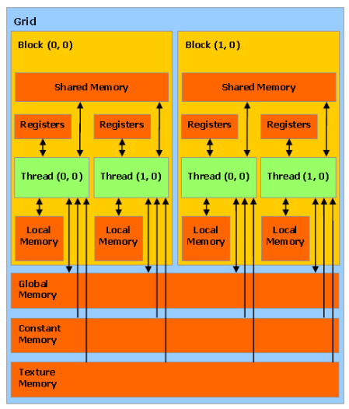
Bachelor Studies in Scientific Engineering at TU Berlin
Sound knowledge in different disciplines of Engineering Science, such as
Mechanics
Fluid Dynamics
Electrical Engineering
Specialization in CFD
Bachelor thesis: Numerical Solution of the Vorticity Transport Equation on Nvidia GPUs

Slide 4
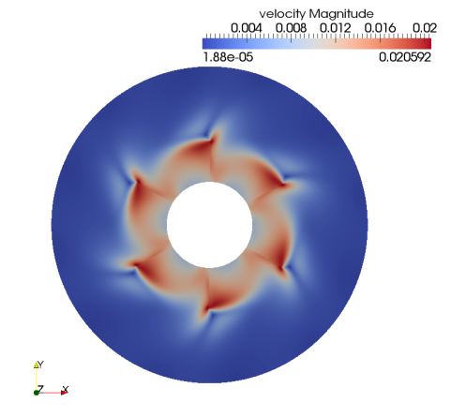
Bachelor Studies in Mathematics
Specialization in Functional Analysis and Numerical Linear Algebra
First Price at Dies Mathematicus of TU Berlin for Best Bachelor Degree in Mathematics
Bachelor Thesis: Modelling and Simulation of Dispersions in Turbulent Flows

Slide 5


Master Studies: COSSE
Erasmus Mundus scholarship, category B
1st year at KTH Stockholm:
Numerical Analysis
Parallel Programming
2nd year at TU Delft:
Stochastic Processes
Systems Theory
Master Thesis (Outline): Model Order Reduction for Nonlinear Dynamical Systems

Slide 6
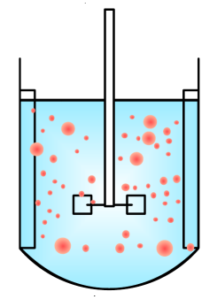
Professional Experience
2 years working as a student research assistant in in the working group Modelling, Numerics and Differential Equations at TU Berlin
Simulation and Control of fluid/fluid dispersions
Participant of the 4th International Conference on Population Balance Modelling, MPI Magdeburg
3 months internship at DLR Braunschweig
Coupled flow-structure simulations with MPI
2 years leading the student working group Development Politics of the Friedrich Ebert Foundation

Slide 7
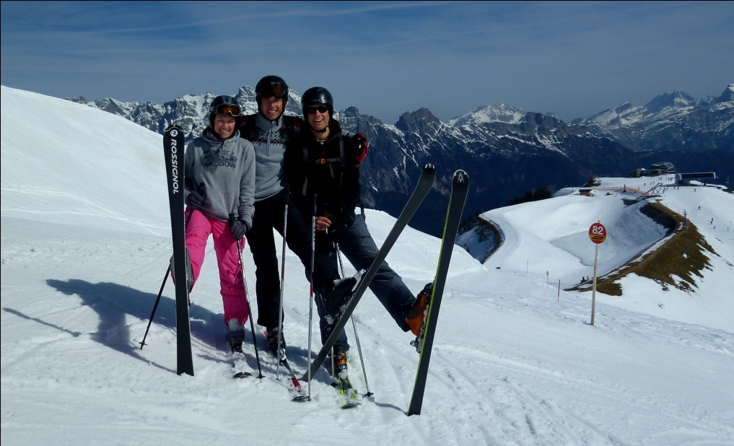
What else do I like…
Skiing
Tennis
Politics

