Slide 1
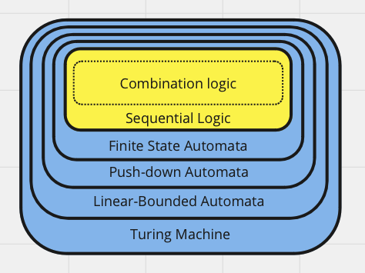
Lecture
Section 3: Digital Logic: Combinational and Sequential Circuits
2 weeks followed by Quiz #3
Boolean Algebra ⇔ Digital Circuits
Combinational Circuits: half adder, full adder, decoders, multiplexers, BCD-7 segment
Sequential Circuits: Latches, Registers, and Memory
Pipeline Architecture: MIPS

Slide 2
Models of Computation
Turning Machines | Recursively Enumerable | TM(Q, Σ, 𝚪, q0, 𝛅)
Linear Bounded Automata | Context Sensitive Languages | LBA(Q, Σ, 𝚪, q0, 𝛅)
Pushdown Automata | Context Free Languages | PDA(Q, Σ, 𝚪, 𝛅, q0, z0, F)
Finite State Automata | Regular Expressions | FA(Q, Σ, 𝛅, q0, F)
Sequential Circuits
Combinational Logic | Boolean Algebra

Slide 3




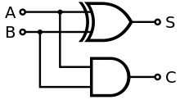
Combinational Logic
Based upon Boolean Algebra
all inputs and outputs restricted to True (1) and False (0)
Operations are restricted to: AND (*), OR (+), NOT (')
Equivalent to Digital Logic, with gates:
Can be used as a building blocks:
XOR: A ⊕ B is equivalent to (A + B) * (A' + B')
Example: Half-Adder

Slide 4
Boolean Algebra ⇔ Digital Circuits
Circuit: a digital realization of a function: y = f(), y = f(x), y =f(a,b), …
Values:
True (T), 1, +5v
False (F), 0,
Functions:
zero inputs: clear (0), set (1)
one input: clear, invert, id, set
#Inputs | Input Combinations |  | Output Combinations
0 | 2^0 | 1 | 2^2^0 | 2
1 | 2^1 | 2 | 2^2^1 | 4
2 | 2^2 | 4 | 2^2^2 | 16
3 | 2^3 | 8 | 2^2^3 | 256
 |  |  | 2^2^4
Input A | Possible Outputs
0 | 0 | 1 | 0 | 1
1 | 0 | 0 | 1 | 1
0 0
0 1
1 0
1 1

Slide 5
Two Input Functions
clear | set
nor | or
↚ | ←
A' | A
↛ | →
B' | B
neq | equiv
nand | and
16 different functions can be created: 2^ 2²
List of functions:
Definitions: Truth Table:
fold line
A | B | 0 | nor | ↚ | A' | ↛ | B' | 'equiv | nand | and | equiv | B | → | A | ← | or | 1
0 | 0 | 0 | 1 | 0 | 1 | 0 | 1 | 0 | 1 | 0 | 1 | 0 | 1 | 0 | 1 | 0 | 1
0 | 1 | 0 | 0 | 1 | 1 | 0 | 0 | 1 | 1 | 0 | 0 | 1 | 1 | 0 | 0 | 1 | 1
1 | 0 | 0 | 0 | 0 | 0 | 1 | 1 | 1 | 1 | 0 | 0 | 0 | 0 | 1 | 1 | 1 | 1
1 | 1 | 0 | 0 | 0 | 0 | 0 | 0 | 0 | 0 | 1 | 1 | 1 | 1 | 1 | 1 | 1 | 1

Slide 6
Boolean Algebra to Circuits
A
A'
Clear: 0 →
Set: 1 →
A: A →
A': A
A + B:
A * B:
A ⊕ B:
A ⊕ B: (A + B) * (A' + B')
B
A
B
A | B | xor | and | or
0 | 0 | 0 | 0 | 0
0 | 1 | 1 | 0 | 1
1 | 0 | 1 | 0 | 1
1 | 1 | 0 | 1 | 1
A
B
A
B

Slide 7
Truth Table Reduced to a Circuit
Generate a circuit as a sum of products
Values: 0, 1
Functions: Not ('), And (*), Or (+)
Example: Implication: A → B
If B is true then A must also be true!
Consider the Truth Table
Evaluate each row:
Combine all rows that are true
Output = A'B' + AB' + AB
A | B | Output
0 | 0 | 1 |  | A'B'
0 | 1 | 0 |  | A'B
1 | 0 | 1 |  | AB'
1 | 1 | 1 |  | AB

Slide 8
More Complex Reduction
Bob : (ABC')'
A | B | C | Bob | Sally
0 | 0 | 0 | 1 | 0 |  | A'B'C'
0 | 0 | 1 | 1 | 0 |  | A'B'C
0 | 1 | 0 | 1 | 0 |  | A'BC'
0 | 1 | 1 | 1 | 0 |  | A'BC
1 | 0 | 0 | 1 | 0 |  | AB'C'
1 | 0 | 1 | 1 | 0 |  | AB'C
1 | 1 | 0 | 0 | 1 |  | ABC'
1 | 1 | 1 | 1 | 0 |  | ABC

Slide 9
Circuit to Boolean Algebra
One Formula for each output
Work Backwards, Divide and Conquer!
Output = ( ) * ( )
Output =
Output =
A
x
?
y
G
B
j
H

Slide 10
Simplification ⇔ Minimization
( 5 + 3 )+ 2 == 5 + ( 3 + 2 )
3* ( 5 + 6 ) == 3 *5 + 3 * 6
R = A'*B + A*B
R = B*A' + B*A
R = B*(A' + A)
R = B * 1
R = B
The above method can yield large circuits
Unnecessary large circuits, like programs, are bad:
require larger chips
require more time to evaluate
generate more heat
Two approaches:
Use algebraic properties to rewrite the formulas
Use Karnaugh maps to visualize patterns of simplification
Algebraic Properties:
associative, commutative, distributive
complement (A*A' ⇔ 0), De Morgan's law : A' * B' ⇔ (A + B)'
A' + A ⇔ 1
Example
R = A'*B + A*B

Slide 11
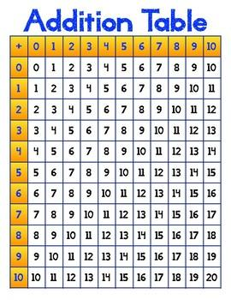
Karnaugh Map
base 10 addition table
Truth Table: R = A'*B + A*B
Karnaugh Map: for two variables
Find groups that contain only 1s
Group size must be in power of two (1, 2, 4, 8)
R = B
A | B | Output
0 | 0 | 0 |  | '(A'B')
0 | 1 | 1 |  | A'B
1 | 0 | 0 |  | '(AB')
1 | 1 | 1 |  | AB
 |  | B
 |  | 0 | 1
A | 0 | 0 | 1
 | 1 | 0 | 1

Slide 12
3-Variable Karnaugh Map
00
01
10
11
 |  | BC
 |  | 00 | 01 | 11 | 10
A | 0 | 1 | 1 | 0 | 0
 | 1 | 1 | 1 | 1 | 0
A | B | C | Output
0 | 0 | 0 | 1
0 | 0 | 1 | 1
0 | 1 | 0 | 0
0 | 1 | 1 | 0
1 | 0 | 0 | 1
1 | 0 | 1 | 1
1 | 1 | 0 | 0
1 | 1 | 1 | 1
output = B' + AC
---
output = B' + ABC

Slide 13
Rules for K-maps
 |  | BC
 |  | 00 | 01 | 11 | 10
A | 0 | 0 | 1 | 1 | 1
 | 1 | 1 | 0 | 0 | 1
Groups only contains 1s
Group size must be a power of two
Groups must be rectangular, no diagonals
Groups can overlap
Groups can wrap
For Minimization:
Use the largest group
Use the fewest number of groups
But all 1s must be contained in at least one group.
output = A'C + AB' + A'BC'
 |  | BC
 |  | 00 | 01 | 11 | 10
A | 0 | 1 |  |  | 1
 | 1 | 1 |  |  | 1
BC
00 | 01 | 11 | 10
1 |  |  | 1
1 |  |  | 1

