Slide 1
mutual exclusivity
Simulating pathways
Simulating pathways
and
mutual exclusivity
and
Blanca Lacruz Pleguezuelos
Víctor Mateo Cáceres
Manuel Moradiellos Corpus
Notes:
Un saludo no estaria mal

Slide 2
Cancer: Challenge and approaches
Cancer is a collection of complex diseases difficult to tackle, many biological variables intertwined
Notes:
Images created with Biorender
Cancer is a collection of complex diseases that prove to be a challenge in their characterization due to the many interactions involved.

Slide 3
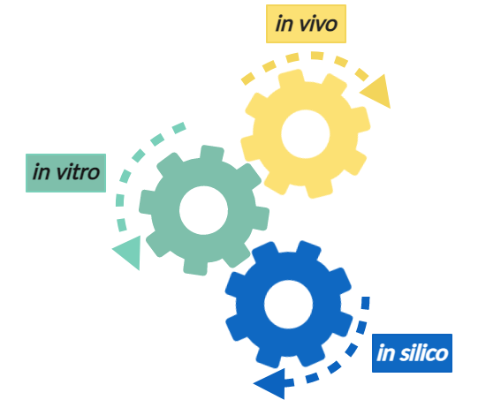
Cancer: Challenge and approaches
Cancer is a collection of complex diseases difficult to tackle, many biological variables intertwined
In silico models integrate data from experimental studies and analytical predictions
Notes:
Images created with Biorender
As is the case for other biological issues, in silico models come in handy as they are essential to answer our possible questions by integrating data from various sources.

Slide 4
Cancer: Challenge and approaches
Cancer is a collection of complex diseases difficult to tackle, many biological variables intertwined
In silico models integrate data from experimental studies and analytical predictions
Model tumor progression to identify candidate genes, valuable information for:
Diagnosis
Treatment
Prognostic
Notes:
Images created with Biorender
One possible approach to research cancer is understating the factors involved in tumor progression events, this can help us to highlight gene interactions or key mutations that would be valuable for several therapeutic purposes.

Slide 5
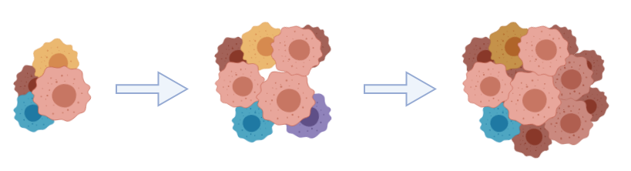
Modeling cancer: CPMs and DAGs
Cancer Progression Models (CPMs)
Genotype frequency data from cross-sectional studies
Notes:
Images created with Biorender
One of the in silico tools used to do so are cancer progression models or CPMs; these employ genotype frequency data to model the possible accumulation of mutations that this event follows.

Slide 6
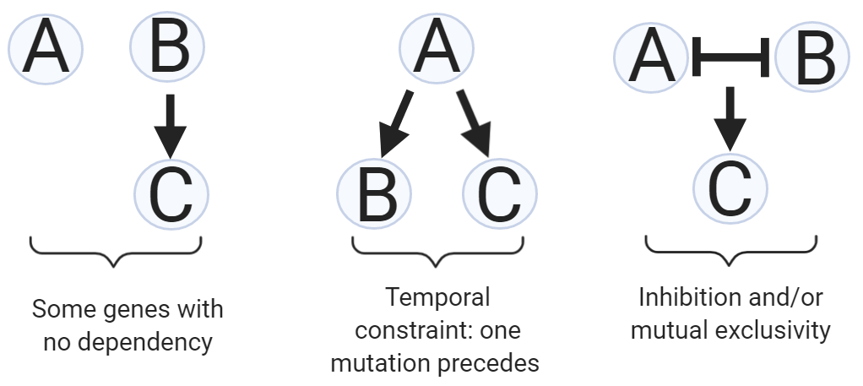
Modeling cancer: CPMs and DAGs
Cancer Progression Models (CPMs)
Directed Acyclic Graphs (DAGs)
Genotype frequency data from cross-sectional studies
Notes:
Images created with Biorender
These CPMS return directed acyclic graphs (DAGs) in which the vertices or nodes are the potentially mutated genes, and their relationships are the edges of the graph (arrows representing temporal order of mutations) Therefore, delimiting the possible paths that can occur in a tumor as they must fulfill the constraints and dependencies restricted within the DAGs.

Slide 7
Modeling cancer: CPMs and DAGs
Cancer Progression Models (CPMs)
Directed Acyclic Graphs (DAGs)
Genotype frequency data from cross-sectional studies
These delimit possible relationships between genes and possible mutational trajectories, useful to identify candidate genes to block relevant pathways
Notes:
Images created with Biorender
Thus, by having these graphical representations we can search for potential candidate genes that could be useful in our therapeutic motivation: such as identifying target genes in relevant pathways that could be used to block that tumor progression.

Slide 8
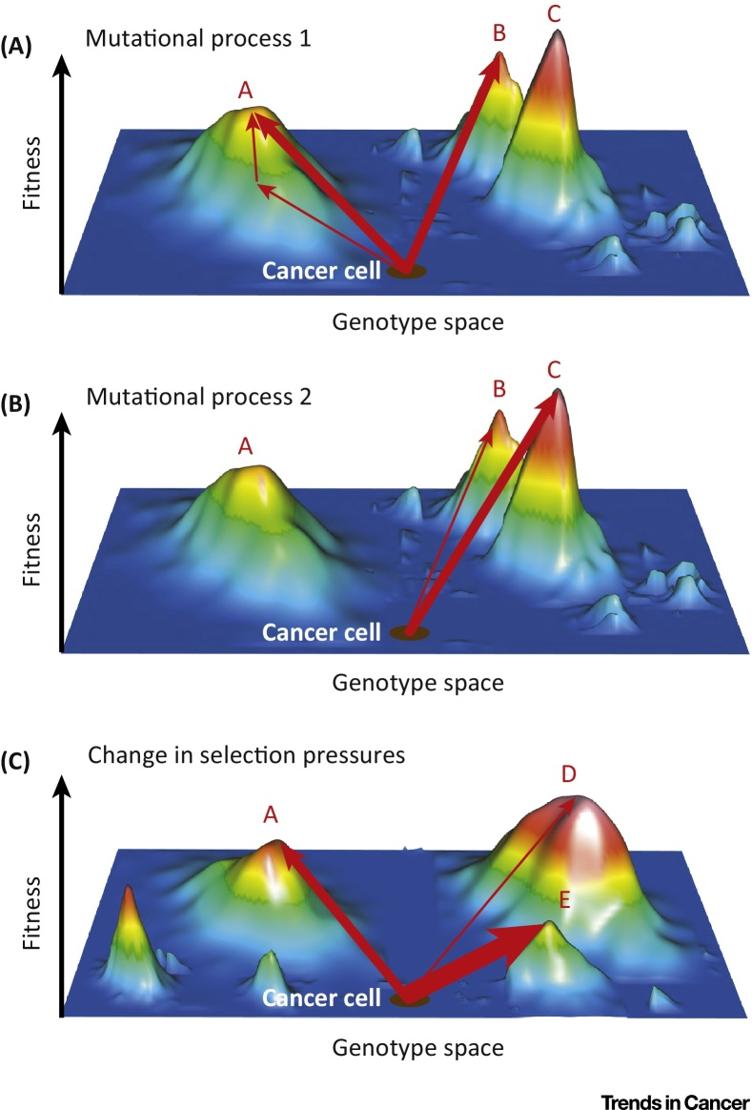
Modeling cancer: Fitness landscapes
Maps of genotypes and their fitness, delimit multiple paths for accumulation of mutations
Lipinski et al. (2016)
Notes:
Figure from: Lipinski, Kamil & Barber, Louise & Davies, Matthew & Ashenden, Matthew & Sottoriva, Andrea & Gerlinger, Marco. (2016). Cancer Evolution and the Limits of Predictability in Precision Cancer Medicine. Trends in Cancer. 2. 10.1016/j.trecan.2015.11.003.
But one thing to keep in mind is that DAGs do not contain any information about the fitness of genotypes, so another convenient approach to understand cancer progression are fitness landscapes. These are maps that specify the observed genotypes and their fitness delimiting multiple paths that can be reached from the wild type to further stages as the it accumulates mutations.

Slide 9
Modeling cancer: Fitness landscapes
Maps of genotypes and their fitness, delimit multiple paths for accumulation of mutations
Accessible genotypes: Mutational pathways along different genotypes where each one is separated by a single mutational step and fitness increases
Lipinski et al. (2016)
Notes:
Figure from: Lipinski, Kamil & Barber, Louise & Davies, Matthew & Ashenden, Matthew & Sottoriva, Andrea & Gerlinger, Marco. (2016). Cancer Evolution and the Limits of Predictability in Precision Cancer Medicine. Trends in Cancer. 2. 10.1016/j.trecan.2015.11.003.
In these maps we can find all accessible genotypes which are key to our goal of finding relevant genes or pathways.

Slide 10
Modeling cancer: Fitness landscapes
Maps of genotypes and their fitness, delimit multiple paths for accumulation of mutations
Accessible genotypes: Mutational pathways along different genotypes where each one is separated by a single mutational step and fitness increases
Tumor progression is an evolutionary process, fitness reinforces prediction of most probable paths (accessible genotypes)
Lipinski et al. (2016)
Notes:
Figure from: Lipinski, Kamil & Barber, Louise & Davies, Matthew & Ashenden, Matthew & Sottoriva, Andrea & Gerlinger, Marco. (2016). Cancer Evolution and the Limits of Predictability in Precision Cancer Medicine. Trends in Cancer. 2. 10.1016/j.trecan.2015.11.003.
As tumor development an evolutionary process, delimiting the most probable paths by incorporating fitness effects reinforces the prediction of cancer progression.
As we can see in the image, there are many accessible genotypes that reach different fitness maxima.

Slide 11
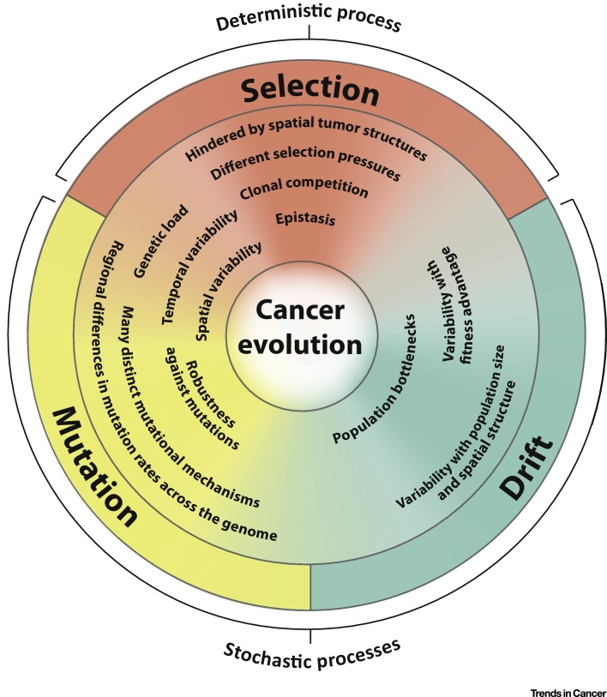
Modeling cancer: Many possible paths
Multiple complex evolutionary paths and high variance in fitness due to biological interactions such as:
Complementarity
Mutual exclusivity (synthetic lethality or no fitness gain in consecutive mutations in the same pathway)
Lipinski et al. (2016)
Notes:
Figure from: Lipinski, Kamil & Barber, Louise & Davies, Matthew & Ashenden, Matthew & Sottoriva, Andrea & Gerlinger, Marco. (2016). Cancer Evolution and the Limits of Predictability in Precision Cancer Medicine. Trends in Cancer. 2. 10.1016/j.trecan.2015.11.003.
Part of this complexity is due to the many biological interactions that occur in tumor progression materializes in our models as multiple possible evolutionary paths where the order of mutations can have restrictions or show complicated patterns such as complementarity or exclusivity, which is the focus of our work.

Slide 12
Modeling cancer: Many possible paths
Multiple complex evolutionary paths and high variance in fitness due to biological interactions such as:
Complementarity
Mutual exclusivity (synthetic lethality or no fitness gain in consecutive mutations in the same pathway)
CPMs cannot represent well this events (only temporal order) but fitness landscape can
Lipinski et al. (2016)
Notes:
Figure from: Lipinski, Kamil & Barber, Louise & Davies, Matthew & Ashenden, Matthew & Sottoriva, Andrea & Gerlinger, Marco. (2016). Cancer Evolution and the Limits of Predictability in Precision Cancer Medicine. Trends in Cancer. 2. 10.1016/j.trecan.2015.11.003.
These intricate interactions are not captured well by CPMs as they only represent genes and their temporal restriction; fitness landscapes can do so but given that producing a comprehensive one is no easy task, many tumor progression models are based on DAGs and carry their limitations

Slide 13
Modeling cancer: Many possible paths
Multiple complex evolutionary paths and high variance in fitness due to biological interactions such as:
Complementarity
Mutual exclusivity (synthetic lethality or no fitness gain in consecutive mutations in the same pathway)
CPMs cannot represent well this events (only temporal order) but fitness landscape can
Exhaustive fitness landscapes are hard to produce (evolution is complicated, duh), many models resort to using CPMs-DAGs and carry their limitations
Lipinski et al. (2016)
Notes:
Figure from: Lipinski, Kamil & Barber, Louise & Davies, Matthew & Ashenden, Matthew & Sottoriva, Andrea & Gerlinger, Marco. (2016). Cancer Evolution and the Limits of Predictability in Precision Cancer Medicine. Trends in Cancer. 2. 10.1016/j.trecan.2015.11.003.
These intricate interactions are not captured well by CPMs as they only represent genes and their temporal restriction; fitness landscapes can do so but given that producing a comprehensive one is no easy task, many tumor progression models are based on DAGs and carry their limitations

Slide 14
Objectives of our work
Various algorithms (pathTiMEx, MEMO, etc.) incorporate mutual exclusivity in their models based on DAGs, but they don’t validate those with evolutionary information → May not represent well enough accessible pathways
Notes:
On account of this, various algorithms have been created to incorporate complex patterns of mutual exclusivity when inferring models based on DAGs, but as they do not validate their performance with evolutionary models their robustness is compromised since they may not represent well enough the accessible paths within this evolutionary process.

Slide 15
Objectives of our work
Various algorithms (pathTiMEx, MEMO, etc.) incorporate mutual exclusivity in their models based on DAGs, but they don’t validate those with evolutionary information → May not represent well enough accessible pathways
Using OncoSimulR we worked on the data simulation from two papers/algorithms, critically assessing them by:
Replicating some of their models and examples
Extending on what they were modeling
Identifying some of their limitations
Notes:
Therefore, we have used the capabilities that OncoSimulR provides to map the simulation of data of models coming from two of those algorithms, critically assessing them by:
· Replicating some of their data simulation examples (models)
· Extending on what they are modeling
· Identifying some of their limitations

Slide 16
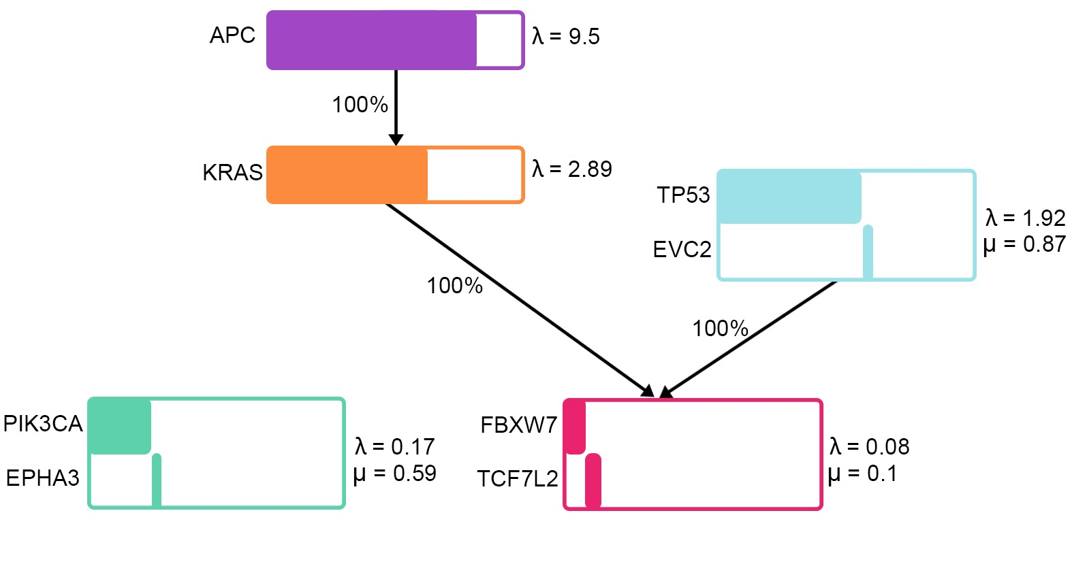
Colorectal cancer: Model found by pathTiMEx
pathTiMEx: Joint Inference of Mutually Exclusive Cancer Pathways and Their Progression Dynamics
Simona Cristea, Jack Kuipers and Niko Beerenwinkel
Notes:
First of all, we will see a model of colorectal cancer progression that can be easily implemented with OncoSimulR, based on data by Wood et al. (2007). This model was inferred by the algorithm defined by Cristea et al.
We can see that this model does not include any information about restrictions for two modules: TP53/EVC2 and PIK3CA/EPHA3, but they did find that mutations in these modules happen at certain stages of tumor progression. Mutations in TP53/EVC2 were found to happen after KRAS was mutated, while mutations in PIK3CA/EPHA3 are usually found at later stages of tumor progression.

Slide 17
Colorectal cancer: Model with order effects
Order effects:
Modules TP53/EVC2 and PIK3CA/EPHA3 appear independently
The positive effect on fitness is greater if order restrictions are respected
Root
APC
KRAS
TP53
EVC2
FBXW7
TCF7L2
PIK3CA
EPHA3
Notes:
Model A: order effects. In this model, we can see that there are some genes that have monotonic dependencies from others, where a mutation in a gene can only be seen if all the genes in the parent nodes have been mutated earlier. The modules that we are interested in have yellow arrows meaning order effects. This means that the fitness advantage provided by a mutation is greater if it happens at a specific point in time. For instance, mutations in APC, TP53 and KRAS will have a greater effect on fitness if they respect the order effects that we have encoded. The advantage is small because we chose to be very conservative about fitness effects.

Slide 18
Colorectal cancer: Model with order effects
Order effects:
Modules TP53/EVC2 and PIK3CA/EPHA3 appear independently
The positive effect on fitness is greater if order restrictions are respected
Root
APC
KRAS
eAG_wood_order[grep("^APC > TP53 > KRAS$", eAG_wood_order[,1]),]
TP53
EVC2
## Genotype Fitness
## 104 APC > TP53 > KRAS 1.44
FBXW7
TCF7L2
PIK3CA
EPHA3
Notes:
Model A: order effects. In this model, we can see that there are some genes that have monotonic dependencies from others, where a mutation in a gene can only be seen if all the genes in the parent nodes have been mutated earlier. The modules that we are interested in have yellow arrows meaning order effects. This means that the fitness advantage provided by a mutation is greater if it happens at a specific point in time. For instance: (ejemplo APC/KRAS/PIK3CA).

Slide 19
Colorectal cancer: Model with order effects
Order effects:
Modules TP53/EVC2 and PIK3CA/EPHA3 appear independently
The positive effect on fitness is greater if order restrictions are respected
Root
APC
KRAS
eAG_wood_order[grep("^APC > TP53 > KRAS$", eAG_wood_order[,1]),]
TP53
EVC2
## Genotype Fitness
## 104 APC > TP53 > KRAS 1.44
"^APC > KRAS > TP53$"
FBXW7
TCF7L2
PIK3CA
EPHA3
## Genotype Fitness
## 104 APC > TP53 > KRAS 1.584
Notes:
Model A: order effects. In this model, we can see that there are some genes that have monotonic dependencies from others, where a mutation in a gene can only be seen if all the genes in the parent nodes have been mutated earlier. The modules that we are interested in have yellow arrows meaning order effects. This means that the fitness advantage provided by a mutation is greater if it happens at a specific point in time. For instance: (ejemplo APC/KRAS/PIK3CA).

Slide 20
Colorectal cancer: What if there was a restriction?
KRAS restrictions:
If the restrictions are not fulfilled, a strong penalty is applied to the fitness
We are assuming a restriction that was not reported by the authors
Root
APC
KRAS
TP53
EVC2
eAG_wood_kras[54, ]
## Genotype Fitness
## 54 APC, KRAS, TP53 1.728
FBXW7
TCF7L2
PIK3CA
EPHA3
Notes:
Model B: nodes branching from KRAS. Note that order effects and monotonic dependencies might seem similar but are not the same thing. We thought it would be illustrative to transform these order effects into monotonic dependencies (turn the yellow arrows into black ones) and see what happened to specific clones.

Slide 21
Colorectal cancer: Comparing both models
eAG_wood_order[50, ]
Root
APC
## Genotype Fitness
## 50 PIK3CA > TP53 1
KRAS
eAG_wood_order[63, ]
## Genotype Fitness
## 63 TP53 > PIK3CA 1.05
TP53
EVC2
FBXW7
TCF7L2
PIK3CA
EPHA3
Notes:
The effect of this is very clear if we focus on the fitness of clones where only TP53 and PIK3CA are mutated and compare what happens in both models.
In the model with order effects we are not breaking any rules and we can see that the clones either have the same fitness as the wild-type or a small advantage.
In the second model, however, there are restrictions that are not being respected and a penalty is applied. Note that these two models, therefore, mean very different things from the biological point of view.

Slide 22
Colorectal cancer: Comparing both models
eAG_wood_order[50, ]
Root
APC
## Genotype Fitness
## 50 PIK3CA > TP53 1
KRAS
eAG_wood_order[63, ]
## Genotype Fitness
## 63 TP53 > PIK3CA 1.05
TP53
EVC2
eAG_wood_kras[35, ]
## Genotype Fitness
## 35 PIK3CA, TP53 0.01
FBXW7
TCF7L2
PIK3CA
EPHA3
Notes:
The effect of this is very clear if we focus on the fitness of clones where only TP53 and PIK3CA are mutated and compare what happens in both models.
In the model with order effects we are not breaking any rules and we can see that the clones either have the same fitness as the wild-type or a small advantage.
In the second model, however, there are restrictions that are not being respected and a penalty is applied. Note that these two models, therefore, mean very different things from the biological point of view.

Slide 23
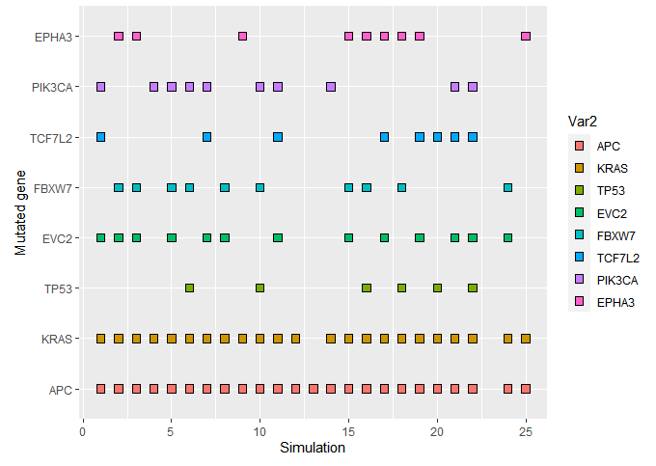
Colorectal cancer: Simulating tumor progression
Resulting genotypes after running the simulation 25 times with oncoSimulPop
Mutual exclusivity is (mostly) maintained
We cannot see order effects
Order effects model
Notes:
A further step would be simulating cancer cell populations, which can be done in different ways. This plot shows the resulting genotypes after running the simulation 25 times. However, we focused on the fitness evaluation to compare the models because these simulations only show the resulting genotypes therefore we lose order effects.
We can see that the graph proposed by the authors is easy to implement, but now we will see an example in which there are many more genes and pathways involved in tumor progression and it is not that easy to implement the model with OncoSimulR.

Slide 24
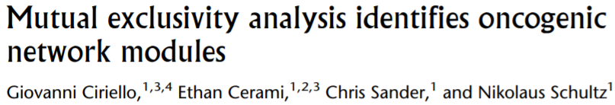

Glioblastoma: Defying the concept of “Module”
Models described in Ciriello et al
Modules that share one or more genes
“The intersection of modules is the empty set”
Notes:
Now, we’ll focus on 2 models for glioblastoma described in this article.
We made this choice because these models include (several) modules that share one or more genes. This is not surprising since it is accepted that most annotated pathways overlap with other pathways, but the concept Modules doesn’t consider this fact.
We know that the definition of “Module” in OncoSimul clearly states that “the intersection between modules is the empty set” but we also wanted to know what would happen if we broke this rule.

Slide 25
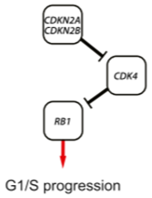
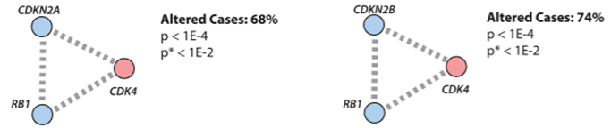
Glioblastoma: 1 pathway but 2 modules
Software applied to Glioblastoma dataset (TCGA)
2 mutually exclusive modules. Rb1 pathway
CDKN2A | CDK4 | RB1
CDKN2B | CDK4 | RB1
Notes:
So, the authors applied their software to the Glioblastoma dataset from TCGA and this resulted in the detection of two mutually exclusive modules inside the Rb1 pathway: one formed by CDKN2A, CDK4 and RB1; and another one formed by CDKN2B, CDK4 and RB1.

Slide 26
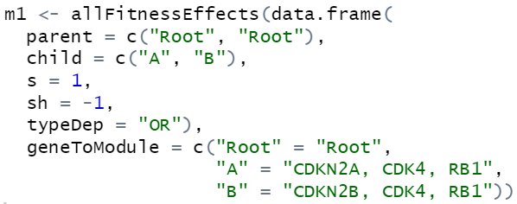

Glioblastoma: 1 pathway but 2 modules
¿2 modules DAG? Not possible in OncoSimul.
Probably it doesn’t make sense
WT
CDKN2A, CDK4, RB1
CDKN2A, CDK4, RB1
Notes:
Given this situation, we could think of creating a model with a simple DAG comprising 2 modules, each one representing each network. But OncoSimul won’t let you do this.

Slide 27
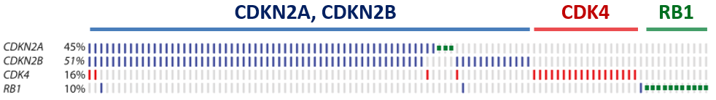
Glioblastoma: 1 pathway but 2 modules
Define effects of each possible genotype manually
CDKN2A+CDKN2B, CDK4 and Rb1 should have the same fitness
Notes:
So, we decided to specify fitness effects of each possible genotype manually:
First, we considered that the fitness of the clones CDKN2A+CDKN2B, CDK4 and Rb1 should be the same, so we could observe these 3 possible clones when running multiple simulations.

Slide 28

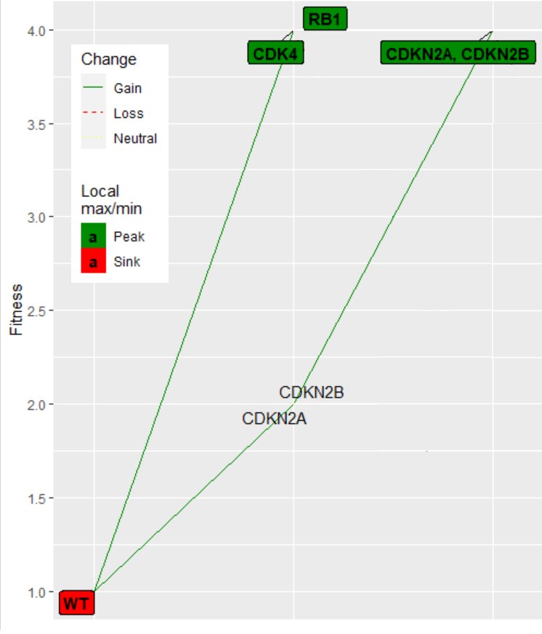


Glioblastoma: 1 pathway but 2 modules
2. CDKN2A and CDKN2B should have lower fitness
4
Genotype | Fitness
CDK4 | 4
RB1 | 4
CDKN2A, CDKN2B | 4
CDKN2A | 2
CDKN2B | 2
2
Notes:
*se pueden cambiar los colores de la tabla para adecuarlos al estilo
First, we considered that the fitness of the clones CDKN2A+CDKN2B, CDK4 and Rb1 should be the same, so we could observe these 3 possible clones when running multiple simulations.

Slide 29
Glioblastoma: 1 pathway but 2 modules
3. Fitness of more complex clones?
4
Mutating in RB1 to a CDKN2A clone
Fitness doesn’t change
2
CDKN2A, RB1

Slide 30
Glioblastoma: 1 pathway but 2 modules
3. Fitness of more complex clones?
4
Mutating in RB1 to a CDKN2A clone
Fitness doesn’t change
Path from RB1 involves a decrease
2
CDKN2A, RB1

Slide 31
Glioblastoma: 1 pathway but 2 modules
CDKN2A, RB1
3. Fitness of more complex clones?
4
b) Mutating CDKN2 in a RB1 clone
Fitness doesn’t change
Path from CDKN2 breaks exclusivity
2
Notes:
On the other hand, if we set the CDKN2A+RB1 genotype in 4 to avoid this problem, adding Rb1 to a CDKN2A clone would involve a fitness increase, which is contrary to the mutual exclusion principle.

Slide 32
Glioblastoma: 1 pathway but 2 modules
RB1 > CDKN2A
3. Fitness of more complex clones?
c) Specify order effects
Fitness doesn’t change
Biological justification?
CDKN2A > RB1
Notes:
Another possibility is to consider order effects but we didn’t find a reason that explained why a CDKN2A > Rb1 clone had a different fitness than a Rb1 > CDKN2A clone.

Slide 33
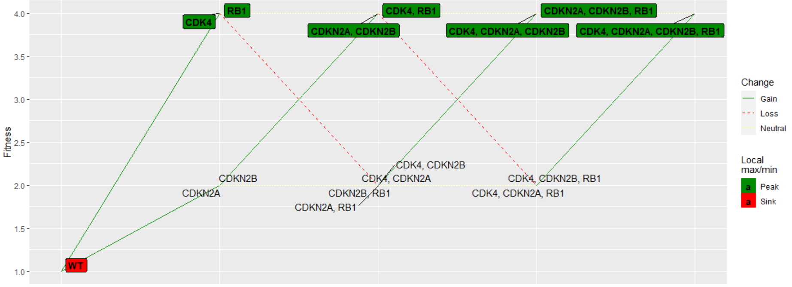
Glioblastoma: 1 pathway but 2 modules
No solution that satisfies all restrictions
But following the first approach we reach this landscape:
Notes:
Summarizing, apparently there is no solution that satisfies all the restrictions in this problem. But if we follow this first logic calculating the rest of the genotypes, we reach a fitness landscape where CDKN2A+CDKN2B acts like a single mutation and the different combinations of this mutation with the other 2 would have the same fitness.

Slide 34
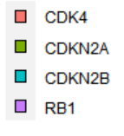
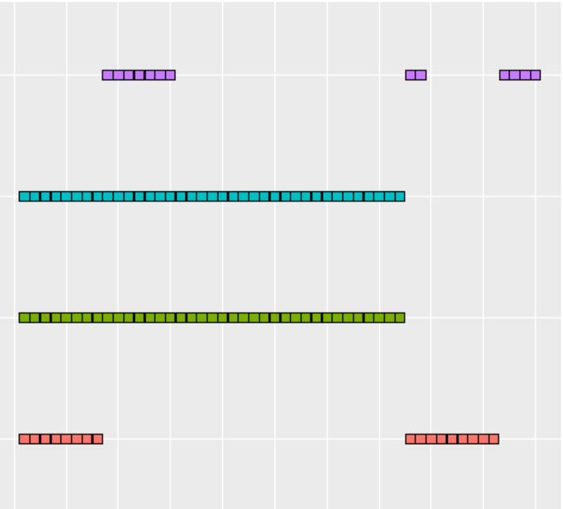
Glioblastoma: 1 pathway but 2 modules
Does our model replicate the data properly?
Multiple simulations (OncoSimulPop):
Notes:
Then, we wanted to test if our model was able to replicate the glioblastoma dataset precisely. To this purpose, we run multiple simulations adjusting some conditions (e.g, giving CDKN2A and CDKN2B a higher mutation rate) and we observed certain similarities.

Slide 35
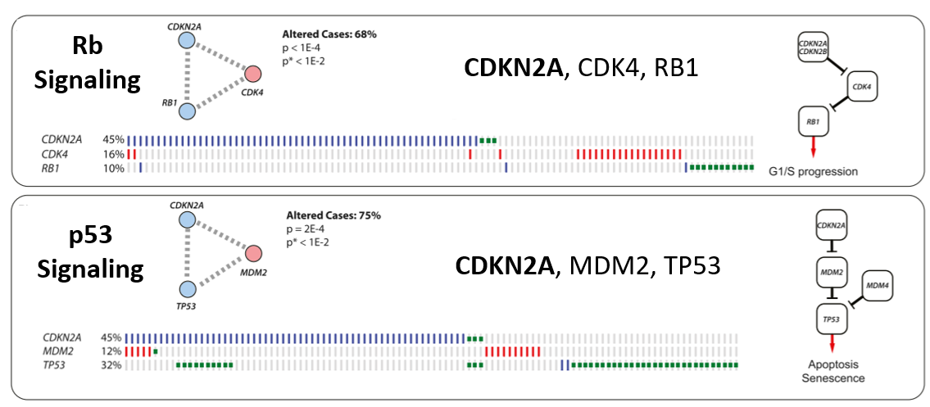
Glioblastoma: 2 pathways and 1 shared gene
Model with 2 different pathways which share one gene:
Notes:
Next, we decided to implement a model with 2 different pathways that share a gene. These are the Rb and p53 signalling pathways, which share CDKN2A.

Slide 36
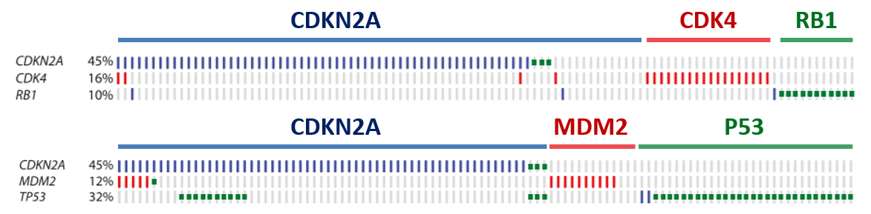
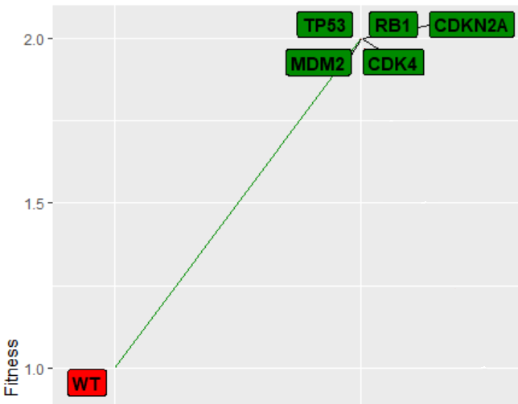
Glioblastoma: 1 pathway but 2 modules
All genotypes with one mutation should have the same fitness
Otherwise, we’d see just 1 genotype
Notes:
In this case, we considered that each single gene genotype should have the same fitness, because otherwise we would only find clones with the highest fitness. Then, each combination of non-exclusive mutations (like Rb1+P53) would have a greater genotype, according to the multiplicative model, and each combination of mutual exclusive mutations would have the same fitness.

Slide 37
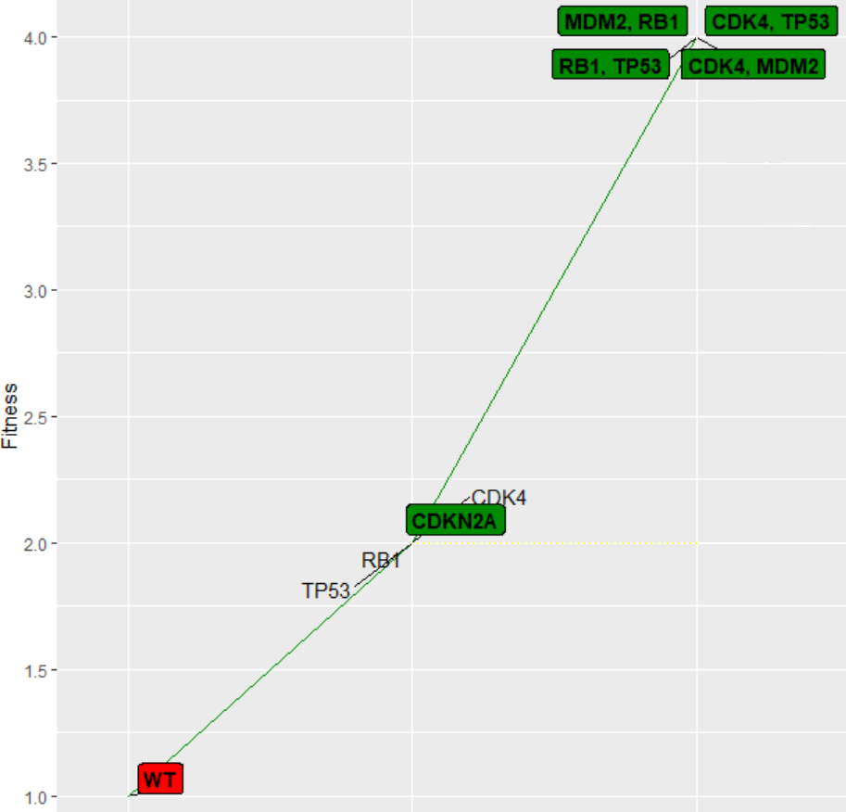
Glioblastoma: 1 pathway but 2 modules
Pair combinations:
Non-exclusive? Greater fitness
RB1 + P53 -> fitness = 4
Mutual exclusivity? Same fitness
RB1 + CDKN2A -> fitness = 2
RB1, TP53
RB1, CDKN2A
Notes:
Then, each combination of non-exclusive mutations (like Rb1+P53) would have a greater genotype, while each combination of mutual exclusive mutations would keep the same fitness.

Slide 38
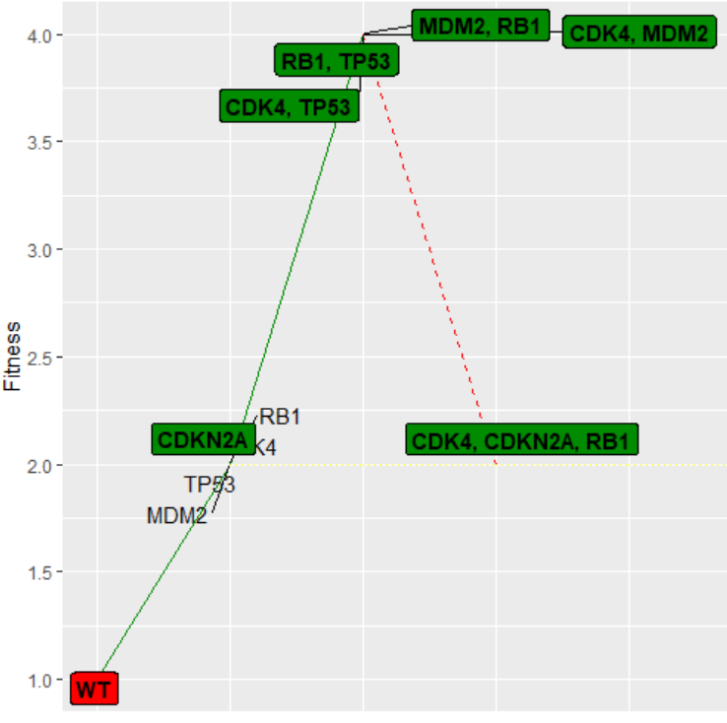
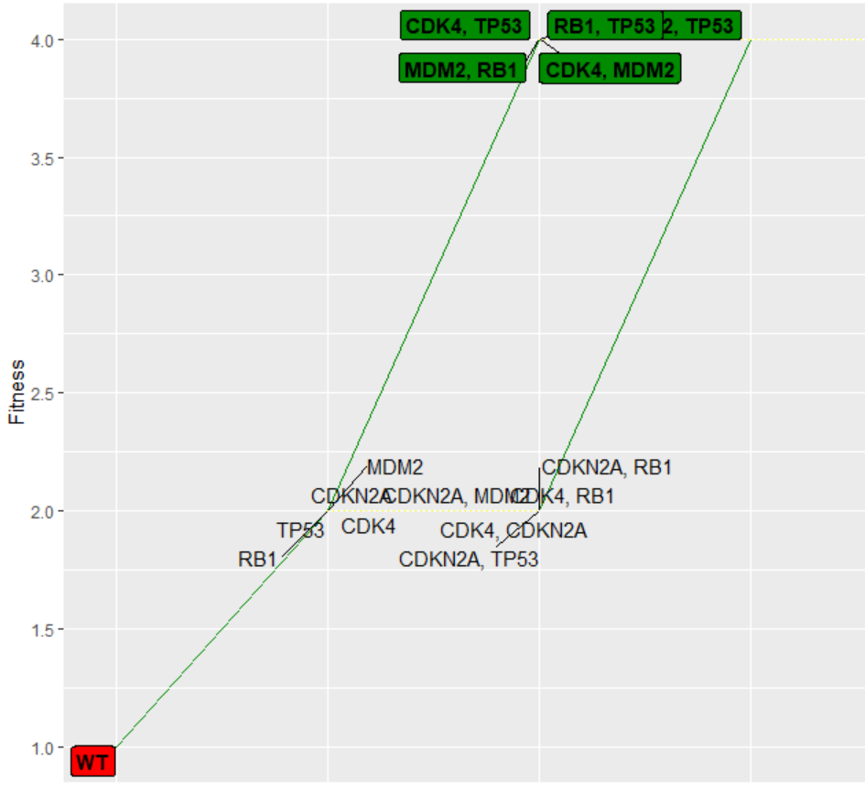
Glioblastoma: 1 pathway but 2 modules
Can define fitness of clones with 3 mutations again...
CDKN2A, RB1, P53
A
B
RB1, TP53
RB1, TP53
CDKN2A, RB1, P53
CDKN2A, RB1
Unjustified decrease
No mut. exclusivity
Notes:
But now, when we try to define the fitness of clones with 3 mutations we face the same problem. For instance:
If we consider that the fitness of CDKN2A+RB1+P53 is 2, we would find that the path from RB1+P53 leads to a decrease in fitness. Again, we preserve the exclusivity rule at the cost of introducing an unjustified decrease.
But if we consider that the fitness of CDKN2A+RB1+P53 is 4, we would be breaking the exclusivity rule because the path CDKN2A+RB1 > CDKN2A+RB1+P53 would involve an increase in fitness.

Slide 39
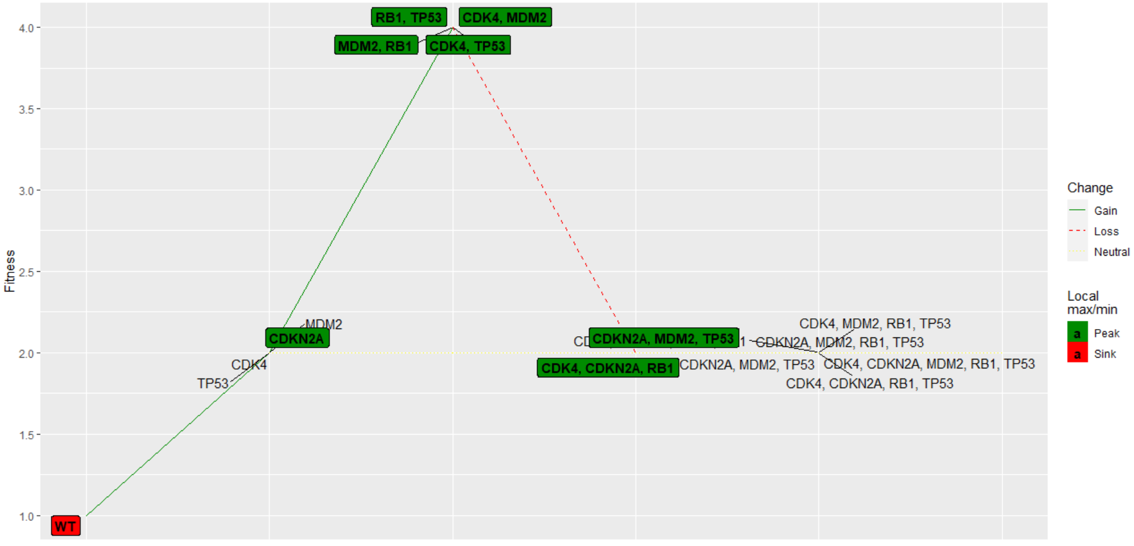
Glioblastoma: 1 pathway but 2 modules
Apply first option (as in previous case):
Complex genotypes fall
Notes:
Furthermore, if we apply the same principle we used in the last case, more complex genotypes will fall in the fitness landscape and we won’t observe them when running multiple simulations.

Slide 40
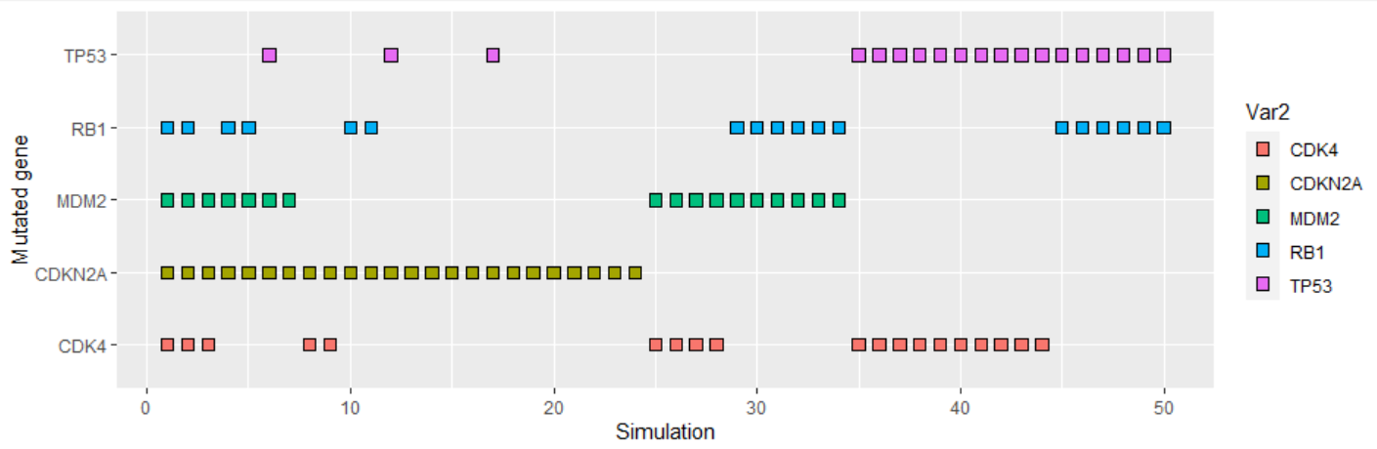
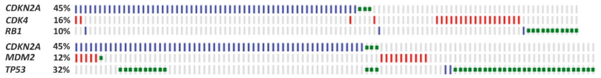
Glioblastoma: 1 pathway but 2 modules
Multiple simulations:
(Can’t really compare data)
Notes:
Thus, this model wouldn’t reflect the dataset nor the cancer progression properly.

Slide 41
Summary
Notes:
To sum up, we found out the following:

Slide 42
Summary
We were able to show simple models with a small number of genes and pathways involved
Notes:
Our work with the colorectal cancer data simulation suggested a model that can be easily implemented with OncoSimulR, as the number of genes and pathways was small.
Even though the various implementations seemed very similar at first, their differences have strong effects on fitness, highlighting the importance of interpreting the models properly.

Slide 43
Summary
We were able to show simple models with a small number of genes and pathways involved, but different interpretations of these have a great impact on fitness values
Notes:
Our work with the colorectal cancer data simulation suggested a model that can be easily implemented with OncoSimulR, as the number of genes and pathways was small.
Even though the various implementations seemed very similar at first, their differences have strong effects on fitness, highlighting the importance of interpreting the models properly.

Slide 44
Summary
We were able to show simple models with a small number of genes and pathways involved, but different interpretations of these have a great impact on fitness values
More complex models are challenging to translate into code, more intricate paths and gene interactions are involved
Notes:
This is especially important for more complex models of tumor progression, where situations that are more challenging to translate into code might be encountered.
Some authors have argued that DAGs may not represent cancer progression with maximum accuracy since latest models break some of their assumptions, as we saw in our examples of glioblastoma. (where we showed some of the obstacles that can appear when tumorigenesis follows a more intricate path)

Slide 45
Summary
We were able to show simple models with a small number of genes and pathways involved, but different interpretations of these have a great impact on fitness values
More complex models are challenging to translate into code, more intricate paths and gene interactions are involved → May break DAGs’ assumptions
(shown in our examples of glioblastoma)
Notes:
This is especially important for more complex models of tumor progression, where situations that are more challenging to translate into code might be encountered.
Some authors have argued that DAGs may not represent cancer progression with maximum accuracy since latest models break some of their assumptions, as we saw in our examples of glioblastoma. (where we showed some of the obstacles that can appear when tumorigenesis follows a more intricate path)

Slide 46
Summary
We were able to show simple models with a small number of genes and pathways involved, but different interpretations of these have a great impact on fitness values
More complex models are challenging to translate into code, more intricate paths and gene interactions are involved → May break DAGs’ assumptions
(shown in our examples of glioblastoma)
One possible improvement would be to relax some DAGs constraints (such as allowing genes to be present in more than one model)
Notes:
Models must accommodate new approaches that relax DAGs constraints in order to simulate cancer progression properly.

Slide 47
Summary
We were able to show simple models with a small number of genes and pathways involved, but different interpretations of these have a great impact on fitness values
More complex models are challenging to translate into code, more intricate paths and gene interactions are involved → May break DAGs’ assumptions
(shown in our examples of glioblastoma)
One possible improvement would be to relax some DAGs constraints (such as allowing genes to be present in more than one model)
Tumor progression characterization is an ongoing challenge, but the improvements to the synergistic tools used are a great approach
Notes:
So even though cancer characterization is a complex ongoing challenge, the continuous improvements and the synergistic work of the tools used to do so are a great approach to figure out this problem.

Slide 48
mutual exclusivity
Simulating pathways
Thank you
and
for your
attention!
Notes:
Un saludo no estaria mal

