Slide 1
Overview
First attempt to verify the Levine model
Comparison of the measured height and the predicted one from the contact angle and pressure
Calculation for 1500 pa and 1250 pa

Slide 2
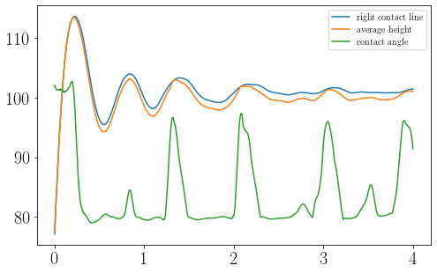
Measure heights compared to contact angle (1500 pa)
Average height is never bigger
than the Contact line height
Small peaks in the contact angle
lead to small peaks in the height
Frequency of the contact angle
is very similar to frequency of the
height

Slide 3
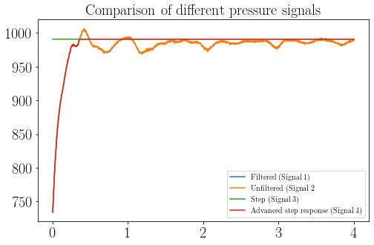
Overview of the different pressure signals
To investigate the effects, 4
pressuresignals were used
For the step response the
measured pressure step was used

Slide 4
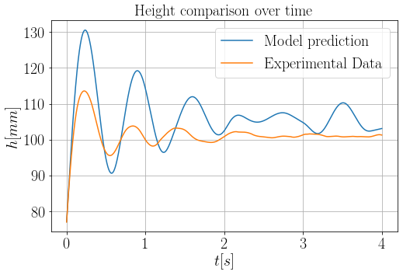
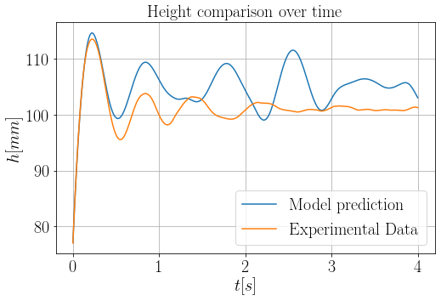
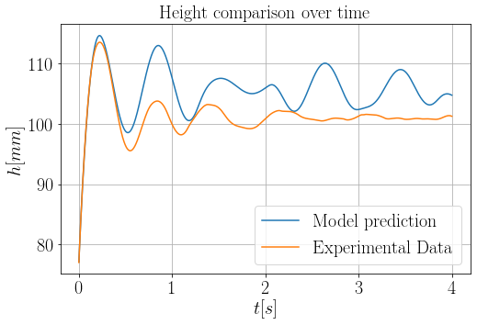
Comparison of heights for different pressure signals
step response
filtered height
Filtering does not change
the graph
Different pressure courses
don’t eliminate the problem
The predicted height shows
properties of a nonlinear
system
advanced step response
unfiltered height

Slide 5
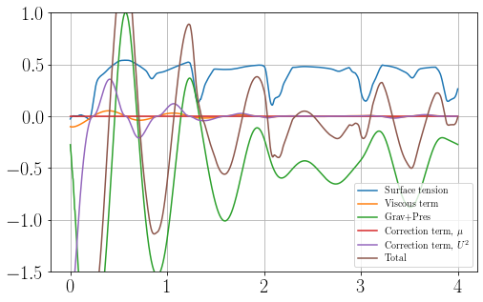
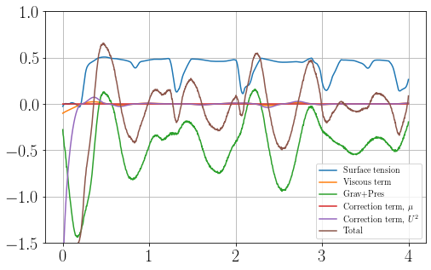
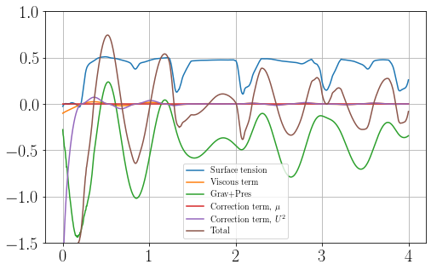
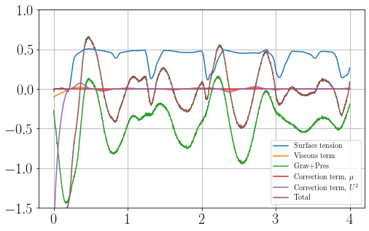
Comparison of accelerations for different pressure signals
acceleration for step response
acceleration for filter
The surface tension/
contact line term has a big
impact on the graph
Frequency of surface
tension and total
acceleration are different
acceleration for advanced step response
acceleration for unfiltered

Slide 6
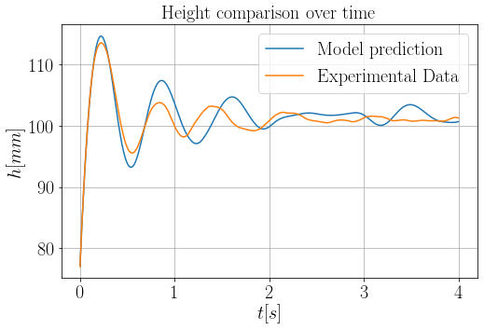
Plot without the surface tension term

Slide 7
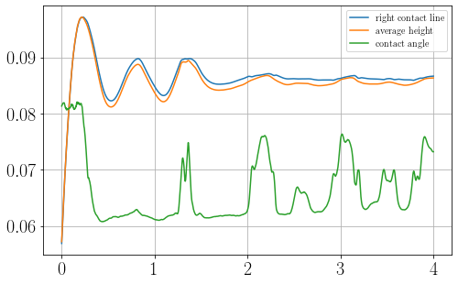
Measure heights compared to contact angle (1250 pa)

Slide 8
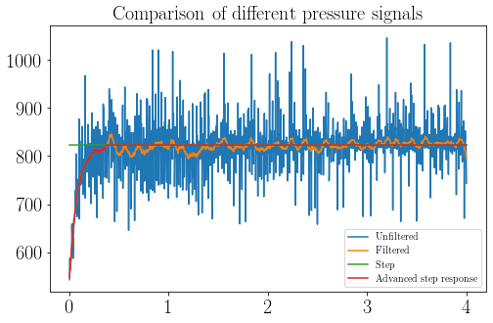
Overview of the different pressure signals
Signal is very noisy
Same concept for the signals
as for 1500 pa

Slide 9
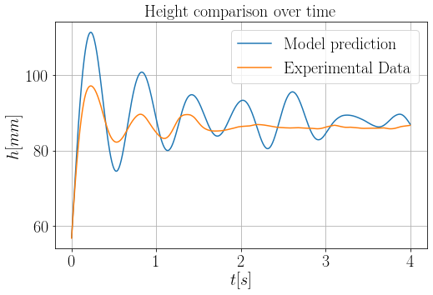
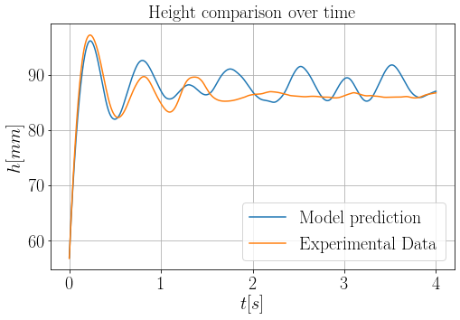
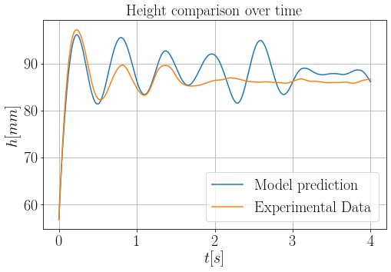

Comparison of heights for different pressure signals
step response
filtered height
advanced step response
unfiltered height

Slide 10
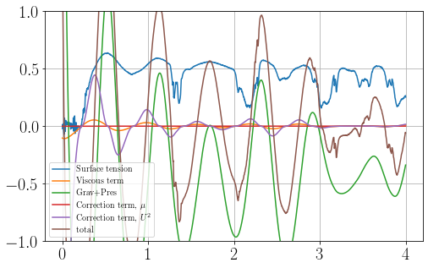
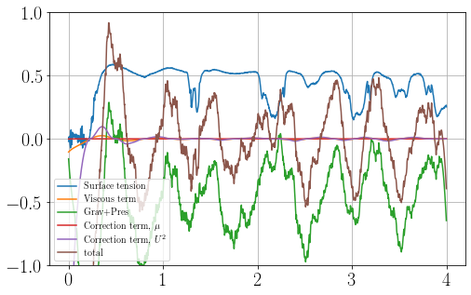
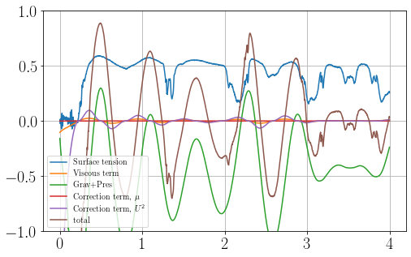
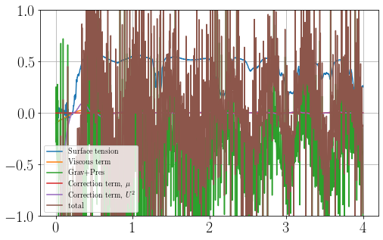
Comparison of accelerations for different pressure signals
acceleration for step response
acceleration for filter
acceleration for advanced step response
acceleration for unfiltered

Slide 11
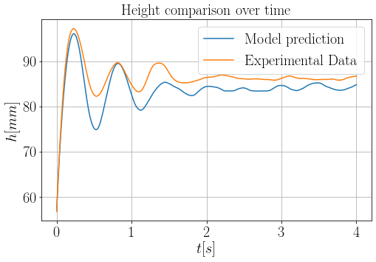
Plot without the surface tension term

