Slide 1
Introduction
Openpiv is an open source code for python
Calculation and visualization of velocity fields from PIV images
Calculation can be influenced by a lot of user defined parameters
Goal of this presentation: look at how different parameters influence the calculation by comparing the resulting velocity fields
The results are purely qualitative to get an idea what each parameter does
Overview of where each parameter influences the program

Slide 2
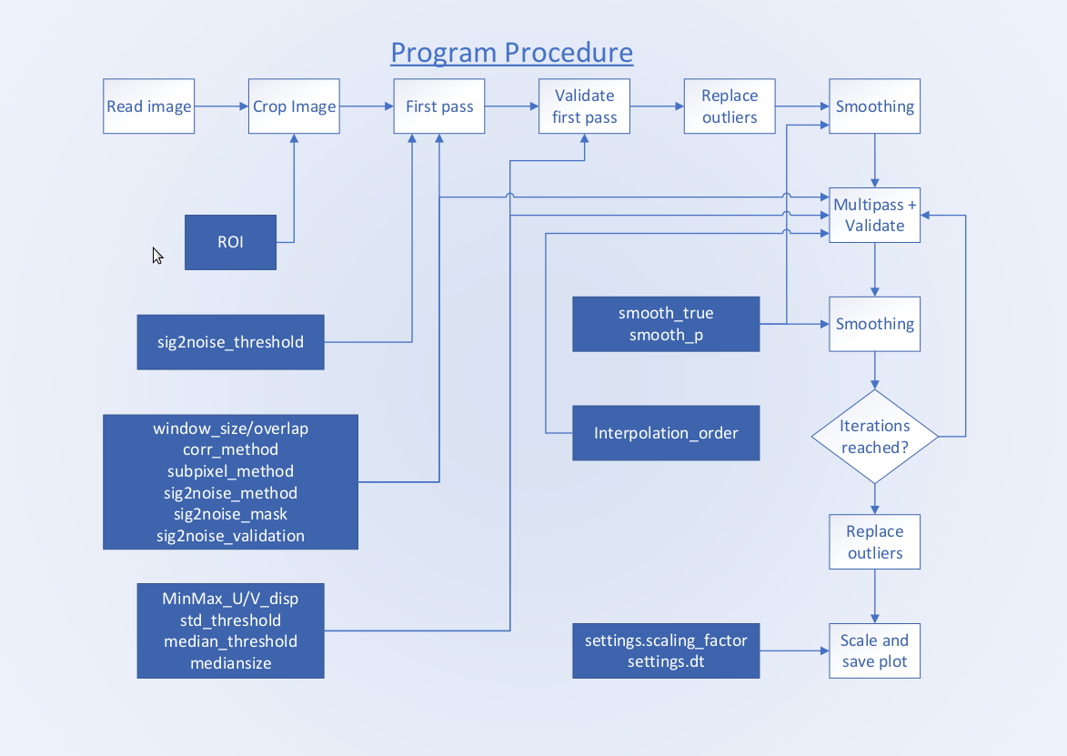

Slide 3
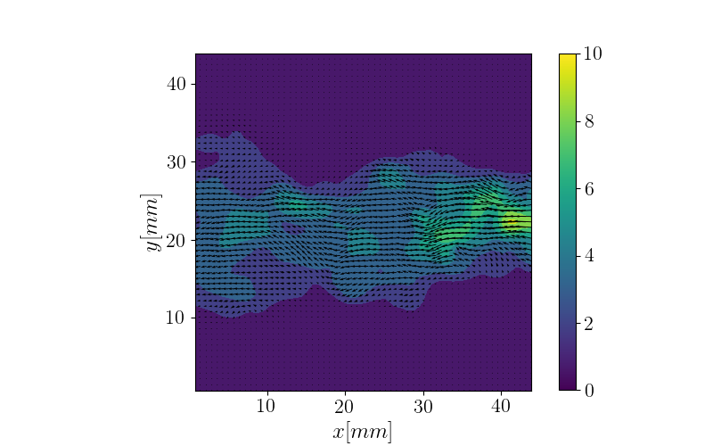
Overview over the data
100 PIV images of a jet flow
Many parameters can be set to lots of values
Comparison of the first image for different settings
Example plot for the given settings
Gathering of qualitative data

Slide 4
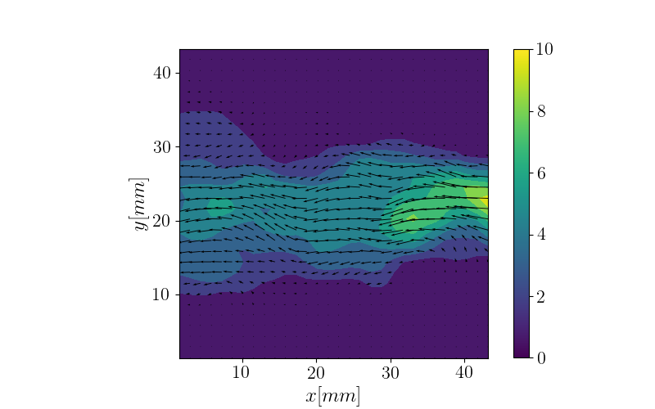
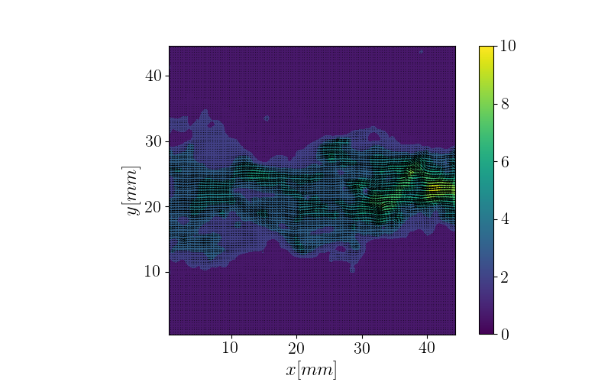
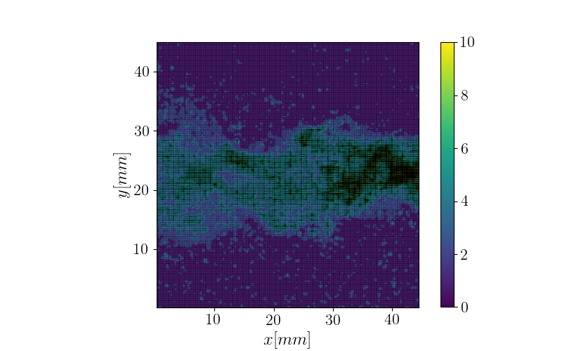
Different iterations
one iteration
two iterations
three iterations
four iterations

Slide 5
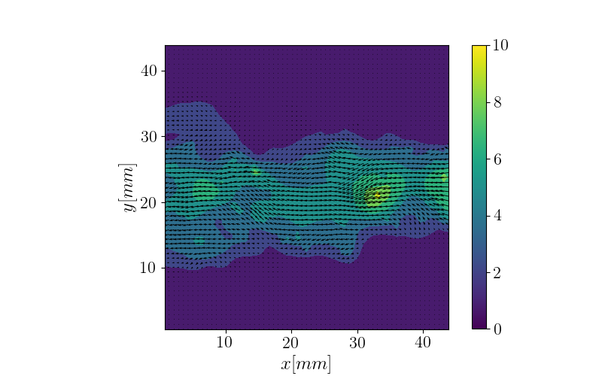
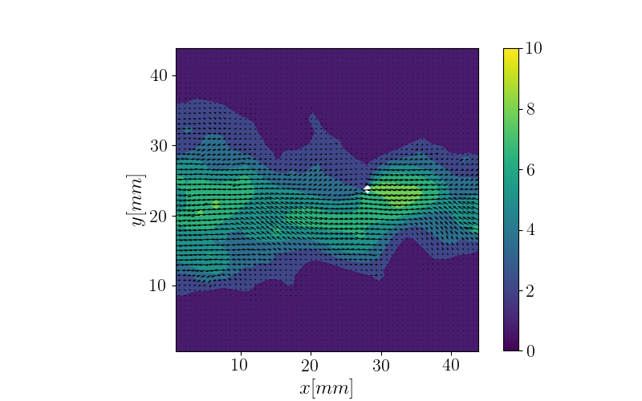
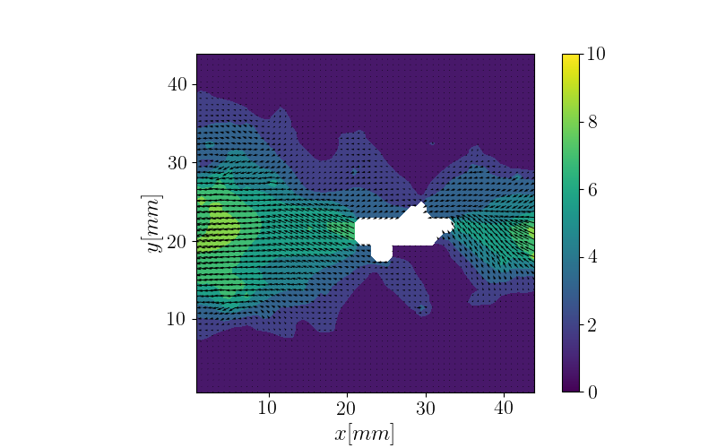
sig2noise method
peak2mean, threshold = 1.1
peak2peak, threshold = 1.1
peak2mean, threshold = 1.2
very sensitive parameter
Look at the data to get an
estimate of the threshold

Slide 6
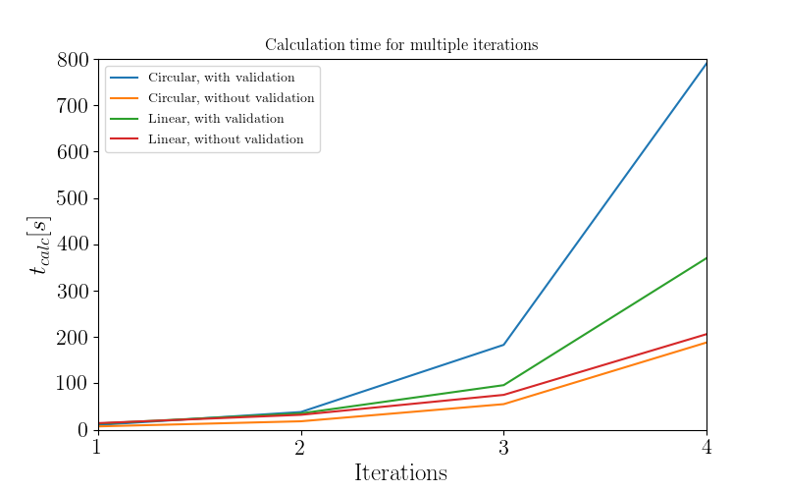
Calculation time
Comparison for circular/linear correlation and with or without sig2noise validation
Calculation of 10 images

Slide 7
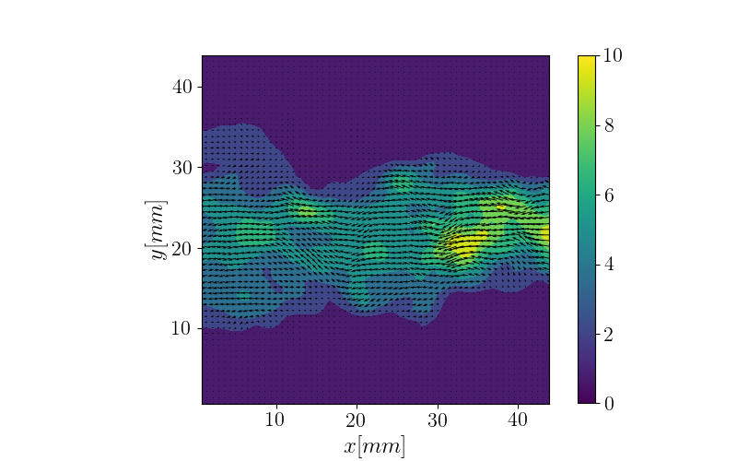
Correlation method
circular correlation
linear correlation
Velocity fields very similar
Linear correlation yields a higher average velocity
Circular correlation slightly faster when no sig2noise validation is done

Slide 8
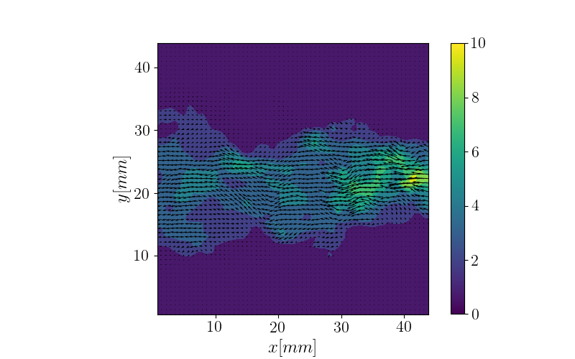
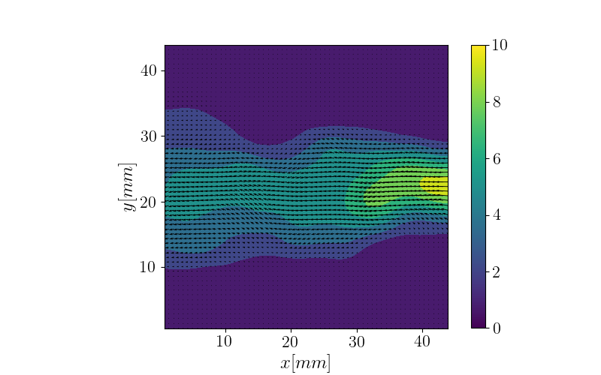
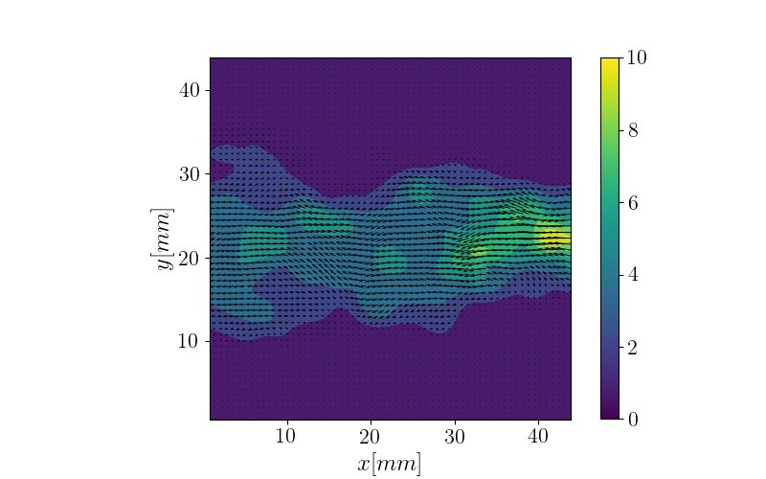
Smoothing
no smoothing
smoothing, p = 5
smoothing, p = 1
Very sensitive parameter
No smoothing leads to large gradients
Too much smoothing erases substructures

Slide 9
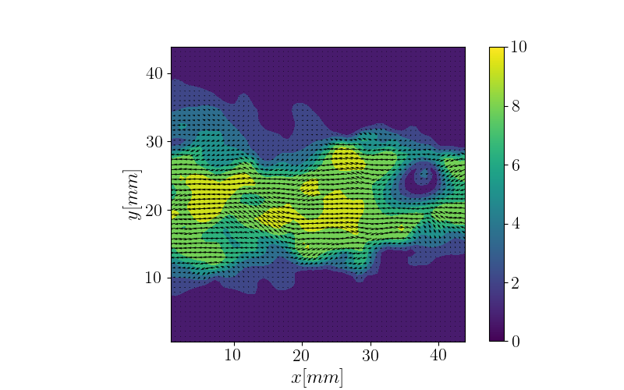

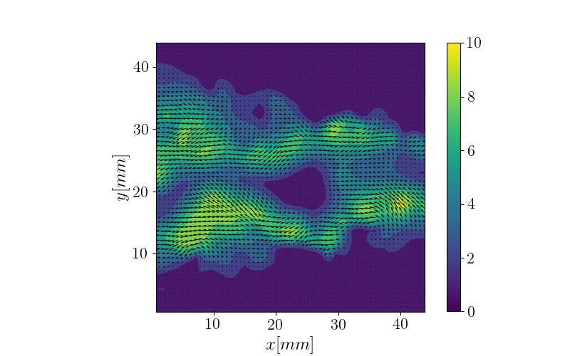

Validation
std_threshold = 0.5
std_threshold = 100
max_U_disp = 2
max_U_disp = 10

Slide 10
Conclusion
A lot of parameters are very sensitive
Look at the data when setting parameters
Set parameters according to your requirements
Find your optimal settings before processing all the images

