Slide 1
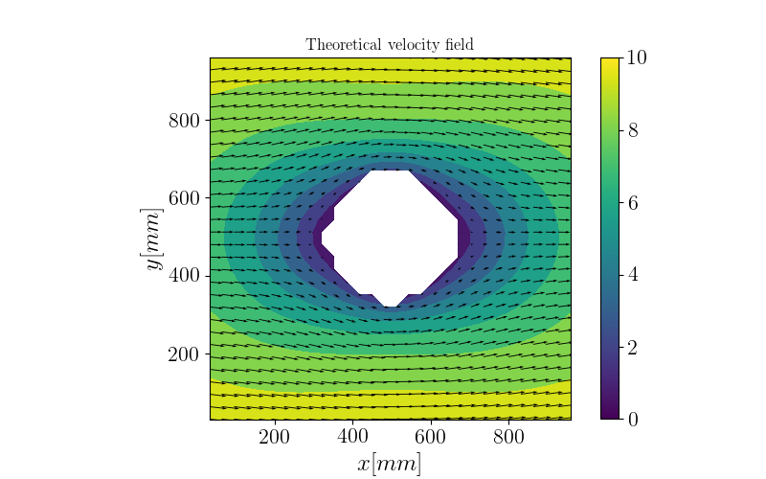
Overview of the data
50 images of a flow past a cylinder
Data created artificially
Calculate the mean flow of 20 images for different settings
Extraction of the velocity profile at x = 352 pixels, shortly
before the cylinder
Nondimensionalize by dividing by the maximum value
Calculation of the Root Mean Square as a measurement
Problem: Flow is laminar some parameters have
no effect

Slide 2
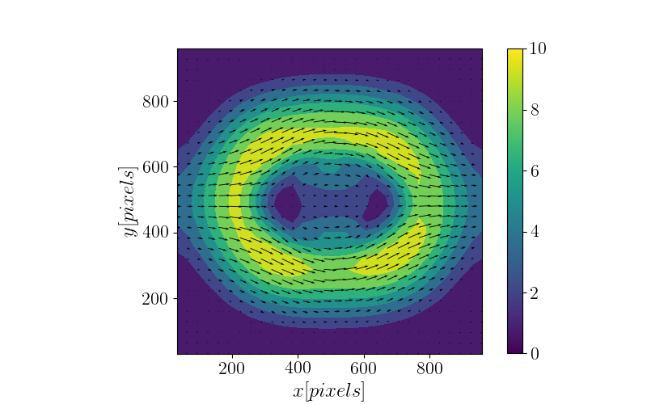
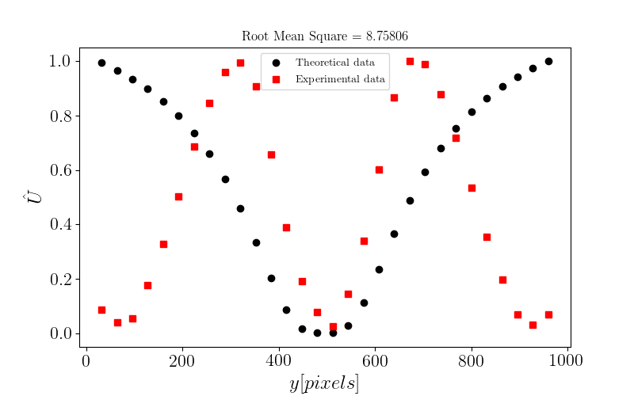
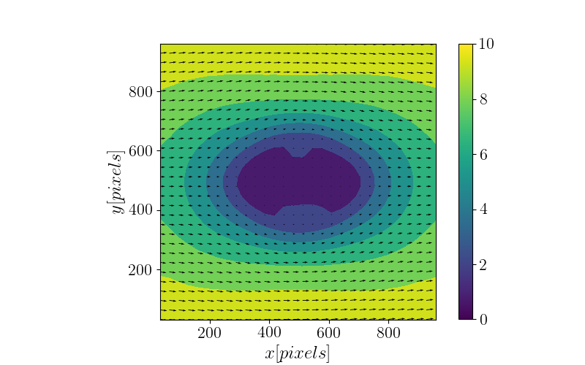
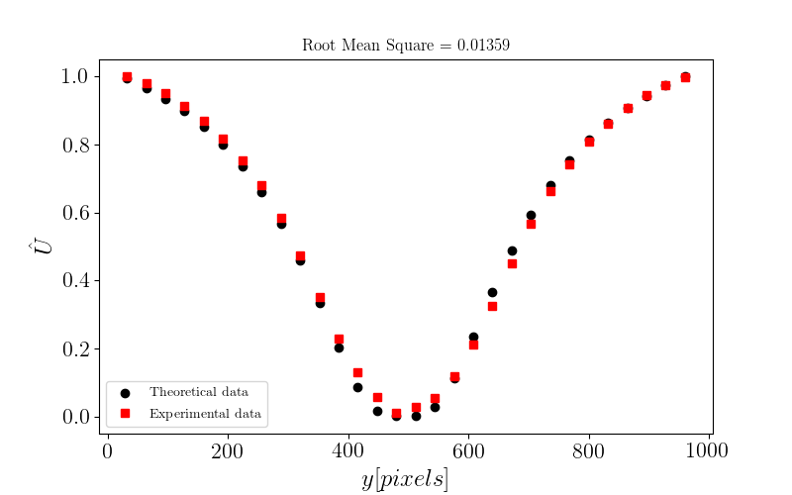
Validation
MinMax_U_disp = 3
Low values result in
unexpected shapes
Higher values result in the
desired shape
Value should be picked by
looking at the data
Very large values make
this parameter useless
MinMax_U_disp = 10

Slide 3
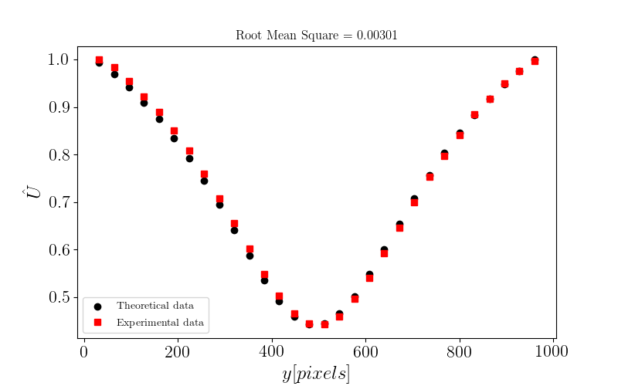
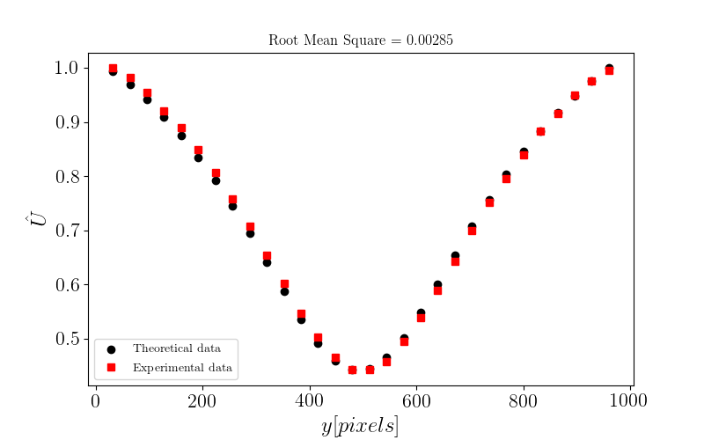
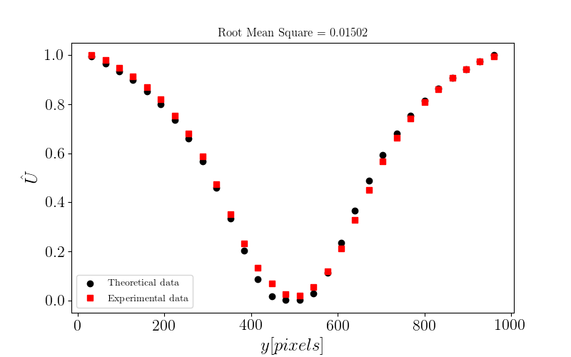
Correlation method
X = 192 pixels, circular
X = 352 pixels, circular
Very similar results
Depending on the x position
the root mean square is
marginally lower for one
X = 192 pixels, linear
X = 352 pixels, linear

Slide 4
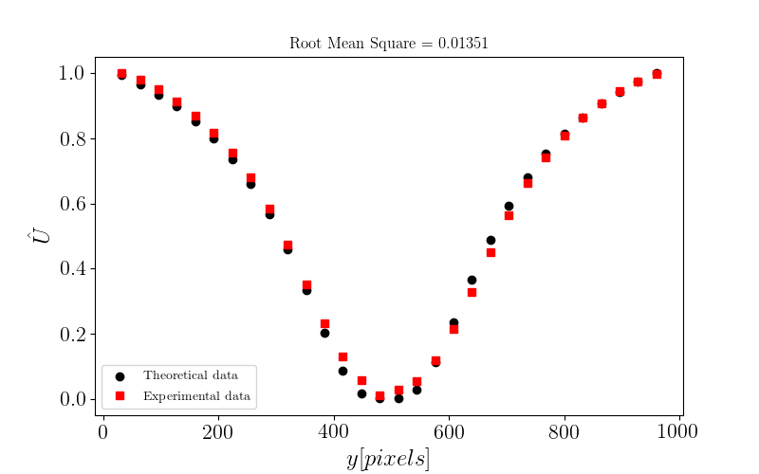
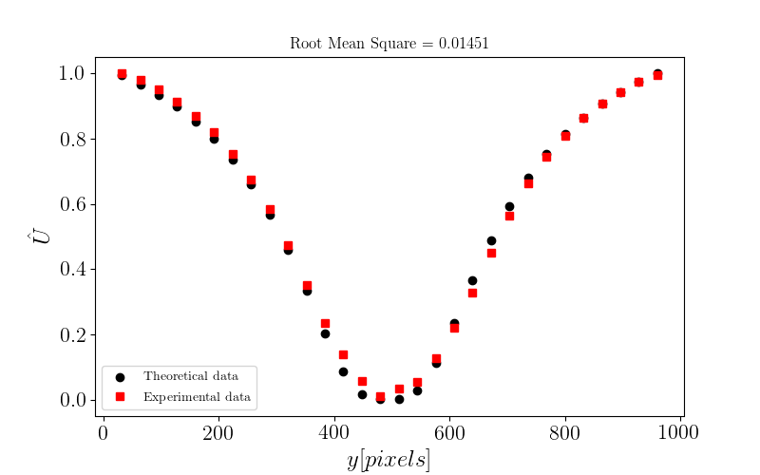
Sig2noise masking
sig2noise_mask = 5
sig2noise_mask = 25
Very minor differences, shape of the curve stays the same
This value should be a little bit larger than the particle size in pixels
Larger values will mask out potential second peaks

Slide 5
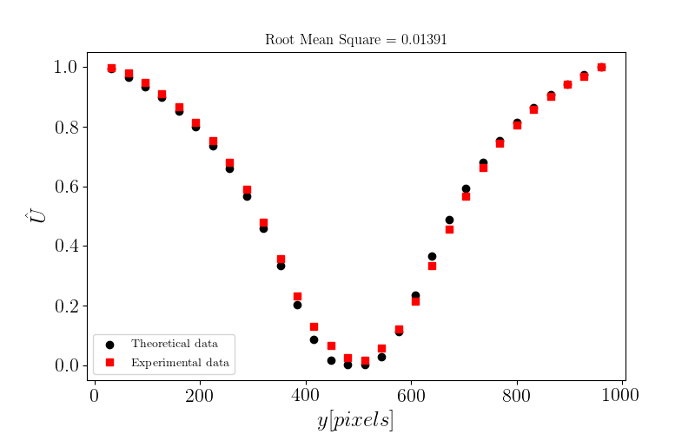
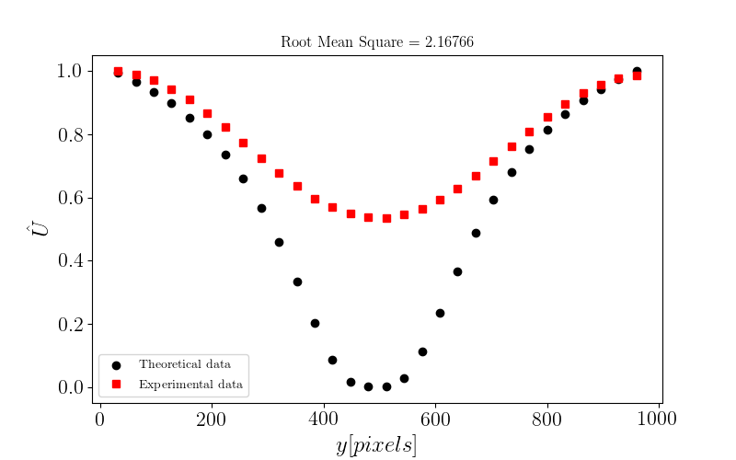
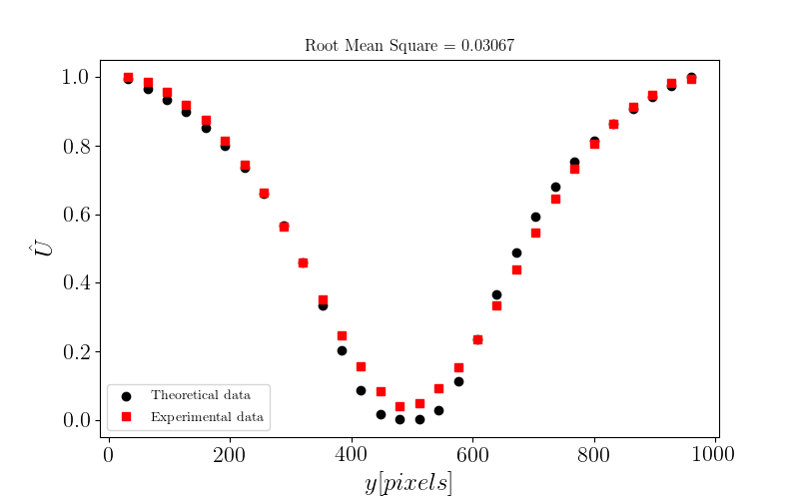
Smoothing
smoothn_p = 0.01
smoothn_p = 20
smoothn_p = 2
Small enough values below
0.5 are all very similar
Higher values result in the minimum
being smoothed out

Slide 6
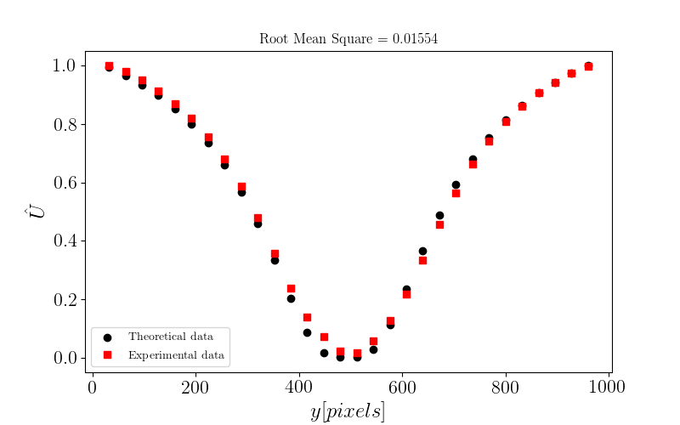
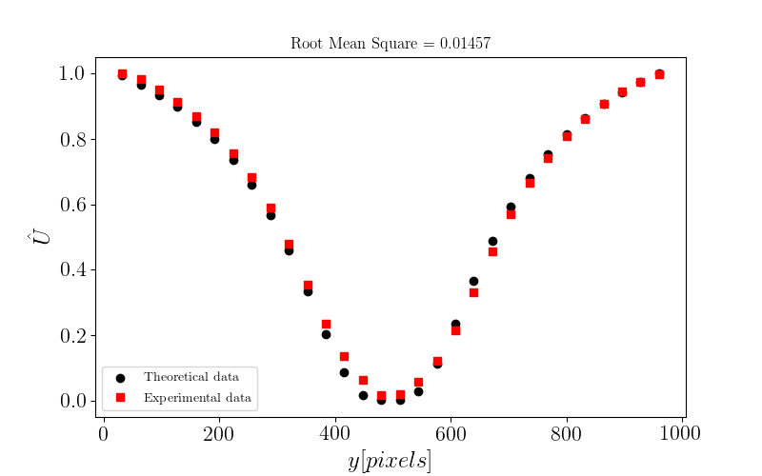
Preprocessing
circular, preprocessed
circular, not preprocessed
Difference in accuraccy not
really noticable
Linear now slightly more
accurate
Sig2noise_ratio increases by
more than factor 2
    Preprocessing should be
    done if possible
linear, preprocessed
linear, not preprocessed

