Slide 1
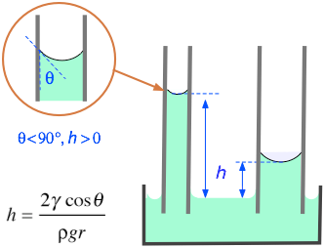
Motivation
General idea: find the coefficients for an ODE with given data
Equation is of second order and nonlinear
Experimental Data is taken in the lab
Goal: Find a correlation for the dynamic contact angle as a function of the velocity

Slide 2

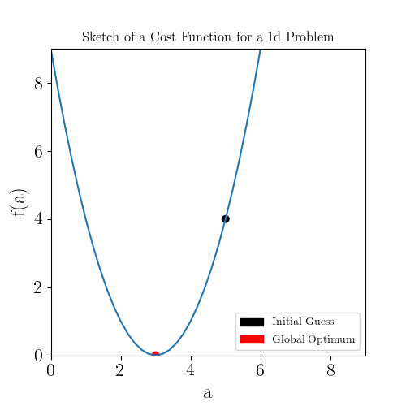
Concept of the method
Define a cost function, here the Mean Root Square:
With - experimental data and - solution for the
current value of
ODE of the form:
Start with arbitrary values for
Minimize cost function by repeatedly
solving the ODE and calculating the cost

Slide 3
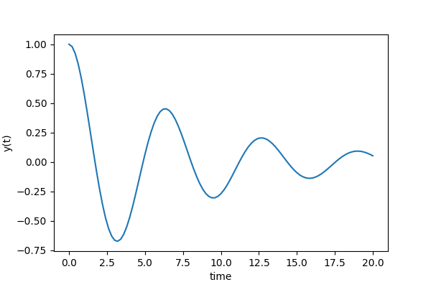
Example
ODE of the form
Initial values and boundary conditions

Slide 4
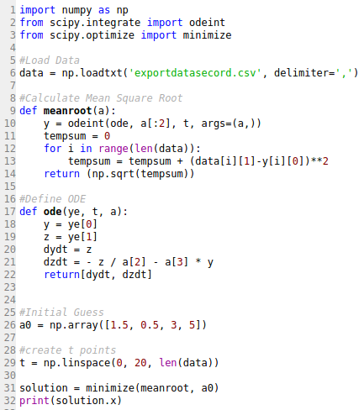
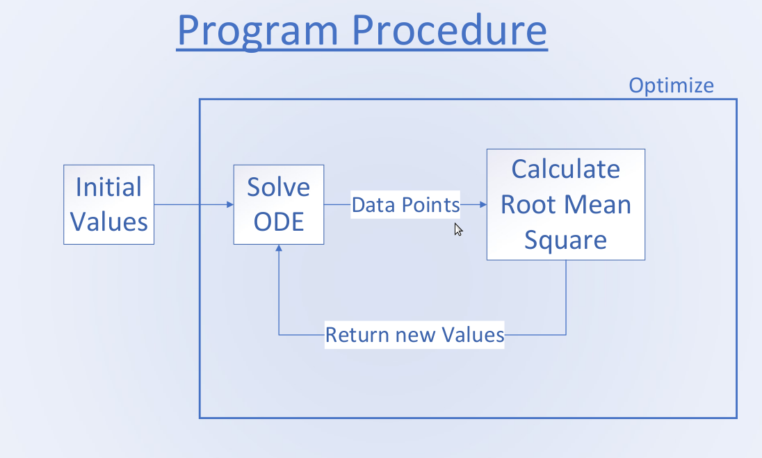
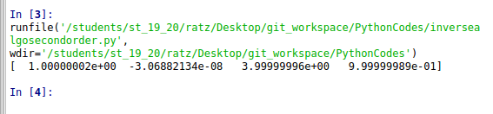
Example Code

Slide 5
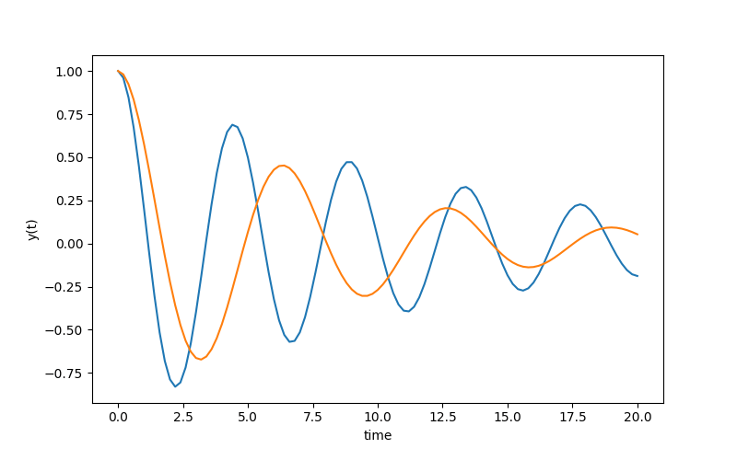
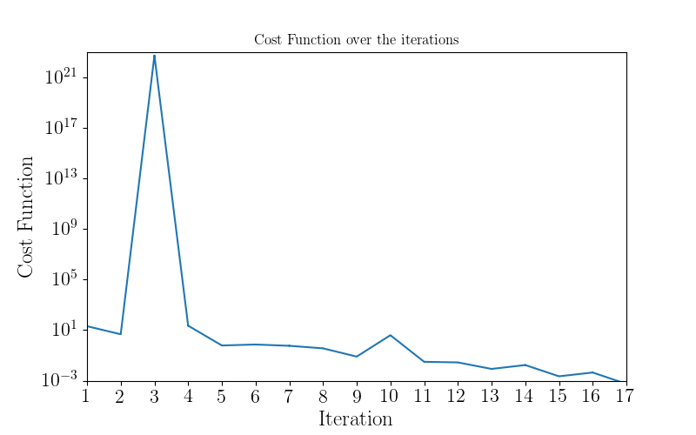
Results
Initial guess:
Final error after 17 iterations: 0.000551708 < 0.001

Slide 6
Sources
https://socratic.org/questions/the-surface-tension-of-benzene-at-20-c-is-28-85-dyne-cm-in-a-capillary-apparatus

