Slide 1
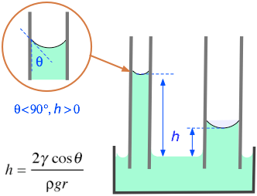
Motivation
General idea: find the coefficients for an ODE with given data
Equation is of second order and nonlinear
Experimental data is taken in the lab
Goal: Find a correlation for the dynamic contact angle as a function of the velocity

Slide 2
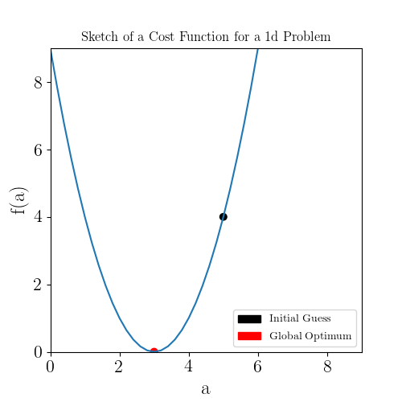




Concept of the method
Define a cost function, here the Root Mean Square:
With - experimental data and - solution for the current value of
ODE of the form:
Start with arbitrary values for
Minimize cost function by repeatedly solving the ODE and calculating the cost
Notes:
\bar{y_i}
y_i
(a_1, a_0)
\ddot{y} + a_1 \dot{y} + a_0 y = 0

Slide 3
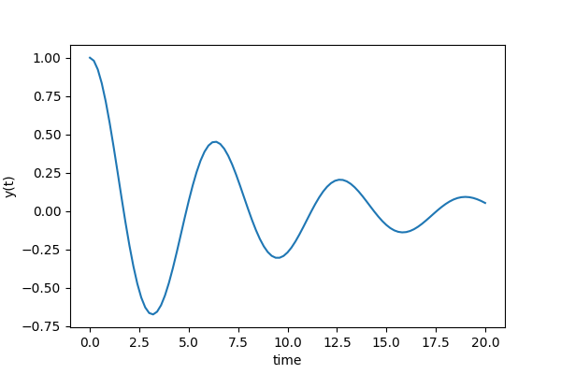
Example
ODE of the form
Initial values and coefficients
Notes:
\ddot{y} + a_1 \dot{y} + a_0 y = 0
a_1 = 1/4,\; a_0 = 1,\; y(0)=1,\; \dot{y} = 0

Slide 4
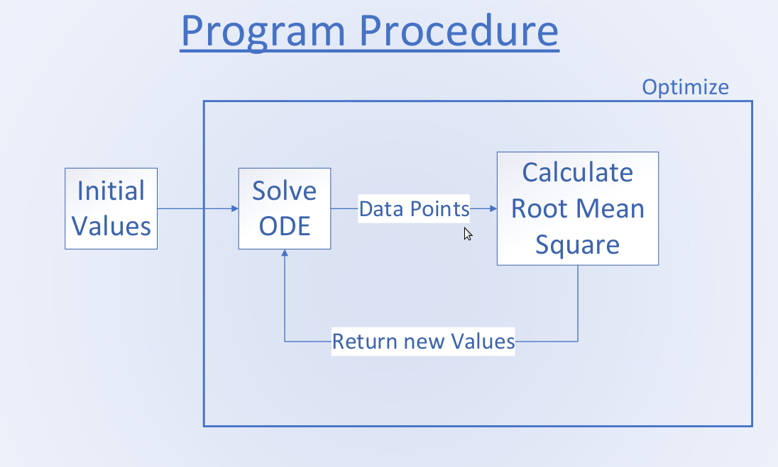
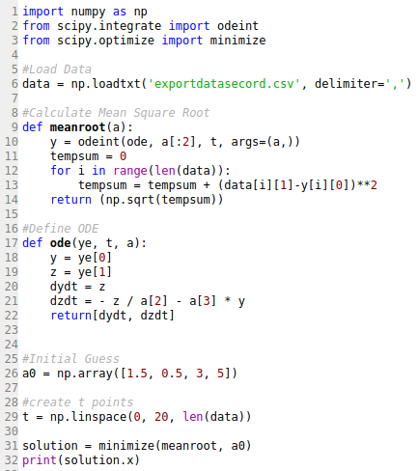
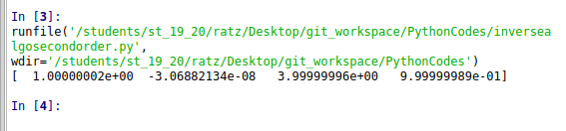
Example code

Slide 5
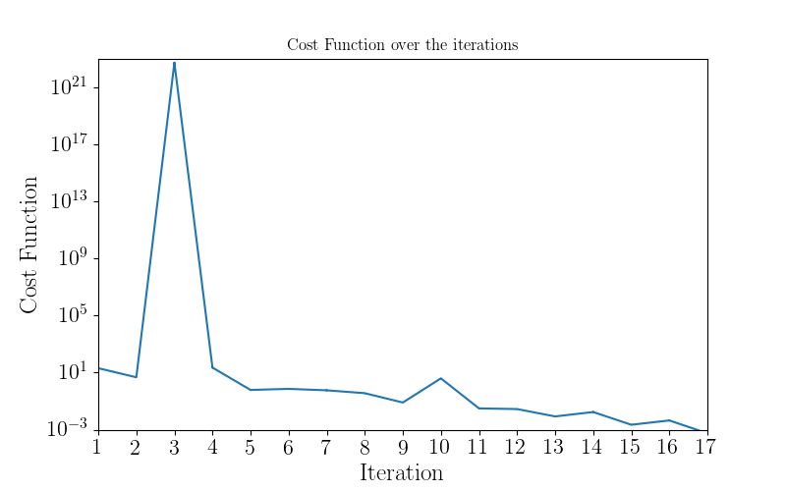
Results
Initial guess:
Final error after 17 iterations: 0.000551708 < 0.001

Slide 6
References
https://socratic.org/questions/the-surface-tension-of-benzene-at-20-c-is-28-85-dyne-cm-in-a-capillary-apparatus

