Slide 1
Overview
First attempt to verify the Levine model
Comparison of the measured height and the predicted one from the contact angle and pressure
Calculation for 1500 pa and 1250 pa

Slide 2
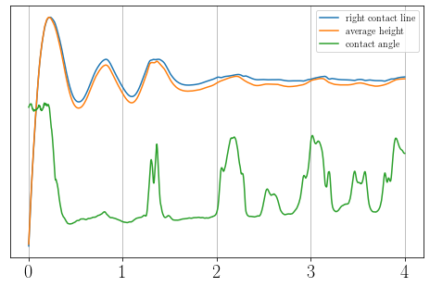
Measured heights and contact angle (1500 Pa)
Average height is never bigger than the contact line height
Small peaks in the contact angle lead to small peaks in the height
Frequency of the contact angle is very similar to frequency of the height

Slide 3
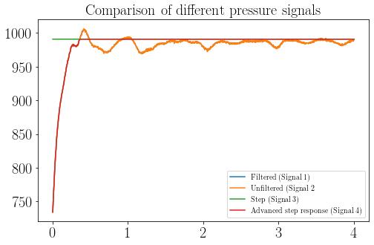
Overview of the different pressure signals
To investigate the effects, 4 pressure signals were used
For the step response the measured pressure was used

Slide 4
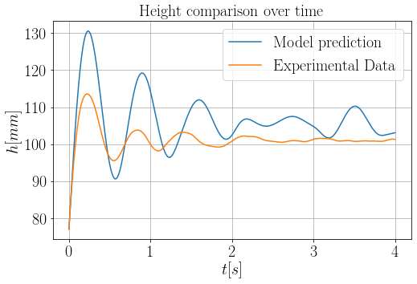
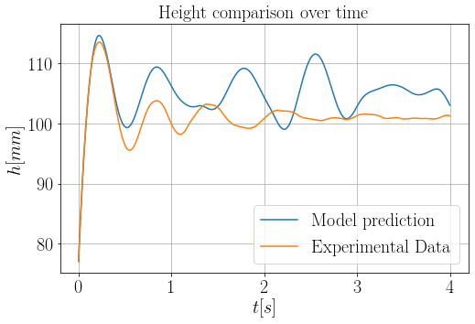
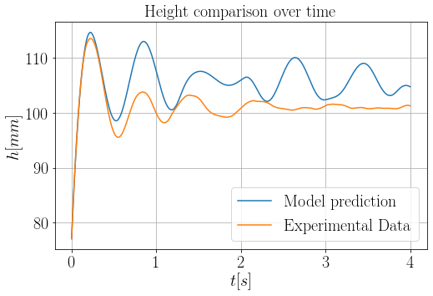
Comparison of heights for different pressure signals
Step response
Filtered pressure
p = 1500 Pa
Filtering does not change the graph
Different pressure courses don’t eliminate the problem
The predicted height shows properties of a nonlinear system
Advanced step response
Unfiltered pressure

Slide 5
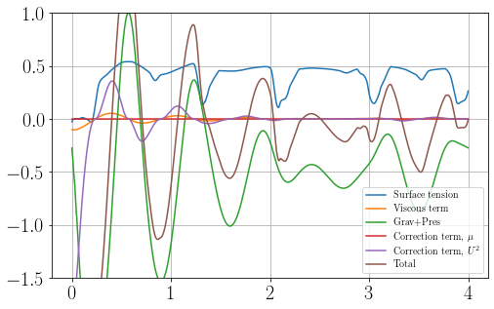
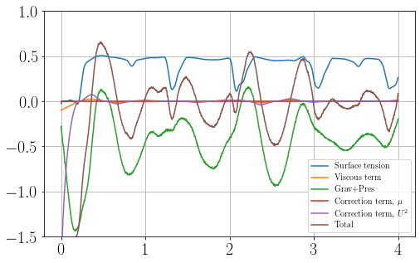
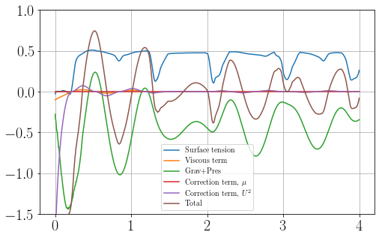
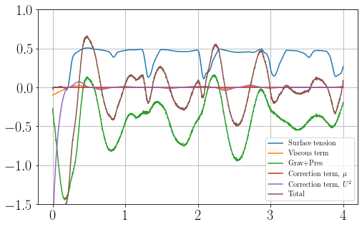
Comparison of accelerations for different pressure signals
acceleration for step response
acceleration for filter
The surface tension/contact line term has a big impact on the graph
Frequency of the surface tension and total acceleration are different
acceleration for advanced step response
acceleration for unfiltered

Slide 6
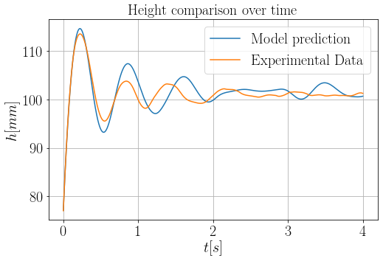
Plot without the surface tension term

Slide 7
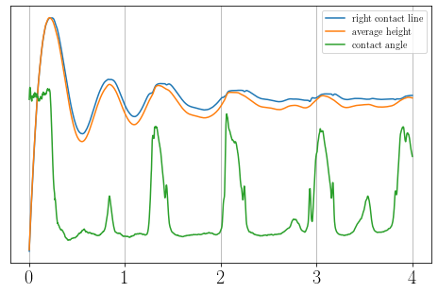
Measured heights and contact angle (1250 Pa)
Same characteristics as for 1500 Pa can be observed
Contact angle is more noisy

Slide 8
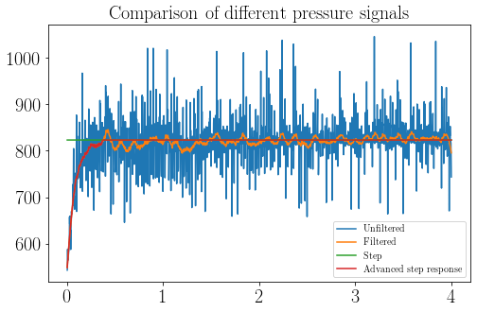
Overview of the different pressure signals
The same idea as for 1500 Pa is being used again
Unfiltered pressure signal is extremly noisy

Slide 9
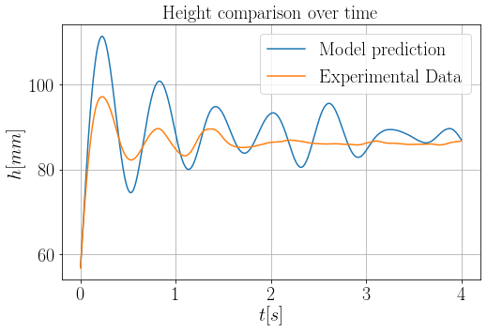
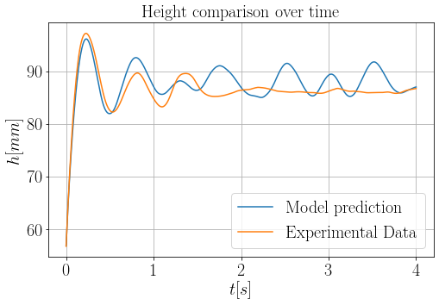
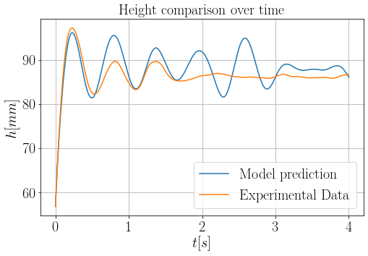

Comparison of heights for different pressure signals
Step response
Filtered pressure
p = 1250 Pa
Filtering does not change the graph
Different pressure courses don’t eliminate the problem
The predicted height shows properties of a nonlinear system
Advanced step response
Unfiltered pressure

