Slide 1
Sem_5_pi Progress Report – Sprint A/C
Data: 28/10/2023
Team/students: 1210804/1210818/1201458/1200585

Slide 2
Topics:
main objectives of the system;
adopted development process and planning;
teamwork methodology and conflict resolution strategy
product quality;
expected results;
'turnkey' format for software delivery/sale; among others relevant aspects.

Slide 3
Main objectives of the system:
Our System should:
Be able to have a login system with systemUsers with roles: Teacher, Student, Manager, PowerUser;
Be able to create Courses / Exams / Users / Boards / Classes;
Be able to enroll a student in a course ;
Be able to set teachers for a course;
List all of the above;

Slide 4
Main objectives of the system:
Our System should:
Students will be able to take exams and view all their grades;
Be able to Create/Update/Undo Post-its, which is the contente of the board ;
Users can view the updates that are made to a board.
Users will be able to share their boards with other users;
Users will have the option to see the board in real time;

Slide 5
Planning :
 | 1210804 | 1210818 | 1201458 | 1200585
1ºa Semana: (18/09 – 24/09) | Planeamento do sprint e divisão das Us | Planeamento do sprint e divisão das Us | Planeamento do sprint e divisão das Us | Planeamento do sprint e divisão das Us
2ºa Semana: (25/09 – 1/10) | Realização da documentação | Realização da documentação | Realização da documentação | Realização da documentação
3ºa Semana: (02/10 – 08/10) | Realização da US150 | Realização da US270 | Realização da US220 | Realização da US190
4ºa Semana: (09/10 – 15/10) | Realização da US160 Realização da US170 | Realização da US280 Realização da US290 | Realização da US240 Realização da US250 | Realização da US200 Realização da US210
5ºa Semana: (16/10 – 22/10) | Realização da US180 Realização da US310 | Realização da US300 Realização da US360 | Realização da US260 | Realização da US220
6ºa Semana: (23/10 – 29/10) | Realização da US350 | Realização da US380 | Realização da US370 | Realização da US390

Slide 6
Completed Activities:
We complet all the User Stories, tests and the correspondent documentation.

Slide 7
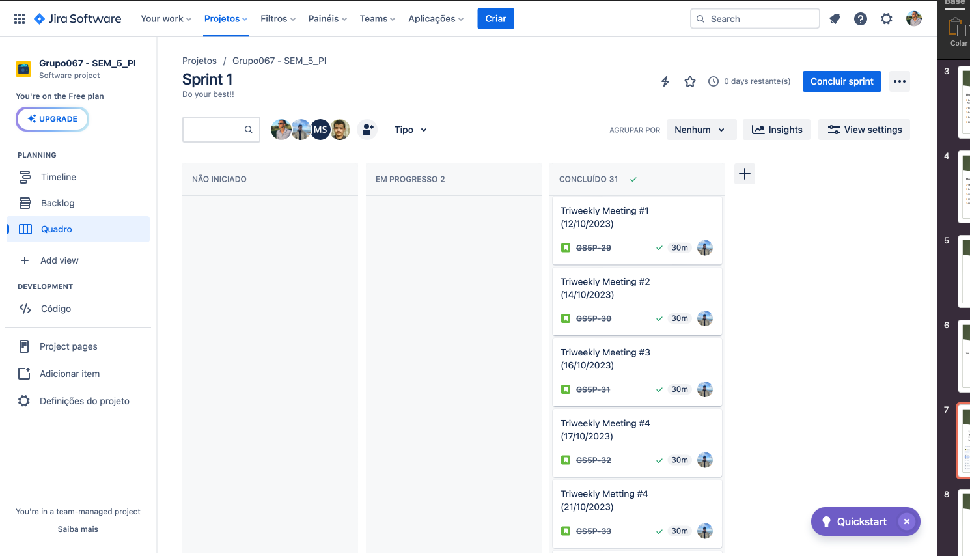
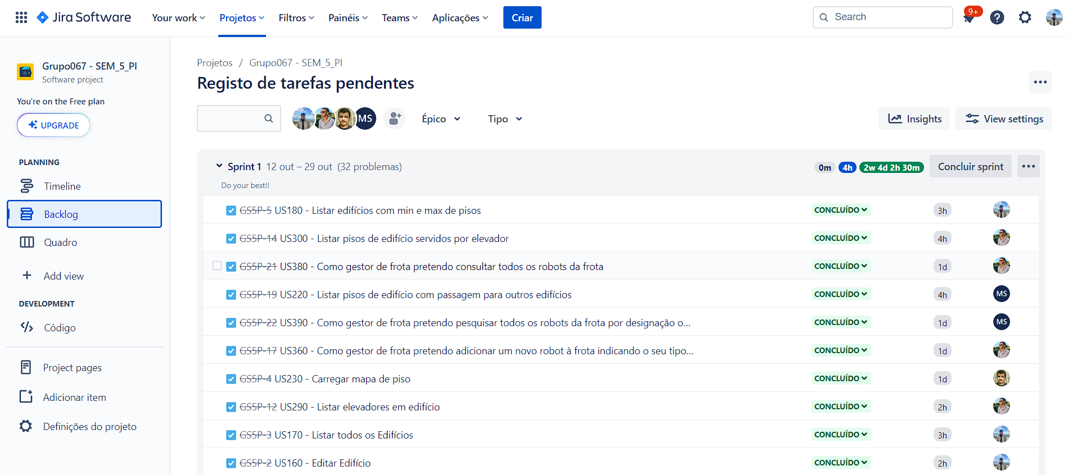
Teamwork methodology and conflict resolution strategy : (I)
Sprint A: We used the scrum methodology, to organize and develop our Project, more specifically the Jira Software. Our team decided to have treeweekly meatings to best organize our work as, shown bellow:

Slide 8
Self-Assessment
Student | Technical Skills | Behaviour Skills | Work Ethic | Progress
1210804 | E | VG | VG | E
1201458 | E | VG | VG | E
1210818 | E | VG | VG | E
1200585 | E | VG | VG | E
VW-very week/ W-weak / F-fair / G-good / VG-very good / E-excellent

Slide 9
What we conclude with this project:
Overall, our team's dedication to improvement, coupled with enhanced communication and an improved work ethic, has led to significant progress. We have created a more collaborative and productive environment, enabling us to achieve our goals more efficiently. By maintaining this positive momentum, we can continue to excel and achieve even greater success in future sprints.

