Slide 1
Quantal Response Equilibrium Simulations
Jesus Manuel Villarreal Ulloa
Darío Trujano ochoa
Hrayr Der Hagopian Tlapanco

Slide 2
Game Theory
Study of strategic behavior
Types:
Standard
Behavioral
Differential
Evolutionary
etc.

Slide 3
Game Theory
Elements of a game:
Players
Strategies
Payoffs
Utility

Slide 4
Game Theory
Types:
According to who chooses first
Simultaneous
Sequential
According to payoff structure
Zero sum games
Constant sum games
Non constant sum games
According to the number of times played
One shot
More than one shot
etc.

Slide 5
Game Theory
Dominant Strategy
Weak
Strong
Equilibrium (Nash)
Pure
Mixed

Slide 6
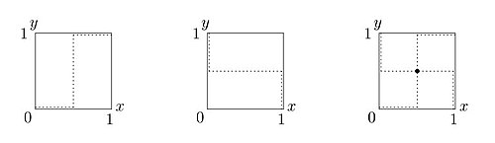
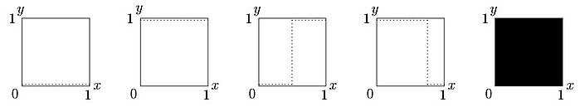
Game Theory
In the bottom panel we can see the possible best responses for a 2x2 game.
In the panel shown above, we see how an equilibrium is determined: first we consider one player’s best response relation, then the other player’s, and finally we impose one above the other. The intersection between best responses is a Nash Equilibrium
Correspondence of best responses

Slide 7
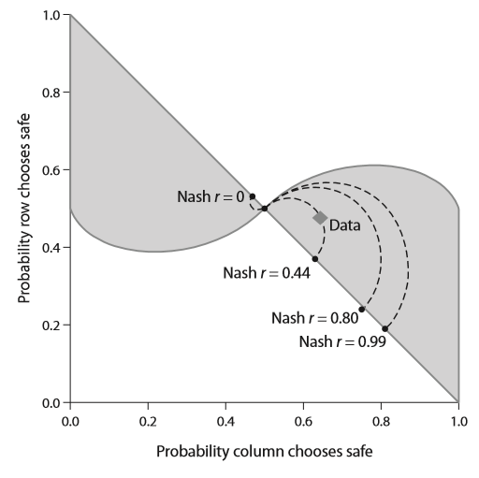
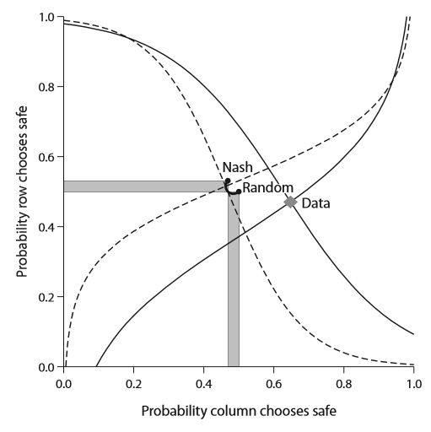
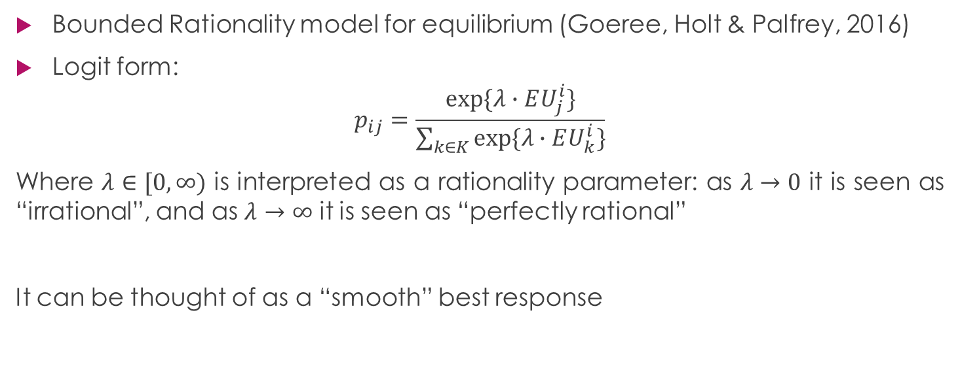
Quantal Response Equilibrium
Bounded Rationality model for equilibrium (Goeree, Holt & Palfrey, 2016)
Logit form:
$$p_{ij}=\frac{exp⁡\{λ∙EU_{j}^{i}\}}{\sum_{k∈K}{exp⁡\{λ∙EU_{k}^{i}\}}}$$
Where $λ∈[0,∞)$ is interpreted as a rationality parameter: as $λ→0$ it is seen as “irrational”, and as $λ→∞$ it is seen as “perfectly rational”
It can be thought of as a “smooth” best response

Slide 8
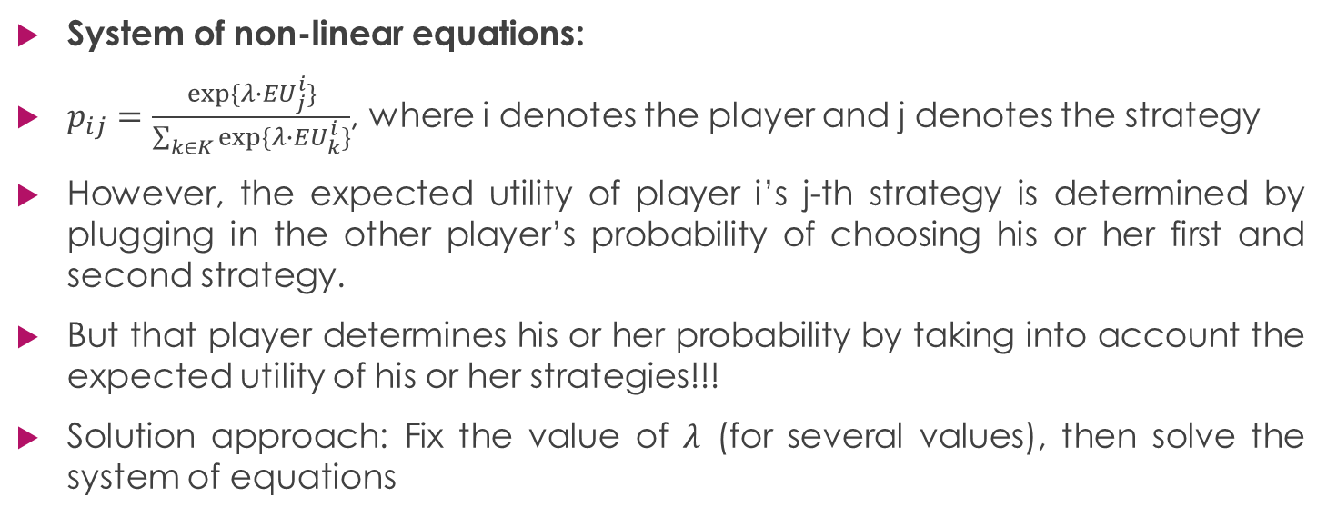
QRE estimation
System of non-linear equations:
$p_{ij}=\frac{exp⁡\{λ∙EU_{j}^{i}\}}{\sum_{k∈K}{exp⁡\{λ∙EU_{k}^{i}\}}}$, where i denotes the player and j denotes the strategy
However, the expected utility of player i’s j-th strategy is determined by plugging in the other player’s probability of choosing his or her first and second strategy.
But that player determines his or her probability by taking into account the expected utility of his or her strategies!!!
Solution approach: Fix the value of $λ$ (for several values), then solve the system of equations

Slide 9
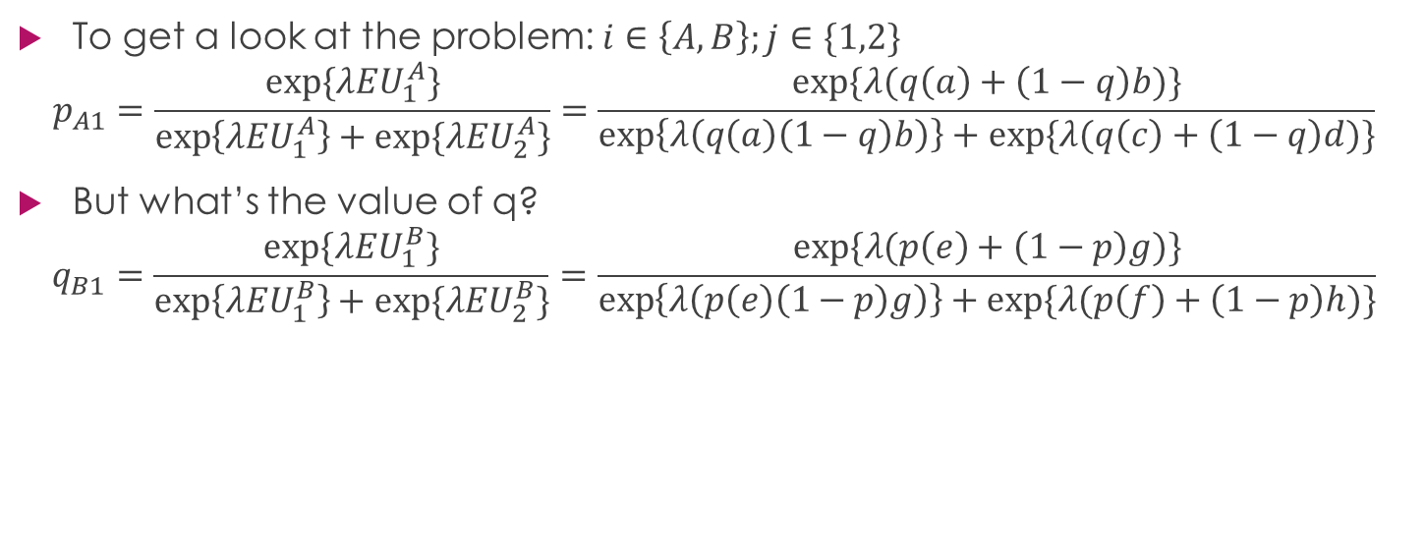
QRE estimation
To get a look at the problem: $i∈\left\{A,B\right\};j∈\{1,2\}$
$$p_{A1}=\frac{exp⁡\{λEU_{1}^{A}\}}{\exp\left\{λEU_{1}^{A}\right\}+exp⁡\{λEU_{2}^{A}\}}=\frac{exp⁡\{λ(q\left(a\right)+\left(1−q\right)b)\}}{\exp\left\{λ\left(q\left(a\right)\left(1−q\right)b\right)\right\}+exp⁡\{λ(q\left(c\right)+\left(1−q\right)d)\}}$$
But what’s the value of q?
$$q_{B1}=\frac{exp⁡\{λEU_{1}^{B}\}}{\exp\left\{λEU_{1}^{B}\right\}+exp⁡\{λEU_{2}^{B}\}}=\frac{exp⁡\{λ(p\left(e\right)+\left(1−p\right)g)\}}{\exp\left\{λ\left(p\left(e\right)\left(1−p\right)g\right)\right\}+exp⁡\{λ(p\left(f\right)+\left(1−p\right)h)\}}$$
 | Player B
Player A | Strategies | 1 (prob. q) | 2 (prob. 1-q)
 | 1 (prob. p) | a,e | b,f
 | 2 (prob. 1-p) | c,g | d,h

Slide 10
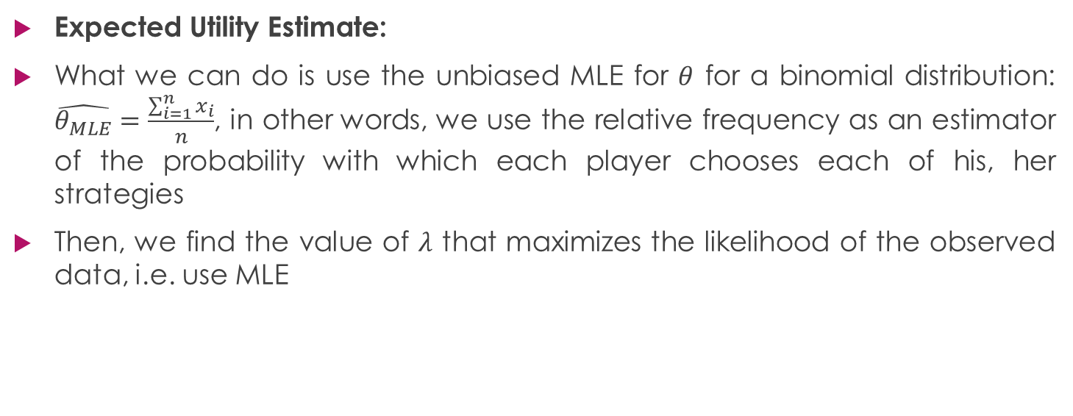
QRE estimation
Expected Utility Estimate:
What we can do is use the unbiased MLE for $θ$ for a binomial distribution: $\hat{θ_{MLE}}=\frac{\sum_{i=1}^{n}{x_{i}}}{n}$, in other words, we use the relative frequency as an estimator of the probability with which each player chooses each of his, her strategies
Then, we find the value of $λ$ that maximizes the likelihood of the observed data, i.e. use MLE

Slide 11
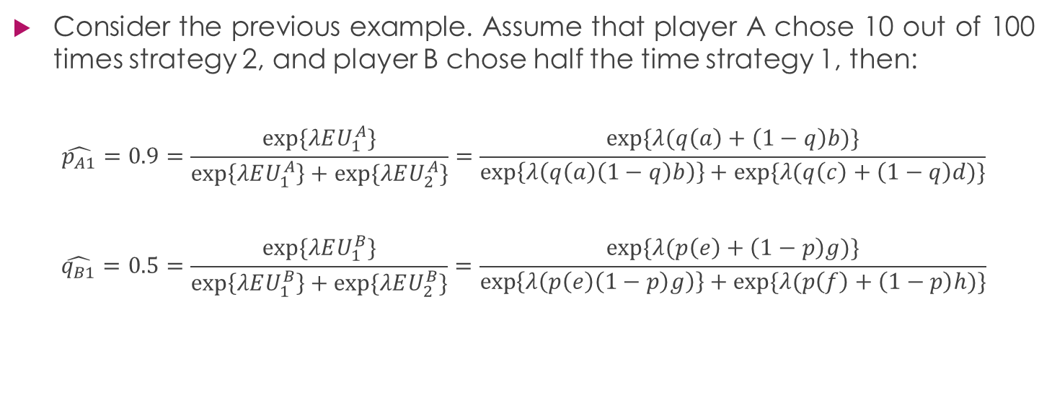
QRE estimation
Consider the previous example. Assume that player A chose 10 out of 100 times strategy 2, and player B chose half the time strategy 1, then:
$$\hat{p_{A1}}=0.9=\frac{exp⁡\{λEU_{1}^{A}\}}{\exp\left\{λEU_{1}^{A}\right\}+exp⁡\{λEU_{2}^{A}\}}=\frac{exp⁡\{λ(q\left(a\right)+\left(1−q\right)b)\}}{\exp\left\{λ\left(q\left(a\right)\left(1−q\right)b\right)\right\}+exp⁡\{λ(q\left(c\right)+\left(1−q\right)d)\}}$$
$$\hat{q_{B1}}=0.5=\frac{exp⁡\{λEU_{1}^{B}\}}{\exp\left\{λEU_{1}^{B}\right\}+exp⁡\{λEU_{2}^{B}\}}=\frac{exp⁡\{λ(p\left(e\right)+\left(1−p\right)g)\}}{\exp\left\{λ\left(p\left(e\right)\left(1−p\right)g\right)\right\}+exp⁡\{λ(p\left(f\right)+\left(1−p\right)h)\}}$$
 | Player B
Player A | Strategies | 1 (prob. q) | 2 (prob. 1-q)
 | 1 (prob. p) | a,e | b,f
 | 2 (prob. 1-p) | c,g | d,h

Slide 12
QRE estimation
 | Maximum Likelihood Estimation | Bayesian Estimation
System of non-linear equations
Expected Utility Estimate

Slide 13
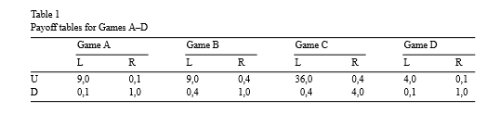
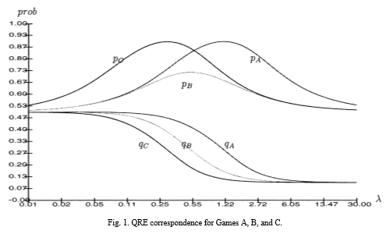
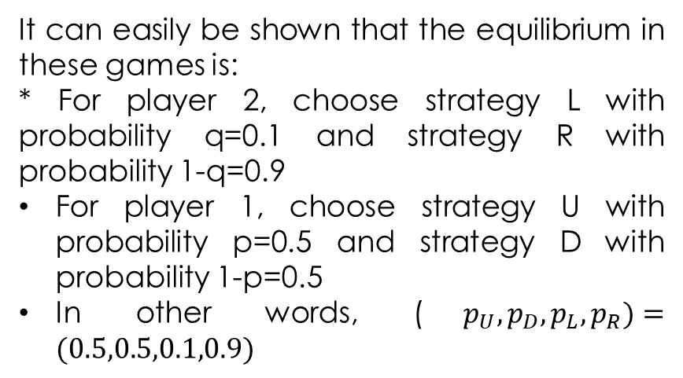
QRE (McKelvey, Palfrey& Weber, 2000)
It can easily be shown that the equilibrium in these games is:
* For player 2, choose strategy L with probability q=0.1 and strategy R with probability 1-q=0.9
For player 1, choose strategy U with probability p=0.5 and strategy D with probability 1-p=0.5
In other words, ($p_{U},p_{D},p_{L},p_{R})=(0.5,0.5,0.1,0.9)$

Slide 14
The story so far
Games:
Battle of the sexes (2 pure strategy equilibriums and 1 mixed)
Asymmetric (1 unique equilibrium in mixed strategies)
Prisoner’s Dilemma (1 unique equilibrium in pure strategies)
O’ Neill’s game (1 unique equilibrium in mixed strategies)
Note: QRE is sensitive to payoffs, so we chose the following payoff matrices

Slide 15
The story so far
Prisoner’s Dilemma | Player B
Player A | Strategies | Cooperate | Defect
 | Cooperate | -1,-1 | -3,0
 | Defect | 0,-3 | -2,-2
Battle of the sexes | Player B
Player A | Strategies | Ballet | Box
 | Ballet | 2,1 | 0,0
 | Box | 0,0 | 1,2
O’Neill’s Game | Player B
Player A | Strategies | Joker | Queen | King | Ace
 | Joker | -1,1 | 1,-1 | 1,-1 | -1,1
 | Queen | 1,-1 | -1,1 | 1,-1 | -1,1
 | King | 1,-1 | 1,-1 | -1,1 | -1,1
 | Ace | -1,1 | -1,1 | -1,1 | 1,-1
Asymmetric | Player B
Player A | Strategies | Left | Right
 | Up | 9,0 | 0,4
 | Down | 0,4 | 1,0

Slide 16

The story so far
Standardize the payoffs between 0 and 1 using (Goeree, Holt & Palfrey, 2003):
$$u\left(x\right)=\frac{x^{1−r}−\min^{1−r}}{\max^{1−r}−\min^{1−r}}, where r=0$$
Justification: QRE is sensitive to the payoffs

Slide 17
The story so far
Prisoner’s Dilemma | Player B
Player A | Strategies | Cooperate | Defect
 | Cooperate | 0.66,0.66 | 0,1
 | Defect | 1,0 | 0.33,0.33
Battle of the sexes | Player B
Player A | Strategies | Ballet | Box
 | Ballet | 1,0.5 | 0,0
 | Box | 0,0 | 0.5,1
O’Neill’s Game | Player B
Player A | Strategies | Joker | Queen | King | Ace
 | Joker | 0,1 | 1,0 | 1,0 | 0,1
 | Queen | 1,0 | 0,1 | 1,0 | 0,1
 | King | 1,0 | 1,0 | 0,1 | 0,1
 | Ace | 0,1 | 0,1 | 0,1 | 1,0
Asymmetric | Player B
Player A | Strategies | Left | Right
 | Up | 1,0 | 0,1
 | Down | 0,1 | 0.11,0

Slide 18
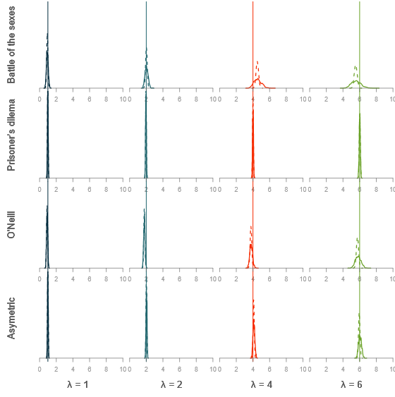
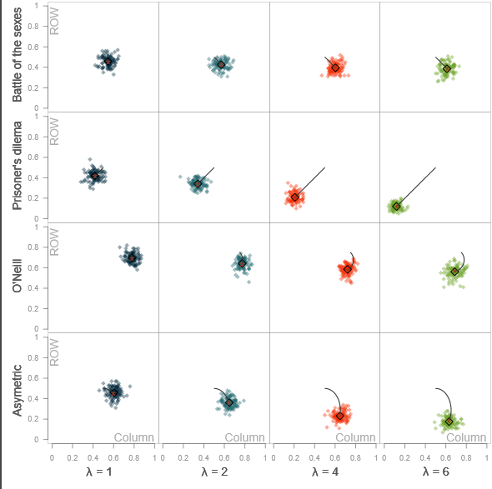

Slide 19
What’s next?
Estimate a different value of lambda for each player
Does it make sense to assume that (generally) one player is more rational than the other?
Hierarchical modeling
Does it make sense to assume that in a given population there are more rational people than others?

Slide 20
Quantal Response Equilibrium Experiments
Jesus Manuel Villarreal Ulloa
Darío Trujano ochoa
Hrayr Der Hagopian Tlapanco

Slide 21
Experiments
Programmed to play “n” times against an opponent, where “n” is variable
Feedback after every trial: your payoff and your opponent’s
NOT available: cumulative payoff
Why?-> Independence assumption
6 different games:
2X2
2X3
3X3
3X4
2X4
4X4

Slide 22
Quantal Response Equilibrium Optimal Design
Jesus Manuel Villarreal Ulloa
Darío Trujano ochoa
Hrayr Der Hagopian Tlapanco

Slide 23
Games with unique mixed strategy Nash Equilibrium
Lemma: In any 2X2 normal form game, there is a unique mixed Nash equilibrium in the non-degenerated sense iff no player is always indifferent between his strategies nor has a weakly (or strongly) dominant strategy
Additional requirement: Either of the two holds:
i) a>c and b<d for player 1 and e<f and g>h for player 2
ii) a<c and b>d for player 1 and e>f and g<h for player 2
 | Player B
Player A | Strategies | 1 (prob. q) | 2 (prob. 1-q)
 | 1 (prob. p) | a,e | b,f
 | 2 (prob. 1-p) | c,g | d,h

Slide 24


Two commonly used utility functions
For Prospect Theory:
Value Function:
$$v\left(x\right)=\left\{\begin{aligned}x^{α} if x≥0 \\ −λ{\left(−x\right)}^{β} if x<0\end{aligned}\right.$$
Goeree et. al.
Utility function:
$$u\left(x\right)=\frac{x^{1−r}−\min^{1−r}}{\max^{1−r}−\min^{1−r}}$$
The idea is that a certain value of lambda (QRE) in conjunction with the parameters of Prospect Theory (lambda and beta) will be able to map a cloud of points in the plane. Similarly, the same value of lambda (QRE) combined with a value of r (Goeree’s utility function) will map a cloud of points (many of them different) in the same plane.
Which are the values of the payoff matrix that should be chosen so as to separate as much as possible the two clouds?

Slide 25
Purpose
Design a 2X2 game that:
Has the payoffs that maximized the distance between the clouds of points in the plane
Has a unique equilibrium in mixed strategies (why?-> stability)
Have people play this optimized game

Slide 26
Bibliography
Goeree, J.K., Holt, C.A., & Palfrey, T.R. (2016). Quantal Response Equilibrium A Stochastic Theory of Games. USA: Princeton University Press.
Goeree, J.K., Holt, C.A., & Palfrey, T.R. (2003). Risk averse behavior in generalized matching pennies games. Games and Economic Behavior, 45(1), 97-113.
McKelvey, R. D., Palfrey, T. R., & Weber, R. A. (2000). The effects of payoff magnitude and heterogeneity on behavior in 2× 2 games with unique mixed strategy equilibria. Journal of Economic Behavior & Organization, 42(4), 523-548.

Slide 27
Thank you!

