Slide 1
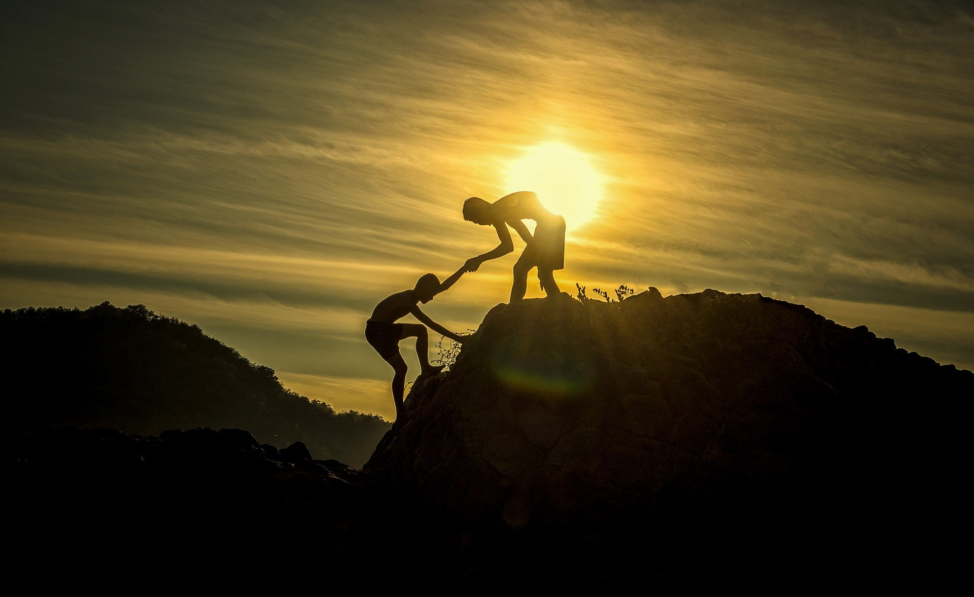
Advanced Software Engineering:
Project Presentation
Manuel Wetzel
5905233
Felix Schütz
6923946
Arbër Rrapaj
1848380
Sascha Kipper
9836038
Notes:
Welcome to our Advanced Software Engineering Project Presentation! We are Manuel, Felix, Arber and me, Sascha – I will guide you through this presentation today. We will now present you the results of our Personal Digital Assistant project.

Slide 2

The worlds smartest* PDA.
* kind of
Notes:
And our result has a name: Gunter! – the worlds smartest Personal Digital Assistant! *Hello my name is Gunter* - well, at least kind of. We will introduce you to him, and he will introduce himself to you, too.

Slide 3

Agenda
1
Requirements Analysis
2
Introducing Gunter
3
A Day with Gunter
4
Conclusion
Advanced Software Engineering: Project Presentation - PDA | 3
Notes:
Before we start with the presentation, here‘s an overview of our agenda.
First, we will go over the project requirements, as specified in the lecture and the script. Over the course of this presentation we will then see, whether Gunter fulfills these requirements or not.
After this, we will introduce you to Gunter – the concepts behind him, with a quick overview of the technology stack he is built with. In this section we will also show you a first overview of Gunters use cases, the APIs he uses, and how Gunter uses these APIs to work on his use cases.
Based on this overview, we will dive deeper into each of our use cases by outlining a typical day in your life - with Gunters assistance. For each use case respectively, the idea behind the use case will be outlined, followed by some diagrams to formalize the use case, and a live demo for each use case.
Finally, we close the presentation with a brief conclusion.
3

Slide 4
Agenda
1
Requirements Analysis
2
Introducing Gunter
3
A Day with Gunter
4
Conclusion
Advanced Software Engineering: Project Presentation - PDA | 4
Notes:
So without further ado, let‘s start with an analysis of the project requirements.
4

Slide 5
Requirements Analysis
Requirements Checklist:
3 Characteristics of a PDA
At least 4 Use Cases
At least 4 Services per Use Case
All Use Cases are functional & executable
Advanced Software Engineering: Project Presentation - PDA | 5
Notes:
We will use this checklist to collect the project requirements specified in the lecture.
First of all, our PDA has to fulfill the 3 characteristics of a PDA.
Our PDA has to offer at least 4 use cases – as our group consists of 4 students – and use at least 4 services per use case.
And lastly, all use cases have to be functional and executable.
So, for your convenience, we will put this checklist into our pocket, and get back to it during the presentation, whenever we‘ve seen a requirement being fulfilled.

Slide 6
Requirements Analysis
Checklist PDA:
Speech Dialogue
Proactivity
Personal
Preferences
Advanced Software Engineering: Project Presentation - PDA | 6
Notes:
Also, the first point on our checklist can be further subdivided into three aspects – let‘s carry a second checklist with us. Here we see the three requirements a PDA has to fulfill:
Speech Dialogue, Proactivity and Personal Preferences.
As with the previous list, we will get back to this list during the presentation whenever we‘ve seen an aspect of it being fulfilled by Gunter.

Slide 7
Agenda
1
Requirements Analysis
2
Introducing Gunter
3
A Day with Gunter
4
Conclusion
Advanced Software Engineering: Project Presentation - PDA | 7
Notes:
Now that we‘ve collected the project requirements, let‘s introduce Gunter!
7

Slide 8
Introducing Gunter
Technology Stack:
Frontend: Vue.js
Backend: Node.js + LowDB
APIs: VVS, Deutsche Bahn, Google Calendar, Microsoft Azure Maps: Places and Weather, Daily Quote (They Said So Quotes)
Notifications through browser (service worker)
Advanced Software Engineering: Project Presentation - PDA | 8
Notes:
Gunter is a Personal Digital Assistant we built using this stack of technology.
He is available as a web-application, whose frontend is created with Vue.js and in his backend, we find a combination of Node.js with LowDB as a database.
The summary of APIs Gunter communicates with in his different use cases are those of VVS, Deutsche Bahn, Google Calendar, Places and Weather from Microsoft Azure Maps, and Daily Quotes from They Said So Quotes. You will see how these are used in detail in just a moment.
And lastly, Gunter uses service workers to communicate with a user through browser notifications, which Gunter can send proactively.

Slide 9
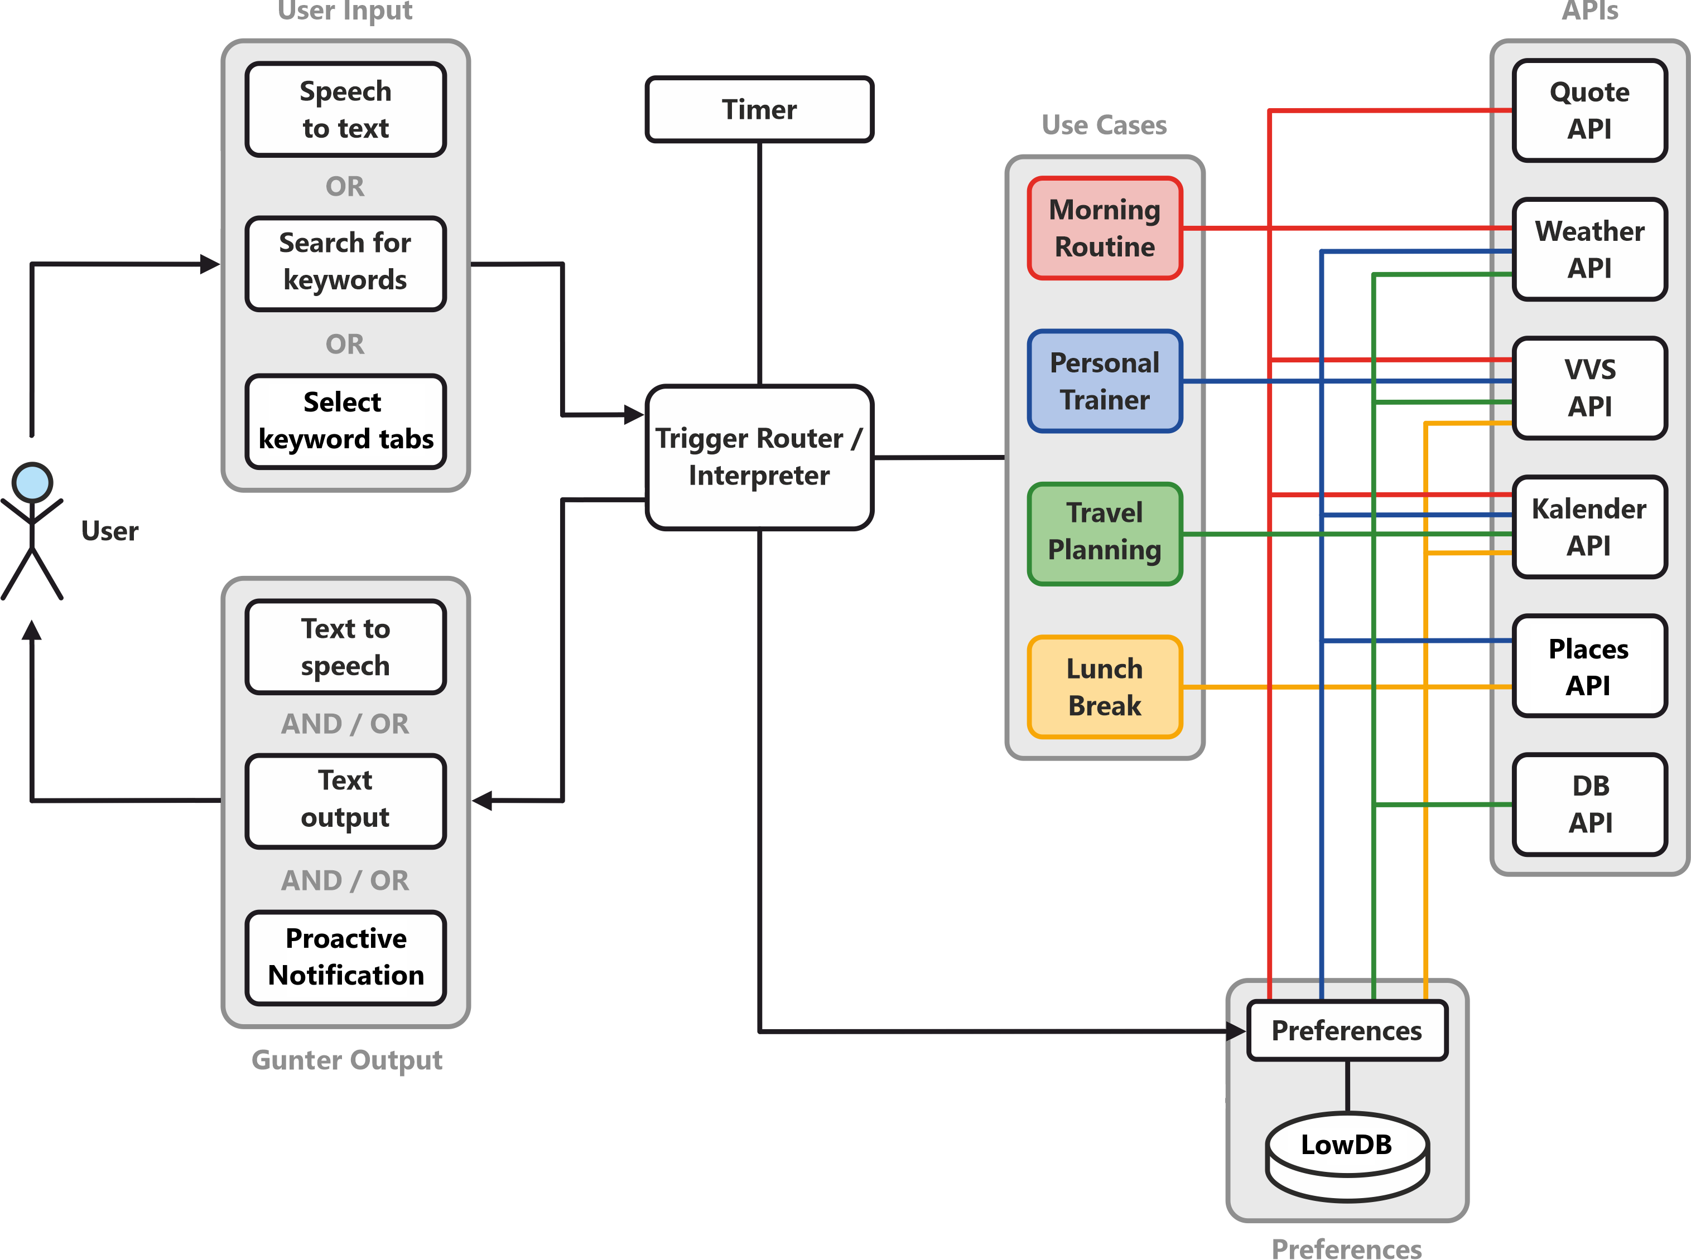
Notes:
Here you can now see a diagram that provides a high-level overview of Gunter. We will go over all of it once, so let‘s start at the left where the user is located.
[Use Laserpointer]
The user can communicate with Gunter using three alternative ways of input. The user can either use speech to text, he can search for keywords by typing them, or select predefined keywords by clickling on tabs corresponding to the use cases. Each of these ways of input will be shown the following live demos at least once.
The users input is then interpreted and then either routed towards one of the four use cases, or to the users preferences. Also, the router takes the users preferences into account when triggering certain use cases.
Here you can see our four use cases, which are Morning Routine, Personal Trainer, Travel Planning and Lunch Break. These use cases will be explained in detail one by one in just a minute. The colored lines depict, which use case queries which API to achieve its functionality. This will also be shown for each use case individually later in the presentation, so you don‘t have to remember it from this diagra. Each use case also queries the users preferences, which are stored in LowDB.
Lastly, a timer can be set by the use cases to trigger the router, so that Gunter can send proactive notifications to the user. Gunter communicates with the user through both text to speech and text output, as well as an optional proactive notification.

Slide 10
Introducing Gunter
Requirements Checklist:
3 Characteristics of a PDA
At least 4 Use Cases
At least 4 Services per Use Case
All Use Cases are functional & executable
Advanced Software Engineering: Project Presentation - PDA | 10
Notes:
As we‘ve seen in the previous diagram, Gunter already fulfills some of the project requirements on our checklist:
He provides at least 4 use cases, and
The use cases respectively use at least 4 services each.

Slide 11
Agenda
1
Requirements Analysis
2
Introducing Gunter
3
A Day with Gunter
4
Conclusion
Advanced Software Engineering: Project Presentation - PDA | 11
Notes:
Now that you‘ve seen a high level overview of Gunter, we will take you through one day in your life with Gunters assistance, and thereby introduce him and his use cases in detail.
11

Slide 12
A Day with Gunter
Your typical Friday:
Getting up in time for the first appointment
Having lunch in between appointments
Doing some physical exercise in between appointments
Open-minded for a weekend-trip to get out of the city
Advanced Software Engineering: Project Presentation - PDA | 12
Notes:
Imagine a typical Friday in your life, and what tasks and needs this day includes.
You have to get up in time to get to your first appointment by public transportation. If the times of your first appointments vary, you may have to check at which time you have to get up in the morning each evening beforehand, and set an appropriate alarm.
Between your appointments during the day, you‘d of course like to have lunch in a nice restaurant, maybe one that you haven‘t tried out before, and also, your new years resolution of becoming fitter could be easily achieved if you had an idea of where to do some physical exercise in between some appointments during the day.
Living in the loud and busy city, you‘re also always open for a weekend-trip to get into nature a little bit more – if you just knew where to travel to!
And guess what – what a suprise – Gunter can help you with all of this! So let‘s dive into your day with Gunter, starting with your new Morning routine.

Slide 13
Use Case 1: Morning Routine
Gunter wakes up the user in the morning, based on:
User preferences (time the user need to get ready)
User calendar (time it takes to travel to first appointment)
Gunter presents the VVS route to the first event and weather forecast for the day
Gunter optionally reads a daily qoute
Advanced Software Engineering: Project Presentation - PDA | 13
Notes:
Gunter wakes you – the user – up in the morning, based on…
… your preferences, which specify how much time you need to get ready for the day before leaving the house, and
… your calendar, which contains your first appointment and its location, which determines how long it takes you to get there.
Gunter then presents you a VVS route to the location of your first appointment, as well as a weather forecast for the coming day, so you can dress just right.
Optionally, Gunter reads you a daily quote of your favourite quote category in a very poetic manner.

Slide 14
Use Case 1: Morning Routine
Gunter
<<include>>
Query user calendar
<<include>>
Query user preferences
Wake up user with event reminder and transport recommedation
<<include>>
Query daily quote
<<include>>
Query VVS connections
User
<<include>>
Query weather information
Advanced Software Engineering: Project Presentation - PDA | 14
Notes:
Formalized as a use case diagram, this use case looks as follows: [Read diagram]

Slide 15







Use Case 1: Morning Routine
VVS
DB
Calendar
Preferences
Quotes
Places
Weather
Wake up the user: → Alarm = Appointment – Transportation – Time to get ready
Advanced Software Engineering: Project Presentation - PDA | 15
Notes:
And now, let‘s have another look for which action Gunter queries which APIs for the morning routine use case.
Firstly, Gunter wakes up the user at a time that is based on: The time of the users appointment, the time it takes the user to get to the appointment by public transport, and the users preferred time to get ready in the morning.
So Gunter queries the VVS and Calendar APIs, as well as the users preferences.

Slide 16
Use Case 1: Morning Routine
VVS
DB
Calendar
Preferences
Quotes
Places
Weather
Wake up the user
Display VVS route to appointment
Advanced Software Engineering: Project Presentation - PDA | 16
Notes:
Secondly, Gunter displays a route to the location of the first appointment by public transportation.
Therefore, he queries the users Calendar for the appointment location, which is then set as a destination in the VVS API call.

Slide 17
Use Case 1: Morning Routine
VVS
DB
Calendar
Preferences
Quotes
Places
Weather
Wake up the user
Display VVS route to appointment
Display weather and daily quote (→ preferred category)
Advanced Software Engineering: Project Presentation - PDA | 17
Notes:
Lastly, Gunter displays the daily weather forecast and a daily quote for the user.
Therefore, he consults the weather API, and the Quotes API with the users favourite quote category, which is stored in the users preferences.
And after this theoretical part, ist now time for a first live demo of this use case!

Slide 18
Use Case 1: Morning Routine
Live Demo Placeholder
This first live demo also includes basic stuff like:
Explain Gunters UI, show help page, etc.
Setting the preferences
Having a look the calendar
Advanced Software Engineering: Project Presentation - PDA | 18
Notes:
Script for each live demo:
Illustrate prerequisites (calendar entries to which the use case is applicable, user preferences set in Gunter)
Illustrate proactivity if possible

Slide 19
Use Case 1: Morning Routine
Checklist:
Speech Dialogue
Proactivity
Personal
Preferences
Advanced Software Engineering: Project Presentation - PDA | 19
Notes:
As the first use case and its live demo has shown, Gunter fulfills all three characteristics of a PDA: Speech Dialogue, Proactivity and Personal Preferences.
So we can tick these boxes on this checklist…

Slide 20
Use Case 1: Morning Routine
Requirements Checklist:
3 Characteristics of a PDA
At least 4 Use Cases
At least 4 Services per Use Case
All Use Cases are functional & executable
Advanced Software Engineering: Project Presentation - PDA | 20
Notes:
And tick the first checkbox on this checklist as well! Let‘s put it back into our pocket and start over with the second use case.

Slide 21
Use Case 2: Lunch Break
Gunter suggests a restaurant for the lunch break, based on:
The users current location
User calendar (amount of free time for lunch break)
The users preferences (distance to restaurant, minimum break length)
Optionally, a VVS route to the suggested restaurant is displayed
Advanced Software Engineering: Project Presentation - PDA | 21
Notes:
In the second use case, Gunter suggests you a restaurant for your lunch break. His suggestion is based on…
… the users current location (so unlike the other use cases, this one actually queries your current location instead of the location set in your preferences), and
… obviously, the users calendar. Based on the times of your appointments, Gunter suggests an appropriate time for a lunch break.
… Also, the user can specify the preferred minimum length of his lunch break and the maximum distance of the restaurant in his preferences.
Optionally, Gunter displays a route to the restaurant by public transport.

Slide 22
Use Case 2: Lunch Break
Gunter
<<include>>
Query user calendar
<<include>>
Query user preferences
Notify user about restaurant suggestions for the lunch break
Query VVS connections
User
<<include>>
<<include>>
Query places service, location
Advanced Software Engineering: Project Presentation - PDA | 22
Notes:
Again, formalized as a use case diagram, this use case looks as follows: [Read diagram]

Slide 23
Use Case 2: Lunch Break
VVS
DB
Calendar
Preferences
Quotes
Places
Weather
Monitor users calendar and notify for possible lunch break → Minimum duration as preferred
Advanced Software Engineering: Project Presentation - PDA | 23
Notes:
For the different tasks in this use case, Gunter queries the following APIs.
Firstly, Gunter monitors the users calendar to derive a suggested time for a lunch break. This is not only based on the users appointments, but also on his preferences, regarding the minimum duration of his lunch break.
So for this first task, Gunter uses the Calendar API and the users preferences.

Slide 24
Use Case 2: Lunch Break
VVS
DB
Calendar
Preferences
Quotes
Places
Weather
Monitor users calendar and notify for possible lunch break
Suggestion for nearby restaurant
Advanced Software Engineering: Project Presentation - PDA | 24
Notes:
Once Gunter has found a spot for a lunch break, he notifies the user with a suggestion for a nearby restaurant.
Therefore he queries the users preferences, which specify the maximum distance of the restaurant to the user, and the Places API to retrieve a restaurant suggestion.

Slide 25
Use Case 2: Lunch Break
VVS
DB
Calendar
Preferences
Quotes
Places
Weather
Monitor users calendar and notify for possible lunch break
Suggestion for nearby restaurant
Display VVS route to restaurant
Advanced Software Engineering: Project Presentation - PDA | 25
Notes:
Lastly, Gunter displays a route to the location of the restaurant by public transportation.
Therefore, he queries the Places API for the restaurant location, which is then set as a destination in the VVS API call.

Slide 26
Use Case 2: Lunch Break
Live Demo Placeholder
Advanced Software Engineering: Project Presentation - PDA | 26

Slide 27
Use Case 3: Personal Trainer
Gunter monitors the users calendar for free spots, and suggests occasions to do physical exercise
Gunter suggests:
Indoors / Outdoors activity based on weather forecast
Travel distance according to user preferences
VVS route to training location
Advanced Software Engineering: Project Presentation - PDA | 27
Notes:
In the third use case, Gunter again monitors the users calendar in order to suggest free slots for physical exercise. He does so by also consulting the users preferences, regarding the preferred minimum length of a training session.
Gunter then suggests a training location based on multiple factors.
… Firstly, the weather forecast: If the weather is sunny and nice, he will suggest an outdoors training location. If it looks more like rain, an indoors training location is more appropriate.
… Furthermore he takes the user preferences into account regarding the maximum distance of the training location preferred by the user.
And lastly, Gunter displays a route to the suggested training location by public transport.

Slide 28
Use Case 3: Personal Trainer
Gunter
<<include>>
Query user calendar
<<include>>
Query user preferences
Remind user about free slots and recommendations for physical exercise
<<include>>
Query places service
<<include>>
Query VVS connections
User
<<include>>
Query weather forecast
Advanced Software Engineering: Project Presentation - PDA | 28
Notes:
Formalized as a use case diagram, this use case looks as follows: [Read diagram]

Slide 29
Use Case 3: Personal Trainer
VVS
DB
Calendar
Preferences
Quotes
Places
Weather
Monitor users calendar and notify for free spots: → Minimum length of free spot
Advanced Software Engineering: Project Presentation - PDA | 29
Notes:
For his first task of monitoring the users calendar, Gunter queries not only the calendar itself, but also the user preferences. These contain information on the minimum length of a training session.

Slide 30
Use Case 3: Personal Trainer
VVS
DB
Calendar
Preferences
Quotes
Places
Weather
Monitor users calendar and notify for free spots
Suggestion for activity based on weather forecast: → Weather good = outdoors; Weather bad = indoors.
Advanced Software Engineering: Project Presentation - PDA | 30
Notes:
Gunter then suggests a training location, based on
… the users calendar and the amount of time the user has
… the users preferences regarding the maximum distance of the training location,
… the Places API for retrieving a suggestion for a training location, which is based on
… the weather forecast: Indoor activities will be preferred if the weather is too bad for an outdoors training, and vice versa.

Slide 31
Use Case 3: Personal Trainer
VVS
DB
Calendar
Preferences
Quotes
Places
Weather
Monitor users calendar and notify for free spots
Suggestion for activity based on weather forecast
Display VVS route to training location
Advanced Software Engineering: Project Presentation - PDA | 31
Notes:
And lastly, Gunter displays a route to the location of the restaurant by public transportation.
He queries the Places API for the training location, which is then set as a destination in the VVS API call.

Slide 32
Use Case 3: Personal Trainer
Live Demo Placeholder
Advanced Software Engineering: Project Presentation - PDA | 32

Slide 33
Use Case 4: Travel Planning
Gunter monitors the users calendar for the upcoming weekend and suggests possible destinations for weekend trips
The suggestions include:
DB ticket prices
A VVS route to Stuttgart main station
The weather forecast for the travel destination
Advanced Software Engineering: Project Presentation - PDA | 33
Notes:
In his last use case, Gunter again monitors the users calendar for free spots in order to make suggestions for possible weekend-trips for the upcoming weekend – if the user has no appointments during this weekend.
Gunter suggests a travel location based on the user preferences, which specify the minimum distance of the destination. His suggestions then include
… The prices of the tickets to the destination with Deutsche Bahn,
… An optional route to the origin train station, in this case Stuttgart Main Station, with public transport, and
… the weather forecast for the travel destination, so you can pack your suitcase just right.

Slide 34
Use Case 4: Travel Planning
Gunter
<<include>>
Query user calendar
<<include>>
Query user preferences
Notify user about possiblities for a weekend trip
<<include>>
Query DB connections
<<include>>
Query VVS connections
User
<<include>>
Query weather forecast
Advanced Software Engineering: Project Presentation - PDA | 34
Notes:
Formalized as a use case diagram, this use case looks as follows: [Read diagram]

Slide 35
Use Case 4: Travel Planning
VVS
DB
Calendar
Preferences
Quotes
Places
Weather
Monitor users calendar and notify for free weekends
Advanced Software Engineering: Project Presentation - PDA | 35
Notes:
For deriving a suggestion, Gunter monitors the user calendar to retrieve free weekends without appointments.

Slide 36
Use Case 4: Travel Planning
VVS
DB
Calendar
Preferences
Quotes
Places
Weather
Monitor users calendar and notify for free weekends
Suggestion for weekend-trip with weather forecast: → Minimum distance of destination as preferred
Advanced Software Engineering: Project Presentation - PDA | 36
Notes:
Gunter then derives a travel suggestion for the free weekend, for which he queries…
… the Deutsche Bahn API for ticket prices to the suggested destination,
… the users preferences for the minimum distance to the suggested destination, and
… The weather forecast for the destination of the weekend trip.

Slide 37
Use Case 4: Travel Planning
VVS
DB
Calendar
Preferences
Quotes
Places
Weather
Monitor users calendar and notify for free weekends
Suggestion for weekend-trip with weather forecast
Display VVS route to departure location (Stuttgart Hbf)
Advanced Software Engineering: Project Presentation - PDA | 37
Notes:
Finally, Gunter optionally displays a route to the origin train station, in this case Stuttgart Main station, by public transportation.

Slide 38
Use Case 4: Travel Planning
Live Demo Placeholder
Advanced Software Engineering: Project Presentation - PDA | 38

Slide 39
Use Case 4: Lunch Break
Requirements Checklist:
3 Characteristics of a PDA
At least 4 Use Cases
At least 4 Services per Use Case
All Use Cases are functional & executable
Advanced Software Engineering: Project Presentation - PDA | 39
Notes:
Now that we‘ve seen all use cases in live demos, we can check the last missing box: All use cases are functional and executable!

Slide 40
Agenda
1
Requirements Analysis
2
Introducing Gunter
3
A Day with Gunter
4
Conclusion
Advanced Software Engineering: Project Presentation - PDA | 40
Notes:
With our checklist complete, we are now finished with our day with Gunter and can conclude our presentation with some poetic words.
40

Slide 41
Conclusion
Gunter is a smart PDA with useful use cases to proactively assist you in your everyday life
Gunter fulfills all project requirements
Further functionalities like Maps could be an enhancement
Gunter may need to practice German pronunciation some more
Advanced Software Engineering: Project Presentation - PDA | 41
Notes:
Any more concluding points? Actually, this slide is not really necessary. The agenda just looked better with a fourth chapter in it.

Slide 42
Thank you for your watching!
Manuel Wetzel
5905233
Felix Schütz
6923946
Arbër Rrapaj
1848380
Sascha Kipper
9836038
Notes:
Thank you for your attention, etc. Bla bla

Slide 43
gunter.felixsz.de
Notes:
If you‘d like to see Gunter in action, visit him at gunter.felixsz.de!

