Slide 1
Modeling and data analysis of biochemical oscillators using Chemical Master Equation and AI: applications to the NF-kB activity in patient derived xenografts
University of Bologna
Master Degree in Applied Physics
Supervisor: Prof. Enrico Giampieri
Co-supervisor: Prof. Daniel Remondini
Submitted by:
Manuela Carriero
Academic Year 2022/2023

Slide 2
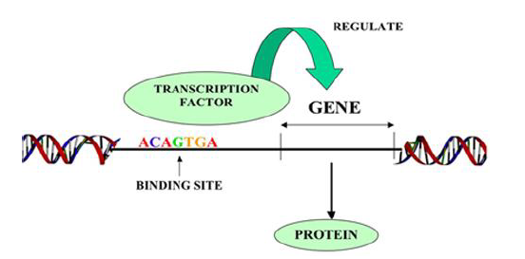
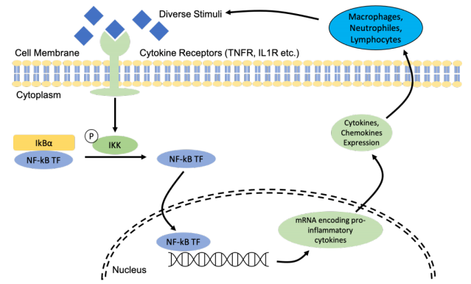
Motivation of the work
The project is inspired by the aim to model and simulate the NF-kB transcription factor activity. NF-kB regulates many genes and its dysfunction is found in many diseases.
Central dogma of biology DNA → RNA → Protein

Slide 3
Workflow
We deepen into stochastic simulation algorithms (Chemical Master Equation);
We model and simulate simple biomolecular oscillators that have similar oscillatory behavior to the NF-kB;
We analyze simulation results;
We train artificial neural networks to predict model parameters given the autocorrelation functions;
SSA simulation of NF-kB model.

Slide 4
Workflow
We deepen into stochastic simulation algorithms (Chemical Master Equation);
We model and simulate simple biomolecular oscillators that have similar oscillatory behavior to the NF-kB;
We analyze simulation results;
We train artificial neural networks to predict model parameters given the autocorrelation functions;
SSA simulation of NF-kB model.

Slide 5
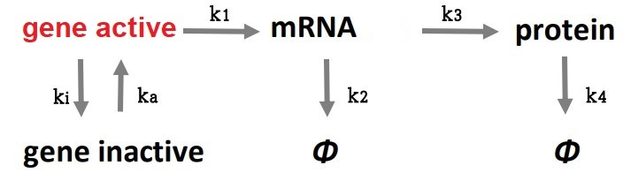
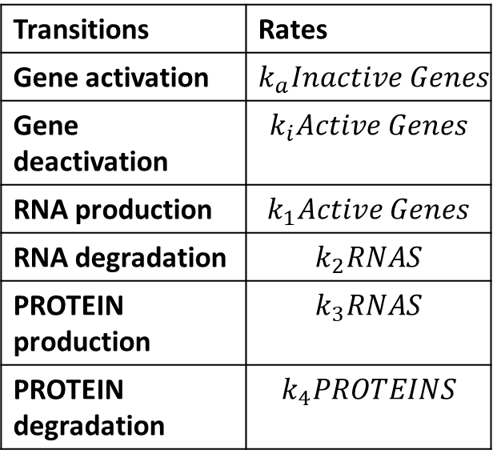
Chemical Master Equation (CME)
Transitions | Rates
Gene activation | $$k_{a}Inactive Genes$$
Gene deactivation | $$k_{i}Active Genes$$
RNA production | $$k_{1}Active Genes$$
RNA degradation | $$k_{2}RNAS$$
PROTEIN production | $$k_{3}RNAS$$
PROTEIN degradation | $$k_{4}PROTEINS$$
Production of molecules in a cellular environment = Stochastic Process
$$P\left(n,t\right)=Probability that the system is in state n at time t$$
$$\frac{∂P(n,t)}{∂t}=\sum_{n′}{W_{n^{′}→n}P\left(n^{′},t\right) − W_{n→n^{′}}P(n,t)}$$

Slide 6
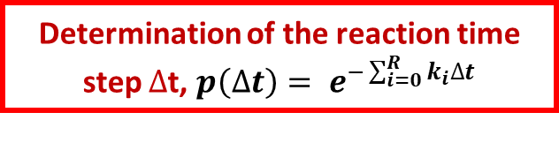
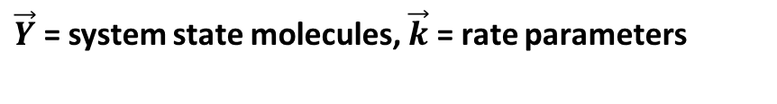



Stochastic Simulation Algorithm (SSA)
$\vec{Y}$ = system state molecules, $\vec{k}$ = rate parameters
Identification of all possible reaction events
Calculation of reaction probabilities
Update $\vec{Y}→ \vec{Y′}$
Generation of two random numbers
No
$${RN}_{2}$$
$${RN}_{1}$$
Determination of the reaction time step $∆$t, $p\left(∆t\right)= e^{−\sum_{i=0}^{R}{k_{i}∆t}}$
Selection of the reaction event
Yes
Tfinal?
Molecules
Execute reaction event

Slide 7
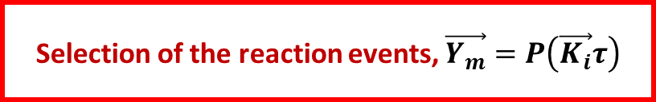
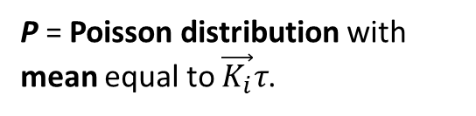


Tau-leap
$\vec{Y}$ = system state molecules, $\vec{k}$ = rate parameters, $τ$ = reaction time step
P = Poisson distribution with mean equal to $\vec{K_{i}}τ$.
Identification of all possible reaction events
Calculation of reaction probabilities
Update $\vec{Y}→ \vec{Y′}$
Generation one random number
No
$${RN}_{1}$$
Selection of the reaction events, $\vec{Y_{m}}=P\left(\vec{K_{i}}τ\right)$
Tfinal?
Yes
Execute reaction events
Molecules

Slide 8
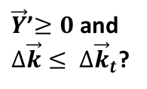

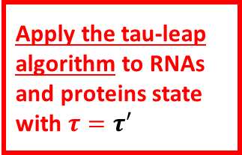




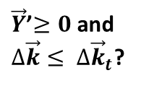


Hybrid Algorithm
(applied to first protein synthesis model)
Apply the tau-leap algorithm to RNAs and proteins state with $τ^{′′}=τ − τ′$
Yes
Tfinal?
Yes
$\vec{Y}$’$≥0$ and
$∆\vec{k}≤$ $∆{\vec{k}}_{t}$?
$\vec{Y}$, $\vec{k}$, $∆{\vec{k}}_{t}$
Molecules
No
Apply the tau-leap algorithm to RNAs and proteins state with $τ=τ′$
Identification of all possible reaction events
No
Yes
Calculation of reaction probabilities
Apply SSA
Update $\vec{Y}→ \vec{Y′}$
No
$\vec{Y}$’$≥0$ and
$∆\vec{k}≤$ $∆{\vec{k}}_{t}$?
No
Apply SSA algorithm to genes state
Yes
Tfinal?
Yes
Molecules
No
$τ^{(n)}≥3t_{c}$?
Apply the tau-leap algorithm to RNAs and proteins state with $τ=$ $t_{gene_state_residency}$
Yes
No
$\vec{Y}$’$≥0$ and $∆\vec{k}≤$ $∆{\vec{k}}_{t}$?
$τ^{(n)}→τ$/2

Slide 9
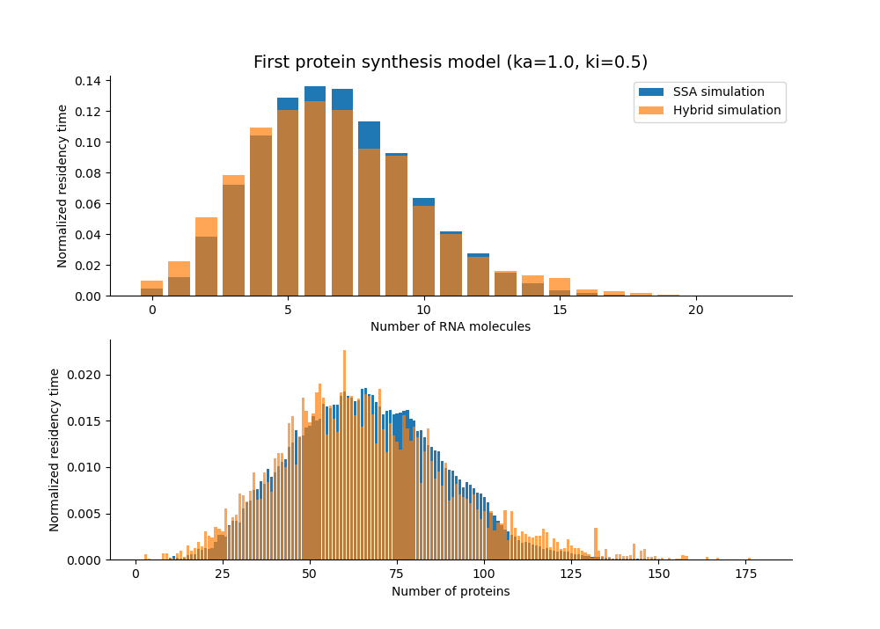

Hybrid Algorithm (results)
$$k_{a}=1,k_{i}=0.5,k_{1}=1,k_{2}=0.1,k_{3}=1,k_{4}=0.1$$
$$∆K_{t}=10$$
 | Time
SSA | 107s
Hybrid | 7.5s

Slide 10
Workflow
We deepen into stochastic simulation algorithms (Chemical Master Equation);
We model and simulate simple biomolecular oscillators that have similar oscillatory behavior to the NF-kB;
We analyze simulation results;
We train artificial neural networks to predict model parameters given the autocorrelation functions;
SSA simulation of NF-kB model.

Slide 11
Workflow
We deepen into stochastic simulation algorithms (Chemical Master Equation);
We model and simulate simple biomolecular oscillators that have similar oscillatory behavior to the NF-kB;
We analyze simulation results;
We train artificial neural networks to predict model parameters given the autocorrelation functions;
SSA simulation of NF-kB model.

Slide 12
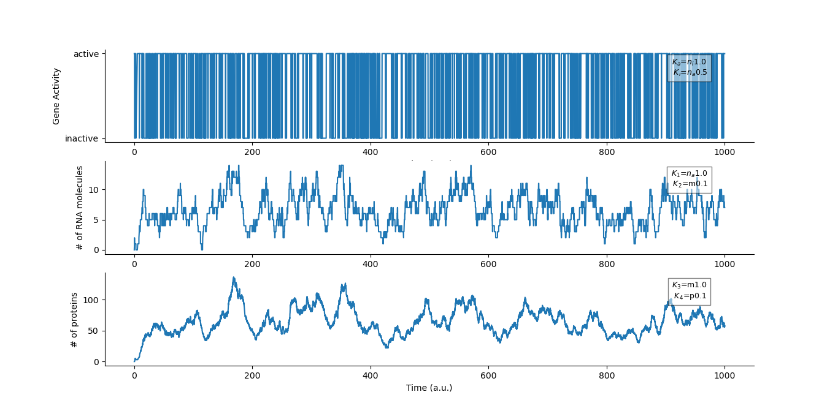
First protein synthesis model (gene more active than inactive)

Slide 13
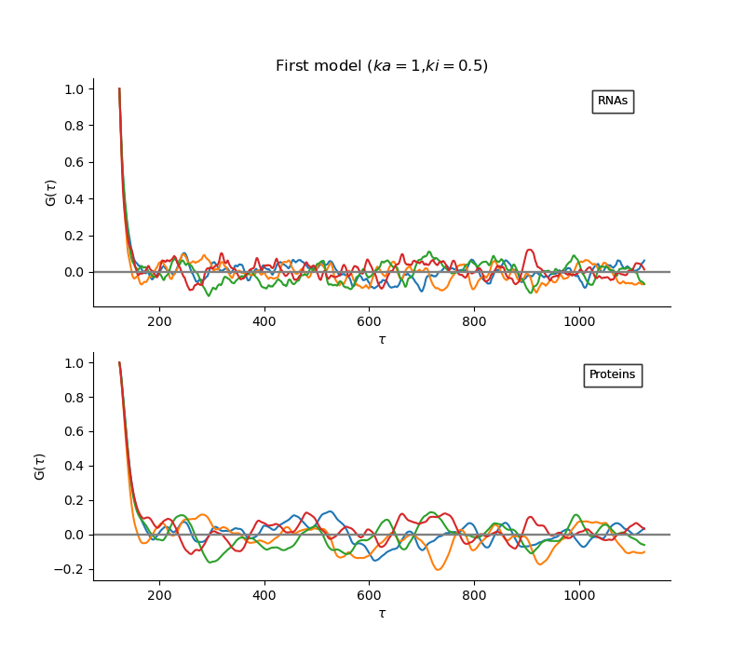
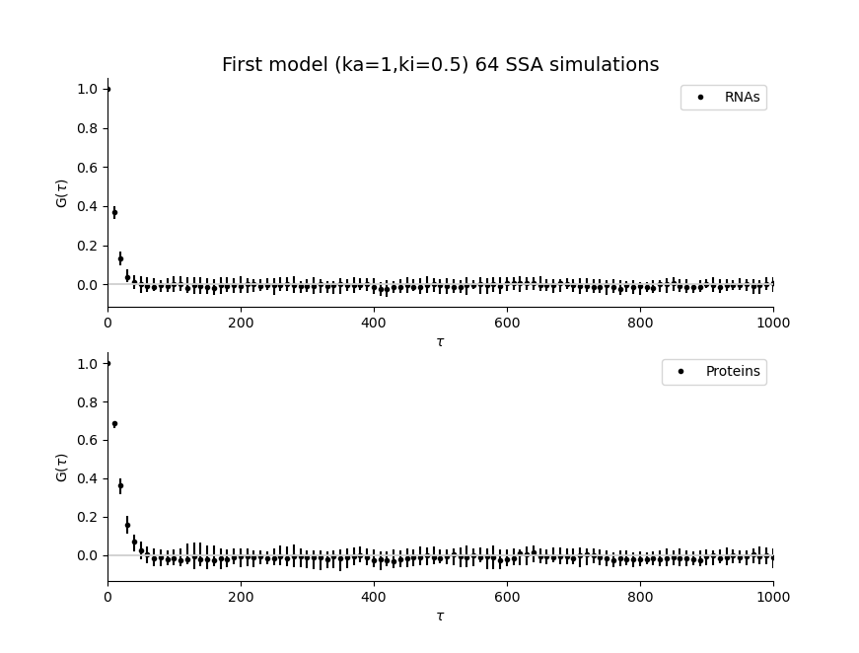


ACF (First protein synthesis model)
$$dt=0.1$$
$$dt=10$$

Slide 14
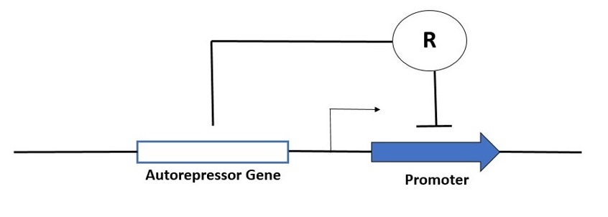
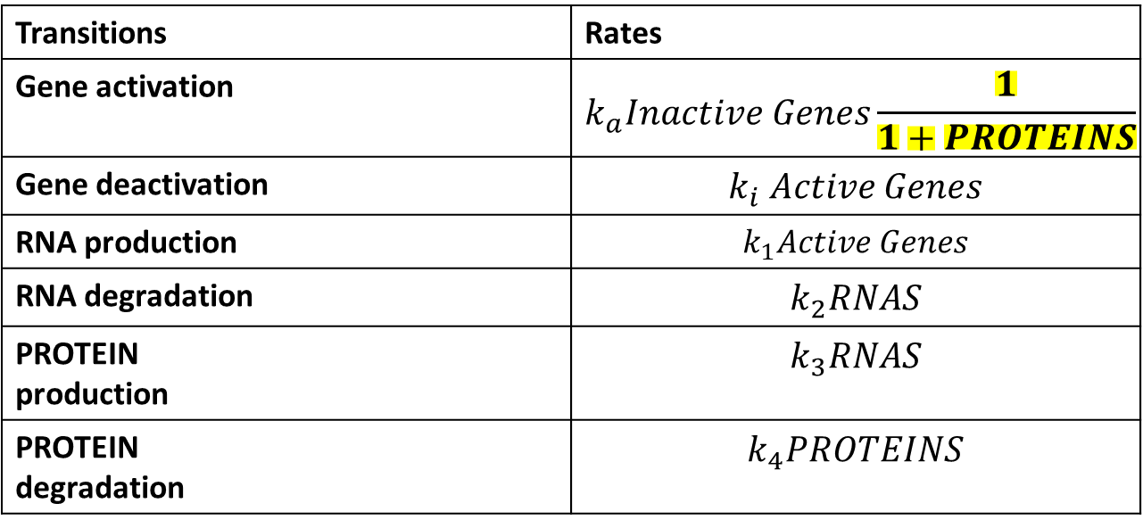
Autorepressor model
Transitions | Rates
Gene activation | $$k_{a}Inactive Genes\frac{1}{1+PROTEINS}$$
Gene deactivation | $$k_{i} Active Genes$$
RNA production | $$k_{1}Active Genes$$
RNA degradation | $$k_{2}RNAS$$
PROTEIN production | $$k_{3}RNAS$$
PROTEIN degradation | $$k_{4}PROTEINS$$

Slide 15
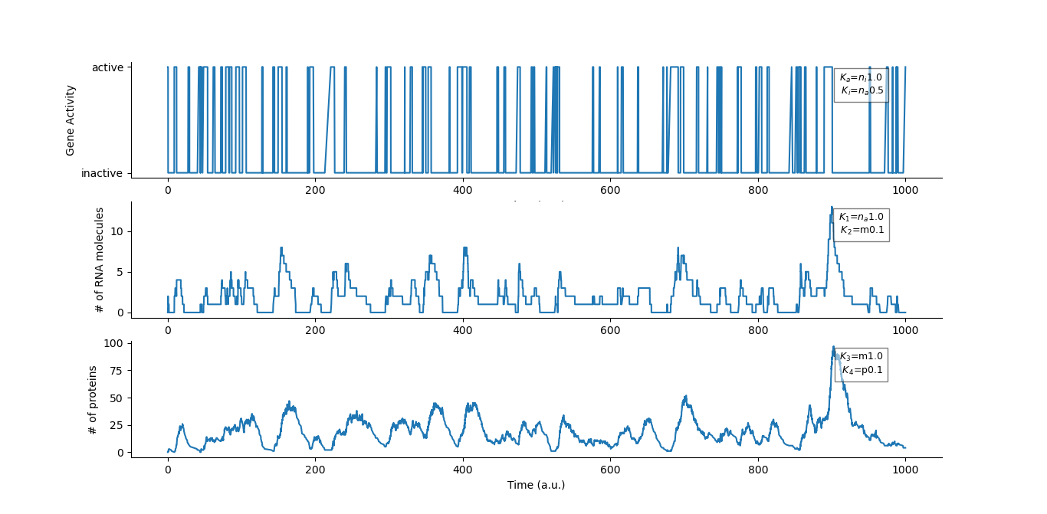
Autorepressor model

Slide 16
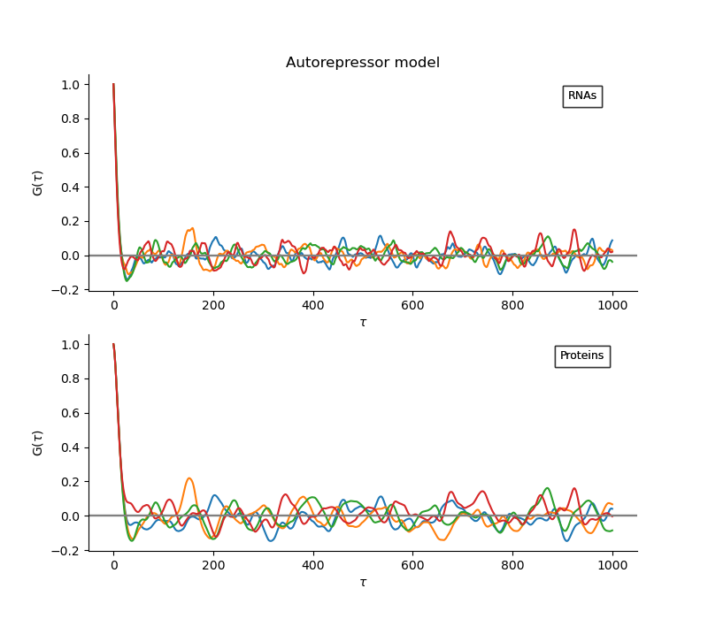
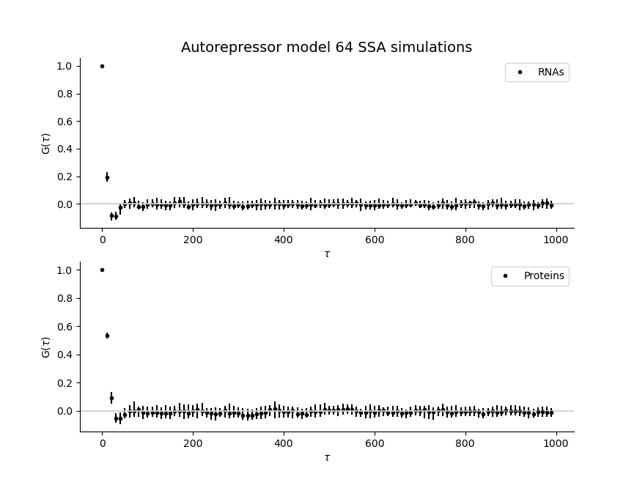


ACF (Autorepressor model)
$$dt=0.1$$
$$dt=10$$

Slide 17
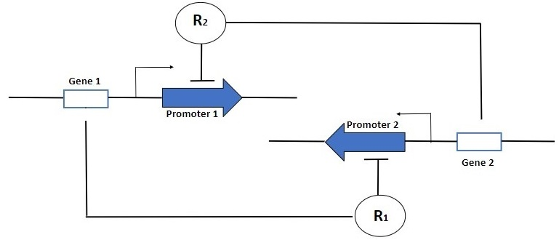
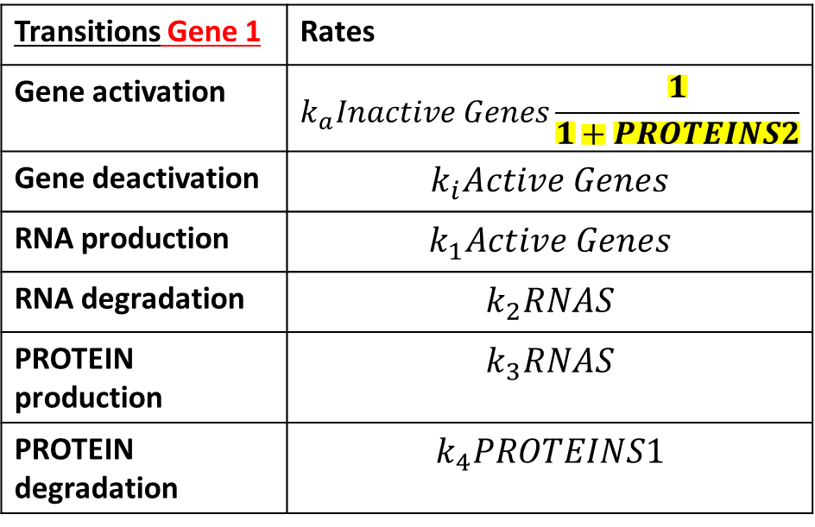
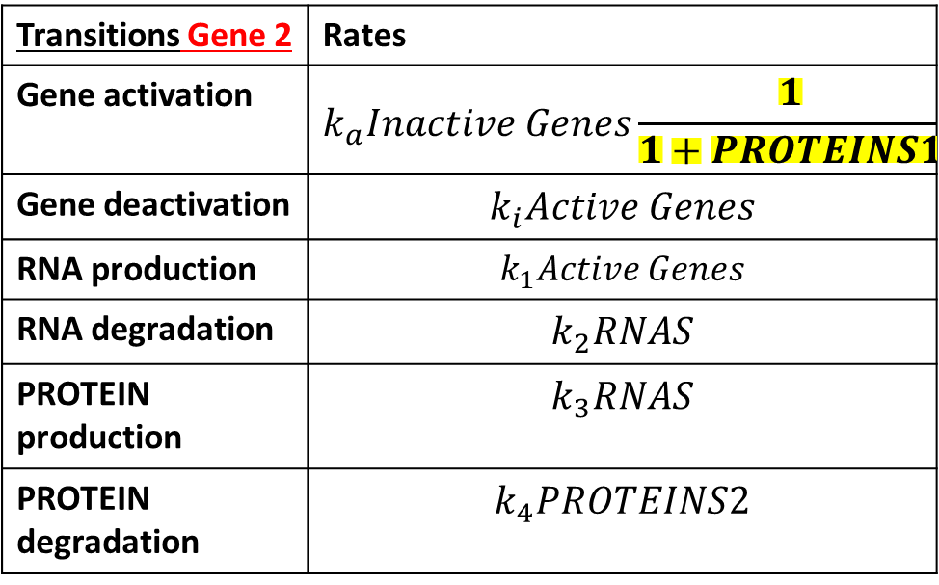
Toggle Switch model
Transitions Gene 1 | Rates
Gene activation | $$k_{a}Inactive Genes\frac{1}{1+PROTEINS2}$$
Gene deactivation | $$k_{i}Active Genes$$
RNA production | $$k_{1}Active Genes$$
RNA degradation | $$k_{2}RNAS$$
PROTEIN production | $$k_{3}RNAS$$
PROTEIN degradation | $$k_{4}PROTEINS1$$
Transitions Gene 2 | Rates
Gene activation | $$k_{a}Inactive Genes\frac{1}{1+PROTEINS1}$$
Gene deactivation | $$k_{i}Active Genes$$
RNA production | $$k_{1}Active Genes$$
RNA degradation | $$k_{2}RNAS$$
PROTEIN production | $$k_{3}RNAS$$
PROTEIN degradation | $$k_{4}PROTEINS2$$

Slide 18
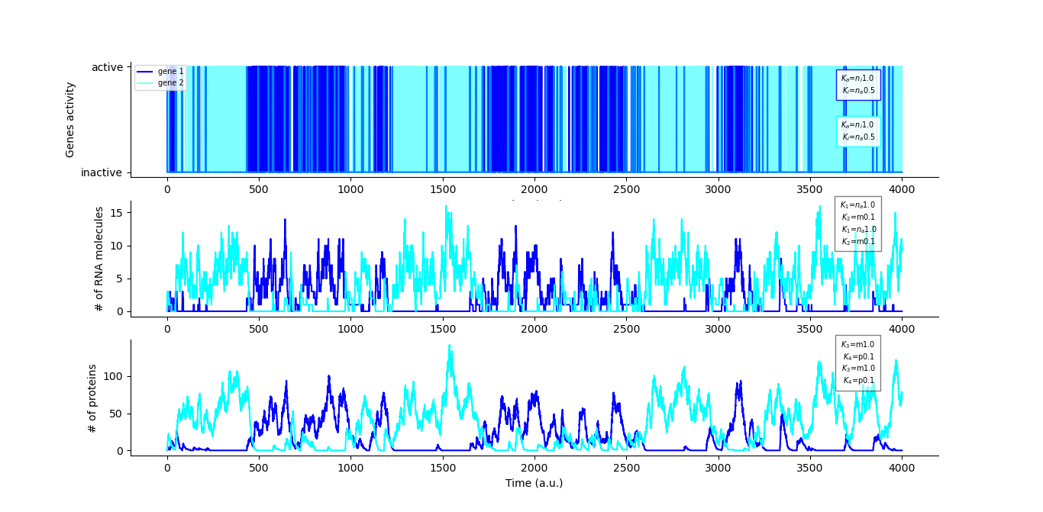
Toggle-Switch model

Slide 19
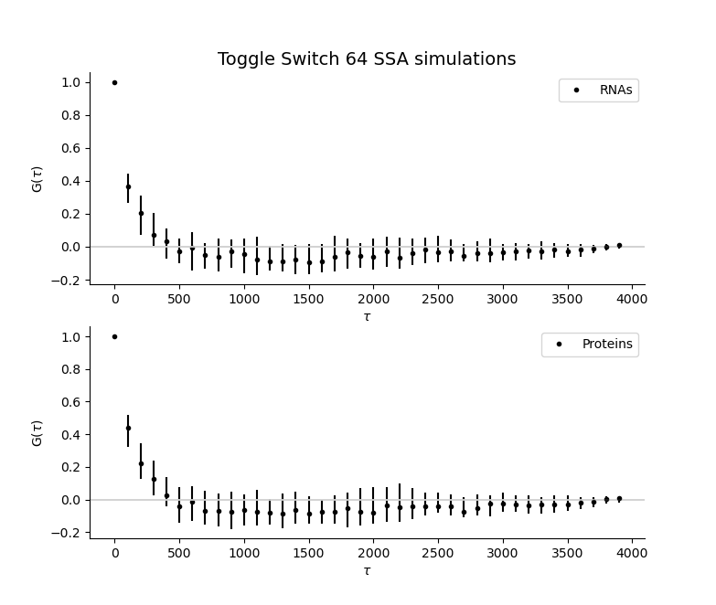
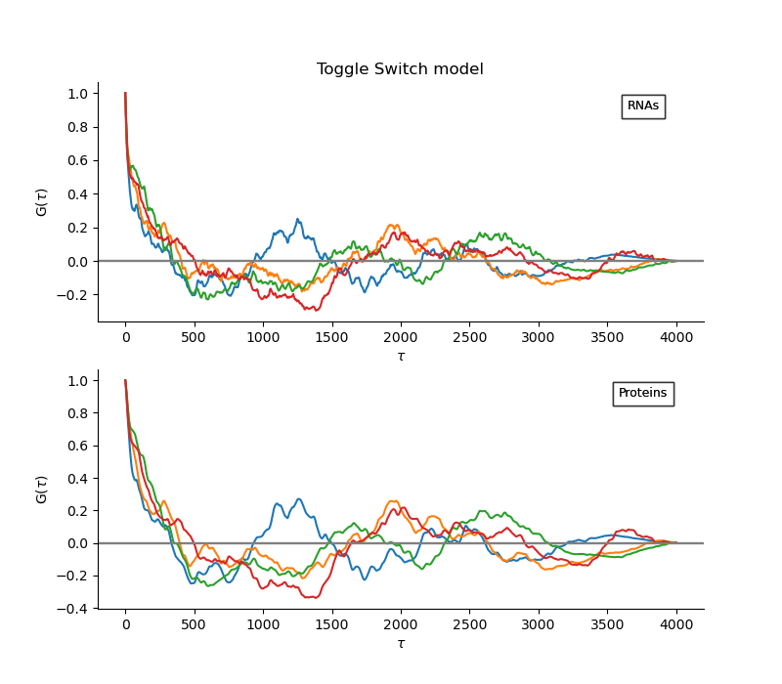


ACF (Toggle-Switch model)
$$dt=0.1$$
$$dt=100$$

Slide 20
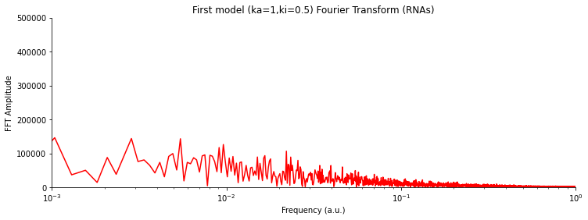
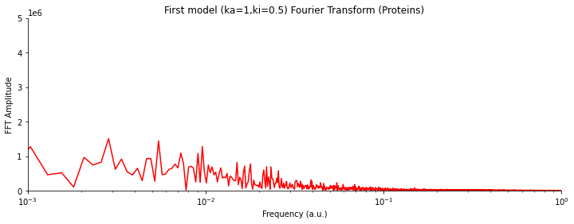
FFT (First protein synthesis model)

Slide 21
Workflow
We deepen into stochastic simulation algorithms (Chemical Master Equation);
We model and simulate simple biomolecular oscillators that have similar oscillatory behavior to the NF-kB;
We analyze simulation results;
We train artificial neural networks to predict model parameters given the autocorrelation functions;
SSA simulation of NF-kB model.

Slide 22
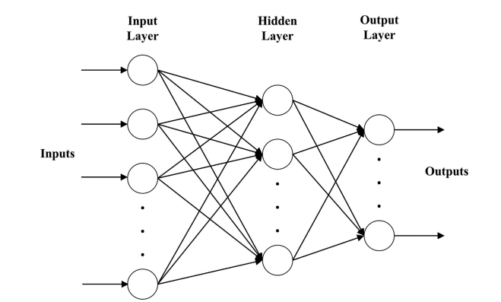
Artificial Neural Networks characteristics
Feed forward regressor neural network
1000 autocorrelations data as input calculated with 5000 lags
Batch size 128
50 epochs

Slide 23
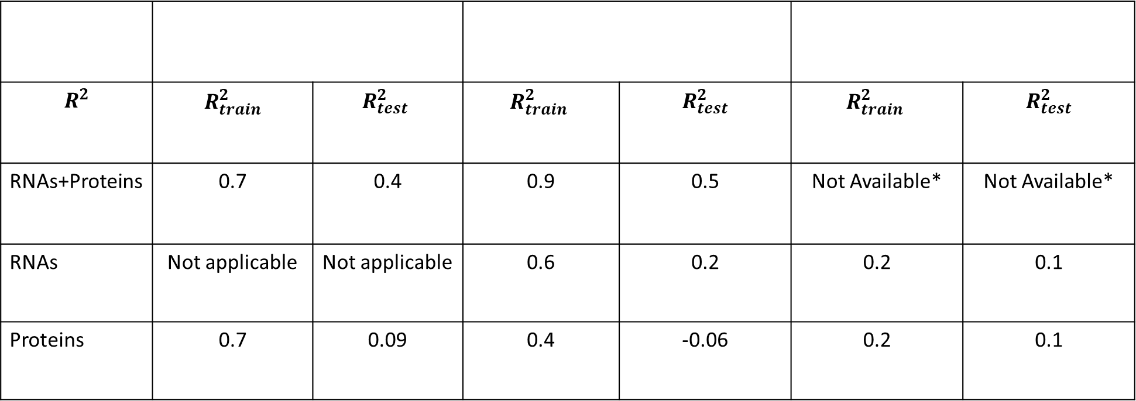
Artificial Neural Networks results
$$R^{2}$$ | $$R_{train}^{2}$$ | $$R_{test}^{2}$$ | $$R_{train}^{2}$$ | $$R_{test}^{2}$$ | $$R_{train}^{2}$$ | $$R_{test}^{2}$$
RNAs+Proteins | 0.7 | 0.4 | 0.9 | 0.5 | Not Available* | Not Available*
RNAs | Not applicable | Not applicable | 0.6 | 0.2 | 0.2 | 0.1
Proteins | 0.7 | 0.09 | 0.4 | -0.06 | 0.2 | 0.1
First genetic model
Autorepressor
Toggle-Switch

Slide 24
Workflow
We deepen into stochastic simulation algorithms (Chemical Master Equation);
We model and simulate simple biomolecular oscillators that have similar oscillatory behavior to the NF-kB;
We analyze simulation results;
We train artificial neural networks to predict model parameters given the autocorrelation functions;
SSA simulation of NF-kB model.

Slide 25
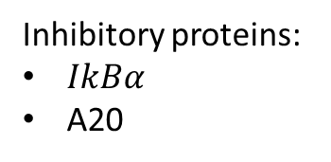
The NF-kB model
Inhibitory proteins:
$IkBα$
A20

Slide 26
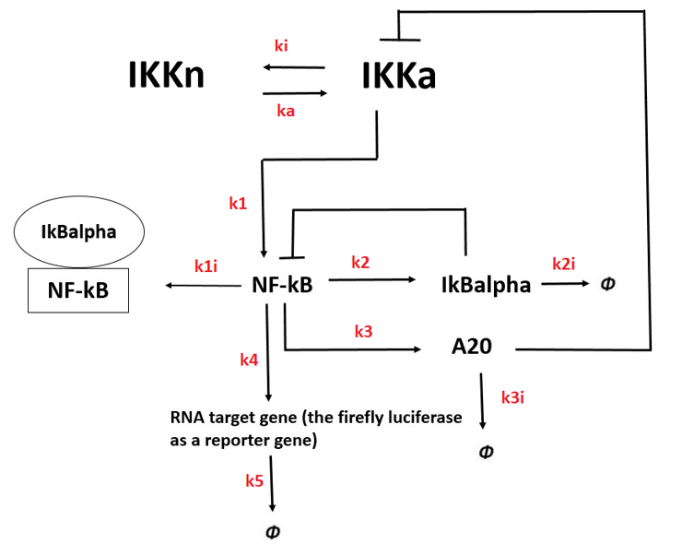
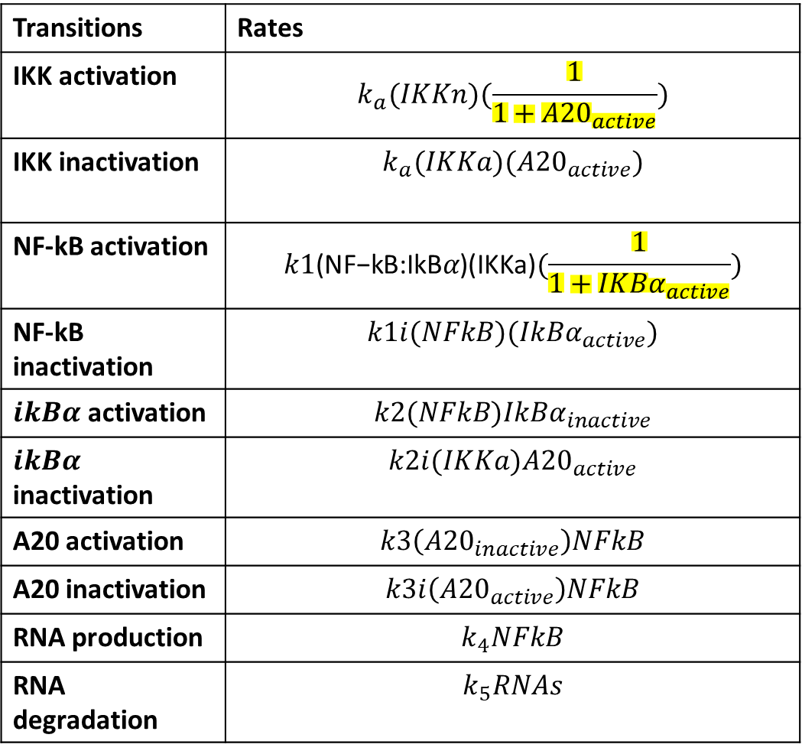
The NF-kB model
Transitions | Rates
IKK activation | $$k_{a}(IKKn)(\frac{1}{1+{A20}_{active}})$$
IKK inactivation | $$k_{a}(IKKa)({A20}_{active})$$
NF-kB activation | $$k1\text{(}\text{NF}\text{−}\text{kB}\text{:}\text{IkB}α\text{)}\text{(}\text{IKKa}\text{)}(\frac{1}{1+{IKBα}_{active}})$$
NF-kB inactivation | $$k1i(NFkB)({IkBα}_{active})$$
$ikBα$ activation | $$k2(NFkB){IkBα}_{inactive}$$
$ikBα$ inactivation | $$k2i(IKKa){A20}_{active}$$
A20 activation | $$k3\left({A20}_{inactive}\right)NFkB$$
A20 inactivation | $$k3i\left({A20}_{active}\right)NFkB$$
RNA production | $$k_{4}NFkB$$
RNA degradation | $$k_{5}RNAs$$

Slide 27
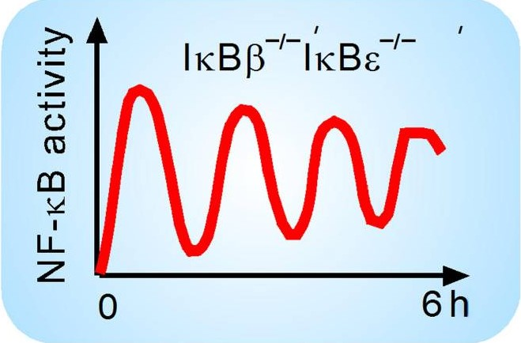
The NF-kB simulation and analysis
Results by Hoffmann et al. in their experiments

Slide 28
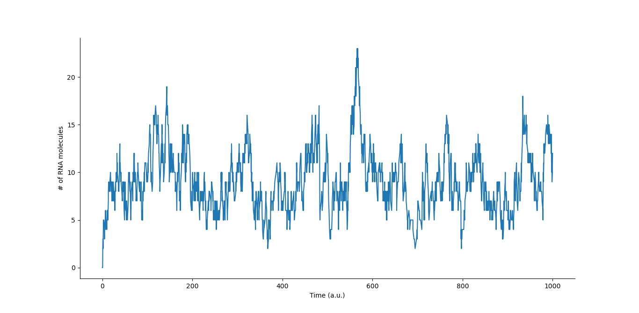
The NF-kB simulation and analysis
BASIC CONFIGURATION
OSCILLATORY PROFILE
Starting state: $IKKn=1, IKKa=0,{NFkB}_{inactive}=1, {NFkB}_{active}=0,$ ${IkBα}_{inactive}=1, {IkBα}_{active}=0, {A20}_{inactive}=1, {A20}_{active}=0.$

Slide 29
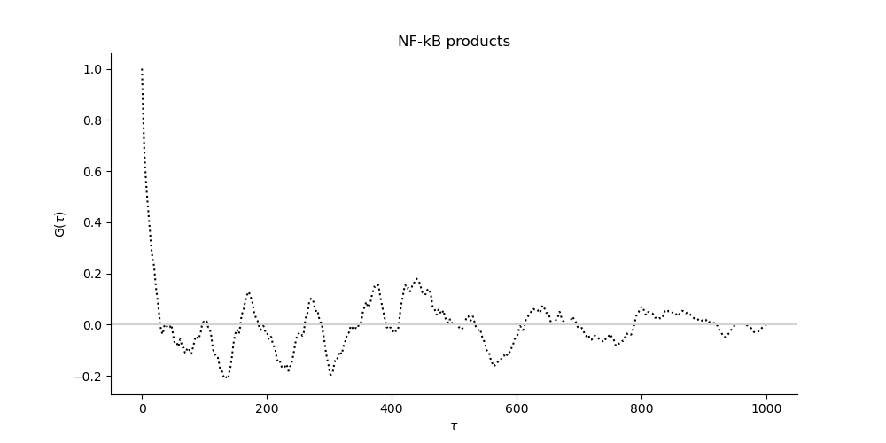
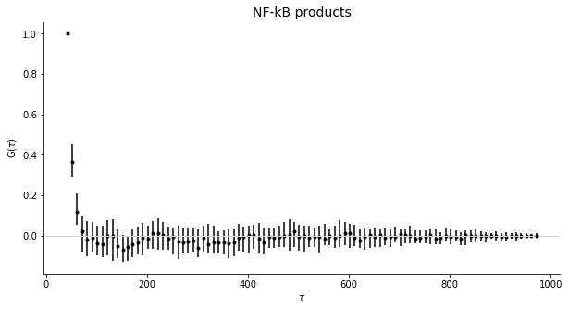
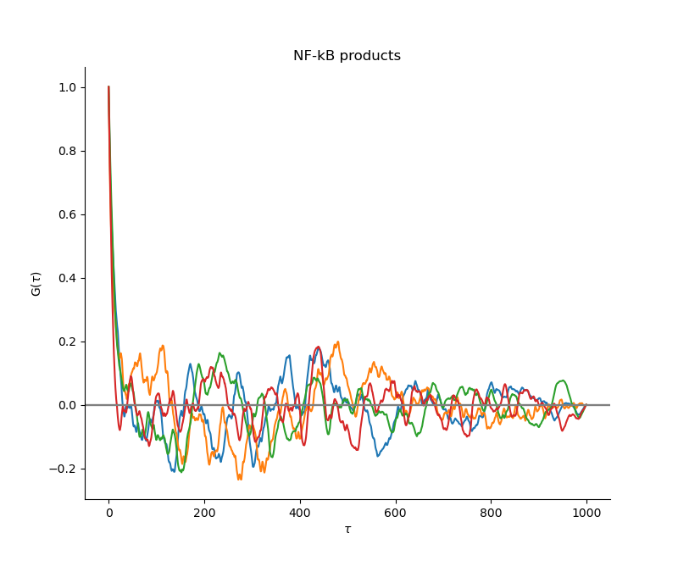

The NF-kB simulation and analysis
Autocorrelation curves
$$dt=10$$

Slide 30
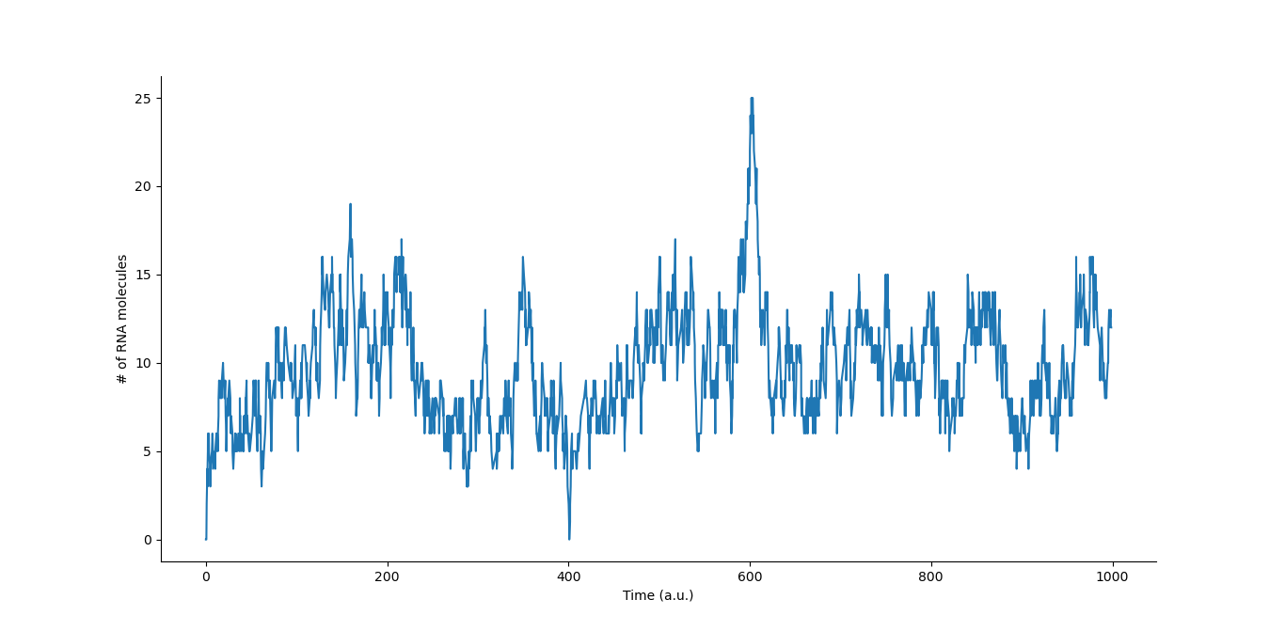

The NF-kB simulation and analysis
$IkBα$ OFF NO OSCILLATIONS
Starting state: $IKKn=1, IKKa=0,{NFkB}_{inactive}=1, {NFkB}_{active}=0,$ ${IkBα}_{inactive}=1, {IkBα}_{active}=0, {A20}_{inactive}=1, {A20}_{active}=0.$

Slide 31
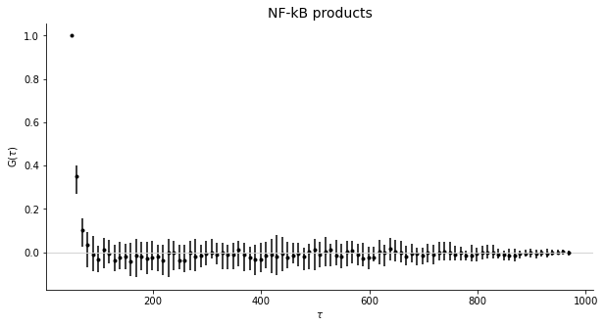

The NF-kB simulation and analysis
$IkBα$ OFF NO OSCILLATIONS
Autocorrelation curve

Slide 32
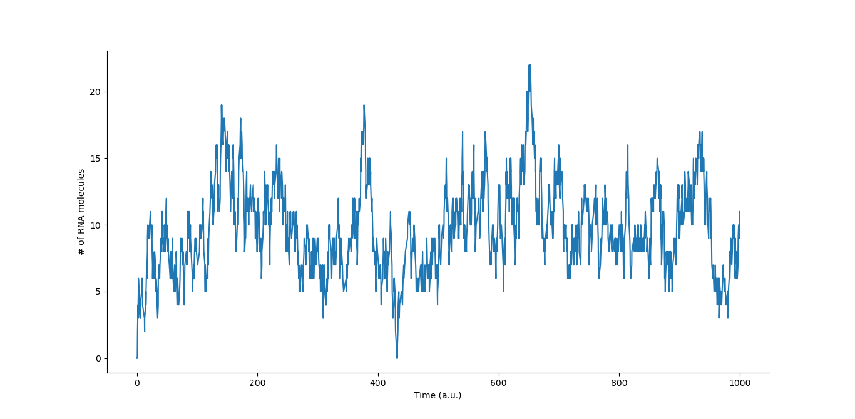
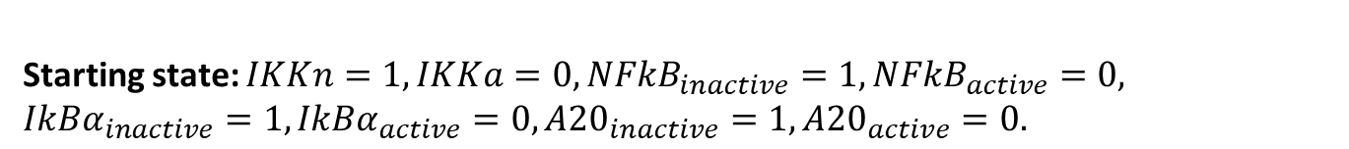
The NF-kB simulation and analysis
$IkBα$ OFF and A20 OFF NO OSCILLATIONS
Starting state: $IKKn=1, IKKa=0,{NFkB}_{inactive}=1, {NFkB}_{active}=0,$ ${IkBα}_{inactive}=1, {IkBα}_{active}=0, {A20}_{inactive}=1, {A20}_{active}=0.$

Slide 33
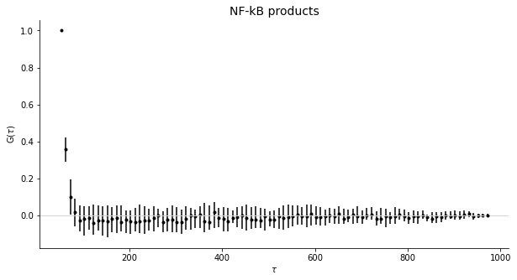
The NF-kB simulation and analysis
$IkBα$ OFF and A20 OFF NO OSCILLATIONS
Autocorrelation curve

Slide 34
Conclusions
Hybrid algorithm faster than SSA with high number of molecules produced;
ANN learn to predict model parameters + gives information about molecular species;
NF-kB model SSA simulation agrees with experimental results (oscillatory behavior analysis) .

Slide 35
Thanks for your attention !
https://github.com/ManuelaCarriero/PyExTra

Slide 36
Appendix A: Fast Fourier Transform plots

Slide 37
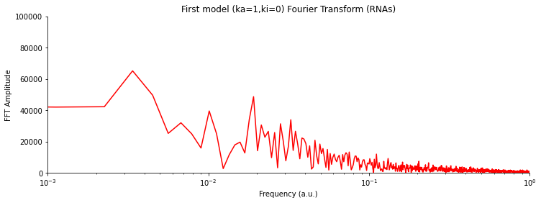
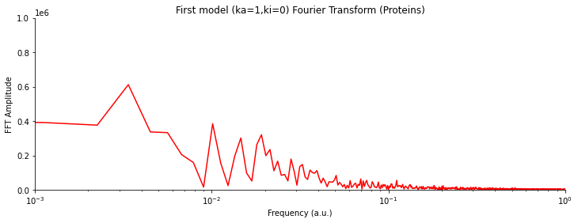
FFT (First protein synthesis model)

Slide 38
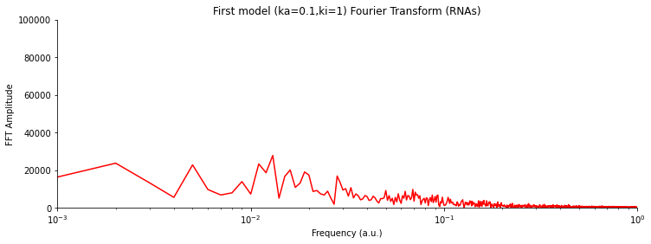
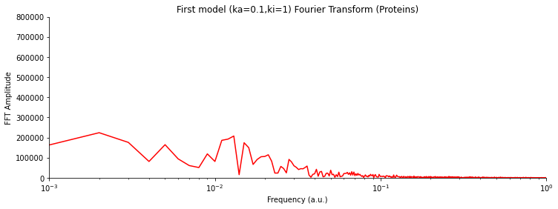
FFT (First protein synthesis model)

Slide 39
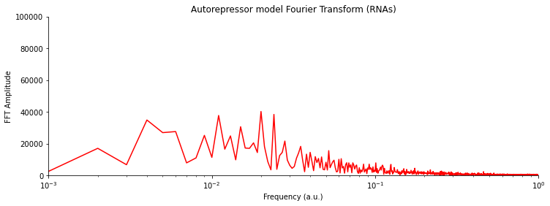
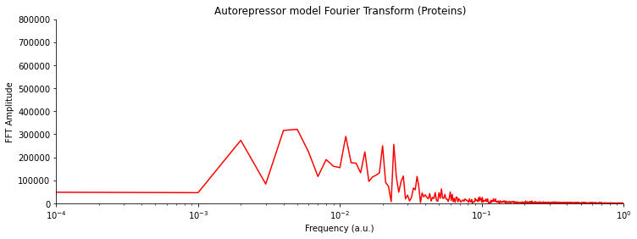
FFT (Autorepressor model)

Slide 40


FFT (Toggle-Switch model)

Slide 41
Appendix B: Hybrid Algorithm Results

Slide 42


Hybrid Algorithm (results)
$$k_{a}=1,k_{i}=0.5,k_{1}=10,k_{2}=0.1,k_{3}=1,k_{4}=0.1$$
$$∆K_{t}=10$$
 | Time
SSA | 718s
Hybrid | 8s

Slide 43


Hybrid Algorithm (results)
$$k_{a}=1,k_{i}=0.5,k_{1}=0.1,k_{2}=0.1,k_{3}=1,k_{4}=0.1$$
$$∆K_{t}=10$$
 | Time
SSA | 8.3s
Hybrid | 7.9s

Slide 44


Hybrid Algorithm (results and limits)
$$k_{a}=0.1,k_{i}=1,k_{1}=1,k_{2}=0.1,k_{3}=1,k_{4}=0.1$$
$$∆K_{t}=10$$
 | Time
SSA | 9s
Hybrid | 35s

Slide 45
Appendix C: First model results using different gene regulations

Slide 46

First protein synthesis model (gene always active)

Slide 47




ACF (First protein synthesis model)
$$dt=0.1$$
$$dt=10$$

Slide 48

First protein synthesis model (gene more inactive than active)

Slide 49




ACF (First protein synthesis model)
$$dt=0.1$$
$$dt=10$$

Slide 50
Appendix D: Continuous Wavelet Analysis

Slide 51



CWT (First protein synthesis model)

Slide 52


CWT (First protein synthesis model)

Slide 53


CWT (First protein synthesis model)

Slide 54


CWT (Autorepressor model)

Slide 55
Appendix E: True vs Predicted data ANN

Slide 56


ANN applied to first model
RNAs+Proteins ACF
Proteins ACF

Slide 57


ANN applied to first model
RNAs+Proteins ACF
Proteins ACF

Slide 58



ANN applied to autorepressor model
RNAs+Proteins ACF
RNAs ACF
Proteins ACF

Slide 59



ANN applied to autorepressor model
RNAs+Proteins ACF
RNAs ACF
Proteins ACF

Slide 60


ANN applied to toggle-switch model
RNAs ACF
Proteins ACF

Slide 61
ANN applied to toggle-switch model
RNAs ACF
Proteins ACF

