Slide 1
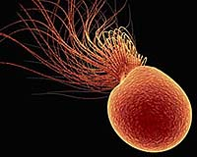
Investigation of the survival strategy of Pyrococcus furiosus exposed to gamma irradiation
Statistical Data Analysis for Applied Physics

Slide 2

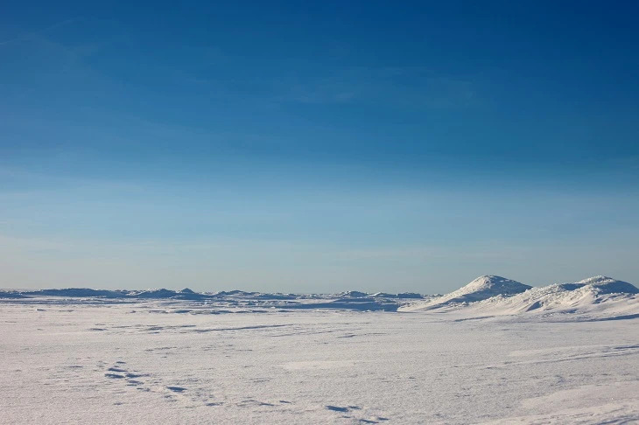
INtroduction
Number of samples | Time | Condition
3 | 0min | Irradiated
4 | 20min | Irradiated
4 | 40min | Irradiated
4 | 60min | Irradiated
4 | 120min | Irradiated
2 |  | Reference
Theory: Pyrococcus furiosus is an extremophile of spiecies of Archea, which are abundant in extreme environments.
NCBI
Experiment: P. furiosus cultures were exposed to 2500 Gy of gamma radiation and samples for mRNA extraction were taken at 0,20,40,60 and 120 min after the irradiation. At this dose, P.furiosus exhibits 75% survival.
Dataset: Microarray analysis; 21 samples; 9216 ORFs (genes) in the P.furiosus genome.

Slide 3
Data Analysis
Preliminary questions:
Is the quantity of mRNA produced by irradiated cell dependent on time?
How the exposure to the gamma radiation affects the production of the quantity of mRNA produced by the cell? (especially DNA repair genes)

Slide 4
Data Analysis
Preliminary questions:
Is the quantity of mRNA produced by irradiated cell dependent on time?
How the exposure to the gamma radiation affects the production of the quantity of mRNA produced by the cell? (especially DNA repair genes)
Data selection (dataframe):
Variables: Gene, mRNA produced, time, condition (if irradiated or not).
5 genes (ID-1,ID-4,ID-5,ID-6,ID-7);
3 genes that encode the synthesis of proteins for DNA repairing.

Slide 5
Data Analysis
Preliminary questions:
Is the quantity of mRNA produced by irradiated cell dependent on time?
How the exposure to the gamma radiation affects the production of the quantity of mRNA produced by the cell? (especially DNA repair genes)
Data selection (dataframe):
Variables: Gene, mRNA produced, time, condition (if irradiated or not).
5 genes (ID-1,ID-4,ID-5,ID-6,ID-7);
3 genes that encode the synthesis of proteins for DNA repairing.
Investigation steps:
First step: visual comparison
Second step: hypothesis testing (t-test)
Third step: building a model
Fourth step: goodness of fit
Results

Slide 6
Data Analysis
Preliminary questions:
Is the quantity of mRNA produced by irradiated cell dependent on time?
How the exposure to the gamma radiation affects the production of the quantity of mRNA produced by the cell? (especially DNA repair genes)
Data selection (dataframe):
Variables: Gene, mRNA produced, time, condition (if irradiated or not).
5 genes (ID-1,ID-4,ID-5,ID-6,ID-7);
3 genes that encode the synthesis of proteins for DNA repairing.
Investigation steps:
First step: visual comparison
Second step: hypothesis testing (t-test)
Third step: building a model
Fourth step: goodness of fit
Results

Slide 7
Time course analysis general study of the expression of 5 genes

Slide 8
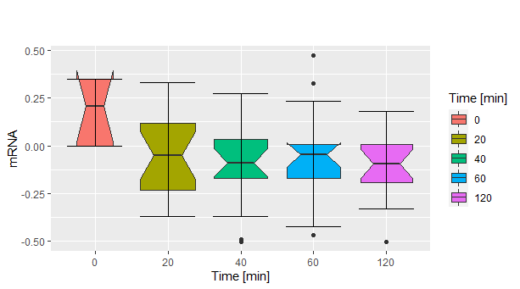
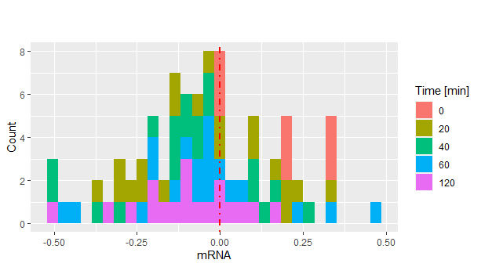
Is the mRNA dependent on the time of extraction ?
First step: visual comparison

Slide 9
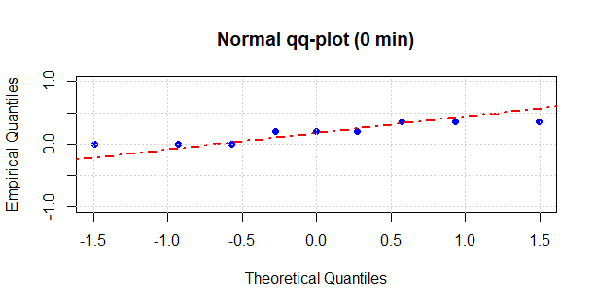
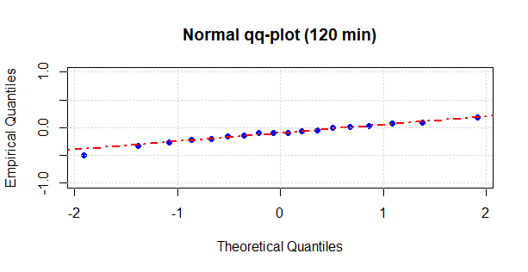
Hypotesis testing
Is the mRNA dependent on the time of extraction ?
H0: mRNA produced is the same at time 0 min and at time 120 min
Between 0 min and 120 min for all genes
p-value
0.0003526
Between 0 min and 120 min for each gene
Gene | p-value
ID-1 | NA
ID-4 | NA
ID-5 | 0.040779294
ID-6 | 0.006408657
ID-7 | 0.021168409
p-values Holm-Bonferroni adjusted
Gene | p-value
ID-1 | NA
ID-4 | NA
ID-5 | 0.04233682
ID-6 | 0.01922597
ID-7 | 0.04233682
Second step: hypothesis testing (t-test)

Slide 10
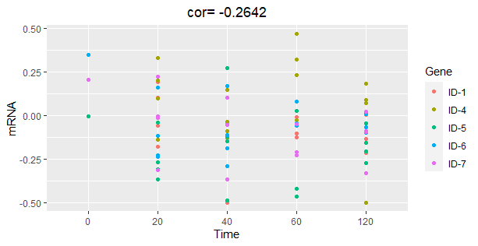
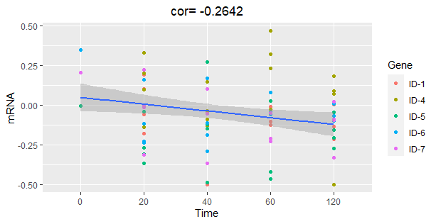
Linear Regression model
Is the mRNA dependent on the time of extraction ?
COR.TEST
Pearson's product-moment correlation
t = -2.4955, df = 83, p-value = 0.01456
alternative hypothesis: true correlation is not equal to 0
95 percent confidence interval:
-0.45187092 -0.05411221
sample estimates:
cor
-0.2641895
Summary lm fit
Coefficients:
Estimate Std. Error t value Pr(>|t|)
(Intercept) 0.09132 0.05927 1.541 0.1272
Time -0.04282 0.01716 -2.496 0.0146 *
---
Signif. codes: 0 ‘***’ 0.001 ‘**’ 0.01 ‘*’ 0.05 ‘.’ 0.1 ‘ ’ 1
Residual standard error: 0.2056 on 83 degrees of freedom
Multiple R-squared: 0.0698, Adjusted R-squared: 0.05859
F-statistic: 6.228 on 1 and 83 DF, p-value: 0.01456
Third step: building a model

Slide 11
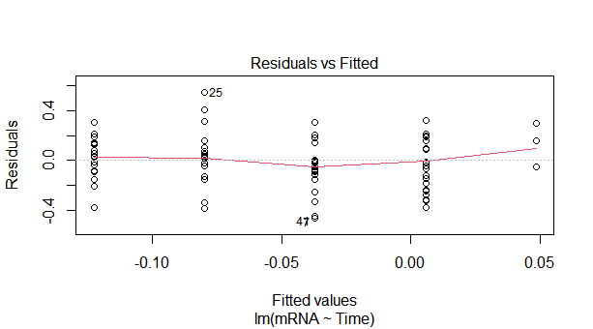
Goodness of fit: Check of the variance of the residuals
Levene's Test for Homogeneity of Variance (center = median)
Df F value Pr(>F)
group 4 0.5542 0.6965
80
Fourth step: goodness of fit

Slide 12
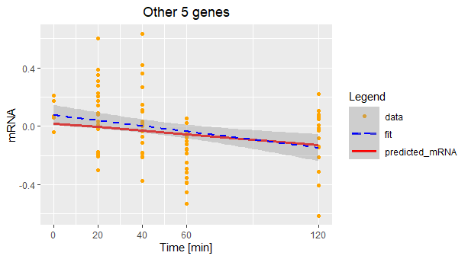
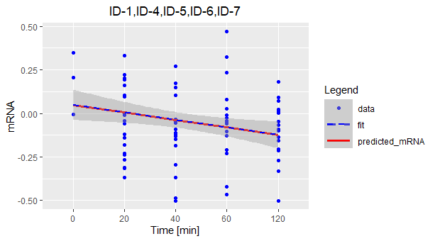
does the linear model work for other genes?
Predict(lm_mRNATime,)
Down-regulation in the time

Slide 13
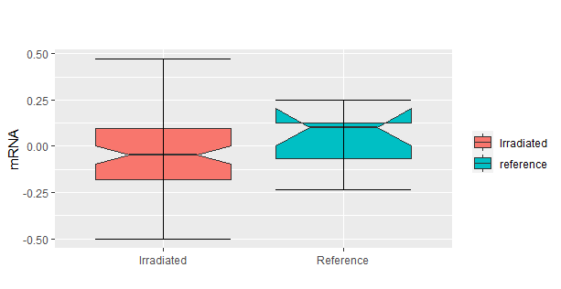
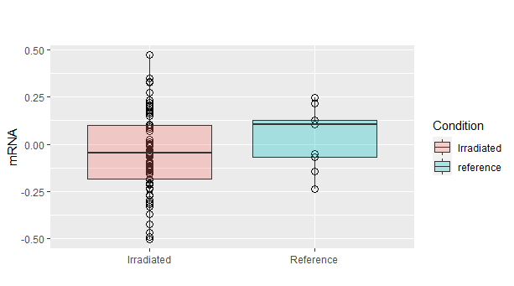
How does the gamma radiation affect the mRNA production?
Welch Two Sample t-test
(Irradiated Vs Not-Irradiated)
p-value = 0.213
summary()
mRNA Irradiated
Min. :-0.50226
1st Qu.:-0.18139
Median :-0.04811
Mean:-0.04571
3rd Qu.: 0.09794
Max. : 0.47011
mRNA not irradiated
Min. :-0.23728
1st Qu.:-0.06691
Median : 0.10277
Mean : 0.03339
3rd Qu.: 0.12617
Max. : 0.24787

Slide 14
Cases and controls comparison study of the expression of the 5 genes and dna repair genes

Slide 15
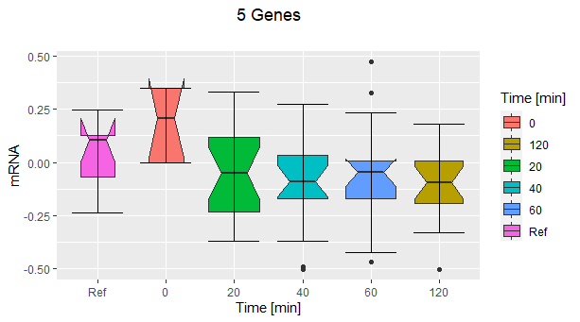
Cases and controls comparison
We want to know if there is any significant difference between the average quantity of mRNA produced in the different experimental conditions (Ref,0min,20min,40min,60min,120min).
Summary aov (mRNA ~ Condition)
Df Sum Sq Mean Sq F value Pr(>F)
Time 5 0.632 0.12631 3.258 0.00956 **
Residuals 88 3.412 0.03877
---
Signif. codes: 0 ‘***’ 0.001 ‘**’ 0.01 ‘*’ 0.05 ‘.’ 0.1 ‘ ’ 1

Slide 16
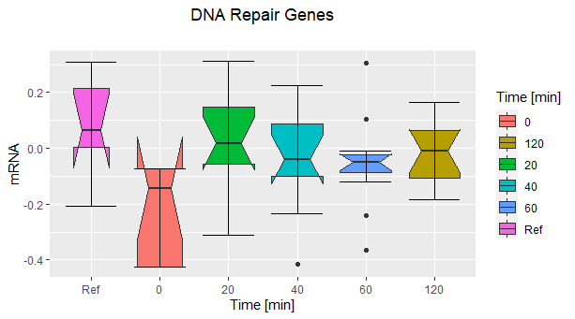
What about dna repair genes?
Summary aov (mRNA ~ Condition)
Df Sum Sq Mean Sq F value Pr(>F)
Condition 5 0.4183 0.08366 3.165 0.0137 *
Residuals 57 1.5065 0.02643
---
Signif. codes: 0 ‘***’ 0.001 ‘**’ 0.01 ‘*’ 0.05 ‘.’ 0.1 ‘ ’ 1
t-test(mRNA, Ref-0min)
p-value = 0.0108
t-test(mRNA, Ref-0min,alternative=“greater”)
p-value = 0.005399
Surprisingly also in this case there are no huge changes in mRNA production and even it decreases immediately after the irradiation
cor.test(Ref-0min)
cor=-0.8281773
Notes:
16

Slide 17
Conclusions and results
Is the mRNA dependent on the time of extraction ?
Negative correlation between mRNA concentration and time: at 20 min following irradiation, mRNA levels decrease and this might represent an adaptation to stress.
 | General Purpose Genes (Time Course Analysis)
t-test | p-value=0.0003526 (0min vs 120min)
Pearson’s Correlation Coefficient | -0.2641895
Analysis Of Variance | p-value=0.01456 (mRNA ~ Time)
Results

Slide 18
Conclusions and results
How does the gamma radiation affect the mRNA production?
No significant changes in DNA repair genes expression levels: proteins in P.furiosus are constitutively expressed and they may be present in the cell at a level sufficient to mantain the integrity of the cell’s genetic material.
 | General Purpose Genes | DNA repair Genes
Analysis Of Variance (mRNA ~ Condition) | p-value=0.00956 | p-value=0.0137
A combination of factors is responsible for
the extreme radiation resistance in P.furiosus.
The End

