Slide 1
Running EMOD local using idmtools-container
Manuela Runge
Faculty Enrichment Program Ghana 2025
August 4th, 2025

Slide 2
Objective: Run EMOD on a local machine without Quest
Why ?
How? What Will You Learn Today:
Run EMOD even when QUEST is down
Build and test EMOD simulations conveniently from your local machine in small bit-size pieces
Faster iteration & debugging
Skills are transferable to cloud or HPC later
Set up EMOD locally
Use emodpy + idmtools to configure and run experiments
Inspect output and analyze results
Understand slurm versus container platform
Note: the simulation setup follows the same structure and principles used -> simulations that run on HPC can also run locally with 1 single change only (platform)
Notes:
Great for learning, development, and testing

Slide 3
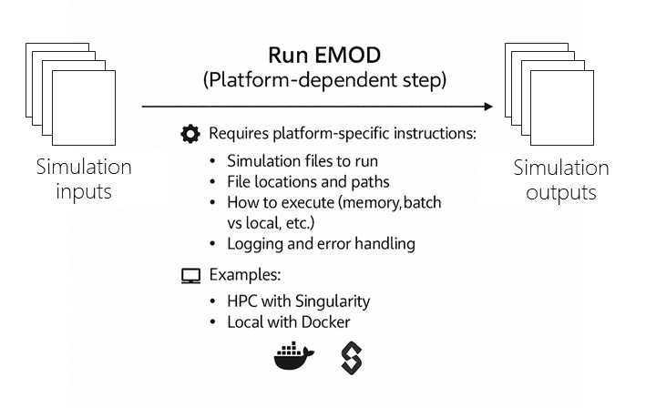
Which Parts of EMOD Are Platform-Dependent?
One can install locally the same packages as used to do on Quest
It will allow to run a python scripts to generate EMOD simulations
However, it will return an error for actually running the simulations
idmtools manages 1) execution platform or scheduler
2) EMOD sif image or docker container
On Quest, using slurm:
subprocess.run(['bash', 'batch.sh'], stdout=subprocess.PIPE, cwd=str(working_directory))
https://github.com/InstituteforDiseaseModeling/idmtools/idmtools_platform_slurm/idmtools_platform_slurm/slurm_platform.py#L203
Local, using container (docker):
subprocess.run(["docker", "exec", self.container_id, "bash", "-c", ";".join(commands)], stdout=subprocess.PIPE)
https://github.com/InstituteforDiseaseModeling/idmtools/blob/main/idmtools_platform_container/idmtools_platform_container/container_platform.py#L226
Notes:
https://github.com/EMOD-Hub

Slide 4
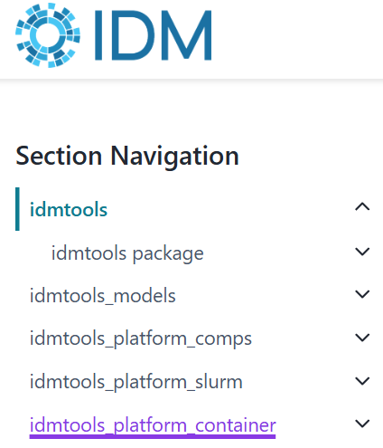
idmtools "control tower for simulation experiment "
https://docs.idmod.org/projects/idmtools/en/latest/api/idmtools_index.html | https://docs.idmod.org/projects/idmtools/en/latest/platforms/platforms.html
idmtools abstracts away platform differences, so you can run the same simulation logic across different environments — from Slurm-based HPC to Docker containers on your laptop.
from idmtools.core.platform_factory import Platform
platform = Platform('SLURM_Local', job_directory=exp.suite_directory)
platform = Platform('Container', job_directory=exp.suite_directory)
experiment.run(wait_until_done=False, platform=platform)
The only change needed in your code.
Except for additional scheduling processes of subsequent jobs that your pipeline may include.
platform = Platform(manifest.platform, job_directory=exp.suite_directory)
Recommended approach, define platform in manifest
https://docs.idmod.org/projects/idmtools/en/latest/api/idmtools.entities.experiment.html#idmtools.entities.experiment.Experiment.run
Notes:
https://github.com/EMOD-Hub

Slide 5
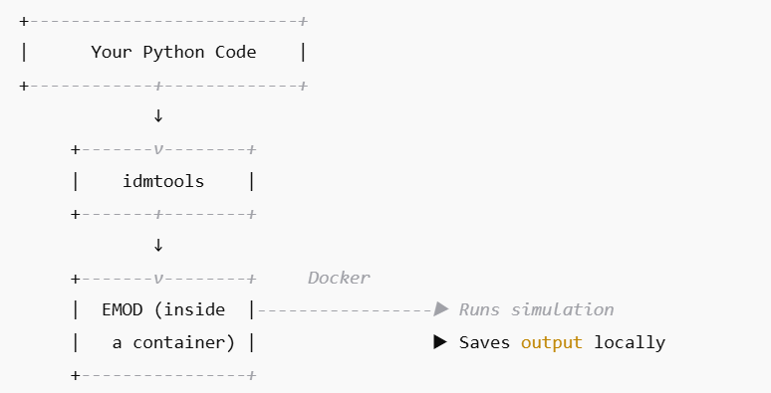

What is a Container Platform?
https://docs.idmod.org/projects/idmtools/en/latest/singularity/singularity-containers.html
In idmtools, Docker runs EMOD inside a container, so you don’t need to:
Manually install binaries
Set up EMOD system libraries
You only need to:
Install Docker Desktop once
Pull EMOD container images (automatically)
Let idmtools use Docker behind the scenes
Doesn’t require internet or external clusters
Stores and runs simulations on your own machine
Simulations run as isolated processes in folders
“A container is a software package that contains everything the software needs to run. This includes the executable program as well as system tools, libraries, and settings”, as quoted from techterms.com (https://techterms.com/definition/container). The conceptual components of containers are the same regardless of the specific container technology, such as Singularity and Docker “

Slide 6
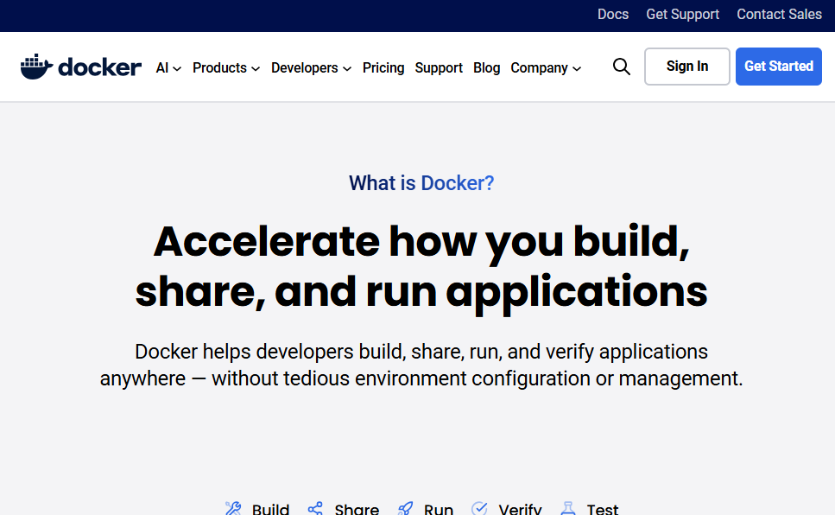
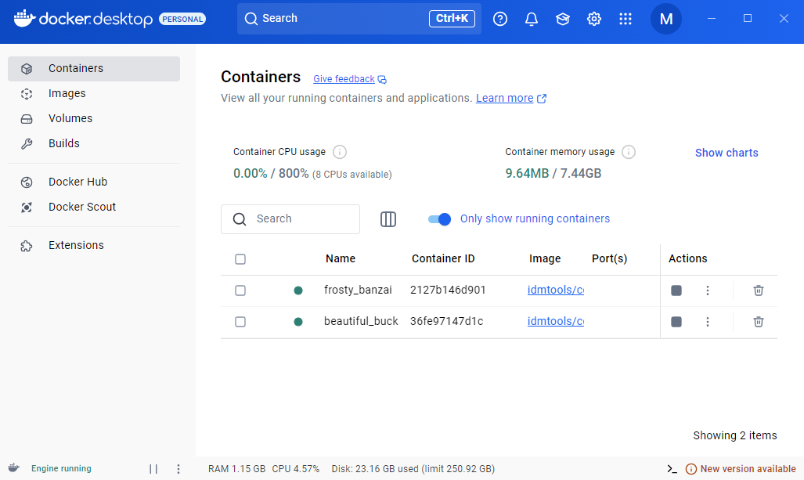
Docker
https://www.docker.com/
Docker provides the environment to run EMOD in isolation — no need to manually install dependencies like C++, Boost, MPI, etc.
Is an account and login required ? – No!
You only need: Docker installed and the Docker daemon running

Slide 7
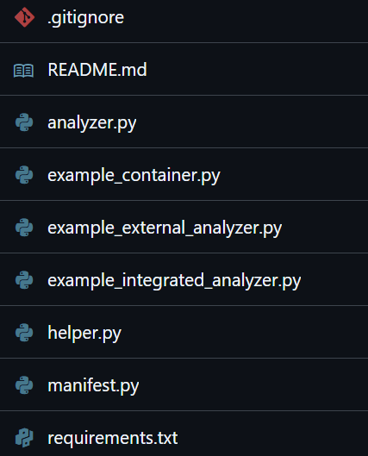
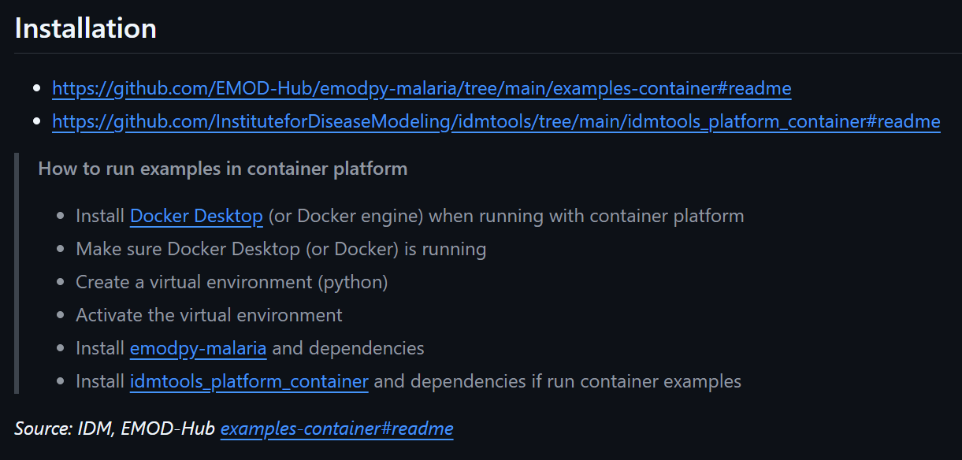
Let`s do EMOD! EMOD local sandbox
https://github.com/ManuelaRunge/EMOD_local_sandbox
Sandbox repository to test out EMOD simulations on a local machine

Slide 8
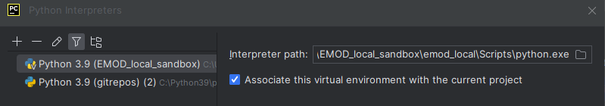
Installation
1) Go to the target repository in which to run EMOD simulations locally
2) Create a new local virtual environment
python -m venv emod_local emod_local\Scripts\activate pip install emodpy-malaria --extra-index-url=https://packages.idmod.org/api/pypi/pypi-production/simple pip install idmtools[container] --index-url=https://packages.idmod.org/api/pypi/pypi-production/simple
Note, when having both idmtools[slurm] and idmtools[container], packages were `in conflict`, hence to be on the safe side, only have one of them. This is based on a one time experience of weird error issues. One does not need both at the same time anyways.
3) Update Python interpreter path to new environment

Slide 9
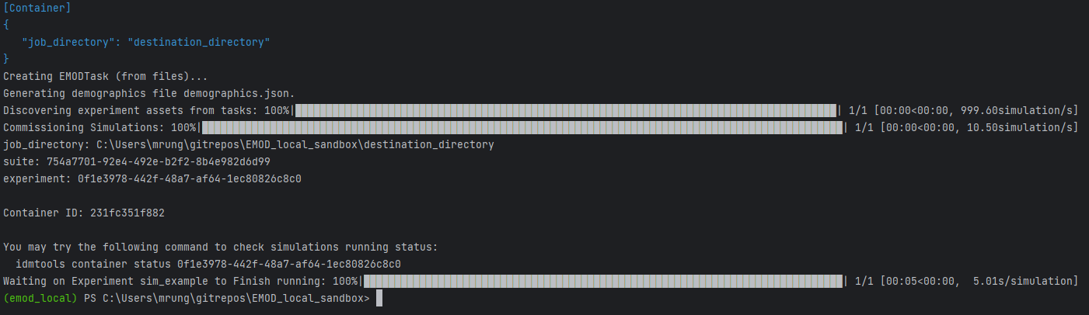
Terminal output when running container
> python example_container.py

Slide 10
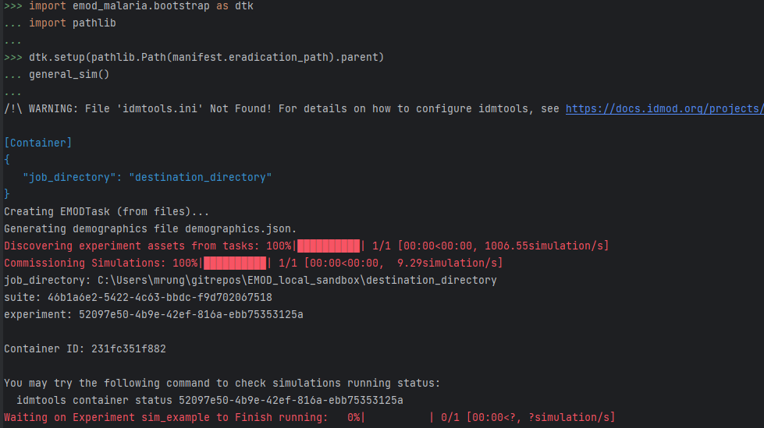
Terminal output when running container interactive mode

Slide 11
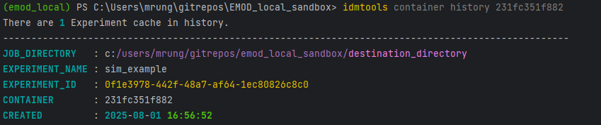
Terminal output running history

Slide 12
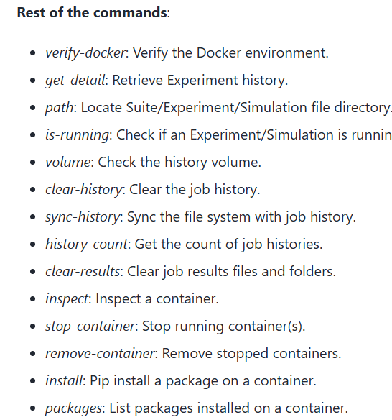
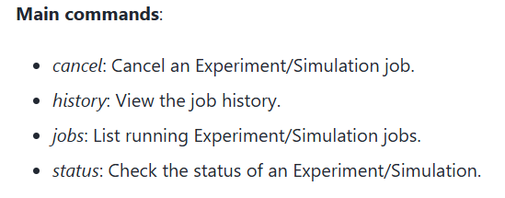
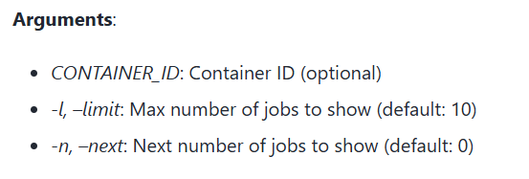
Container CLI commands
https://docs.idmod.org/projects/idmtools/en/latest/cli/container/cli-detail.html
``The ContainerPlatform CLI provides a set of commands to manage and interact with containers.
These commands allow you to verify the Docker environment, manage experiments and simulations, and inspect containers.``
Usage: idmtools container history [CONTAINER_ID] [-l LIMIT] [-n NEXT]
. . .

Slide 13
Additional notes and considerations
Note, if the computer turns off, simulations will be lost
Use same relative path structure for input files that the simulations depend on
Serialization is also possible
..
..

Slide 14
Questions or comments?

