Slide 1
Towards a Process-Driven Design of Data Platforms
Matteo Francia, Matteo Golfarelli, Manuele Pasini
{m.francia, matteo.golfarelli, manuele.pasini} @unibo.it
25/03/2024

Slide 2
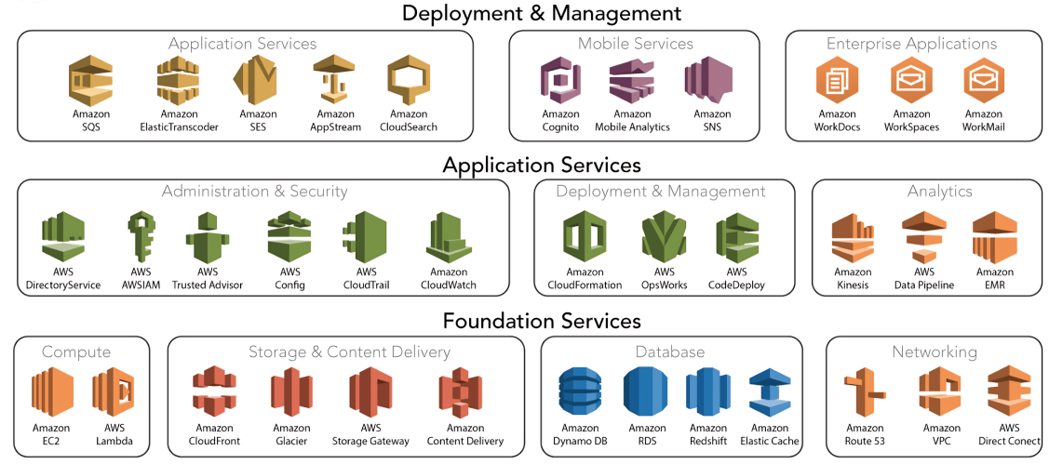
A Cloud Data Platform
is an infrastructure that facilitates the ingestion, storage, management, and exploitation of large volumes of heterogeneous data.
Centralized infrastructre composed of independent and well-integrated services meeting the end-to-end needs of data pipelines:
Centralized: a data platform is conceptually a single and unified component;
Independent: changes in a a service do not affect others;
Well-integrated: services have interfaces enabling a frictionless composition;
End-to-end: services cover the entire data life cycle.
Cloud DP are built out of service ecosystems offered by Cloud Service Providers (CSPs).
Some of the AWS Services

Slide 3
Data platforms for analytics
Data analytics nowadays mostly rely on cloud infrastructures!

Slide 4
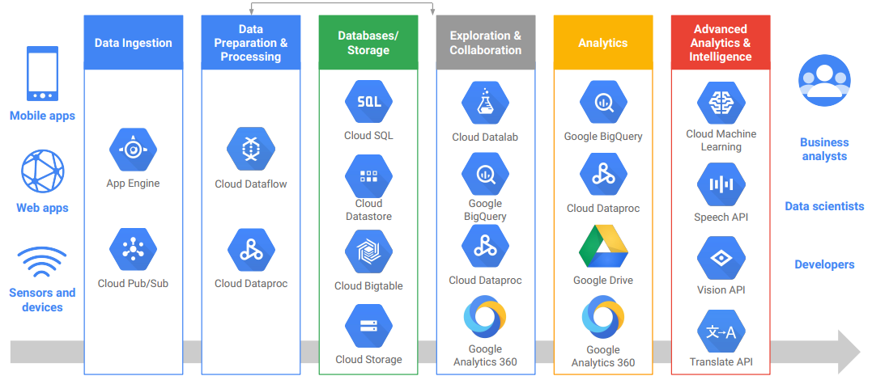
Some CSPs categorize their services in relation to the role they play in an analytical data pipeline…
… So data pipelines might serve as pivotal points in the design of data platforms!
But even for experienced data pipeline designers, this is a non trivial task…
Some of the Google Cloud Platform Services

Slide 5
Challenges in building data platforms
Each CSP offers services with overlapping functionalities;
CSPs offer different service categorizations that can hardly be mapped together;
Evolution of cloud ecosystems is fast and it is difficult to keep up with the pace;
Third parties can publish their own services on marketplaces (e.g., AWS Marketplace).
As if it was not hard enough…
Multiple solutions could fulfill the desiderata:
It requires deep knowledge of CSPs’ ecosystems…
… And requires vertical knowledge on the design of data pipelines.
Several abstract big data architectures are available (e.g., NIST, Lambda, and Kappa):
They provide the necessary architecture for big-data applications but do not address their deployment!
Research question: given an ecosystem of services, which is the optimal subset enabling a data platform?

Slide 6
Process-driven design
The description of data-driven processes should drive such activity!
Data pipelines are the backbone of a data platform encode many constraints on the choices to be made…
… And outline data flows!
Research goal: methodology to aid designers in selecting the services necessary to implement clients’ data pipelines out of the “unstructured” lists of services from CSPs.
Three types of users (stakeholders):
Cloud service providers: IT experts with in-depth knowledge of services ecosystems;
Designers: people with expertise in designing data flows but with no vertical knowledge on service ecosystems;
Clients asking for the design of the data platform blueprint.
Methodology for the Design of Data Platforms

Slide 7
(1) Define the service ecosystem
CSP identifies una tantum:

Slide 8
The services to compose the blueprint of the data platform:
Not necessarily all of them…
… But they must cover the “basic” functionalities for a data platform such as the ones from NIST!
The taxonomy of tags that characterize such services:
Bottom-up feeding: built out of the experience of the CSP and/or automatically extracted using NLP algorithms;
Top-down feeding: from the literature (e.g., Vs of big data).

Slide 9
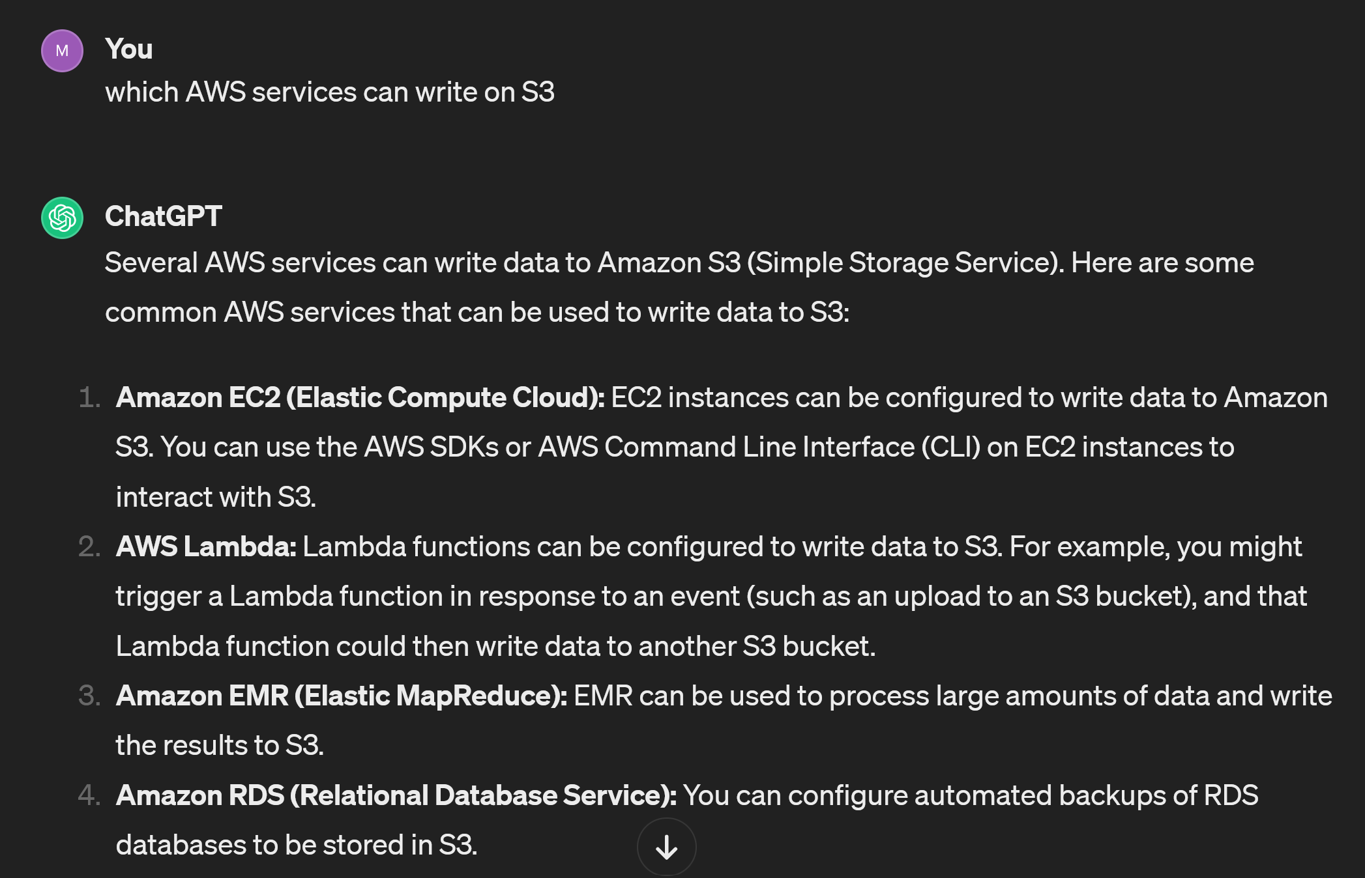
“Alternative” bottom-up feeding
Using ChatGPT

Slide 10
Service graph
Services are organized in a directed property service graph.
A directed property graph is a tuple $G=\left(N,A,P,L\right)$ where:
$N=\{...,n_{i},...\}$ is a set of nodes;
$A=\{...,a_{ij},...\}$ is a set of arcs connecting nodes;
$P=\{...,\left(h,v\right),...\}$ is a set of key-value properties;
$L$ is a set of labels.
Nodes are engines from the service ecosystem and can be labelled as preferred.
Each node is characterized with a set of properties from the previously determined taxonomy.
Arcs are alternatively labeled as {Requires, IsCompatible}:
Requires: represents whether a service mandatorily relies on another;
IsCompatible: represents whether a service natively interfaces with another.
Example
Excerpt of service graph
Excerpt of service graph
IsCompatible: SageMaker natively R/W from/to Redshift;
Requires: GeoServer requires EC2 since it is deployed on it.
GeoServer might be characterized by the following properties:
$\begin{matrix}props\left(GeoServer\right)=\{ & \left(DataModel,File\right), \\ \left(DataNature,Raster\right)\} \\ \end{matrix}$

Slide 11
Input: clients’ questionnaries
Clients compile questionnaires about their processes and the main steps, subjects, and goals of their analysis.
Example: deploy a data platform supporting analytic tasks from 8 clients within the Agritech European project
Excerpt of one of the workflows:
Data comes from soil moisture sensor grids, weather stations, and SENTINEL-2 satellites.
Sensor and weather data is uploaded every 15 minutes, while satellite data is periodically downloaded.
Soil moisture data is interpolated using mathematical and machine learning techniques.
The interpolated data is stored in tables that include the positions of the sensors.
Vegetation indexes are computed out of raw satellite observations and integrated with enriched sensor data.
Reports are periodically generated out of enriched data.
Given an optimal soil moisture matrix, the enriched data is used to decide how much to irrigate the soil.

Slide 12
(2) Formalize the requirements
Designers refine the answers and formalize the processes into DFDs:
A Data Flow Diagram (DFD) is a directed property graph $G^{D}$:
Nodes are alternatively labeled as {Agent, Repository, Process};
Arcs are labeled as Flow.
DFD represents flows of data at a high level of abstraction:
Hide details such as decision points and interactions;
Knowing which types of repositories/processes compose the processes is enough to return a blueprint.
Decompose the data flows into agents, processes, and repositories:
Start from an aggregated overview;
Recursively split candidate processes/repositories until each of them is characterized by homogeneous tags.
Example
DFD of the Agritech Case Study
DFD of the Agritech Case Study
Moisture Sensors streams data into the platform while Satellite images are periodically downloaded;
Sensor Data and Raw Images cannot be grouped, they contain heterogeneous data types.

Slide 13
(3) Enrich the DFD with service tags
Building our blueprint requires to match the DFD and service graphs.
To do so, the two must share the same characterization:
Each process and repository in the DFD is enriched with the tags from the previously identified taxonomy:
To characterize them, clients answer an additional set of questions driven by the tag taxonomy.
Example: given a repository from the DFD, designers ask the question: “What are the main types of collected data?”
☐ Sensor data
☐ Images
☐ Videos
☒ Satellite observations
☐ Tables
Answering “Satellite observations” tags the repository with the properties (Volume, Big), (Data Model, File), and (Data Nature, Raster) since earth observations are data-heavy files (e.g., around 1 GB for 100 $km^{2}$) and tags the process to download such data as (Collection, Pull) since files are downloaded from an FTP server.

Slide 14
(4) Match the DFD and service graphs
Since DFD and service graphs are characterized by the same taxonomy, we can automatically match them!
A DFD process or repository matches (can be implemented by) a service only if the service has the same or more functionalities;
If no match is found, we force it to a default (e.g., a VM where any functionality can be implemented).
Example: given the node Raw Images from the DFD where
$\begin{matrix}props\left(RawImages\right)=\{ & \left(DataModel,File\right),\left(DataNature,Raster\right)\}\end{matrix}$
and the nodes S3 and GeoServer from the service graph where
$\begin{matrix}props\left(GeoServer\right)=\{ & \left(DataModel,File\right),\left(DataNature,Raster\right)\} \\ props\left(S3\right)=\{ & \left(DataModel,File\right),\left(Volume,All\right)\}\end{matrix}$
Raw Images can be implemented by GeoServer but not in S3 since the former is natively capable of managing geographical raster images (while S3 would only provide storage for the images).

Slide 15
Matched graph
The matched graph is composed of the union of the nodes, and the union of the arcs plus additional arcs IsImplementedBy that represent candidate implementations for the DFD processes/repositories.
Example
Matched graph
Matched graph
Consume can be implemented by either Lambda or Kinesis;
Churn Prediction and Athena can be discarded a priori since they are not reachable (i.e., they are neither candidate implementations nor required by other services).

Slide 16
(5) Select the optimal services
Out of all matching services, only some of them must be selected:
The amount of selected services is minimized.
Coverage: all processes and repositories in the DFD must be covered.
Dependency: if a service is selected, all its required services must be selected too.
Compatibility: a service can be selected only if it is compatible with the services selected for the previous/following nodes in the DFD.
Preference: preferred services should have more chances to be selected.
This is a facility location optimization linear programming problem (available on Github w/ Python + CPlex library).
Given a matched graph $G^{M}=\left(N,A,P,L\right)$ e mini​wisis.t. si∈{0,1} ∀ni∈N,labelni=Servicesij∈{0,1} ∀aij∈A,labelaij=ImplementedBysj≥sij ∀sijj,labelaij=ImplementedBy,aij∈A​sij=1 ∀ni∈N,labelni∈{Process,Repository}sj≥si ∀aij∈A,labelaij=Requiressij+skh≤1 ∀aik∈A s.t. labelaik=Flow,ajh∉A s.t. labelajh=IsCompatiblewi=0.5 if Preferred,True∈propsni1.0 otherwise
Optimal blueprint
Services selected (in bold) for the blueprint of the data platform
Services selected (in bold) for the blueprint of the data platform

Slide 17
Conclusion and future works
The design of data platforms is a nontrivial task:
We introduced a process-driven design methodology to aid designers in selecting the optimal set of services out of a service ecosystem;
We have addressed such selection as a facility location optimization problem.
Improvement in multiple aspects:
Expressivenes: matching and selection should consider more complex architectural patterns (Lakehouse to replace both data lakes and warehouses) as well as support additional constraints (e.g., consider only some service vendors).
User evaluation: the produced blueprints should be compared with the ones recommended by expert designers.
Resource provisioning: a complete approach should also consider how many instances of a service are required (to do so, a cost model should be studied).
Graphs formalization: the definition both service graph and process graph relies on manual work, more automated techniques should be explored (e.g., NLPs)
Metadata integration: while catalog and meta-data management services do not directly introduce functionalities for data transformation and exploitation, the design should also recommend services helping in the management of the platform itself.

Slide 18
Thanks!
Questions?

