Slide 1
Digital Twins (DT)
Differences between digital shadow, digital model, digital twin
Enclosing on a definition…
3 components: phyisical model, virtual model, communication services

Slide 2
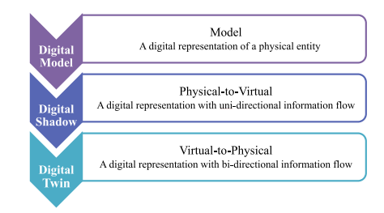
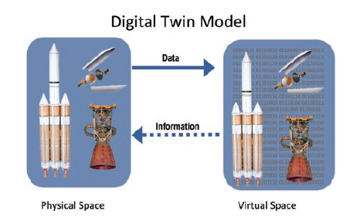
Differences between twins
DT components

Slide 3
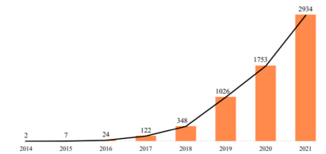
DT in literature - #1
Still a buzzword
Rising number of publications
Mostly non IT papers
Not really twins…
DT by year (Fei, Tao 2022)

Slide 5
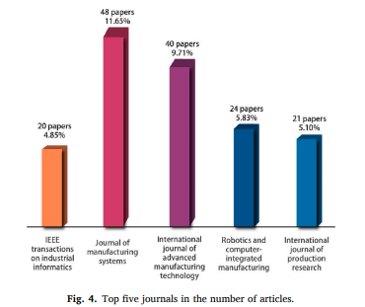
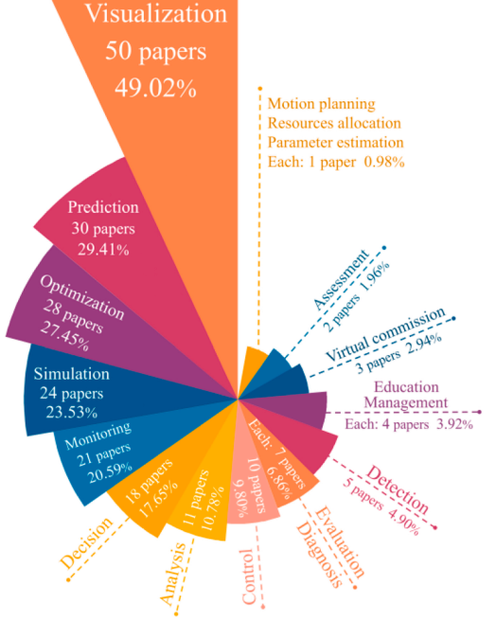
DT by journal (Fei, Tao 2022)
DT by goal (Fei, Tao 2022)

Slide 6
DT in literature - #2
Mostly manufacturing, smart cities, health domain
Still mostly application oriented, focused on visualization (e.g. Unity3D)
While concept of data as a core component is arising..
… Still left unconsidered in most research papers.
However, some standard models are emerging…
Most cited: Fei Tao, Univ. of Beijing

Slide 7
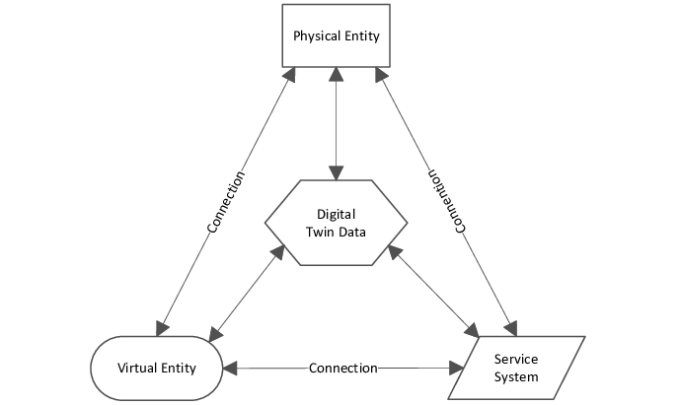
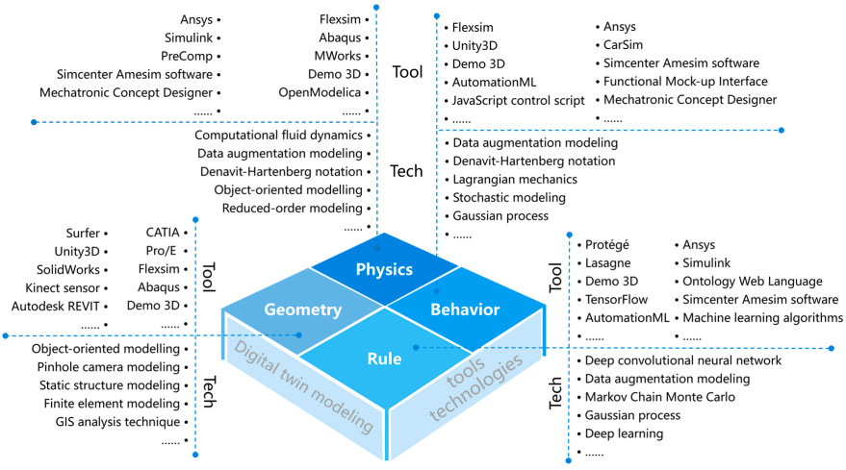
5-Dimensional DT (Fei, Tao 2020)
Virtual Entity architecture (Fei, Tao, 2020)

Slide 8
DT in industry
Azure Digital Twins
AWS IoT Twin Maker
Digital Twin Consortium

Slide 9
Azure Digital Twins
FIWARE like
Digital Twin Definition Language (DTDL) - JSON-LD/NGSI-LDgi
Offers interfaces to control the physical device (not supported)
Native support for Azure Data Explorer (Relational, time-series, ingestion & analytics)
Not clear if it facilitates or provides integration with Azure big data services.

Slide 10
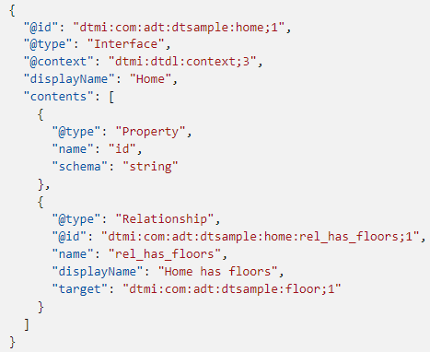
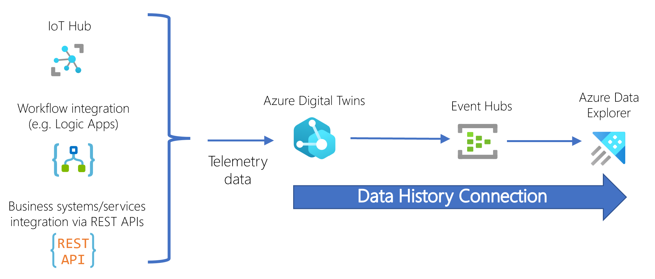
Example of DTDL
Azure DT Platform

Slide 11
AWS IoT Twin Maker
Similar to Azure Digital Twins (also JSON Entity-Component model)
Different JSON semantics
Also graph representation
Native support for Grafana, AWS IoT Site Wise (which leverages AWS Timestream, a time-series DB)

Slide 12
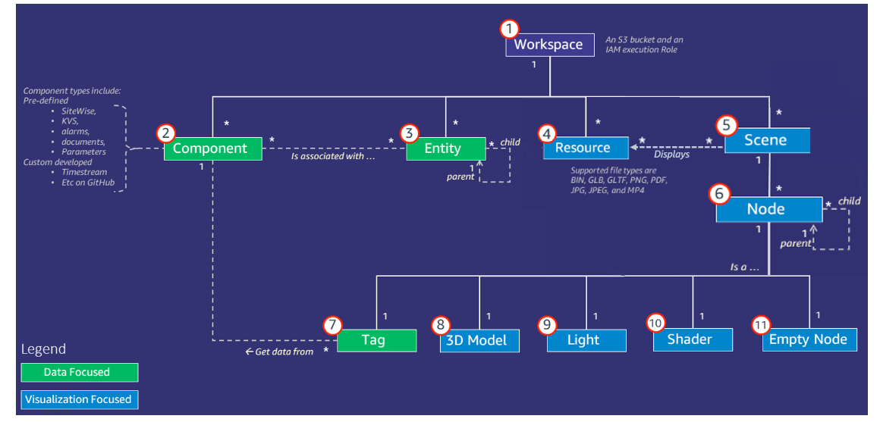
Component JSON documents that describe the connection between a data source and AWS IoT Twin Maker. They access external datasource via a Lambda function defined in the JSON
Each workspace is assigned an S3 Bucket
Key concept and components AWS IoT Twin Maker (documentation here)

Slide 13
DT Data Related Aspects

Slide 14
DT Data - Modeling
Focused on entities last state
In literature, wide spread of AutomationML, XML, etc.
Mostly graphs (too many connections between data)
Initially pure linked data and semantic graphs (RDF, ontologies)
New standards (JSON-LD, NGSI-LD) to seamelessly integrate semi-structured data, property graphs and semantic graphs (also supported by RDF)

Slide 15
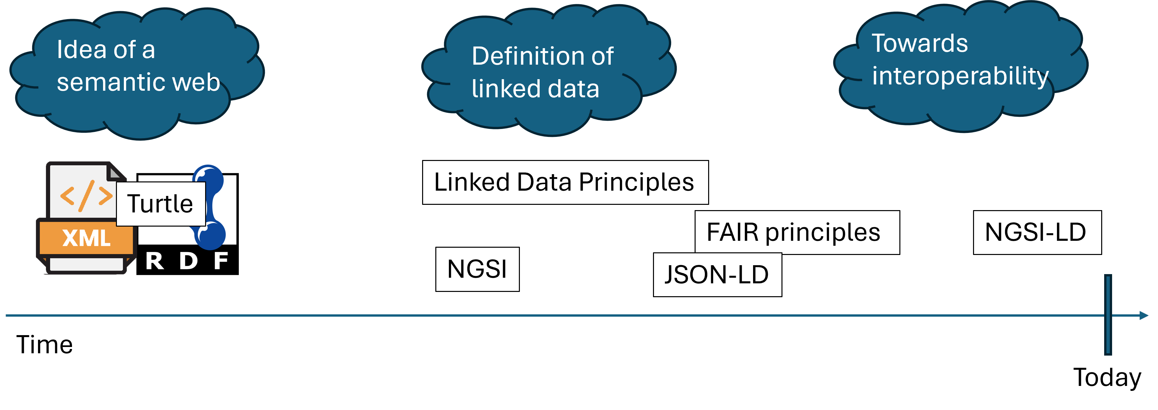
DT Data - A brief history
Simplified technology history

Slide 16
NGSI-LD (Next Generation Service Interface – Linked Data)
Evolution of NGSI v2, powered by FIWARE
Defines a metamodel and APIs (Swagger URL) for property graphs
“id” now must be an URN (or an URI HTTP)
The entity must have a “type” attribute which represent the class of the entity
The class must then be defined in the @context
@context implicitly includes the core @context of NGSI-LD:

Slide 17
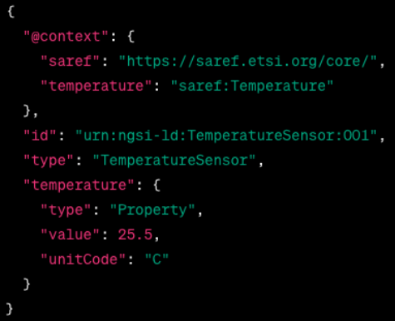
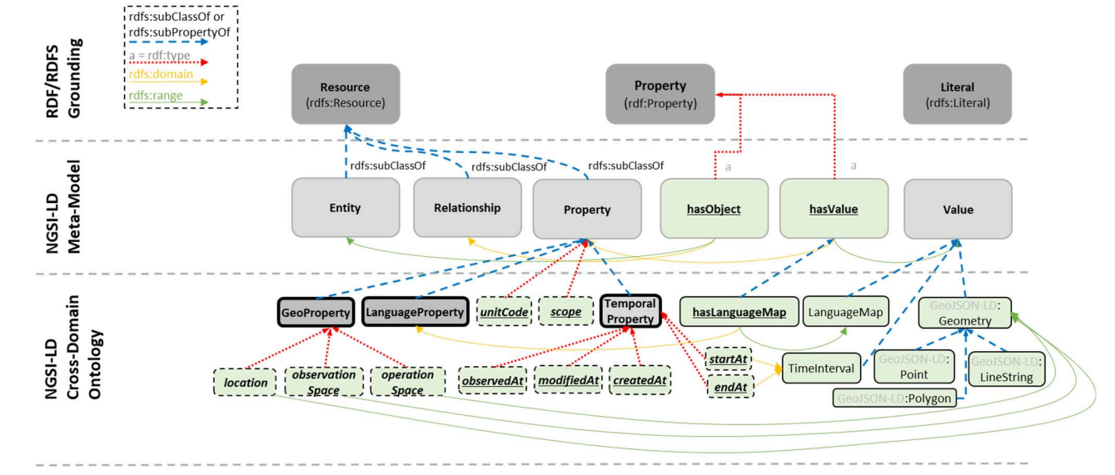
NGSI-LD Metamodel
NGSI-LD Entity Example

Slide 18
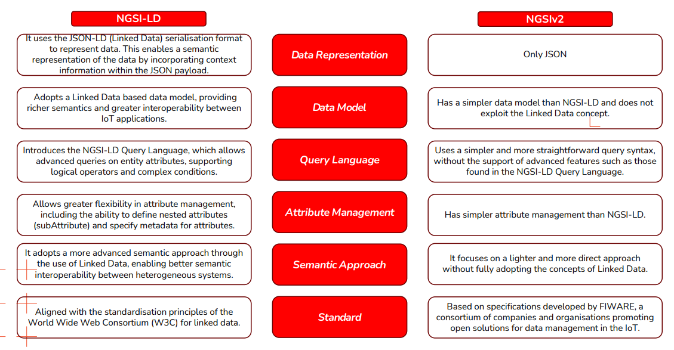
NGSI-LD vs. NGSIv2
Comparison NGSIv2 - NGSI-LD

Slide 19
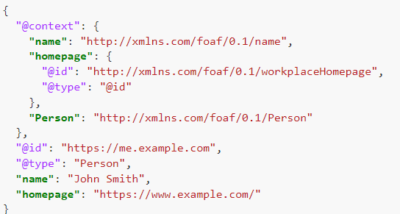
JSON-LD
Make JSON machine-readable again!
Defined to merge semantic data and commonly used JSON documents
Standard for encoding linked data
FIWARE is evolving as well… (Orion-LD)
JSON-LD Example

Slide 20
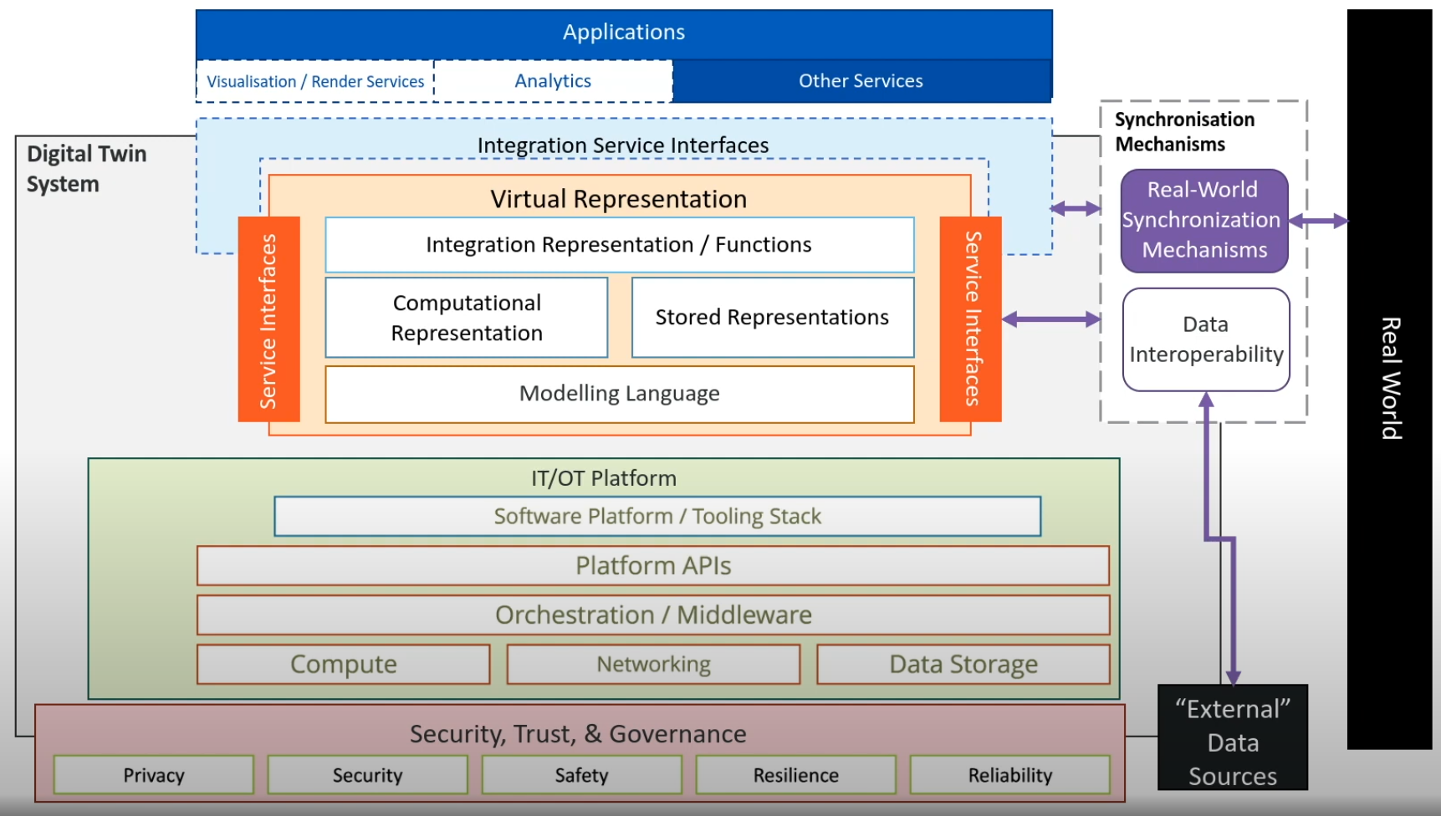
DT Data - Architectures
Most papers don’t even mention it!
When they do, they focus on entities last-state.
Is it really different from a Lambda-like big data architecture?
e.g. Digital Twin Consortium
Digital Twin Consortium Architecture

Slide 21
DT Data - Lifecycle
Something is starting to pop out
“Trash” literature ? (non IT academics, e.g. Dihan et. al., 2024)
Are we reinventing the wheel?

Slide 22
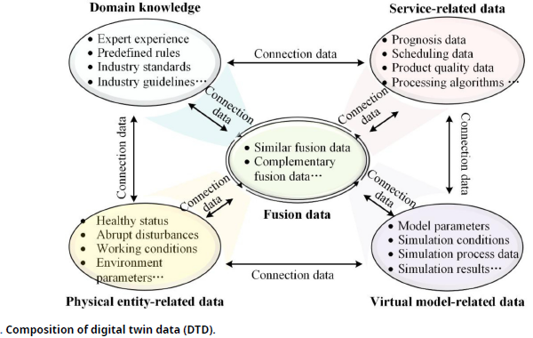
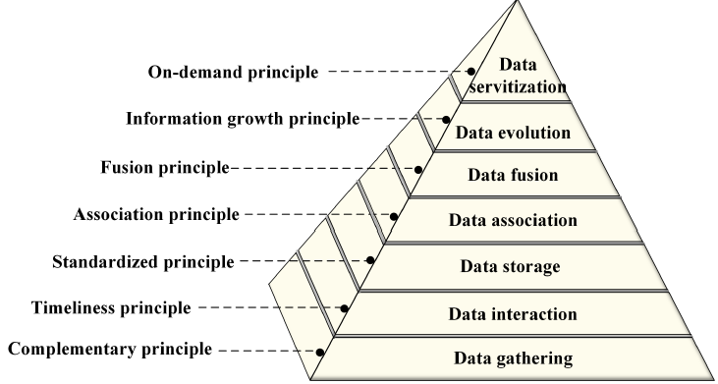
Data Methodology (Fei, Tao 2023)
Digital Twin Data (Fei, Tao 2023)

Slide 23
What next?
Data Architectures
Focus on historical data
Digital Twins Platforms (!!!)
Data modeling (on two different abstraction levels)
Meta-Models for historicized data in a DT (domain driven?)
Standardazing a wider concept (e.g. interoperability between different DT)
Methodology
Watering Digital Twin
P.h.D. Proposal timeline

