Slide 1
Architectures and Methods for Digital Twin Platforms
Manuele Pasini - Ph.D. Student
Business Intelligence Group (B.I.G.)
Supervisor: Prof. Matteo Golfarelli
Introduction to Digital Twins
Differences between digital shadow, digital model, Digital Twin (DT)
Still a buzzword, but enclosing on a definition…
4 components: phyisical model, virtual model, communication services and the data

Slide 2
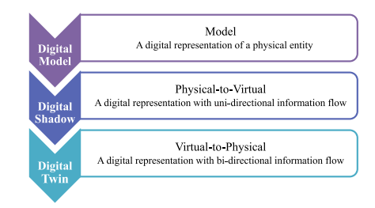
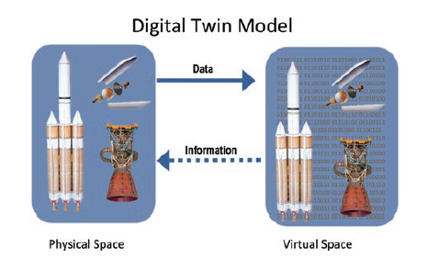
Differences between twins
DT components

Slide 3
Introduction to Digital Twins
The role of data as a core component of Digital Twins is increasingly recognized…
… yet it is often overlooked in research contributions.
Some reference models are emerging (e.g., Fei Tao, Univ. of Beijing).

Slide 4
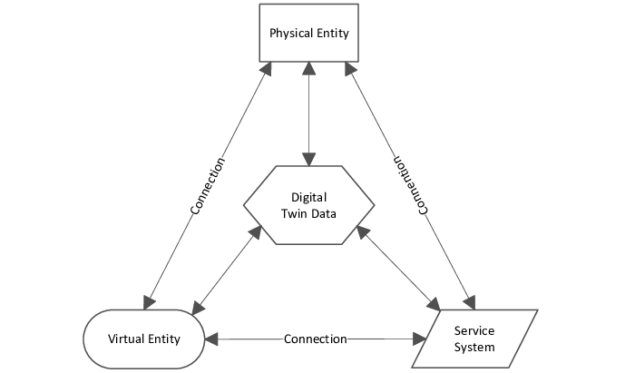
However…
Each solution develops its own data model and storage system;
No interoperability between DTs, even when relying on the same data;
Capabilities of DTs are thus limited;
A standardization effort is required to foster integration.
Standardization should begin at the data layer
5-Dimensional DT (Fei, Tao 2020)

Slide 5
A Digital Twin for Precision Agriculture
Five year ongoing project (within PNRR - Agritech Spoke 9) on precision irrigation of fruit orchards
Demo available at this link
Paper submitted to Computer and Electronics in Agriculture (September 2025).

Slide 6
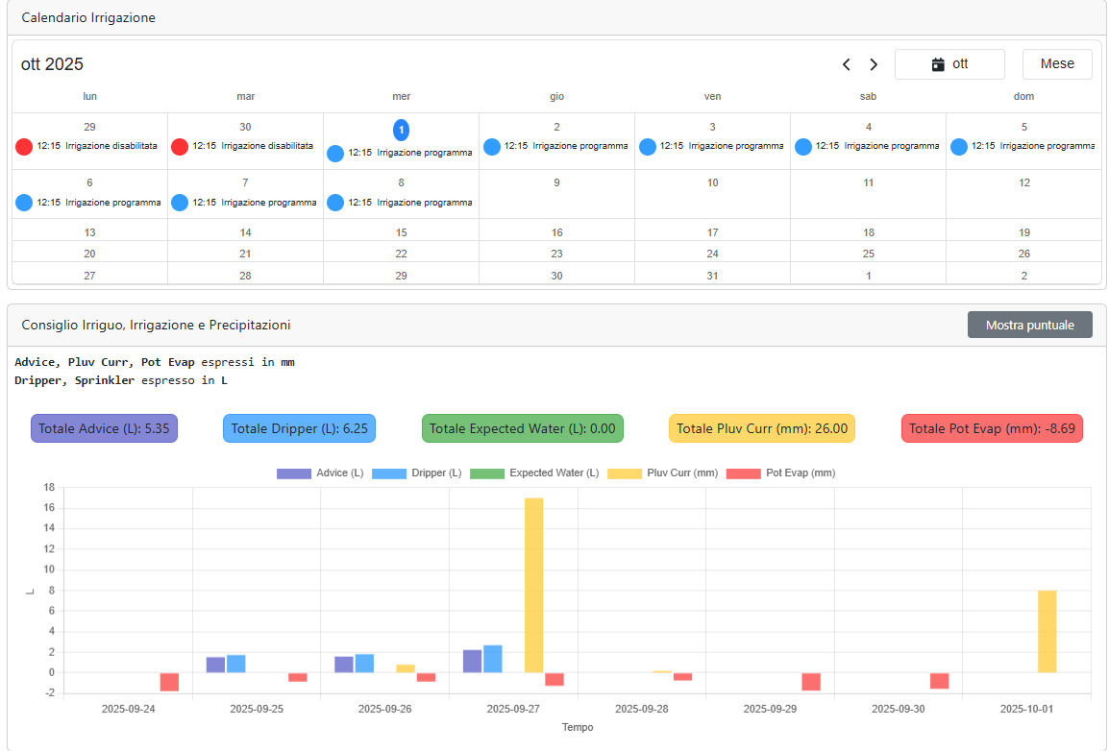
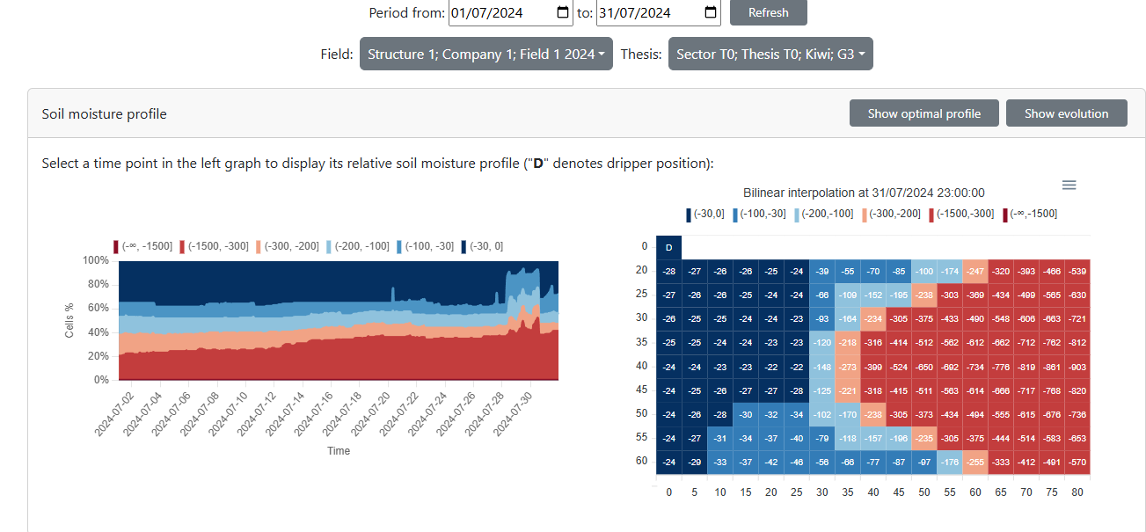
Soil moisture distribution within a monitored plant
Example of controlling action to the physical entity - applying irrigation

Slide 7
Ongoing work: ZESPRI, the world’s largest kiwifruit producer, has decided to undertake large-scale experimental implementation of the system for the 2026 irrigation season.
A Data Platform fostering collaboration between DTs
Within Agritech - Spoke 3, a data platform fostering integration across research projects has been developed.
When defining integration policies and standards, several recurrent data requirements were identified:
Heterogeneous data: from structured to unstructured (including images).
Interconnected data: capturing physical entities together with the IoT networks describing them.
Temporal aspects: datasets often evolve as time series.
Spatial aspects: data are often geo-referenced.

Slide 8
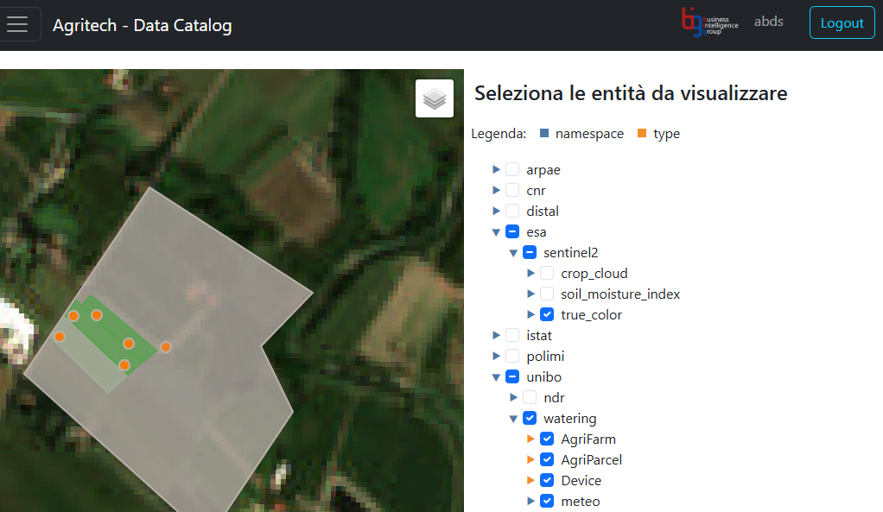
General purpose: supporting heterogeneous data through heterogeneous storage systems;
Interoperable: Interoperable: integration and sharing via common data models (e.g., FIWARE);
Ongoing work: supporting and sharing data processes (e.g., donwload ESA images) and applications.
Excerpt of the Agricolture Data Platform

Slide 9
From application-oriented to domain-oriented
Research Question 1.: Can we move from application-level DT platforms to domain-level platforms?
Takeaway: a DT can be represented as a data pipeline that collects, processes, and exploits data.
Research question 2.: given a data pipeline, can we identify the set of data platform services required to support it?
References:
Matteo Francia, Matteo Golfarelli, Manuele Pasini — Towards a Process-Driven Design of Data Platforms. In DOLAP, pp. 28–35, 2024.
Matteo Francia, Matteo Golfarelli, Manuele Pasini — Process-Driven Design of Cloud Data Platforms. Information Systems Journal, Manuscript No. INFOSYS-D-24-00444.
But an issue emerged: pipelines of different DTs entail different data models & storage systems, yet they share some of the same recurrent requirements….
Modelling Digital Twin Data

Slide 10
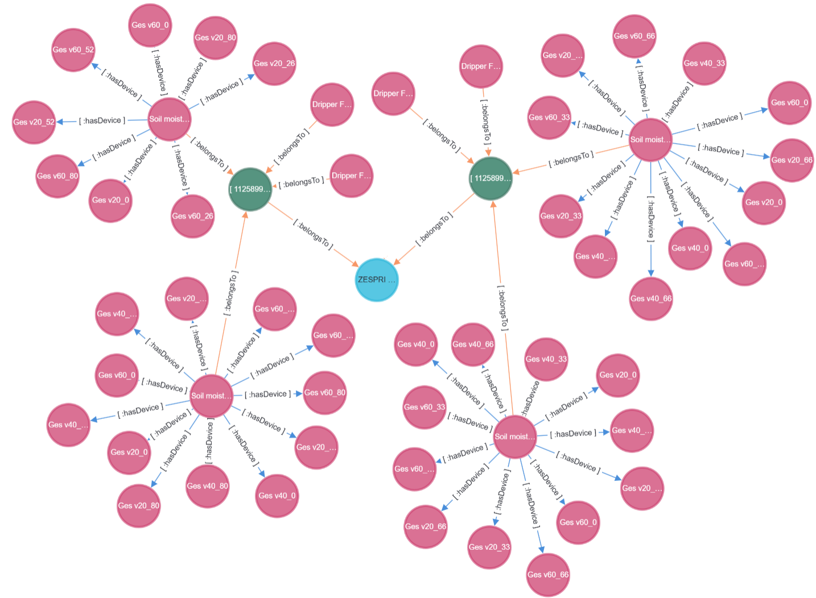
DT data involve highly interconnected entitieS (e.g., a fruit tree and the IoT network describing it), suggesting the use of graph data layout for efficient storage and querying…
… yet, they struggle with such volume of data
Time-Series storage systems efficiently manage large volumes of temporal data…
… but fall short in capturing the complex inter-entity dynamics.
Even the Data Platform Design methodology suggested different architectures tailored to each DT…
Yet, no multi-store solution has yet achieved broad adoption in the literature.
What about an hybrid data structure?
Graph representation of Precision Irrigation DT
Time-Series representation of Precision Irrigation DT

Slide 11
An Hybryd data structure enabling Digital Twin Data
Combining the strength of Graph and Time-Series data layouts with a novel, hybrid data structure.

Slide 12
A representative query workload has been designed, capturing the core of Digital Twin applications by integrating IoT, Time-Series, and Graph queries.
The data structure has been implemented in Kotlin and benchmarked against state-of-the-art techniques, showing promising performance gains.
The paper is curently under writing and to be submitted to VLDB 2026
Graph+TimeSeries Hybrid data model

Slide 13
Future Works
Efficient querying: The semantic capabilities of Large Language Models (LLMs) make them a compelling solution for managing the inherent complexity of transparent querying in hybrid storage environments.
Other activities

Slide 14
Tutoring
95631 - MACHINE LEARNING AND DATA MINING - 6 cfu (2023/2024)
95631 - MACHINE LEARNING AND DATA MINING - 6 cfu (2024/2025)
95631 - MACHINE LEARNING AND DATA MINING - 6 cfu (2025/2026)
Summer schools
6th ACM Europe Summer School on Data Science, Ioannina (Greece)
Graph foundatons and Graph Data Science
IoT Edge Computing
Conferences
EDBT/ICDT 2024 Joint Conference
SEBD 2024, 2025
External activities
Teaching Relational Database, 30 hrs, ITS Olivetti (2023/2024)
Teaching NoSQL Database, 30 hrs, ITS Olivetti (2024/2025)
Teaching NoSQL Database, 30 hrs, ITS Olivetti (2025/2026)
Consultancy on Digitalization in Precision Agriculture, iFarming s.r.l.
Bachelor Thesis advisor
Denis Nikaj (Progettazione e prototipazione di un’applicazione web per l’irrigazione di precisione), March 2024.
Davide Speziali (Progettazione e realizzazione di un simulatore per l’irrigazione di precisione), December 2024.
Federico Capponi (Progettazione e prototipazione di un sistema di irrigazione di precisione), July 2025.

Slide 15
Manca titolo e info miei
Cambia slide 1, fai focus su altra roba
Three year ongoing project
Ongoing or future works
Aggiungi metamodello
SU DT il modello dati è tailored, application based
per muoverci più in alto, dobbiamo muoverci verso domain, e.g. piattaforma precision agriculture.
Poi metamodello, un caso possibile è quello.

