Slide 1
Architectures and Methods for Digital Twin Platforms
Manuele Pasini, Student ID: 0001129119
Business Intelligence Group
Supervisor: Prof. Matteo Golfarelli
Introduction to Digital Twins
Still a buzzword, but enclosing on a definition…
Four key components: physical model, virtual model, data, and communication services.
Mostly standalone, application-oriented systems with limited or none data interoperability.

Slide 2
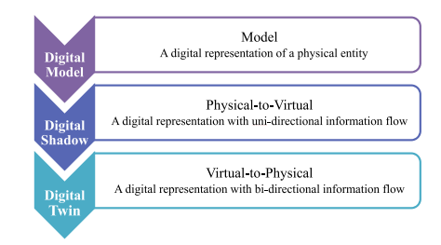
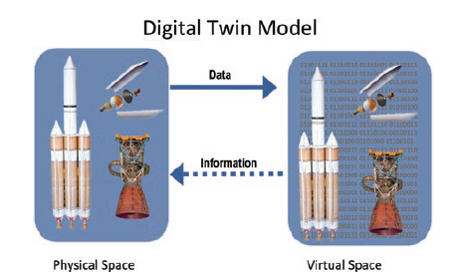
Differences between twins
DT components

Slide 3
Introduction to Digital Twins
The role of data as a core component in Digital Twins is increasingly recognized…
… yet it is often overlooked in research contributions.
Some reference models are emerging (e.g., Fei Tao, Univ. of Beijing).

Slide 4
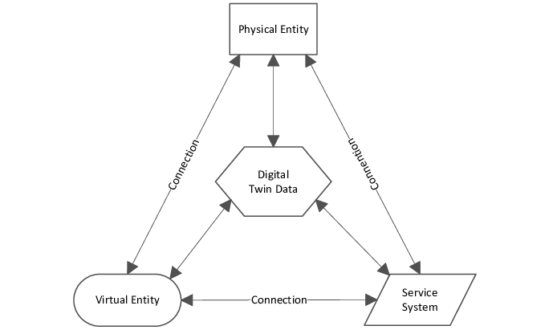
However…
Each solution is independent in both data modelling and semantics
No interoperability between DTs, even when relying on the same data;
Capabilities of DTs are thus limited.
A standardization effort is required to foster integration.
Standardization should begin at the data layer
5-Dimensional DT (Fei, Tao 2020)

Slide 5
A Digital Twin in Precision Agriculture
Three year ongoing project (within PNRR - Agritech Spoke 9) on precision irrigation of fruit orchards
Demo available at this link
Paper submitted to Computer and Electronics in Agriculture (September 2025).

Slide 6
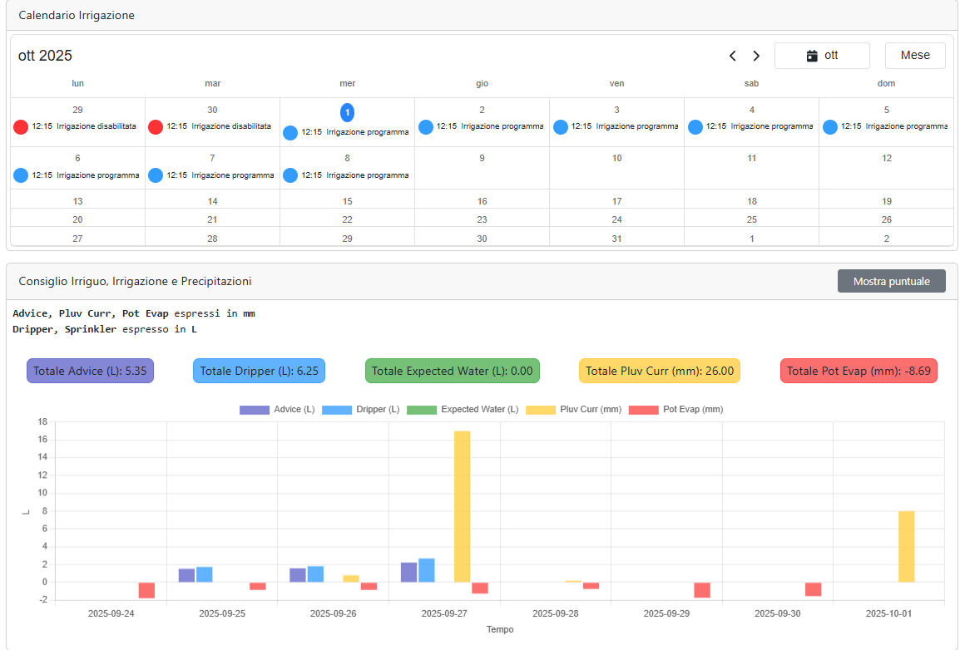
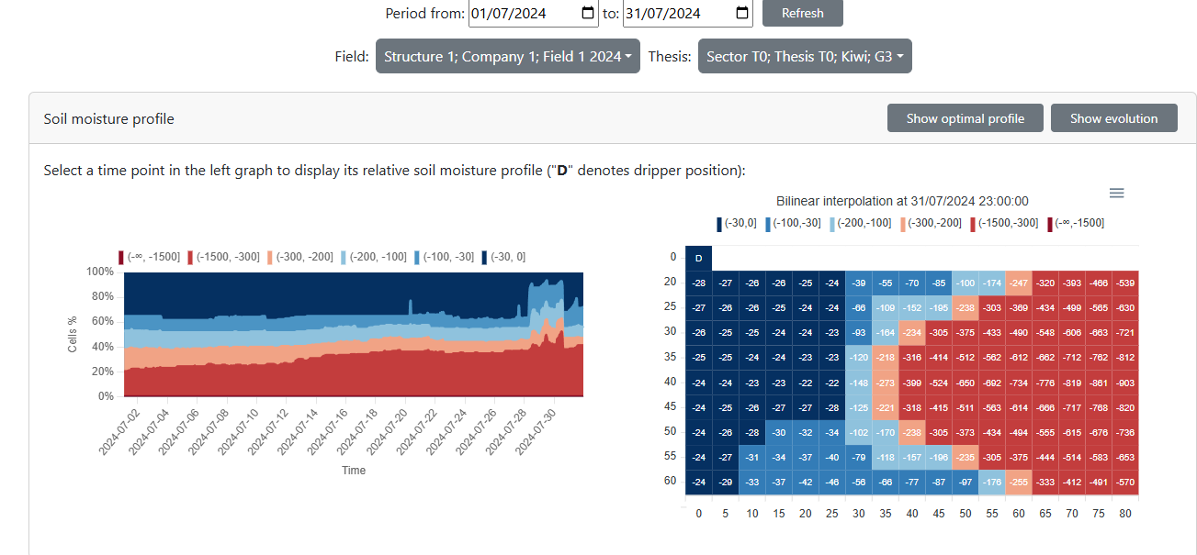
Soil moisture distribution within a monitored plant
Example of controlling action to the physical entity - applying irrigation

Slide 7
Ongoing work: ZESPRI, the world’s largest kiwifruit producer, has decided to undertake large-scale experimental implementation of the system for the 2026 irrigation season.
From application-oriented to domain-oriented
The precision irrigation digital twin is still a standalone system with a tailored data model and semantics.
Integration with different agriculture application is still limited…
Research Question 1.: can we move from application-level DT to domain-level Digital Twin Platforms (DTP) that can facilitate standardization and integration of data?
A first attempt was made within the agriculture domain:

Slide 8
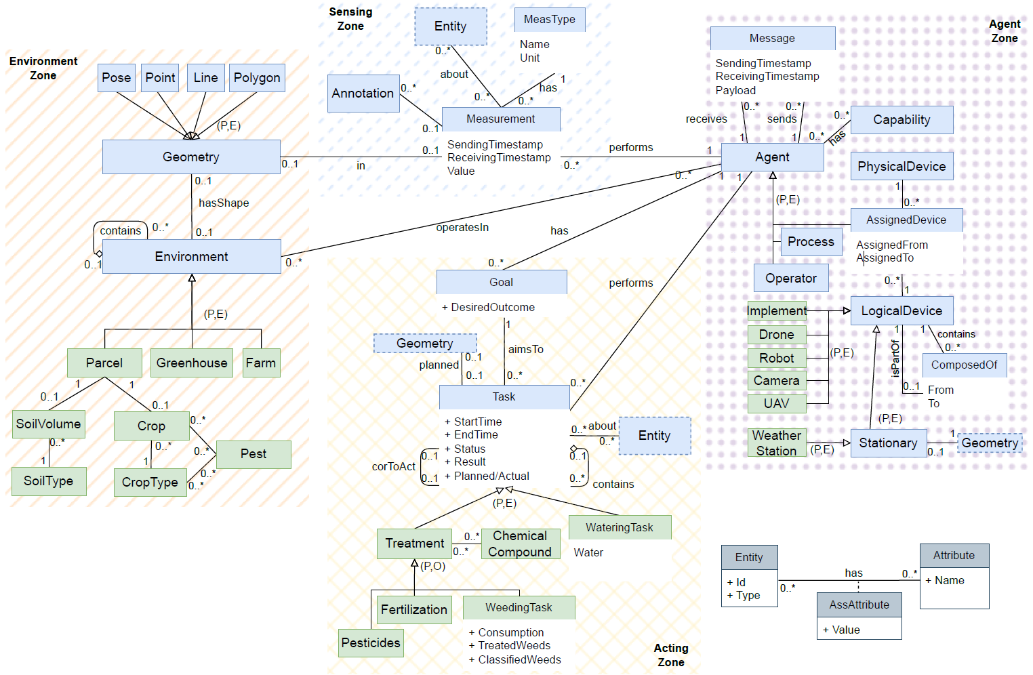
Precision agriculture UML data model
Component schema of the Agriculture Data Platform

Slide 9
A Data Platform fostering collaboration between DTs
Within Agritech - Spoke 3, a data platform fostering integration across research projects has been developed.
When defining integration policies and standards, several recurrent data requirements were identified:
Heterogeneous data: from structured to unstructured (including images).
Interconnected data: capturing physical entities together with the IoT networks describing them.
Temporal aspects: datasets often evolve as time series.
Spatial aspects: data are often geo-referenced.

Slide 10
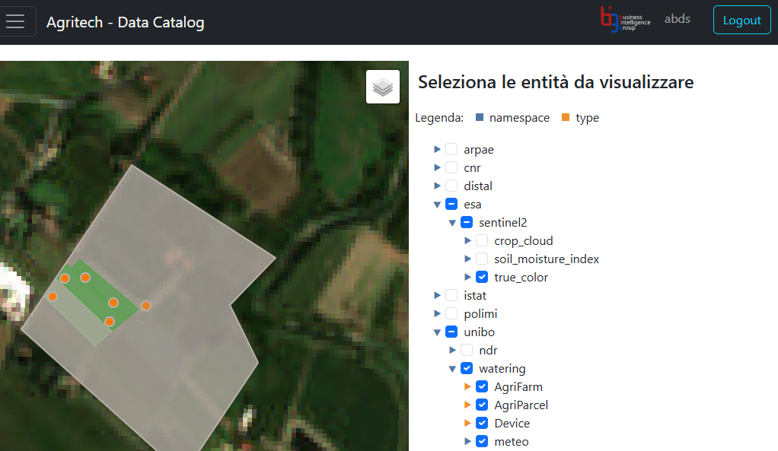
Key aspects
General purpose: supporting heterogeneous data through heterogeneous storage systems;
Interoperable: Interoperable: integration and sharing via common data models (e.g., FIWARE);
Ongoing work: supporting and sharing data processes (e.g., donwload ESA images) and applications.
Excerpt of the Agricolture Data Platform

Slide 11
Modelling Digital Twin Data

Slide 12
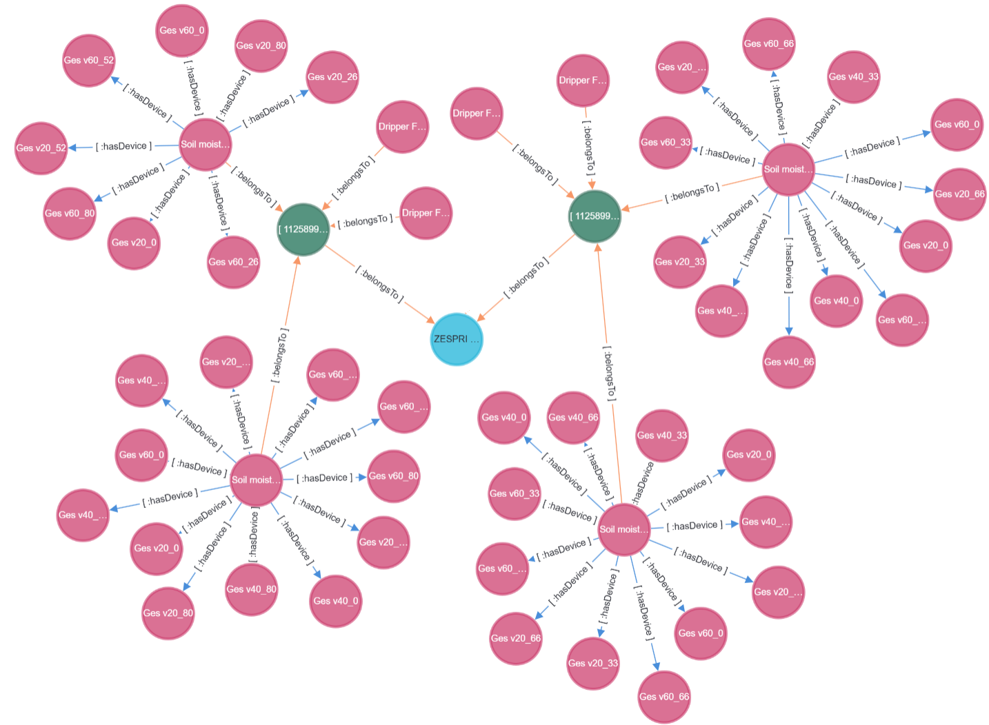
DT data involve highly interconnected entitieS (e.g., a fruit tree and the IoT network describing it), suggesting the use of graph data layout for efficient storage and querying…
… yet, they struggle with such volume of data
Time-Series storage systems efficiently manage large volumes of temporal data…
… but fall short in capturing the complex inter-entity dynamics.
Even the Data Platform Design methodology suggested different architectures tailored to each DT…
Yet, no multi-store solution has yet achieved broad adoption in the literature.
What about an hybrid data structure?
Graph representation of Precision Irrigation DT
Time-Series representation of Precision Irrigation DT

Slide 13
An Hybryd data structure enabling Digital Twin Data
Combining the strength of Graph and Time-Series data layouts with a novel, hybrid data structure.

Slide 14
A representative query workload has been designed, capturing the core of Digital Twin applications by integrating IoT, Time-Series, and Graph queries.
The data structure has been implemented in Kotlin and benchmarked against state-of-the-art techniques, showing promising performance gains.
The paper is curently under writing and to be submitted to VLDB 2026
Graph+TimeSeries Hybrid data model

Slide 15
Future Work
Efficient querying: The semantic capabilities of Large Language Models (LLMs) make them a compelling solution for managing the inherent complexity of transparent querying in hybrid storage environments.
Methodology aspects
How can we efficiently deploy digital twin applications on a DTP?
A digital twin application is essentially a sequence of data processes powering its functionality.
Even for experts and within cloud environments, identifying the right services for a data pipeline is far from trivial.
Research question: given a data pipeline, can we identify the set of data platform services required to support it?
References:
Matteo Francia, Matteo Golfarelli, Manuele Pasini — Towards a Process-Driven Design of Data Platforms. In DOLAP, pp. 28–35, 2024.
Matteo Francia, Matteo Golfarelli, Manuele Pasini — Process-Driven Design of Cloud Data Platforms. Information Systems Journal, Manuscript No. INFOSYS-D-24-00444.
Other activities

Slide 16
Tutoring
95631 - MACHINE LEARNING AND DATA MINING - 6 cfu (2023/2024)
95631 - MACHINE LEARNING AND DATA MINING - 6 cfu (2024/2025)
95631 - MACHINE LEARNING AND DATA MINING - 6 cfu (2025/2026)
Summer schools
6th ACM Europe Summer School on Data Science, Ioannina (Greece)
Graph foundatons and Graph Data Science
IoT Edge Computing
Conferences
EDBT/ICDT 2024 Joint Conference
SEBD 2024, 2025
External activities
Teaching Relational Database, 30 hrs, ITS Olivetti (2023/2024)
Teaching NoSQL Database, 30 hrs, ITS Olivetti (2024/2025)
Teaching NoSQL Database, 30 hrs, ITS Olivetti (2025/2026)
Consultancy on Digitalization in Precision Agriculture, iFarming s.r.l.
Bachelor Thesis advisor
Denis Nikaj (Progettazione e prototipazione di un’applicazione web per l’irrigazione di precisione), March 2024.
Davide Speziali (Progettazione e realizzazione di un simulatore per l’irrigazione di precisione), December 2024.
Federico Capponi (Progettazione e prototipazione di un sistema di irrigazione di precisione), July 2025.

