Slide 1
Introduction
Hi!
  Manuele Pasini, 3rd year Ph.D. Candidate
  Supervisor: Matteo Golfarelli
  Research interests:
    Database / Data Engineering
    Digital Twins & Precisision Agriculture
  Thesis: Architectures and Methods for Digital Twin Platform

Slide 2
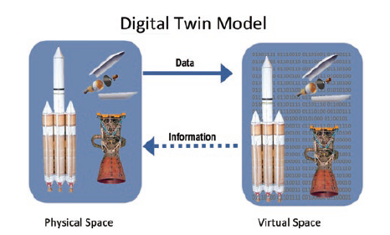
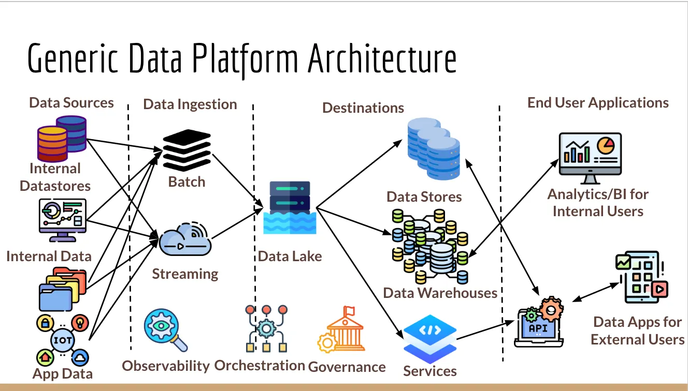
Digital Twin functional view
An example of a generic data platform with its components and layers

Slide 3
Digital Twins: Concept & State of the Art
Digital Twin (DT): physical entity (PE) + virtual representation (VE), connected via bidirectional data flow
Reference architectures:
  3D model (M. Grieves)
  5D model (Tao et al.): PE, VE, connection, data, service
Data is not a by-product — it’s the component connecting every dimension
M. Grieves 3D Model

Slide 4
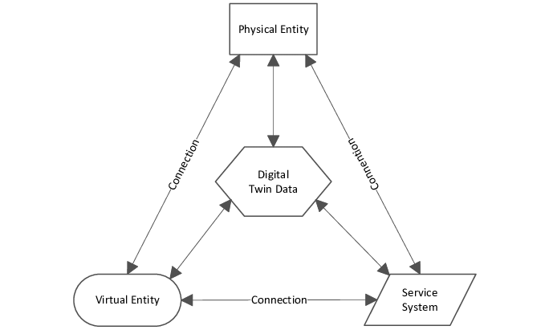
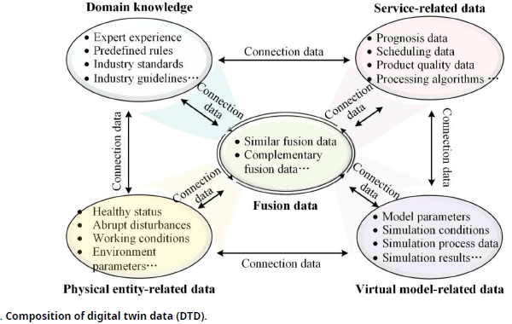
5-Dimensional DT (Tao et al.)
Characterizing Digital Twin data (Fei, Tao 2023)

Slide 5
The Challenge: Fragmentation
Digital Twins adopted across many independent domains:
  manufacturing, energy, aerospace, healthcare, agriculture, smart cities, transportation…
No universally accepted definition (Wuni et al.: 358 definitions surveyed)
Most application builds its own:
  architecture and technological stack
  data representation
Result: isolated, application-specific Digital Twins
  data isolation
  architectural heterogeneity
  scalability issues
Fragmentation → limited standardization & interoperability

Slide 6
Digital Twin Platform: A Data-Oriented Perspective
A Digital Twin is a data-intensive application
Divide et impera: separate the software and data dimensions
  Software dimension → substantial work, increasingly mature
  Data dimension → far less mature ⇐ focus of my research
Standardization should start from data
Digital Twin Platform (DTP):
  hosts DTs across their lifecycle, but organized around data
  agnostic to how a DT is implemented — as long as it respects the platform’s data models

Slide 7
Prescriptive watering: Data-driven optimization of water consumption in kiwifruit orchards

Slide 8
STGraph: A Multistore for Spatio-Temporal Property Graphs and Time-Series Data . Under review @ VLDB 2027
A multistore data structure for large spatio-temporal property graphs
  Graph data model on top of heterogeneous storage
    Low-evolving data on Graph storage
    Highly-dynamic data on Time-Series storage
  Transparent graph query interface.
STGraph System Architecture

Slide 9
STGraph Data Model

Slide 10
STGraph: A Multistore for Spatio-Temporal Property Graphs and Time-Series Data
Property Graph data model:
  TS events (nodes) can hold edges and properties
  Edges built at query time
Hybrid storage:
  Dedicated Time-Series streaming ingestion of data
  Query optimization through filter-pushdown
  Efficient graph traversal & temporal reasoning

Slide 11
Querying STGraph

Slide 12
Anomaly Detection in Complex Sensor Networks
Complex sensor networks are increasingly common
Anomaly detection in time-series data is a well-known research field
What about anomalies that are cross-time series?
An example of cross-time series anomaly
An example of cross-time series anomaly

Slide 13
LLM-Assisted Metadata Query Answering on Data Warehouses

