Slide 1
Introduction
Who am I ?
Manuele Pasini, Ph.D. Candidate in Computer Science and Engineering
University of Bologna, Business Intelligence Group
Area of Interest:

Slide 2
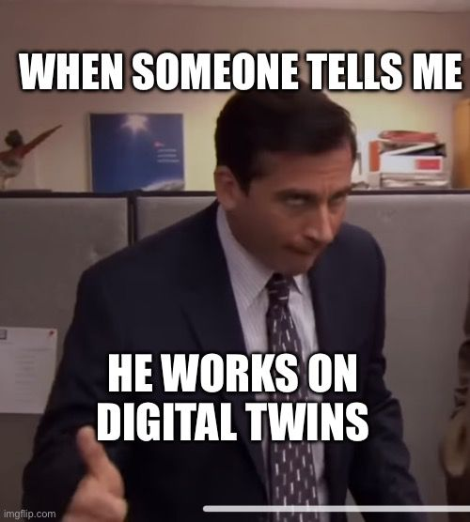
Big Data, Data Platforms, Data Engineering
Data architectures and methodologies for Digital Twins (oh god not DTs again)
Precision Agriculture (static & dynamic entities)
Oh God no, not DTs again

