Slide 1
Architectures and Methods for Digital Twin Platforms

Slide 2
Introduction to Digital Twins
Differences between digital shadow, digital model, Digital Twin (DT)
Still a buzzword, but enclosing on a definition…
3 components: phyisical model, virtual model, communication services

Slide 3
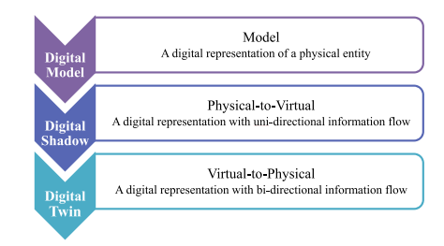
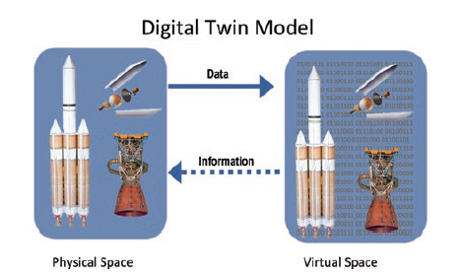
Differences between twins
DT components

Slide 4
Introduction to Digital Twins
While concept of data as a core component is arising..
… Still left unconsidered in most research papers.
… However, some standard models are emerging
e.g.: Fei Tao, Univ. of Beijing

Slide 5
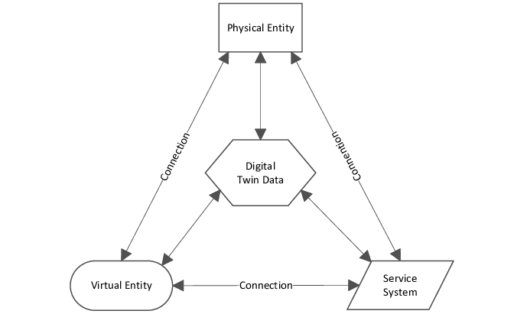
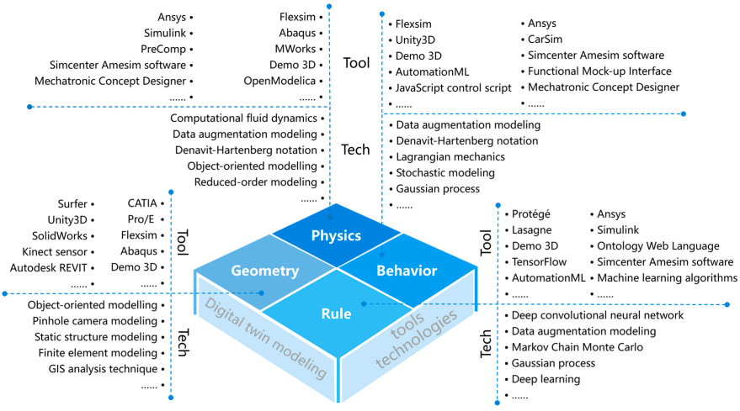
5-Dimensional DT (Fei, Tao 2020)
Virtual Entity architecture (Fei, Tao, 2020)

Slide 6
A Digital Twin for Precision Agriculture
Five year ongoing project (also in PNRR - Spoke 9) in precision irrigation of orchards
Demo available at https://big.csr.unibo.it/projects/smarter/
Scientific Article submitted to Computer and Electronics in Agriculture (September 2025).

Slide 7
A Data Platform fostering collaboration between DTs
Within PNRR Agritech - Spoke 3, building a Data Platform fostering collaboration and integration between research projects…
While defining integration policies and standards…
Some key data requirements emerged:
Heterogeneous data: encompassing structured and unstructured types, including images.
Interconnected data: representing both physical entities and the IoT networks describing them.
Temporal aspects: datasets often exhibit time-series behavior.
Spatial aspects: data are frequently geolocated.
Currently working on its implementation

Slide 8
From application-oriented to domain-oriented
A DT can be characterized by the data pipelines that collect, process, and generate insights from data.
Is it possible, given a data pipeline, to determine the set of a data platform services enibling such pipeline?
Matteo Francia, Matteo Golfarelli, Manuele Pasini - Towards a process-driven design of data platforms. In DOLAP, pages 28–35, 2024.
Matteo Francia, Matteo Golfarelli, Manuele Pasini - Process-Driven Design of Cloud Data Platforms, Information Systems journal, Manuscript Number: INFOSYS-D-24-00444
But something was missing..

Slide 9
Modelling Digital Twin Data

Slide 10
An Hybryd data structure enabling Digital Twin Data
Workload definition (queries)

Slide 11
External activities
Tutoring
95631 - MACHINE LEARNING AND DATA MINING - 6 cfu (a.a. 23/24)
95631 - MACHINE LEARNING AND DATA MINING - 6 cfu (a.a. 24/25)
95631 - MACHINE LEARNING AND DATA MINING - 6 cfu (a.a. 25/26)
Summer schools
6th ACM Europe Summer School on Data Science, Ioannina (Greece)
Conferences
Project meeting Spoke 3 PNRR Agritech
EDBT/ICDT 2024 Joint Conference
External activities
Teaching Relational Database, 30 hrs, ITS Olivetti (2023/2024)
Teaching NoSQL Database, 30 hrs, ITS Olivetti (2024/2025)
Teaching NoSQL Database, 30 hrs, ITS Olivetti (2025/2026)
Consultancy on Digitalization in Precision Agriculture, iFarming s.r.l.
Bachelor Thesis advisr
Denis Nikaj (Progettazione e prototipazione di un’applicazione web per l’irrigazione di precisione), March 2024.
Davide Speziali (Progettazione e realizzazione di un simulatore per l’irrigazione di precisione), December 2024.
Federico Capponi (Progettazione e prototipazione di un sistema di irrigazione di precisione), July 2025.

