Slide 1
Graph + LLM state of the art

Slide 2
Surveys
Unifying Large Language Models and Knowledge Graphs: A Roadmap - TKDE, 2023
A survey on augmenting knowledge graphs (KGs) with large language models (LLMs): models, evaluation metrics, benchmarks, and challenges - Discover artificial intelligence, 2024
Graph Retrieval-Augmented Generation for Large Language Models: A Survey - Conference on AI, Science, Engineering, and Technology (AIxSET), 2024
A Survey of Large Language Models for Graphs - KDD, 2024
Research Trends for the Interplay between Large Language Models and Knowledge Graphs - PVLD, 2024
Large Language Models on Graphs: A Comprehensive Survey - TKDE, 2024
Think-on-Graph: Deep and Responsible Reasoning of Large Language Model on Knowledge Graph - ICLR, 2024
A survey of large language models for data challenges in graphs - Expert systems with Applications, 2025
Bring Your Own Knowledge: A Survey of Methods for LLM Knowledge Expansion - ??, 2025

Slide 3
LLMs on Graphs: A Comprehensive Survey - TKDE, 2024
Three types of graphs:
Pure Graphs without Textual Information
Text-Attributed Graphs: nodes or edges are associated with semantically rich text information
Text-Paired Graphs: have textual descriptions defined for the entire graph structure.
HOW TO Input graph into LLM:
Plainly verbailizing graph: Verbalizing the graph structure in natural language (e.g., describe edges and adjacency lists)
Paraphrasing graph: paraphrase the graph structure into more natural or concise sentences.
[125] find that by prompting LLMs to generate a format explanation of the raw graph inputs for itself (Format-Explanation) or to pretend to play a role in a natural task (Role Prompting), the performance on some problems can be improved but not systematically. [130] explores the effect of grounding the pure graph in a real-world scenario, such as social networks, friendship graphs, or co-authorship graphs. In such graphs, nodes are described as people, and edges are relationships between people.
Encoding Graphs Into Implicit Feature Sequences : Usually train a graph encoder to encode the graph structure into a sequence of features and fine-tuning the LLMs to adapt to the new input format.

Slide 4
LLMs on Graphs: A Comprehensive Survey - TKDE, 2024
Applications - Pure graphs
Direct answering: just provide me an answer.
On verbalized/paragraphed graphs…
LLMs can answer easy questions (e.g., connectivity, neighbor identification, graph size counting) but fail to answer more complex questions (e.g., cycle detection and Hamiltonian pathfinding).
On encoded graphs…
Drastic performance improvement on problems including substructure counting, maximum triplet sum, shortest path, and bipartite matching.
Heuristic Reasoning: Perform a series of intermediate reasoning steps that might heuristically lead to the correct answer
Reasoning step-by-step: Chain of Thouhg (CoT) like, improves performances on simpler problems (e.g., cycle detection, shortest-path) but fails on complex problems(e.g, hamiltonian PF, topological sorting).
Retrieving subgraphs as evidence: when not all graph is relevant to the task, LLM retrieve the subgraphs as evidence first and then perform reasoning on it.
Build-a-Graph: reconstruct the relevant graph structures and then perform reasoning on them. This
Context-Summarization: summarize the key nodes, edges, or sub-graphs and perform reasoning.
Searching on Graphs: e.g., DFS, BFS.
At each step LLM decides if answer the question or explore one node through an edge (good for scaling in graph size)
Algorithmic Reasoning: prompts the LLMs to recall the algorithms that are relevant to the questions and then perform reasoning step by step according to the algorithms. bad results
Overall, no consensus on how to represent graphs

Slide 5
LLMs on Graphs: A Comprehensive Survey - TKDE, 2024
Applications - Text-attributed graphs
LLM as Predictor : LLM as the main model architecture to capture both the text information and graph structure information, depending on how structure information in graphs is injected:
LLM as Encoder : LLMs extract textual features to serve as initial node feature vectors for GNNs, which then generate node/edge representations and make predictions
LLM as Aligner

Slide 6
LLMs on Graphs: A Comprehensive Survey - TKDE, 2024
Applications - Text-attributed graphs - LLM as Predictor
Graph as Sequence : The ego-graphs associated with nodes/edges are serialized into a sequence, depending on how it gets serialized:
Rule-based methods
GNN-based methods: graph encoder models (i.e., GNN) to ego-graph associated with nodes into token representations which are concatenated with the text information
Graph-Empowered LLMs : modify the architecture of Transformersb to encode text and graph structure simultaneously.
Graph-AwareLLM finetuning methods :adopt vanilla language mode and finetune them with structure signals on the graph. tons of methods on this

Slide 7
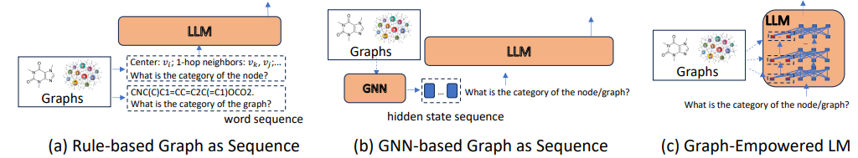
Takeouts:
Graph as Code Sequence : GraphsASequence are rule-or GNN-based. Another way is to obtain a structure-aware sequence that can capture structures (e.g., graph XML or JSON) and utilize code LLMs.
More powerful Graph-Empowered LLms
Schemas for LLM as encoder

Slide 8
LLMs on Graphs: A Comprehensive Survey - TKDE, 2024
Applications - Text-attributed graphs - LLM as Encoder
LLMs extract textual features to serve as initial node feature vectors for GNNs, which then generate node/edge representations and make predictions
Goals:
Optimization : of the GNN output
Data Augmentation: LLMs generate additional text data for theLLM-GNNcascaded architecture.
Knowledge Distillation : Train a GNN+LLM, but using it is costly because of GNN. So we train a “teacher” GNN+LLM model and save embeddings/output, and then a student LLM model leverage those in order to avoid inference costs

Slide 9
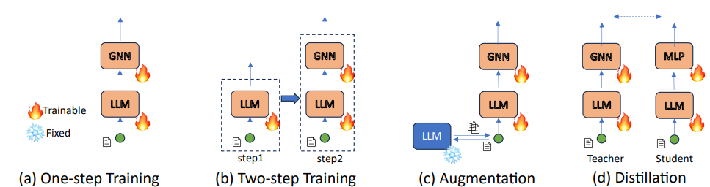
Takeouts:
LLM is just used for encoding, but not to generate anything
Low efficient knowledge distillation: it’s promising, but costly. Potential solution is to distill the model into a smaller LM or even an MLP
Schemas for LLM as encoder

Slide 10
LLMs on Graphs: A Comprehensive Survey - TKDE, 2024
Applications - Text-attributed graphs - LLM as Aligner
Two components: LLM for text encoding and GNN for structure encoding. They iteratively interact with each other. According to how they interact:
LLM-GNN Prediction Alignment : Iteratively train LLM with graph text data, train GNN with graph structure data. LLM generates labels for nodes from the text perspective and serve them as pseudo-labels for GNN training; GNN generates labels for nodes from the structure perspective and serve them as pseudo-labels for LLM training.
LLM-GNN Latent Space Alignment : connecting text encoding (LLM) and structure encoding (GNN) with cross-modality contrastive learning. The integration between the two models happens in the latent space, similar text encoding and structure encoding will be close in the latent space

Slide 11
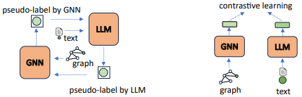
Takeouts:
Heterogeneous semantic relations: the semantic relationships between data units can be multiplex. Different relations have different distributions and a single semantic alignment will fail to capture the comprehensively. Risks of flatting the semantics of data
Low efficient knowledge distillation: it’s promising, but costly. Potential solution is to distill the model into a smaller LM or even an MLP
Schemas for LLM as Aligner

Slide 12
Moro Takeouts
Use RAG only if the question lies beyond the typical training data, if the knowledge we’re asking is not embedded in parameters, otherwise performances might get worse

Slide 13
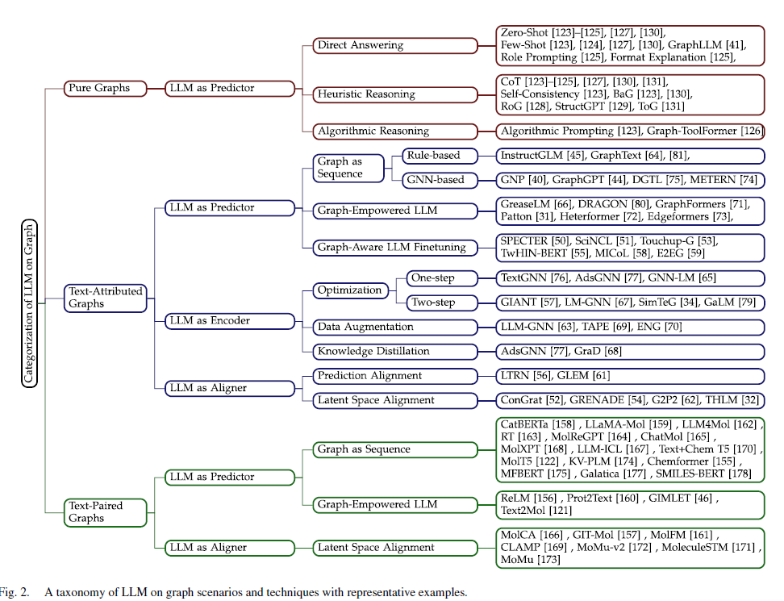
LLMs on Graphs: A Comprehensive Survey - TKDE, 2024
Applications - Text-Paired graphs - LLM as Aligner
Taxonomy of graph + llm contributions in literature

