Slide 1
Introduction
Who am I ?
  Manuele Pasini, Ph.D. Candidate in Computer Science and Engineering
  University of Bologna, Business Intelligence Group
Area of Interest:
  Traditional DBMS, Big Data and Data Platforms
    Data architectures and methodologies for Digital Twins
    Precision Agriculture:
      Irrigation optimization
      Data Platform for italian agriculture domain @Agritech
Oh God no, not DTs again
Oh God no, not DTs again

Slide 2
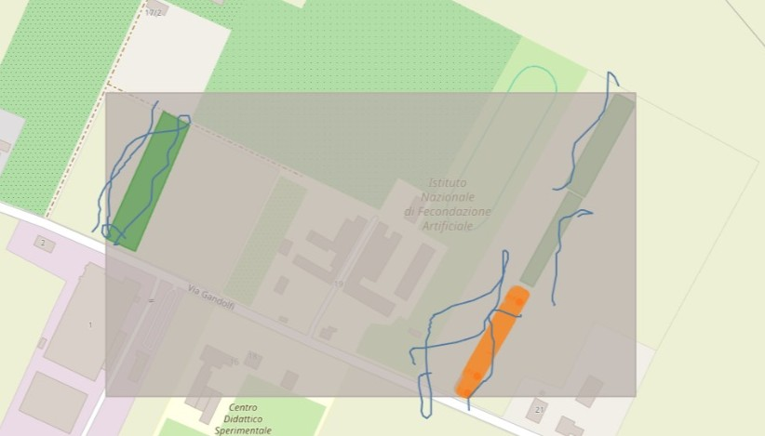
Current Work
Graph+TimeSeries Hybrid data model
Graph+TimeSeries Hybrid data model
Excerpt of our P.A. platform

Slide 3
Future plans
Hopefully finish and publish the paper;
optimize querying performances;
enhance query expressiveness;
Survive this journey without developing PTSD

