Slide 1
Introduction
Who am I ?
Manuele Pasini, Ph.D. Candidate in Computer Science and Engineering
University of Bologna, Business Intelligence Group
Area of Interest:
Traditional DBMS, Big Data and Data Platforms
Data architectures and methodologies for Digital Twins
Precision Agriculture:
Irrigation optimization
Data Platform for italian agriculture domain @Agritech
Oh God no, not DTs again
Oh God no, not DTs again

Slide 2
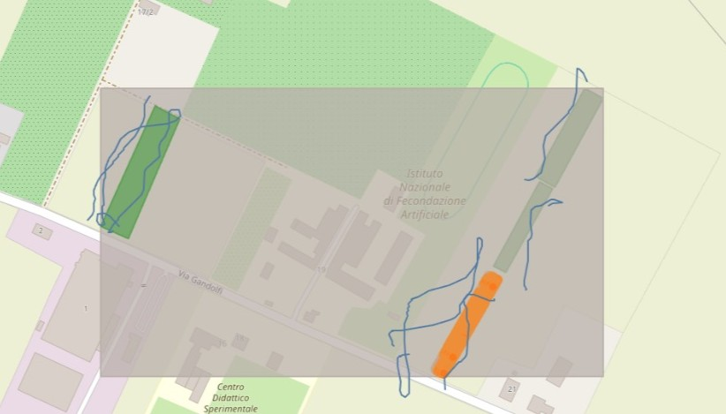
Current Work
Graph+TimeSeries Hybrid data model
Graph+TimeSeries Hybrid data model
Excerpt of our P.A. platform

Slide 3
Future plans
Hopefully finish and publish the paper;
optimize querying performances;
enhance query expressiveness;
Survive this journey without going insane

