Slide 1
Digital Twins (DT)
Differences between digital shadow, digital model, digital twin
Enclosing on a definition…
3 components: phyisical model, virtual model, communication services

Slide 2
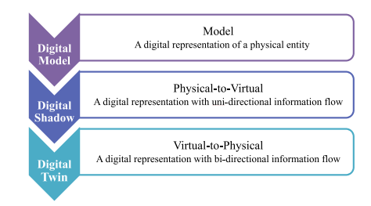
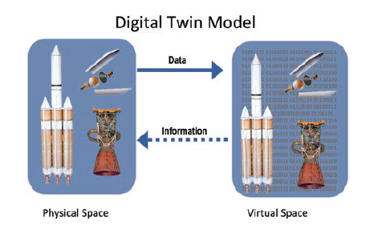
Differences between twins
DT components

Slide 3
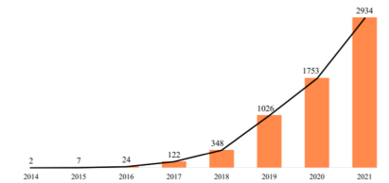
DT in literature - #1
Still a buzzword
Rising number of publications
Mostly non IT papers
Not really twins…
DT by year (Fei, Tao 2022)

Slide 5
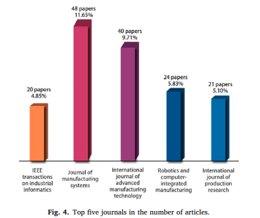
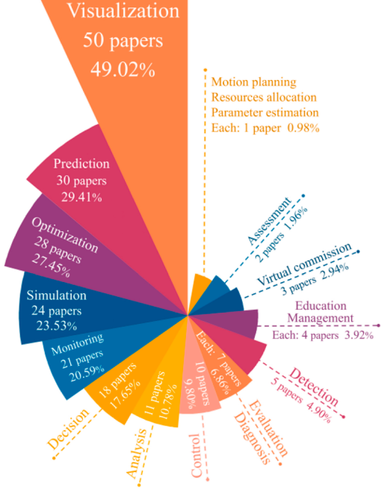
DT by journal (Fei, Tao 2022)
DT by goal (Fei, Tao 2022)

Slide 6
DT in literature - #2
Mostly manufacturing, smart cities, health domain
Still mostly application oriented, focused on visualization (e.g. Unity3D)
While concept of data as a core component is arising..
… Still left unconsidered in most research papers.
However, some standard models are emerging…
Most cited: Fei Tao, Univ. of Beijing

Slide 7
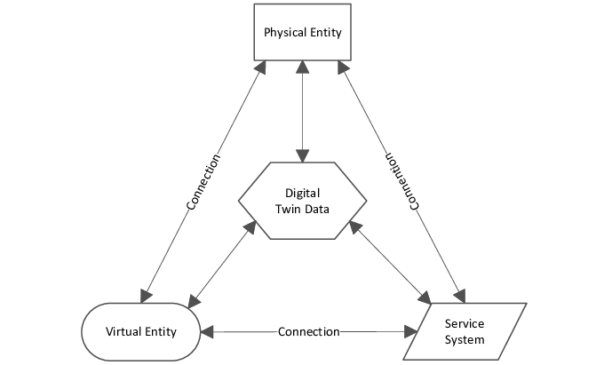
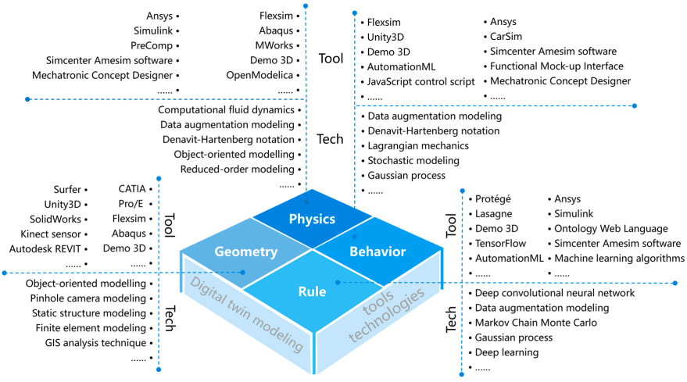
5-Dimensional DT (Fei, Tao 2020)
Virtual Entity architecture (Fei, Tao, 2020)

Slide 8
DT in industry
Azure Digital Twins
AWS IoT Twin Maker
Digital Twin Consortium

Slide 9
Azure Digital Twins
FIWARE like
Digital Twin Definition Language (DTDL) - JSON-LD/NGSI-LDgi
Offers interfaces to control the physical device (not supported)
Native support for Azure Data Explorer (Relational, time-series, ingestion & analytics)
Not clear if it facilitates or provides integration with Azure big data services.

Slide 10
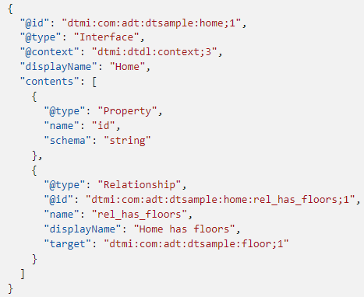
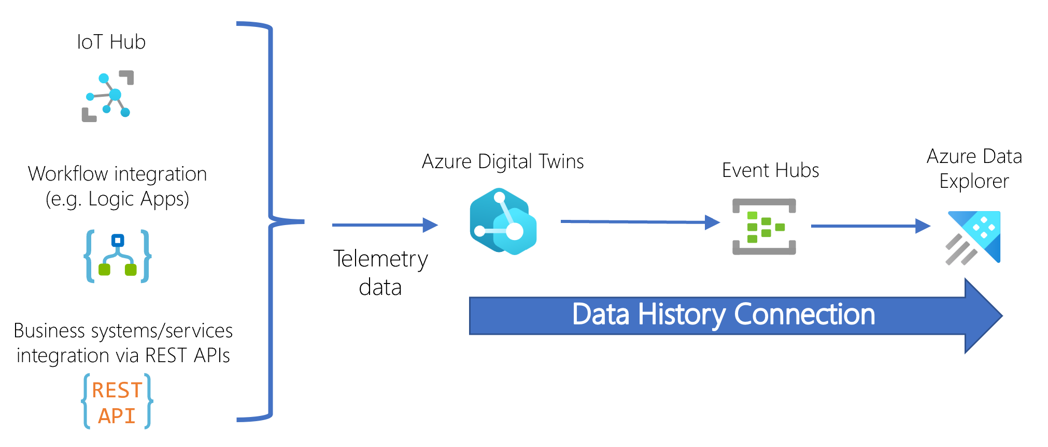
Example of DTDL
Azure DT Platform

Slide 11
AWS IoT Twin Maker
Similar to Azure Digital Twins (also JSON Entity-Component model)
Different JSON semantics
Also graph representation
Native support for Grafana, AWS IoT Site Wise (which leverages AWS Timestream, a time-series DB)

Slide 12
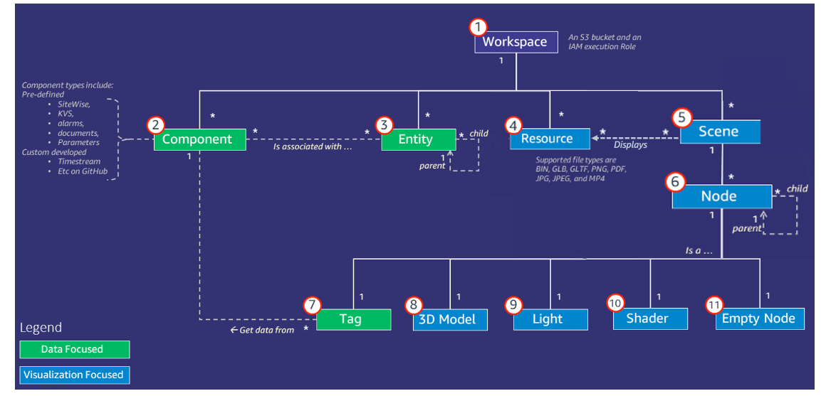
Component JSON documents that describe the connection between a data source and AWS IoT Twin Maker. They access external datasource via a Lambda function defined in the JSON
Each workspace is assigned an S3 Bucket
Key concept and components AWS IoT Twin Maker (documentation here)

Slide 13
DT Data Related Aspects

Slide 14
DT Data - Modeling
Focused on entities last state
In literature, wide spread of AutomationML, XML, etc.
Mostly graphs (too many connections between data)
Initially pure linked data and semantic graphs (RDF, ontologies)
New standards (JSON-LD, NGSI-LD) to seamelessly integrate semi-structured data, property graphs and semantic graphs (also supported by RDF)

Slide 15
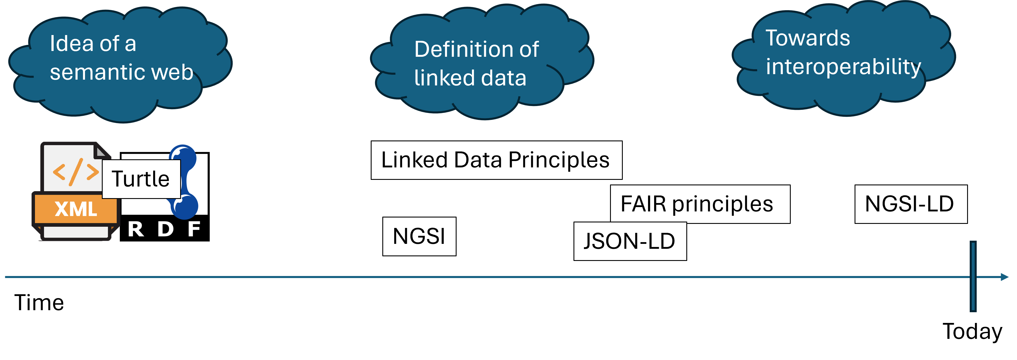
DT Data - A brief history
Simplified technology history

Slide 16
NGSI-LD (Next Generation Service Interface – Linked Data)
Evolution of NGSI v2, powered by FIWARE
Defines a metamodel and APIs (Swagger URL) for property graphs
“id” now must be an URN (or an URI HTTP)
The entity must have a “type” attribute which represent the class of the entity
The class must then be defined in the @context
@context implicitly includes the core @context of NGSI-LD:

Slide 17
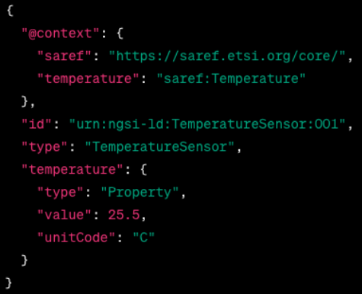
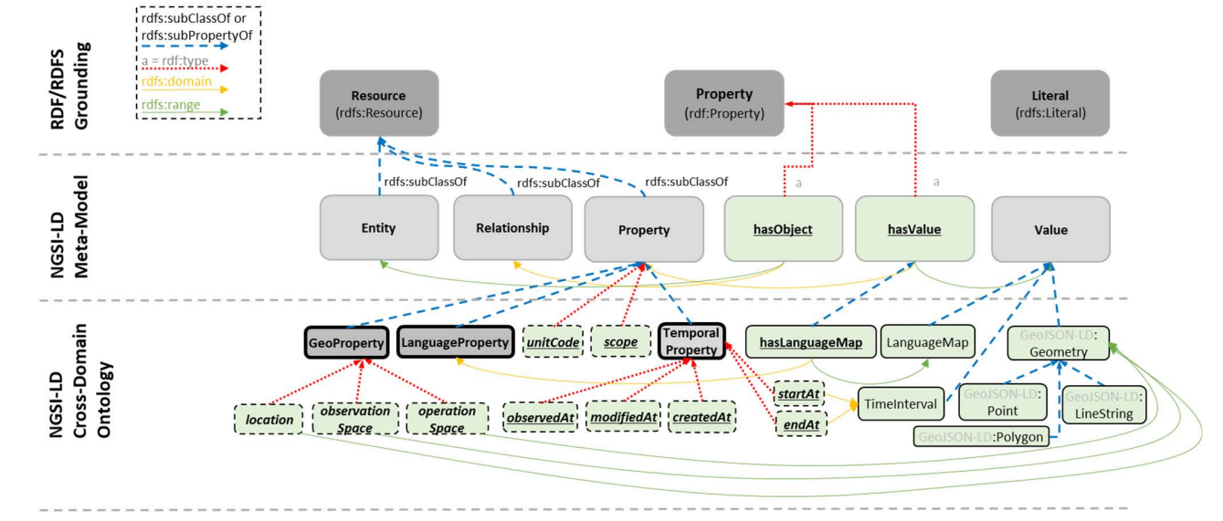
NGSI-LD Metamodel
NGSI-LD Entity Example

Slide 18
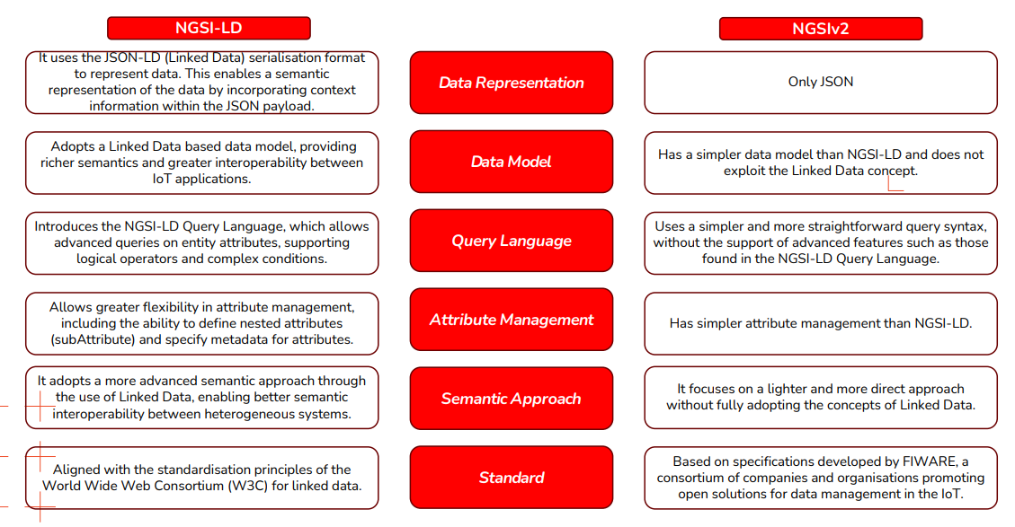
NGSI-LD vs. NGSIv2
Comparison NGSIv2 - NGSI-LD

Slide 19
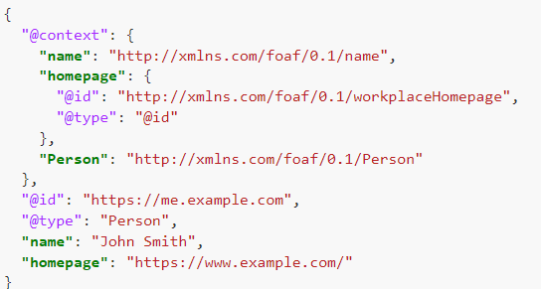
JSON-LD
Make JSON machine-readable again!
Defined to merge semantic data and commonly used JSON documents
Standard for encoding linked data
FIWARE is evolving as well… (Orion-LD)
JSON-LD Example

Slide 20
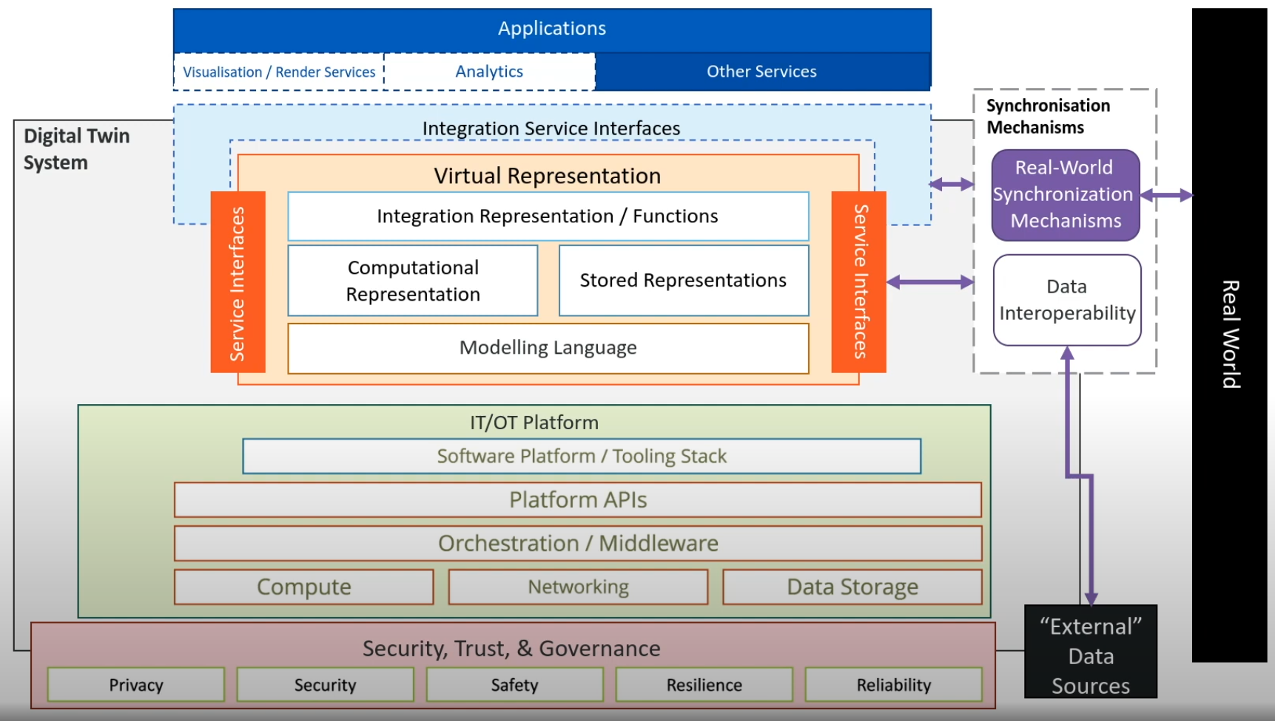
DT Data - Architectures
Most papers don’t even mention it!
When they do, they focus on entities last-state.
Is it really different from a Lambda-like big data architecture?
e.g. Digital Twin Consortium
Digital Twin Consortium Architecture

Slide 21
DT Data - Lifecycle
Something is starting to pop out
“Trash” literature ? (non IT academics, e.g. Dihan et. al., 2024)
Are we reinventing the wheel?

Slide 22
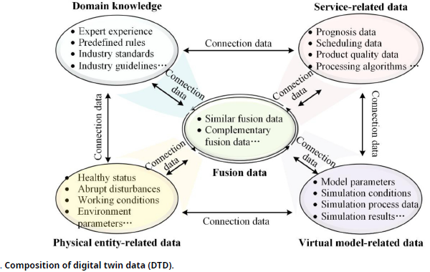
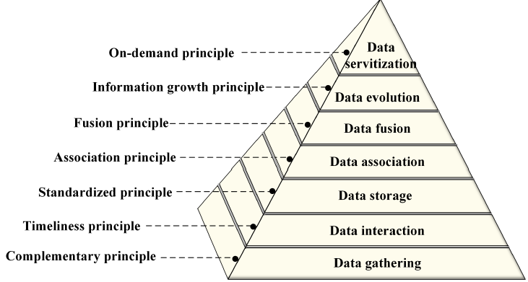
Digital Twin Data (Fei, Tao 2023)
Data Methodology (Fei, Tao 2023)

Slide 23
What next?
Data Architectures
Focus on historical data
Digital Twins Platforms (!!!)
Data modeling (on two different abstraction levels)
Meta-Models for historicized data in a DT (domain driven?)
Standardazing a wider concept (e.g. interoperability between different DT)
Methodology
Watering Digital Twin
P.h.D. Proposal timeline

Slide 24
Carbonaro 17/09
Loro usano property-knowledge graph
Open word assumption: solo in AND …
CONSTRUCT (è quello che utilizzo per le “implementedBy”)
Hanno necessità di separare ciò che è corrente e ciò che è passato.
SWRL + SPARQL
Utilizzano GraphDB (hanno provato)
Dov’è il confine tra ciò che è nuovo e ciò che è passato? Tradeoff tra quanto velocemente cambiano le cose? Un sensore che cambia ogni 10ms non posso storicizzare.

Slide 25
Benchmark workload
Aspects
Dimensions
Spatial
Temporal
Workload:
Operational
Analytical
Mode:
Online (?)
Offline (?)
From IoTAbench, ICPE 2015
Total readings: counts the total number of readings (i.e., rows) for the given time period.
Total consumption: sums the resource consumption for the given time period.
Peak consumption: Create a sorted list of the aggregate consumption in each ten minute interval in the given time period.
Top consumers: create a list of the distinct consumers, sorted by their total (monthly) consumption.
Time of Usage Billing: calculate the monthly bill for each consumer based on the time of usage.
From SmartBench, VLDB 2020
IoTABench data model

Slide 26
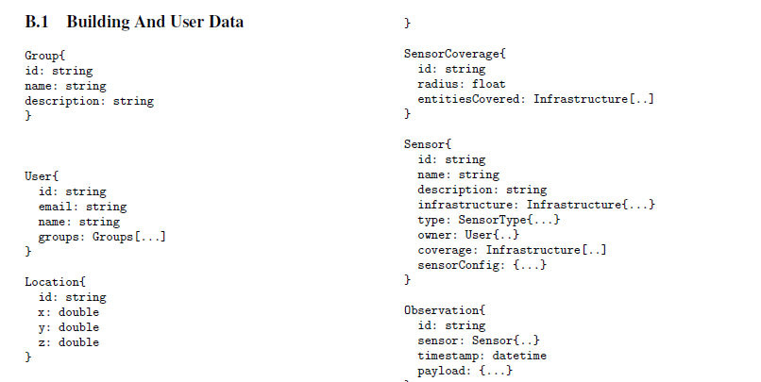
Coverage (s ∈ Sensors): returns the location of a given sensor s.
InverseCoverage(L, τ), where L is a list of locations, and τ is a sensor type: lists all sensors that can generate observations of a given type τ that can cover the locations specied in L.
Observations (S ∈ Sensors, $t_{b}$, $t_{e}$): selects observations from sensors in the list of sensors S during the time range [$t_{b}$; $t_{e}$].
C Observations (τ , cond, $t_{b}$, $t_{e}$): selects observations generated by sensors of given type τ in the time range [$t_{b}$; $t_{e}$] that satisfy the condition cond.
Statistics(S ⊆ Sensors, A, F, $t_{b}$, $t_{e}$): retrieves statistics (e.g., average) based on functions specifed in F during the time range [$t_{b}$; $t_{e}$]. The statistics are generated by firstrst grouping the data by sensor, and further by the value of the attributes in the list A
Trajectories($t_{b}$, $t_{e}$, $l_{b}$, $l_{e}$): retrieves the names of users who went from location $l_{b}$ to location $l_{e}$ during the time interval [$t_{b}$; $t_{e}$]
CoLocate($u$ ∈ Users, $t_{b}$, $t_{e}$): retrieves all users who were in the same Location as user $u$ during the specifoed time period.
TimeSpent($u$ ∈ Users, η, tb, te): retrieves the average time spent per day by subject $u$ in locations of type η,
Continuous Query(τ, α, β): retrieves, after every α seconds (hop size), the minimum, maximum, and average occupancy levels of locations of type τ in the last β seconds (window size).

Slide 27
Other benchmarks
Spatial DB
The SEQUOIA 2000 Storage Benchmark, SIGMOD 1993
Building a ScalableGee-SpatialDBMS: Technology, Implementation,and Evaluation SIGMOD 1997
Time Series DB
TS-Benchmark: A Benchmark for Time Series Databases, ICDE 2021
SciTS: A Benchmark for Time-Series Databases in Scientific Experiments and Industrial Internet of Things, International Conference on Scientific and Statistical Database Management 2022 (SSDBM)
TSM-Bench: Benchmarking Time Series Database Systems for Monitoring Applications, VLDB 2023
Spatio-Temporal
BerlinMOD: A benchmark for moving object databases, VLDB Journal 2009
Benchmarking moving object functionalities of DBMSs using real-world spatiotemporal workload, International Conference on Mobile Data Management 2022
Performance Evaluation of MongoDB and PostgreSQL for spatio-temporal data, EDBT/ICDT Workshops 2019
How to manage massive spatiotemporal dataset from stationary and non-stationary sensors in commercial DBMS?, Knowledge and Information Systems 2024

Slide 28
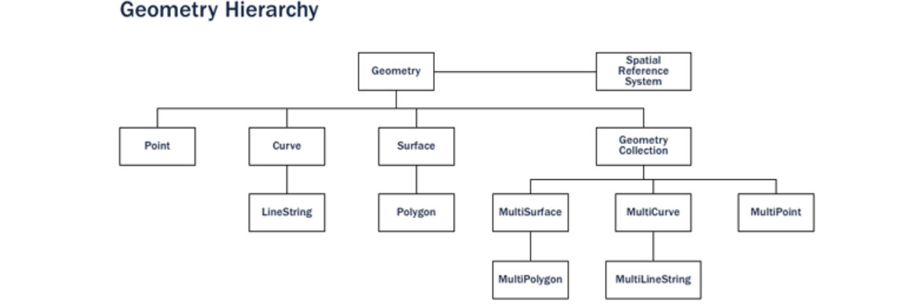
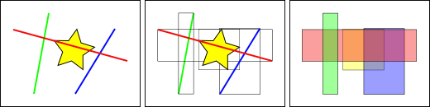
PostGIS
Spatial Functions
Routing. With pgRouting and road data you can find optimal routes and do different network analytics;
Polygon skeletonization. This function enables you to build the medial axis of a polygon on the fly;
Geometry subdivision. Dividing your geometries for further processing can significantly speed up your processes;
Clustering. Find clusters and patterns from your data. With the AI hype at peak, the k-means might be even more interesting for some than before…
Indexing
Indexes have to perform quickly in order to be useful. So instead of providing exact results, as B-trees do, spatial indexes provide approximate results. The question “what lines are inside this polygon?” will be instead interpreted by a spatial index as “what lines have bounding boxes that are contained inside this polygon’s bounding box?”
The most common implementations are the R-Tree and Quadtree (used in PostGIS), but there are also grid-based indexes and GeoHash indexes implemented in other spatial databases.
The way the database efficiently answers the question “what lines intersect the yellow star” is to first answer the question “what boxes intersect the yellow box” using the index (which is very fast) and then do an exact calculation of “what lines intersect the yellow star” only for those features returned by the first test.
PostGIS Geometry Hierarchy
BBox Example

Slide 29
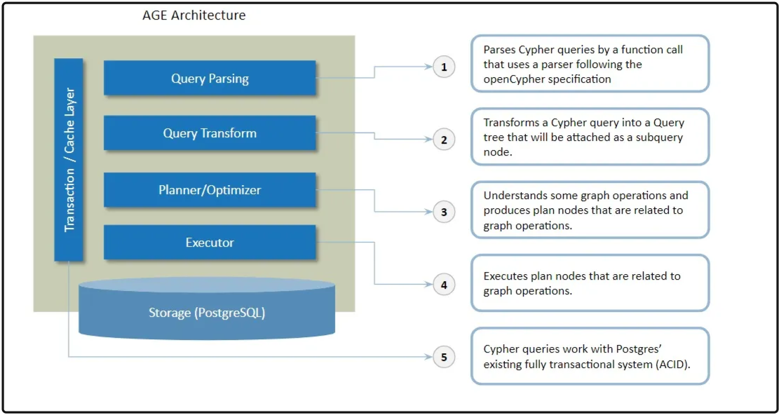
Apache AGE
Extends PostgreSQL with graph semantics
No graph data model!
Wrapper upon PostgreSQL relational storage
A table for each node/vertex label
Setup
Create and load AGE extension
CREATE EXTENSION IF NOT EXISTS age; LOAD 'age';
Allow user access to such path
SET search_path = ag_catalog, "$user", public;
Create a node A
SELECT * FROM cypher('test_graph', $$ CREATE (:label {property:"Node A"}) $$) as (v agtype);
Create a node B
SELECT * FROM cypher('test_graph', $$ CREATE (:label {property:"Node B"}) $$) as (v agtype);
Create an edge between node A and node B
SELECT * FROM cypher('test_graph', $$ MATCH (a:label), (b:label) WHERE a.property = 'Node A' AND b.property = 'Node B' CREATE (a)-[e:RELTYPE {property:a.property + '<->' + b.property}]->(b) RETURN e $$) as (e agtype);
Select those edges
SELECT * from cypher('test_graph', $$ MATCH (V)-[R]-(V2) RETURN V,R,V2 $$) as (V agtype, R agtype, V2 agtype);
Apachce AGE under the hood architecture

Slide 30
Spatio Temporal DBMS
A Survey on Spatio-temporal Data Analytics Systems, ACM Surveys 2022
Categorizes spatio-temporal DBMSs in groups:
Spatial DBMS:
RDBMS
No-SQL DBMS
Big data spatio-temporal processing infrastructures
Hadoop based infrastructures
Spark based infrastructures
No-SQL infrastructures
Programming languages
DASK
RAPIDS
Spatial DBMS

Slide 31
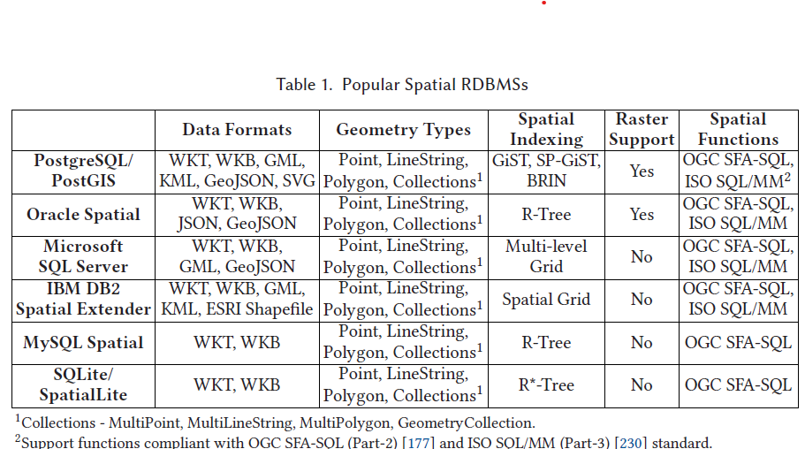
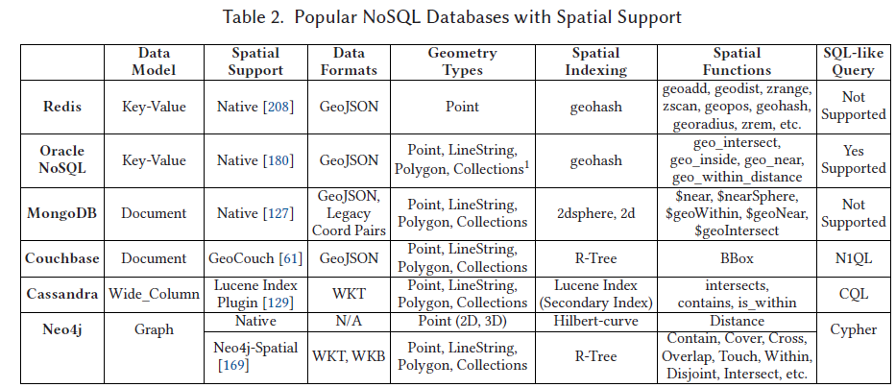
RDBMS
Due to the I/O bottleneck, lack of parallelism and scalability, the performance of these systems deteriorated with the increasing volume of data.
PostgreSQL -> PostgresXL
MobilityDB was developed as an extension of PostgreSQL/PostGIS, providing support for storing and querying moving objects data (trajectory). This support includes spatio-temporal data types, indexing techniques, and query operations. Recently, MobilityDB emerged as a distributed system by integrating with Citus for processing massive trajectory data
No-SQL DBMS
Currently, the spatial support of NoSQL databases lacks available spatial operations compared to spatial RDBMSs.
Taxonmy of RDBMS for spatio-temporal data
Taxonmy of No-SQL DBMS for spatio-temporal data

Slide 32
RDBMS vs NoSQL for Spatial Data
Performance Evaluation of MongoDB and PostgreSQL for Spatio-temporal Data, EDBT/ICDT Workshops 2019

Slide 33
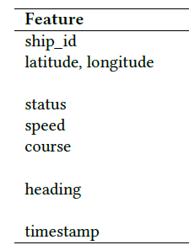
Dataset Size
11 GB, 43 288 vessels, 146.491.511 records
MongoDB: 116 GB
PostgreSQL: 32 GB
Dataset Schema

Slide 34
MongoDB stores data in GeoJson format, each record has many extra characters + unique auto created ObjectId. PostgreSQL ingests data as CSV, with adding the_geom column that contains the POINT geometries for latitude and longitude.
Results
The results show that PostgreSQL with the PostGIS extension, outperforms MongoDB in all queries.
Big spatio-temporal data processing infrastructures

Slide 35
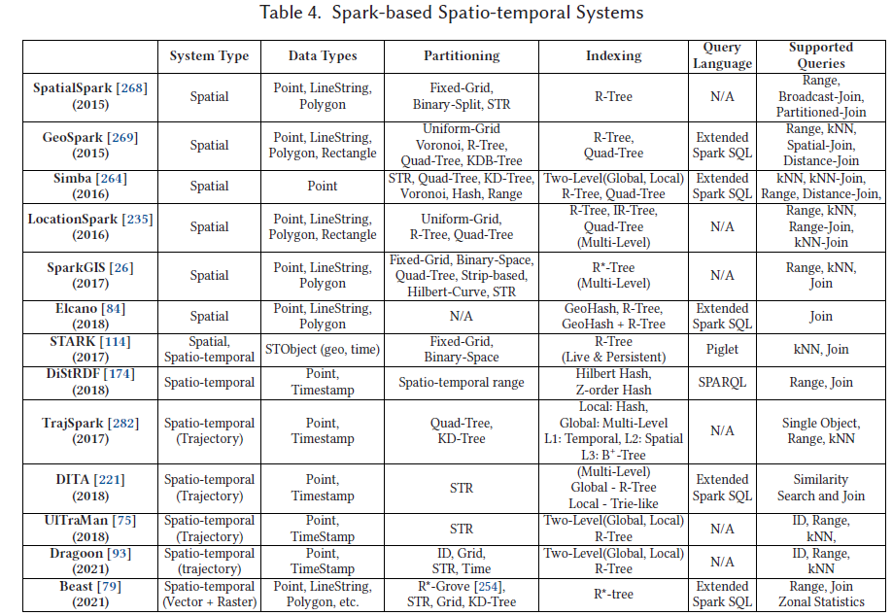
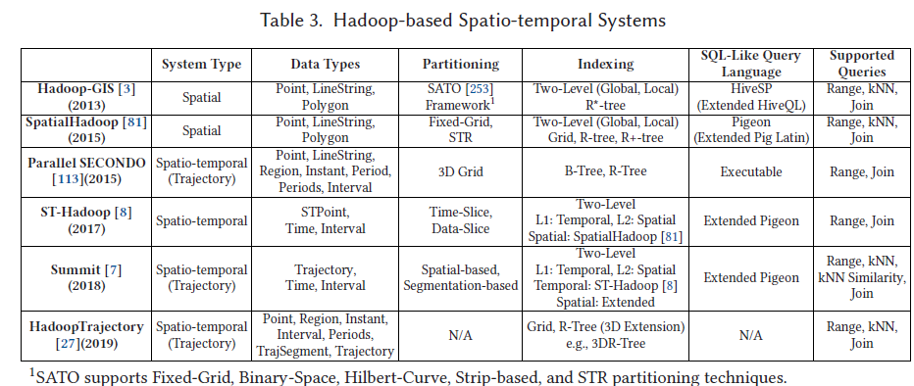
Hadoop based
Due to the lack of spatio-temporal data types, partitioning, and indexing techniques, Hadoop-GIS & SpatialHadoop suffer querying spatio-temporal datasets
ST-Hadoop was developed by considering attributes of discrete spatio-temporal point data, not trajectory data. So data might be wrong-sharded when indexed.
Summit is an extension of ST-Hadoop to include data types, partitioning and indexing techniques, and operations, for processing trajectory data.
Bakli et al. [27] have proposed HadoopTrajectory, which adds a diverse set of data types and operators into the core of Hadoop to store and process trajectory data.
Spark-based
First five spatial data processing solutions are not fully compliant with the ISO standard and OGC specifications.
STARK integrates spatio-temporal support to Spark RDDs
DiStRDF is a distributed system for processing spatio-temporal RDF data; however, these last two focus on discrete data points and not trajectories.
TrajSpark does not have any support for SQL-like queries.
UITraMan has added an off-heap key-value store, Chronicle Map
Among TrajSpark, DITA, and UITraMan, only TrajSpark alleviates the overhead of repartitioning the whole dataset when a new batch of dataset arrives. Thus, TrajSpark achieves near real-time trajectory processing capability. Besides, this newbatch of data is loaded as RDDs in Spark, which are immutable, and any updates on RDD create a new RDD, which is costly.
Dragoon [93] is a hybrid system for processing both historical (offline) and streaming (online) trajectories. The offline module of Dragoon is similar to UITraMan, but Dragoon has utilized Chronicle Map in such a way that it works for both historical and streaming trajectories.
All these systems are for processing vector spatial and spatio-temporal data. None of these systems has support for raster data except Apache Sedona.
Beast supports both vector and raster data with multidimensional data types and partition and index structures.
Taxonmy of Hadoop based systems for spatial data
Taxonmy of Spark based systems for spatial data

Slide 36
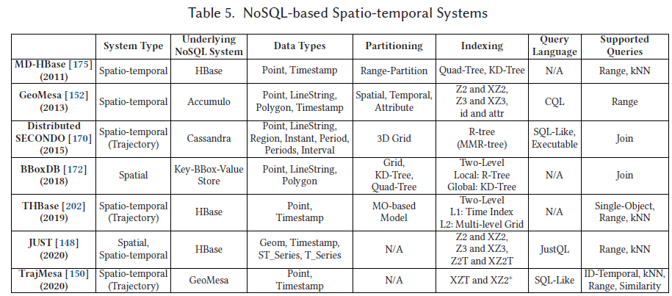
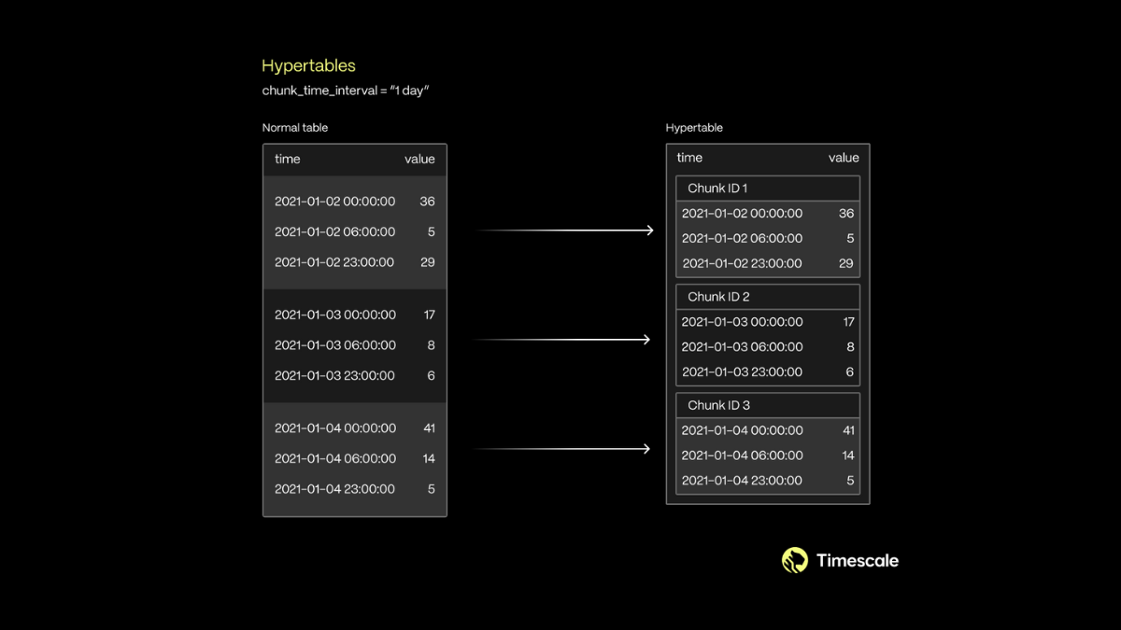
Big spatio-temporal data processing infrastructures
NoSQL based
GeoMesa linearizes the keyspace by transforming multi-dimensional data (location, timestamp) into 1D keys using space-filling curves.
JUST incorporates leverages HBase, GeoMesa, and Spark. Introduces two new indexing techniques, Z2T and XZ2T and efficient compression mechanism that improves the query performance significantly.
TrajMesa, horizontal storage schema (H-Store) is proposed. Allowing to store an entire trajectory in one-row with compression.
Recent literature
SpaceTimeDB (commercial, (?))
Springbok, ICDE 2024
CUPID, Future Generation Computer Systems 2024
TMan, ICDE 2024
Other Research Trends
ML for query optimization
Spatial Query Optimization With Learning, VLDB 2024
Indexing
A Time-Identified R-Tree: A Workload-Controllable Dynamic Spatio-Temporal Index Scheme for Streaming Processing, International Journal of Geo-Information 2024
A case study for Digital Twins
Graph + TimeSeries (Apache AGE + PostgreSQL + PostGIS + Timescale)
MobilityDB (PostgreSQL + PostGIS + trajectory data support)
Beast
CUPID
Springbok
Case study 0 - Apache Age + TimescaleDB + PostGIS
Emerged considerations
Given a FIWARE document, what’s a Property and what’s an Edge? - It’s an edge if it links to an NGSI URN
Should the graph enforce some kind of schema? E.g. metamodel - I beleve so but dunno
If not, Do I have to check wether a FIWARE key-value pair links to a node?
But then, I have to check all properties, understand if its an edge or a property, remove it from the entity if it’s an edge, check if the edge destination already exists and if it does not, create it and link it to the source node-
What about device composition? e.g. moisture grid
What about Ids? Apache AGE uses its own custom IDs that cannot be disabled
What happens when a new measurements comes by?
I have to check if such node exists, if not, it’s a new edge, if it is
An entity comes in: there’s already a node with such id; is it an update? Is it a measurement?
Modellazioni Measurement
AgriRobot non è un device, come capisco se qualcosa ha dei measurement da storicizzare?
Agri robot non storicizza le controlled property, come faccio a capire cosa devo storicizzare?
Problemi sui dati
I dati dei pinotech hanno il dateObserved sbagliato (“Z” alla fine della data)
Per creare un arco, devo prima avere entrambi i nodi altrimenti non funzia
Age Middleware
Builds a connection to a Apache Age + PostGIS + Timescale DBMSs.
Processes JSON entities following the NGSI schema.
Entity required schema
“id”: follows the NGSI standard (urn-ngsi-[…]) and define the existence of an entity in the graph
“type”: defines the label of the node/edge in the graph.
Entity optional schema
“hasDevice”: defines device composition. Each value of this key needs to be a json representing an entity.
Building the graph
Each distinct entity (unique “id”) gets mapped into the graph as a node.
Each entity key that has an ID as a value becomes an edge with the key as the edge label.
If an entity with the given “id” exists, update such entity in the graph
Parsing into measurement
Measurement = TimescaleTable(timestamp, device_id, controlledProperty, value, raw_value)
A mapping can defined for each entity “type”: it’s a Python functions that extracts the measurements from a JSON entity with the Measurement table structure
Environment setup
CREATE EXTENSION IF NOT EXISTS age; CREATE EXTENSION IF NOT EXISTS postgis; LOAD ‘age’; SET search_path = ag_catalog, “$user”, public;
CREATE TABLE measurements( timestamp timestamp, device_id text, controlled_property text, location geometry, value float, raw_value text ) SELECT create_hypertable(‘measurements’, ‘timestamp’);
ALTER TABLE measurement ADD PRIMARY KEY(timestamp, device_id, controlled_property)
CREATE INDEX location_index ON measurements USING GIST (timestamp);
Problematiche
Tre cause delle problematiche: - Modellazione concettuale (e.g. no tipo di device in measurements) - Architetturale (Apache Age) - Ottimizzazione query (e.g. no tabella location ausiliaria)
Espressività
Mancanza di un’interfaccia uniforme sul modello, devi interfacciarti e integrare due tipologie di modelli dati diversi
No storicizzazione di ciò che non è measurement
Modellazione
Se parti dal grafo arrivi ad un punto in cui joini sul relazionale, va fatta attenzione alla query su grafo in quanto è molto facile ritorni un insieme di valori ridondanti che fanno esplodere il tempo computazionale
Cosa succede sul grafo se il nodo esiste già? Lo aggiorno, ma in che modo? Sovrascrivo il vecchio? Aggiungo le diff? E le diff in negativo vanno tolte? Cosa succede ai suoi archi? Se nella nuova versione non vedo un arco?
Random considerations (constantly updated)
Timescale DB
Based on hypertables:
Logical table
Organizes the data in chunks (of a predefined time range) based on some time/bigint column of the table
Other columns can be added in partitioning columns
Support for distributed hypertables
Supports a large set of PostgreSQL extensions (e.g. PostGIS, PostGIS_Raster)
Query language
Taxonmy of NoSql based big systems for spatial data
Table organization in chunks

Slide 37
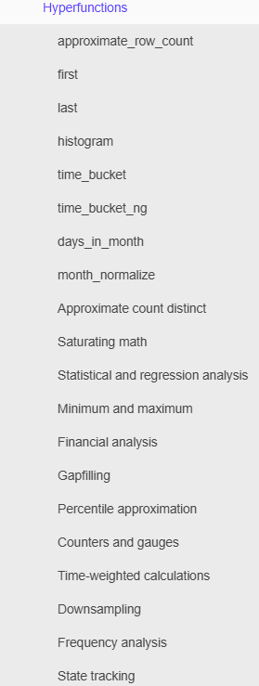
Uses standard SQL with a more operators/functions:
time_bucket(‘1 hour’, column_name): same as date_trunc in PostgreSQL but with custom granularity
…
Hyperfunctions:
Time-weighted averages;
Percentile approximation;
Hyperfunctions list

Slide 38
Further functionalities

Slide 39
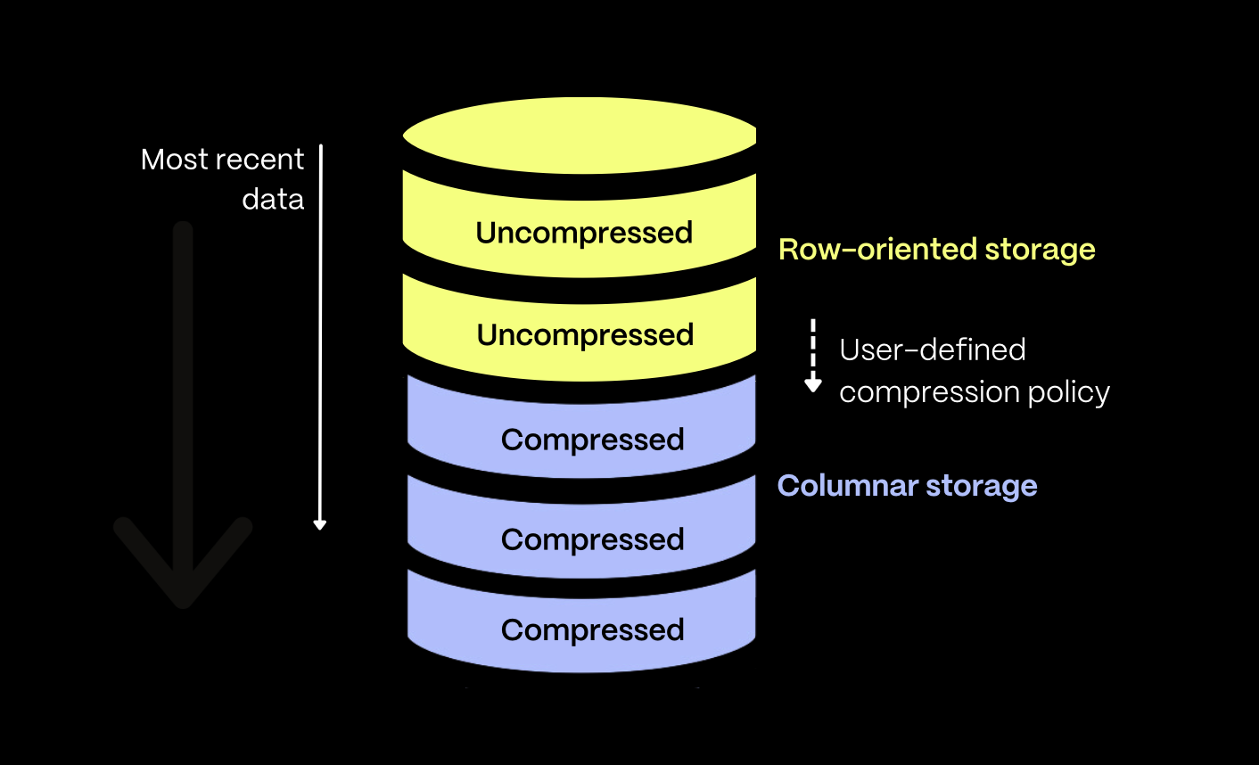
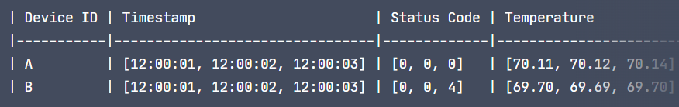
Hybrid row-column oriented data model: define a retention period where data older will be stored as column-oriented data.
Column-Oriented data can still be performed DML/DDL operations upon.
Hybrid model optimizations
segmentby: partion data inside chunk on [column1, …]
orderby: orders data within a chunk based on time and stores metadata w.r.t min/max values in the chunk (similar to Databricks data-skipping)
Together: data is first grouped by the segmentby column, then ordered based on the orderby parameter, and finally divided into smaller, timestamp-ordered “mini-batches,” each containing up to 1,000 rows.
Timescale hybrid model
Segmentby example - partition by device id

Slide 40
Further functionalities
Continuous aggregates
Automatically (in background) maintain the results from the query.
Refreshed automatically in the background as new data is added, or old data is modified.

