Slide 1
Towards a Process-Driven Design of Data Platforms
Matteo Francia, Matteo Golfarelli, Manuele Pasini
{m.francia, matteo.golfarelli, manuele.pasini} @unibo.it
25/03/2024

Slide 2
Introduction
A data platform is an infrastructure that facilitates the ingestion, storage, management, and exploitation of large volumes of heterogeneous data
Centralized collection of independent and well-integrated services meeting the end-to-end needs of data pipelines
Centralized: a data platform is conceptually a single and unified component
Independent: changes in a a service do not affect others
Well-integrated: services have interfaces enabling a frictionless composition
End-to-end: services cover the entire data life cycle

Slide 3
Data platforms for analytics
Data analytics nowadays mostly rely on cloud infrastructures
⇒ Data Platforms (DP) can be built on top of cloud infrastructures as facilitators of such analytics
⇒ Cloud DP are usually built out of service ecosystems offered by Cloud Service Providers (CSPs)
Research question: given an ecosystem of services, which is the optimal subset enabling a data platform?
Some of the AWS Services
Some of the AWS Services

Slide 4
Challenges in building data platforms
Answering this question is hard since:
Each CSP offers services with overlapping functionalities
CSPs offer different service categorizations that can hardly be mapped together
Evolution of cloud ecosystems is fast and it is difficult to keep up with the pace
Third parties can publish their own services on marketplaces (e.g., AWS Marketplace)

Slide 5
Some of the AWS Services
Some of the AWS Services
Some of the Google Cloud Platform Services
Some of the Google Cloud Platform Services

Slide 6
Design of data platforms
The design of data platforms is mainly left to the expertise of practitioners in the field
Choosing the optimal set of services is hard since multiple solutions could fulfill the desiderata
it requires deep knowledge of CSPs’ ecosystems
… and requires vertical knowledge on the design of data pipelines
Several abstract big data architectures are available (e.g., NIST, Lambda, and Kappa).
They provide the necessary functionalities for big-data applications but not their implementation

Slide 7
Process-driven design
The description of data-driven processes should drive such activity
Data pipelines are the backbone of a data platform encode many constraints on the choices to be made
… and outline data flows!
Research goal: methodology to aid designers in selecting the services necessary to implement clients’ data pipelines out of the “unstructured” lists of services from CSPs
Methodology for the Design of Data Platforms
Methodology for the Design of Data Platforms
Three types of users (stakeholders):
Cloud service providers: IT experts with in-depth knowledge of services ecosystems
Designers: people with expertise in designing data flows but with no vertical knowledge on service ecosystems
Clients asking for the design of the data platform blueprint

Slide 8
(1) Define the service ecosystem
CSP identifies una tantum

Slide 9
The services to compose the blueprint of the data platform
Not necessarily all of them…
… but they must cover the “basic” functionalities for a data platform such as the ones from NIST!
The taxonomy of tags that characterize such services
Bottom-up feeding: built out of the experience of the CSP and/or automatically extracted using NLP algorithms
Top-down feeding: from the literature (e.g., Vs of big data)

Slide 10
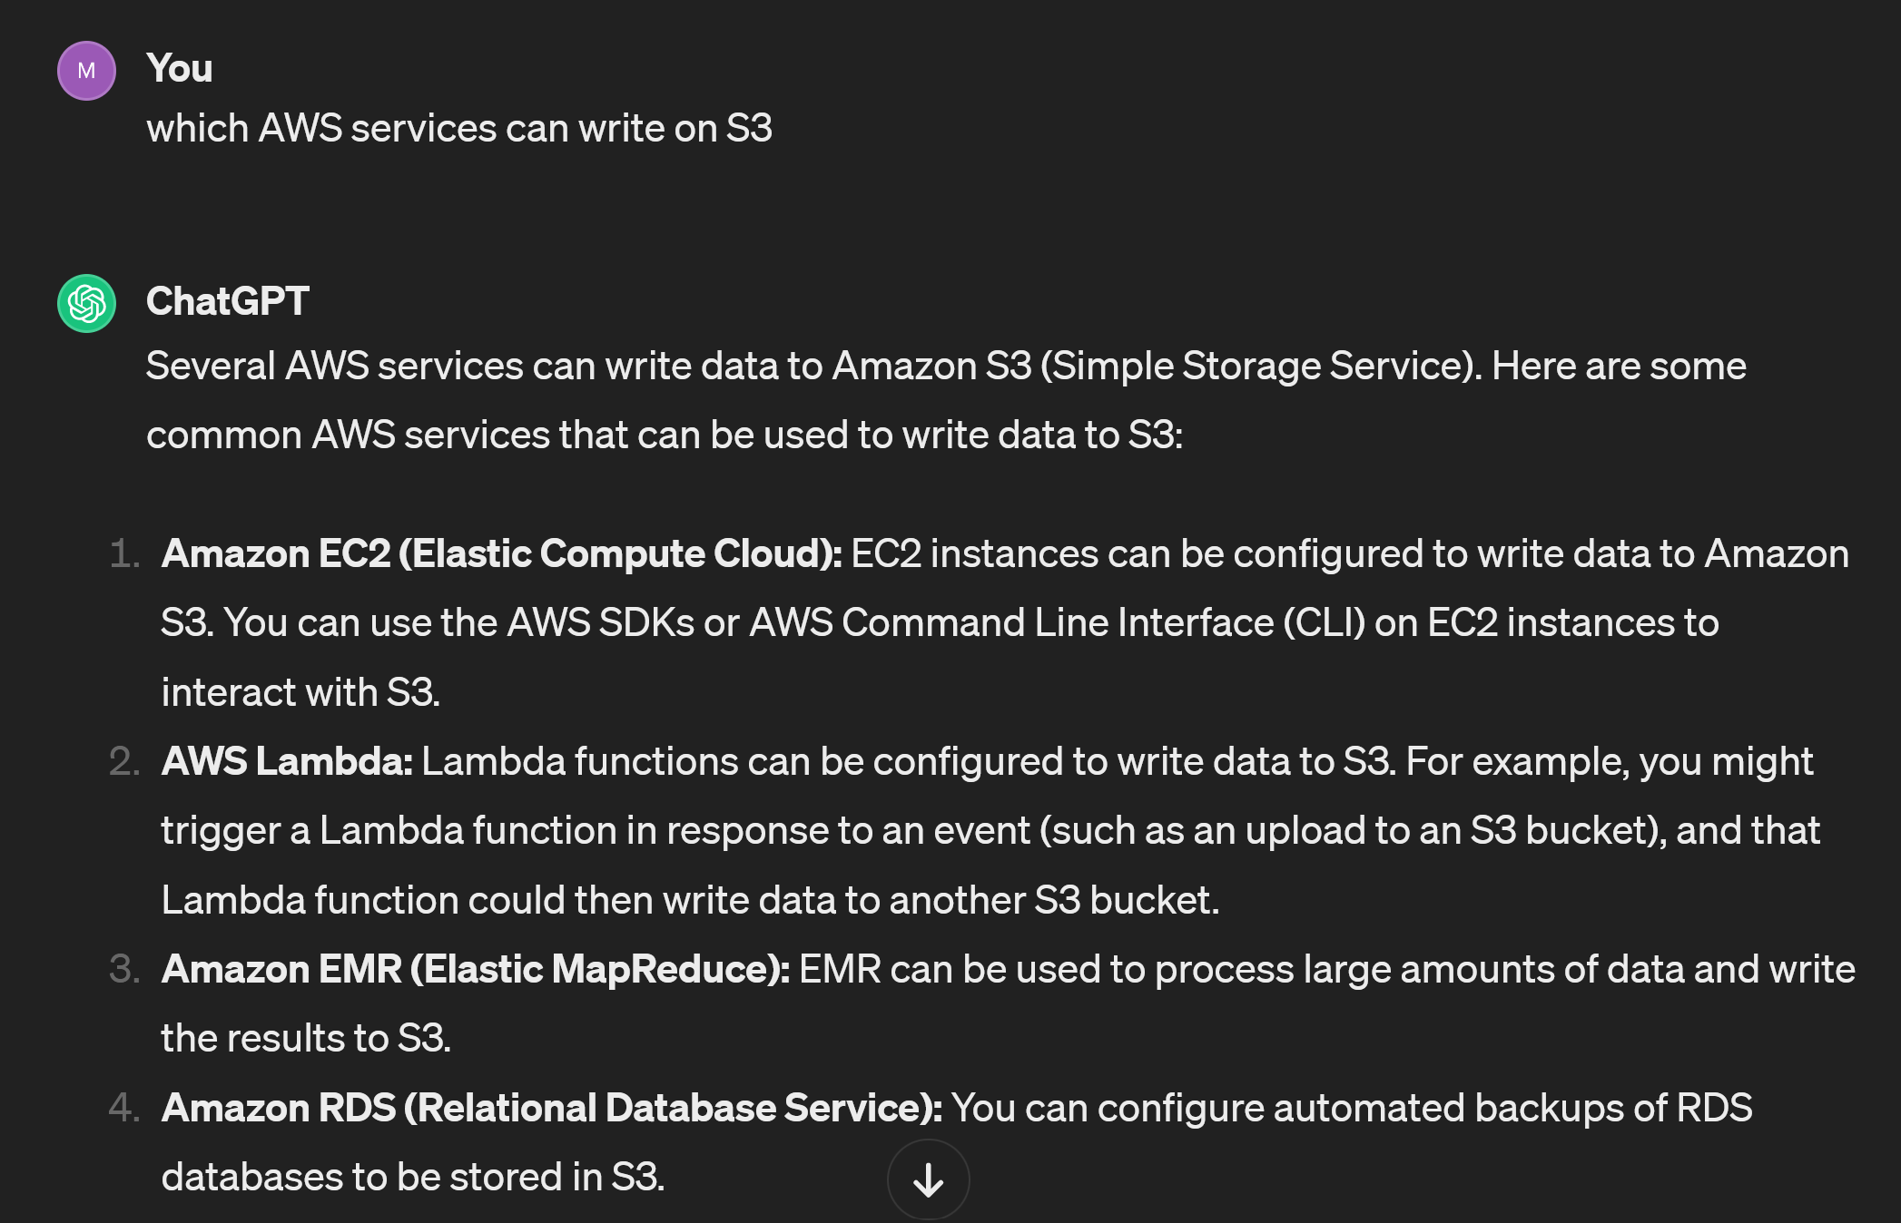
“Alternative” bottom-up feeding
Using ChatGPT

Slide 11
Service graph
Services are organized in a directed property service graph
A directed property graph is a tuple $G=\left(N,A,P,L\right)$ where
$N=\{...,n_{i},...\}$ is a set of nodes
$A=\{...,a_{ij},...\}$ is a set of arcs connecting nodes
$P=\{...,\left(h,v\right),...\}$ is a set of key-value properties
$L$ is a set of labels
Nodes are engines from the service ecosystem and are labeled as Service
Nodes can be labelled as preferred
Since CSPs do not provide identical engines, no services have the same tags
Arcs are alternatively labeled as {Requires, IsCompatible}
Requires: represents whether a service mandatorily relies on another
IsCompatible: represents whether a service natively interfaces with another
Example
Excerpt of service graph
Excerpt of service graph
IsCompatible: SageMaker natively R/W from/to Redshift
Requires: GeoServer requires EC2 since it is deployed on it

Slide 12
Input: clients’ questionnaries
Clients compile questionnaires about their processes and the main steps, subjects, and goals of their analysis
Example: deploy a data platform supporting analytic tasks from 8 clients within the Agritech European project
Excerpt of one of the workflows:
Data comes from soil moisture sensor grids, weather stations, and SENTINEL-2 satellites
Sensor and weather data is uploaded every 15 minutes, while satellite data is periodically downloaded
Soil moisture data is interpolated using mathematical and machine learning techniques
The interpolated data is stored in tables that include the positions of the sensors
Vegetation indexes are computed out of raw satellite observations and integrated with enriched sensor data
Reports are periodically generated out of enriched data
Given an optimal soil moisture matrix, the enriched data is used to decide how much to irrigate the soil

Slide 13
(2) Formalize the requirements
Designers refine the answers and formalize the processes into DFDs
A Data Flow Diagram (DFD) is a directed property graph $G^{D}$
Nodes are alternatively labeled as {Agent, Repository, Process}
Arcs are labeled as Flow
DFD represents flows of data at a high level of abstraction
Hide details such as decision points and interactions
Knowing which types of repositories/processes compose the processes is enough to return a blueprint
Decompose the data flows into agents, processes, and repositories
Start from an aggregated overview
Recursively split candidate processes/repositories until each of them is characterized by homogeneous tags
Example
DFD of the Agritech Case Study
DFD of the Agritech Case Study
Moisture Sensors streams data into the platform while Satellite images are periodically downloaded
Sensor Data and Raw Images cannot be grouped, they contain heterogeneous data types

Slide 14
(3) Enrich the DFD with service tags
Building our blueprint requires to match the DFD and service graphs
To do so, the two must share the same characterization
Each process and repository in the DFD is enriched with the tags from the previously identified taxonomy
To characterize them, clients answer an additional set of questions driven by the tag taxonomy
Example: given a repository from the DFD, designers ask the question: “What are the main types of collected data?”
☐ Sensor data
☐ Images
☐ Videos
☒ Satellite observations
☐ Tables
Answering “Satellite observations” tags the repository with the properties (Volume, Big), (Data Model, File), and (Data Nature, Raster) since earth observations are data-heavy files (e.g., around 1 GB for 100 $km^{2}$) and tags the process to download such data as (Collection, Pull) since files are downloaded from an FTP server.

Slide 15
(4) Match the DFD and service graphs
Since DFD and service graphs are characterized by the same taxonomy, we can automatically match them
A DFD process or repository matches (can be implemented by) a service only if the service has the same or more functionalities
If no match is found, we force it to a default (e.g., a VM where any functionality can be implemented)
Example: given the node Raw Images from the DFD where
$\begin{matrix}props\left(RawImages\right)=\{ & \left(DataModel,File\right),\left(DataNature,Raster\right)\}\end{matrix}$
and the nodes S3 and GeoServer from the service graph where
$\begin{matrix}props\left(GeoServer\right)=\{ & \left(DataModel,File\right),\left(DataNature,Raster\right)\} \\ props\left(S3\right)=\{ & \left(DataModel,File\right),\left(Volume,All\right)\}\end{matrix}$
Raw Images can be implemented by GeoServer but not in S3 since the former is natively capable of managing geographical raster images (while S3 would only provide storage for the images).

Slide 16
Matched graph
The matched graph is composed of the union of the nodes, and the union of the arcs plus additional arcs IsImplementedBy that represent candidate implementations for the DFD processes/repositories
Example
Matched graph
Matched graph
Consume can be implemented by either Lambda or Kinesis
Churn Prediction and Athena can be discarded a priori since they are not reachable (i.e., they are neither candidate implementations nor required by other services)

Slide 17
(5) Select the optimal services
Out of all matching services, only some of them must be selected
The amount of selected services is minimized
Coverage: all processes and repositories in the DFD must be covered
Dependency: if a service is selected, all its required services must be (recursively) selected too
Compatibility: a service is selected only if it is compatible with the services selected for the previous/following nodes in the DFD
Preference: preferred services should have more chances to be selected
This is a facility location optimization linear programming problem (available on Github w/ Python + CPlex library)
Given a matched graph $G^{M}=\left(N,A,P,L\right)$ e mini​wisis.t. si∈{0,1} ∀ni∈N,labelni=Servicesij∈{0,1} ∀aij∈A,labelaij=ImplementedBysj≥sij ∀sijj,labelaij=ImplementedBy,aij∈A​sij=1 ∀ni∈N,labelni∈{Process,Repository}sj≥si ∀aij∈A,labelaij=Requiressij+skh≤1 ∀aik∈A s.t. labelaik=Flow,ajh∉A s.t. labelajh=IsCompatiblewi=0.5 if Preferred,True∈propsni1.0 otherwise
Optimal blueprint
Services selected (in bold) for the blueprint of the data platform
Services selected (in bold) for the blueprint of the data platform

Slide 18
Conclusion and future works
The design of data platforms is a nontrivial task
We introduced a process-driven design methodology to aid designers in selecting the optimal services out of a service ecosystem
We have addressed such selection as a facility location optimization problem
Improvement in multiple aspects
Expressivenes: matching and selection should consider more complex architectural patterns (Lakehouse to replace both data lakes and warehouses) as well as support additional constraints (e.g., consider only some service vendors).
User evaluation: the produced blueprints should be compared with the ones recommended by expert designers.
Resource provisioning: a complete approach should also consider how many instances of a service are required (to do so, a cost model should be studied).
Metadata integration: while catalog and meta-data management services do not directly introduce functionalities for data transformation and exploitation, the design should also recommend services helping in the management of the platform itself.

Slide 19
Thanks!
Questions?

