Slide 1
CCHDO Netcdf files
Netcdf file format :
Conventions : COARDS/WOCE
WOCE_VERSION : 3.0
QC values
1 Not calibrated
2 Acceptable measurement
3 Questionable measurement
4 Bad measurement
5 Not reported
6 Interpolated over >2 dbar interval
7 Despiked
8 Not assigned for CTD data
9 Not sampled

Slide 2
CCHDO NETCDF Files
Parameters names and Quality Flags names
different for cruises :
pressure pressure_QC
temperature temperature_QC
or CTDTMP
salinity salinity_QC
oxygen oxygen_QC
or CTDOXY
Pressure CTDPRS_QC
Temperature CTDTMP_QC
Salinity CTDSAL_QC
Oxygen_CTD CTDOXY_QC

Slide 3
CCHDO Netcdf files
Cruise | Anomalies
ANAS5 Expocode=316N19810721 | station 159, pressure from 1 to 2257 dbar, then one value equal to 159 dbar, then from 1to 2189 dbar. QC_flag = 2
AR8 (year 1994) Expocode = 08PD0196_1 | All oxygen values are 0, and flaggued to 1, instead of 9
All the AR07W cruises | CTDTMP instead of temperature No flag
AR12_10 | CTDOXY instead of oxygen No flag quality
AR8 (year 1996) Expocode = 08PD0196_1 | Oxygen values (micromoles/kg) between 0.5 and 1.1 and flags = 2
AR07E Expocode=64PE20050907 | Oxygen = 0 and flags with abnormal values : 27851,311 ... TEMP and PSAL with QC-flag = 2 In the CSV files (ascii), data look correct.
AR15_N Expocode = 06MT41_3 | Interval between values : 10,100, 500 dbar : impossible to create files for NAARC

Slide 4
CCHDO Netcdf Files
ARS01 Expocode=33H420090506 Year 2009 | From a level, in a lot of files, salinity values = -9.99 and QC_ flag= 2 Oxygen values=-10 and QC_flags = 2
 | Error value different in different cruises : sometimes -999.0, sometimes -9.99, sometimes NaN

Slide 5
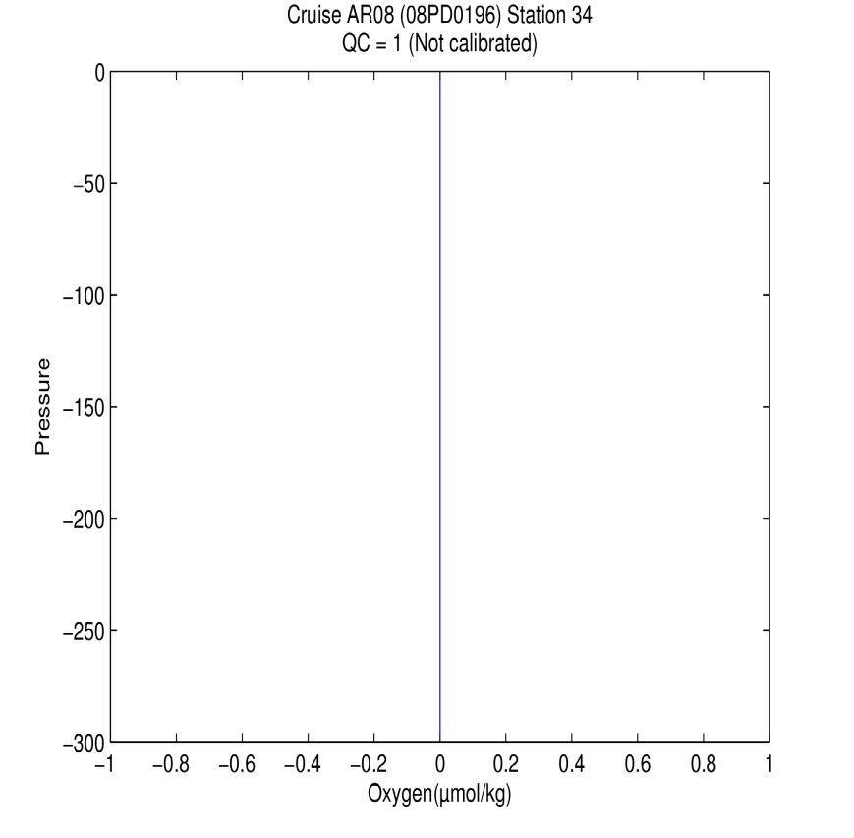
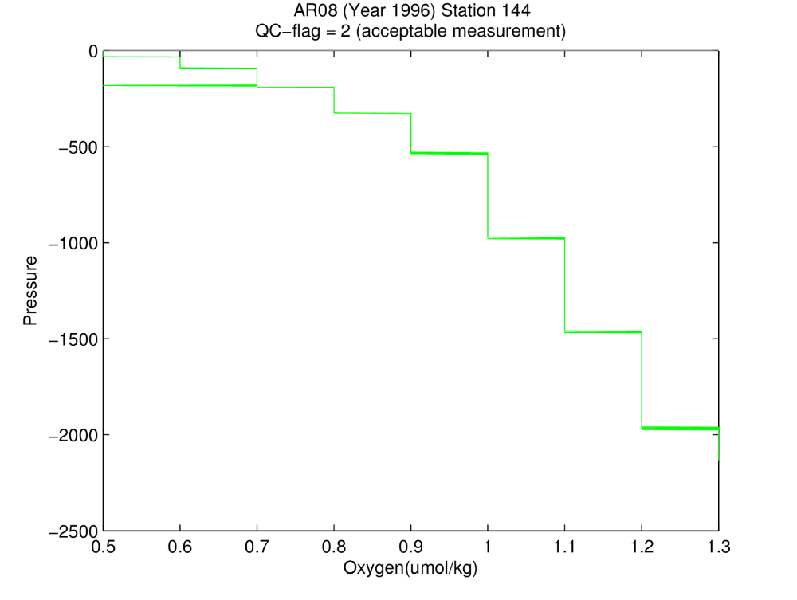
CCHDO Netcdf files

Slide 6
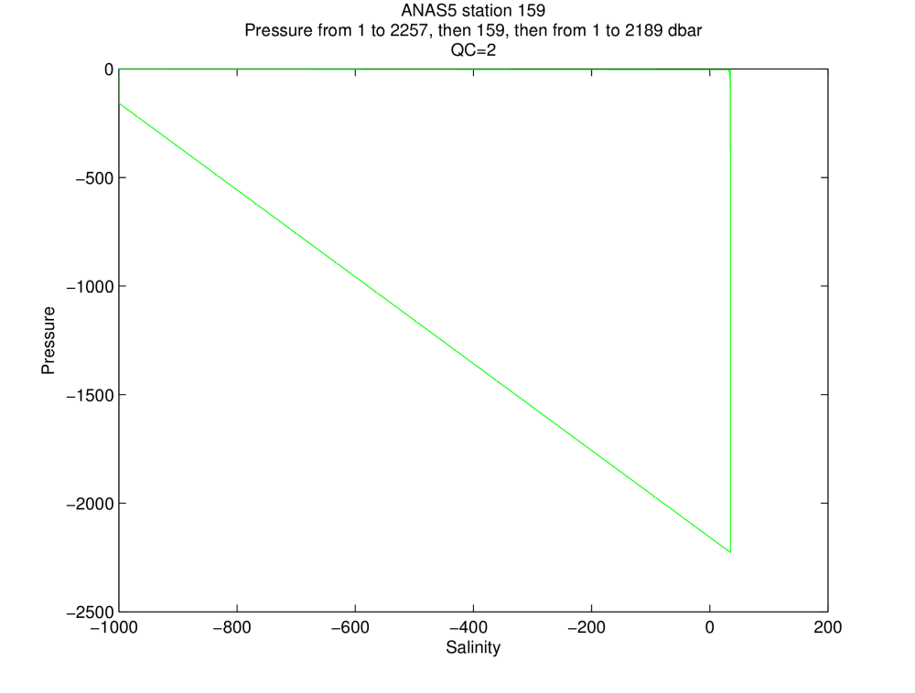
CCHDO Netcdf Files

Slide 7
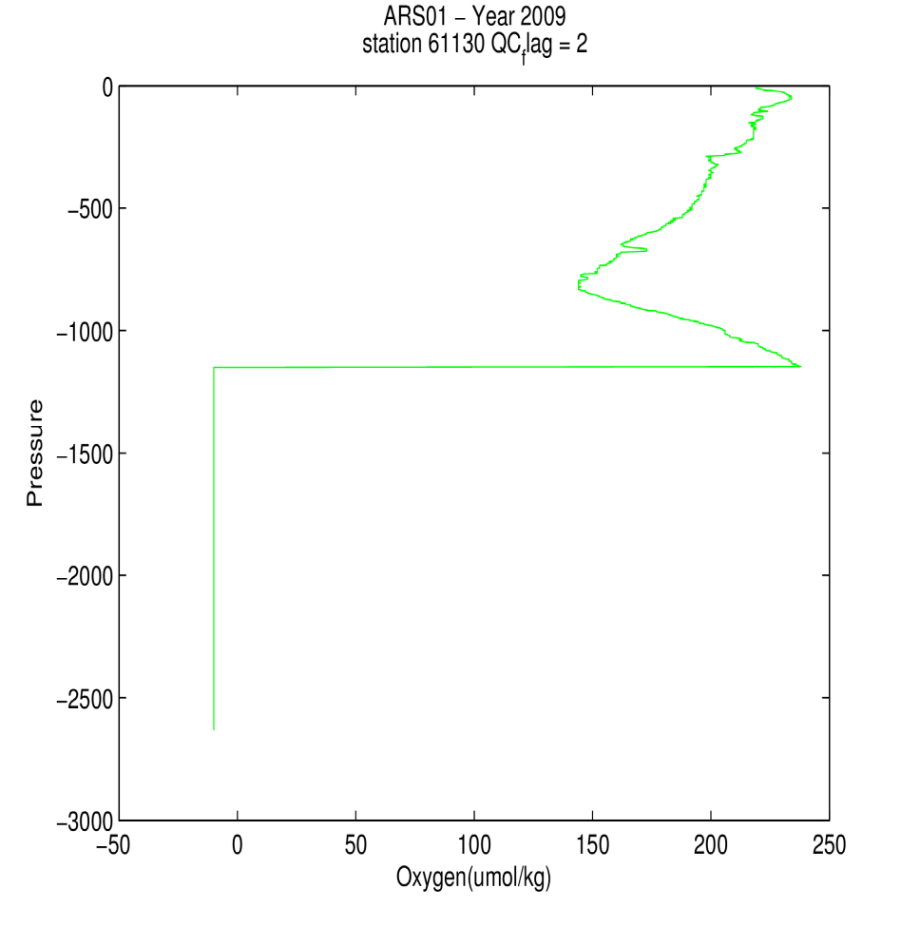
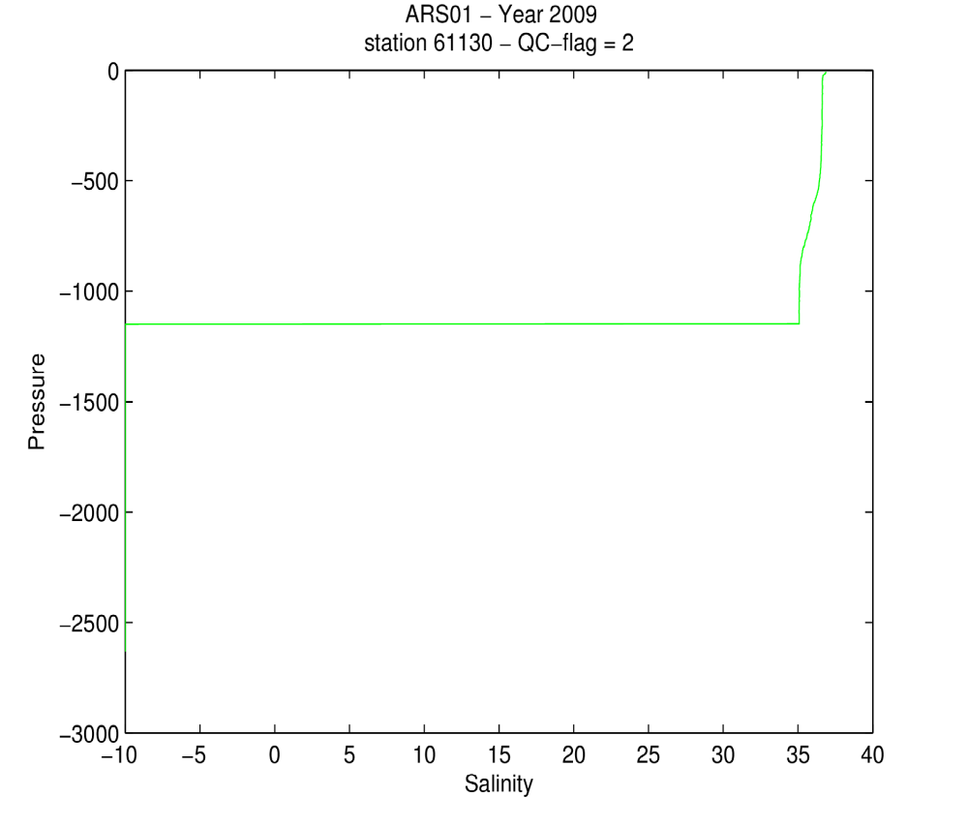
CCHDO Netcdf files

Slide 8
CCHDO CSV (Ascii) Files
Problems with the number and the type of parameters :
13 treated cruises : 7 different lists of parameters
Sometimes no QC, sometimes QC=0
In 2 cruises, header is longer (20 lines)
CTDPRS | CTDTMP | CTDSAL | CTDOXY |  |  |  | 7 cruises
THETA | CTDPRS | CTDTMP | CTDSAL |  |  |  | 1 cruise
CTDPRS | CTDTMP | CTDSAL | CTDOXY | CTDTMP2 | CTDSAL2 | CTDOXY2 | 2 cruises
THETA | CTDPRS | CTDTMP | CTDSAL | CTDNOBS |  |  | 1 cruise
CTDPRS | CTDTMP | CTDSAL | THETA |  |  |  | 1 cruise
CTDPRS | CTDOXY | EWCT | CTDTMP | NSCT | CTDSAL |  | 1 cruise

