Slide 1
ELECTRIC WATER HEATER
Represented to AMIT

Slide 2
AGENDA

Slide 3
Introduction
Electric water heater can be found in many systems, such as factories and in
smaller applications, we have chosen this topic to make our project for many
reasons as it’s easy to be developed and imported to a larger system, the main
function of system is clear and easy to obtained, also it will be a good way to
express what we have learned.

Slide 4
SYSTEM OVERVIEW
As mentioned earlier the system will be managed by a microcontroller, we choose High-performance, Low-power, RISC Architecture, Atmel AVR 8-bit Microcontroller Atmega32 with specs: 32Kbytes Flash memory, 1024Bytes EEPROM, 2Kbytes internal SRAM, 32 Programmable I/O Lines, 4.5V - 5.5V Operating Voltage, External and Internal Interrupt Sources, 8-channel, 10-bit ADC, Two 8-bit Timer/Counters and One 16- bit Timer/ Counters.

Slide 5
System contains:
Heater
Cooler,
Temperature sensor (LM35)
two seven segments
three Push buttons
three indication LEDs.

Slide 6
How the system works: - The System has 4 modes, STARTING STATE (when system is powered) OFF state (system is on sleep mode and isn’t working since System ON/OFF switch is pressed), ON STATE (System is working after System ON/OFF switch pressed) SETTING STATE (setting required temperature that microcontroller will control heater and cooler to obtain it).

Slide 7
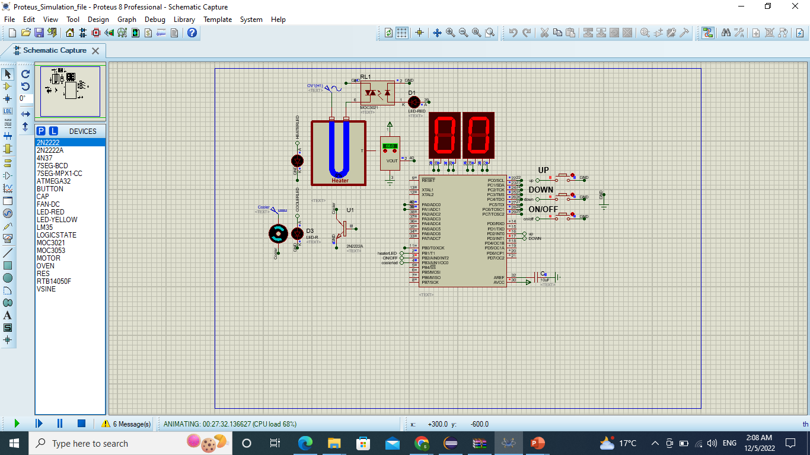
System Simulation

Slide 8
System FLOWCHART

Slide 9
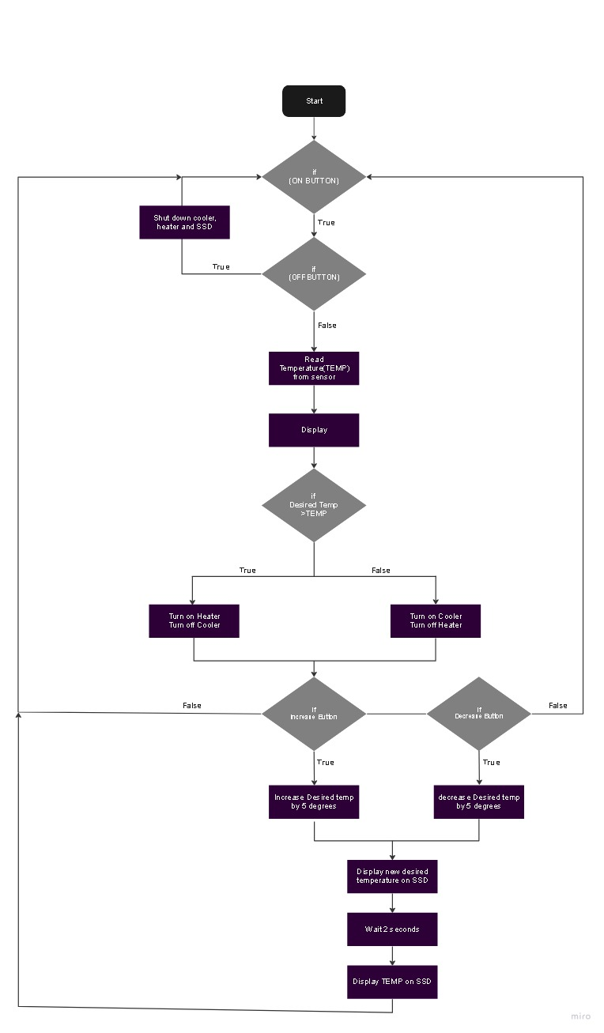

Slide 12
THANK YOU

