Slide 1
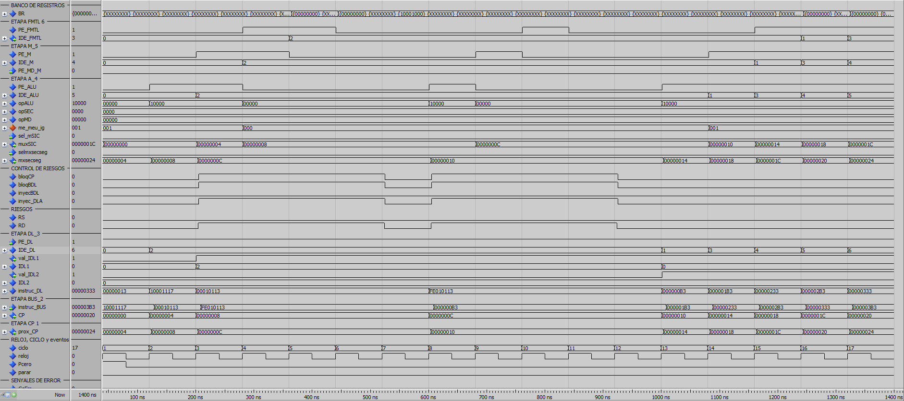
Dir | Inst. hex | Inst. ascci | 1 | 2 | 3 | 4 | 5 | 6 | 7 | 8 | 9 | 10 | 11 | 12 | 13 | 14 | 15 | 16 | 17
0 | 00000013 | addi x0 , x0 , x000 | DL | A | M | FMLT | ES
4 | 10001117 | auipc x2 , x10001 | B | DL | A | M | FMLT | ES
8 | 00010113 | addi x2 , x2 , x000 | CP | B | DLB | nop | nop | nop | nop
 |  |  |  |  |  | DLB | nop | nop | nop | nop
 |  |  |  |  |  |  | DLB | nop | nop | nop | nop
 |  |  |  |  |  |  |  | DLB | nop | nop | nop | nop
 |  |  |  |  |  |  |  |  | DL | A | M | FMLT | ES
C | FE010113 | addi x2 , x2 , xFE0 |  | CP | B | B | B | B | B | DLB | nop | nop | nop | nop
 |  |  |  |  |  |  |  |  |  |  | DLB | nop | nop | nop | nop
 |  |  |  |  |  |  |  |  |  |  |  | DLB | nop | nop | nop | nop
 |  |  |  |  |  |  |  |  |  |  |  |  | DLB | nop | nop | nop | nop
 |  |  |  |  |  |  |  |  |  |  |  |  |  | DL | A | M | FMLT | ES
10 | 000000B3 | add x1 , x0 , x0 |  |  | CP | CP | CP | CP | CP | B | B | B | B | B | DL | A | M | FMLT | ES
Riesgos |  |  |  |  | RD | RD | RD | RD |  | RD | RD | RD | RD

