Slide 1


VERSION CONTROL WITH GIT
April 3, 2023

Slide 2
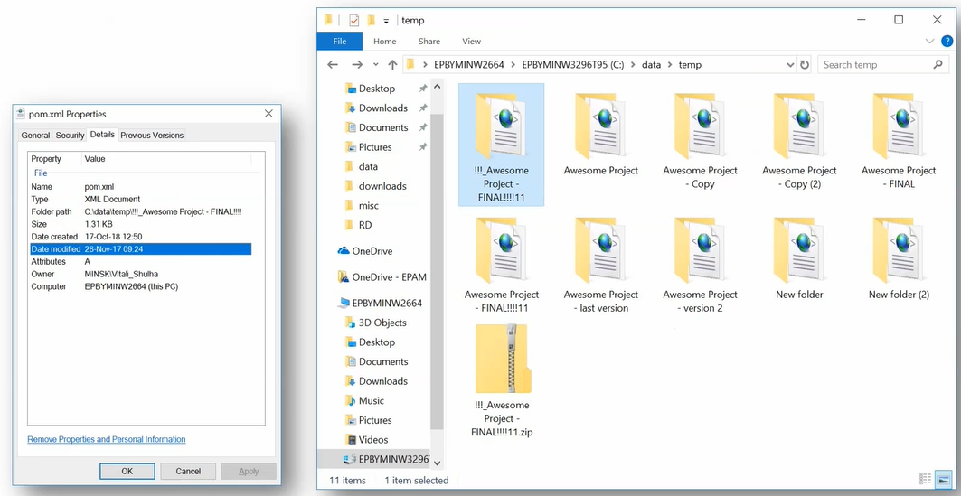
Standalone work. level 1 - beginner

Slide 3
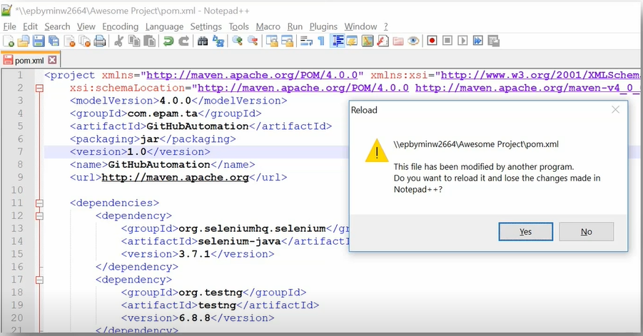
Team work. level 2 - network share

Slide 4
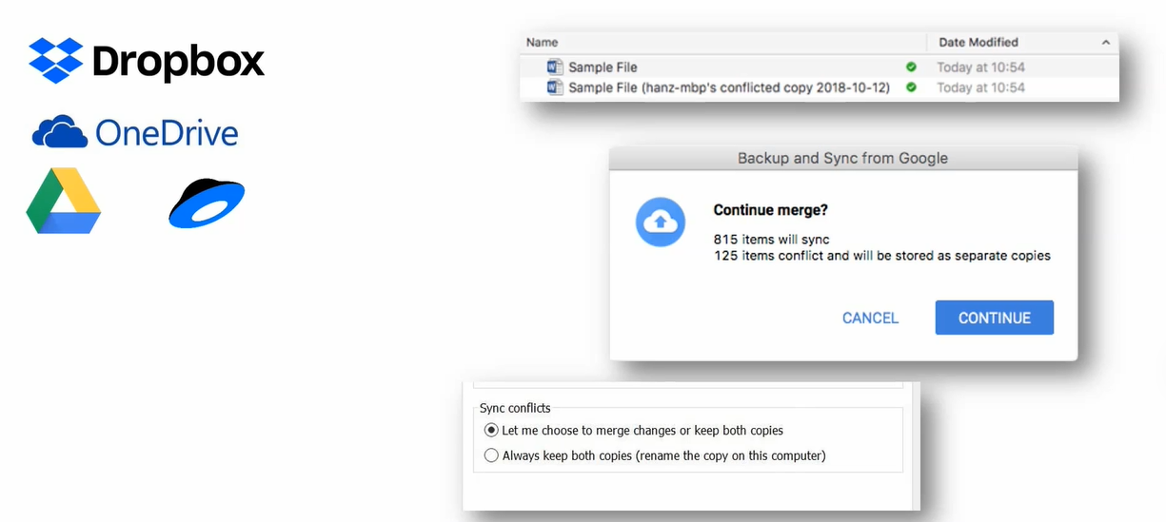
Standalone/Team work. level 3 - cloud

Slide 5
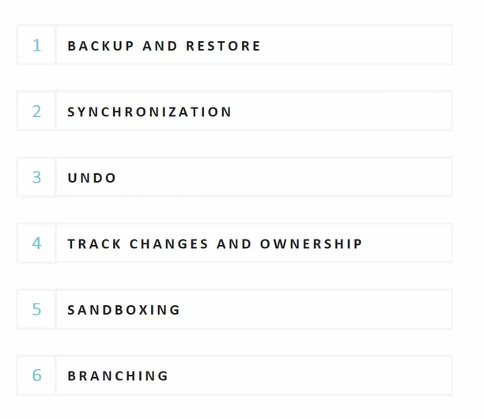
VCS goals

Slide 6
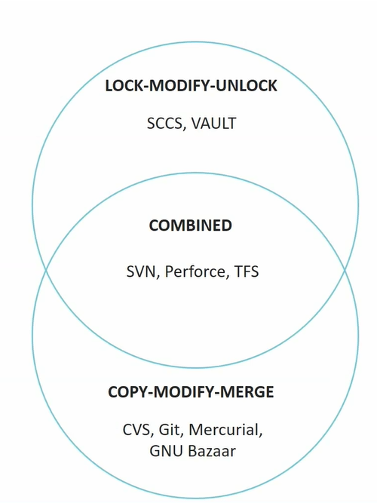
VCS goals

Slide 7
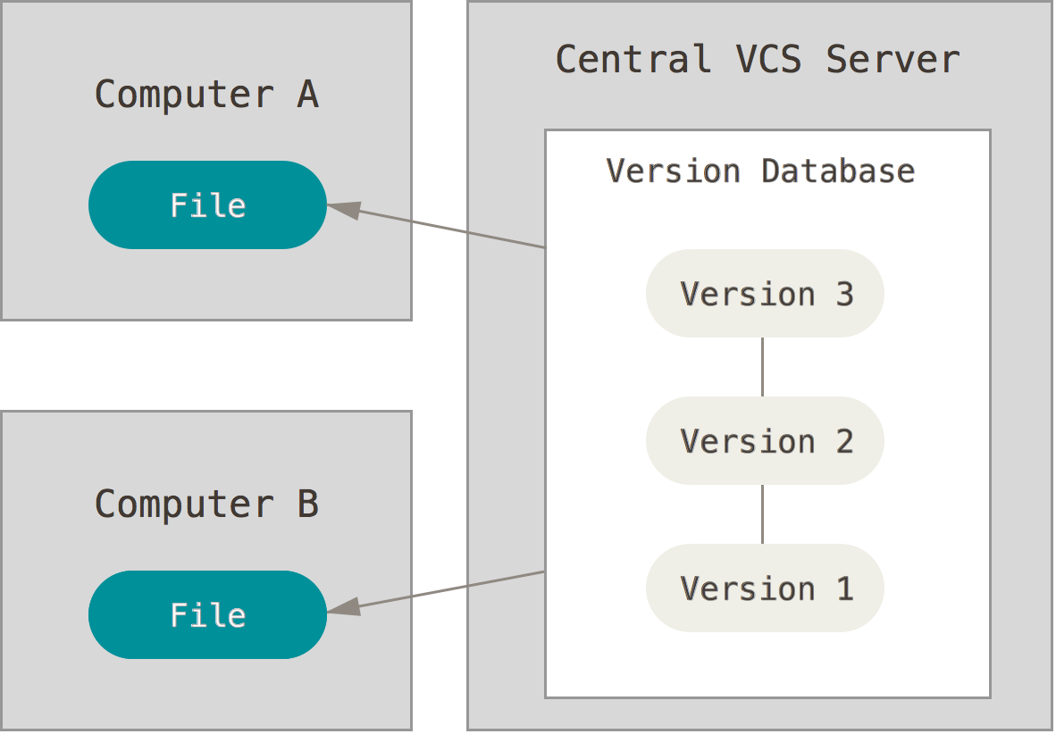
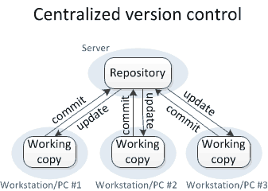
CENTRALIZED VS DISTRIBUTED

Slide 8
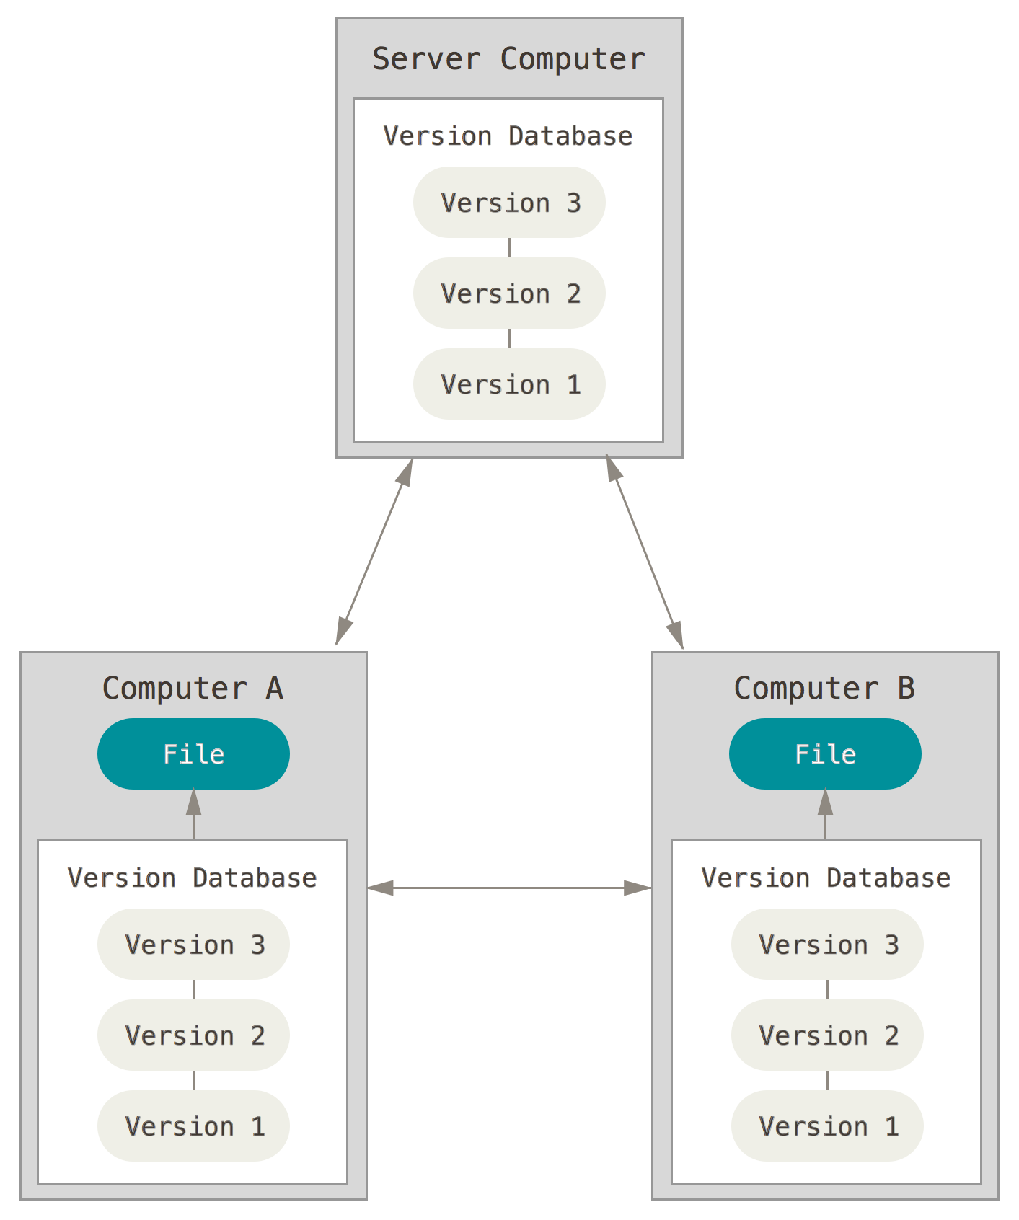
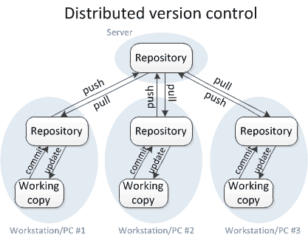
CENTRALIZED VS DISTRIBUTED

Slide 9

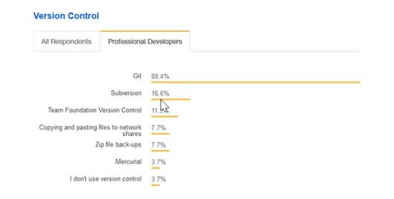
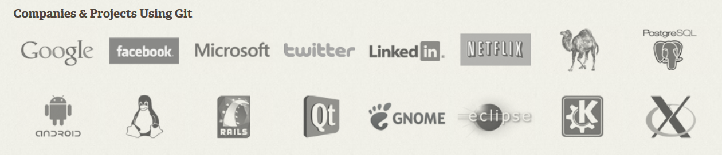
GIT
Git is a free and open source distributed version control system designed to handle everything from small to very
large projects with speed and efficiency.

Slide 10
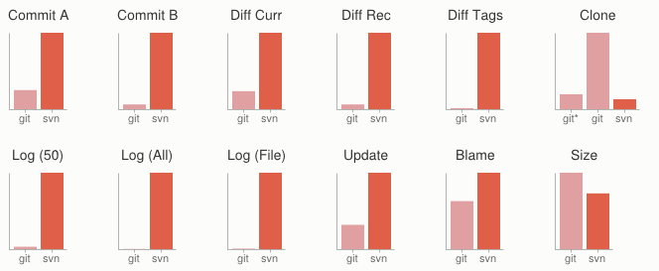
WHY GIT?
Fast
Small
Distributed
Data Assurance
Free and Open Source

Slide 11
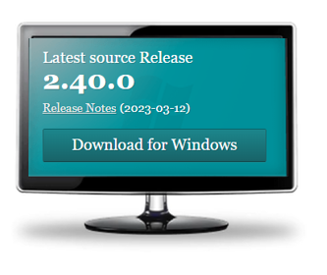
Download, install, configure
Download and install
Configure
Download binary from here https://git-scm.com/downloads
Follow the steps using the default options
Generate SSH key pair $ ssh-keygen -o -t rsa -C "your@email.com"
Send public key to repository owner or upload to your profile
Configure username and email $ git config --global user.name "Your Name"
$ git config --global user.email "your@email.com"

Slide 12
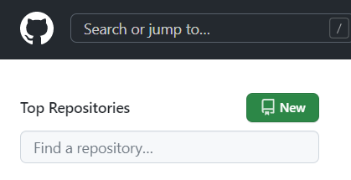
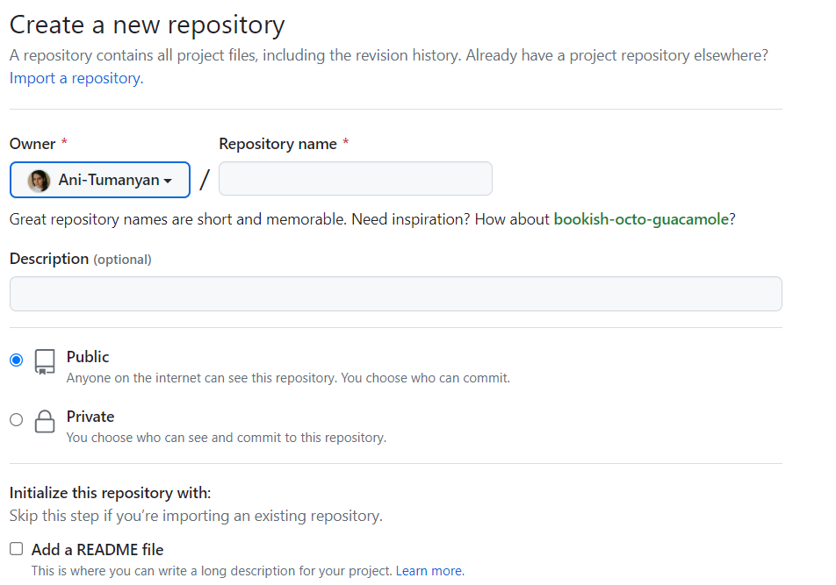
Create github, clone, git flow

Slide 13
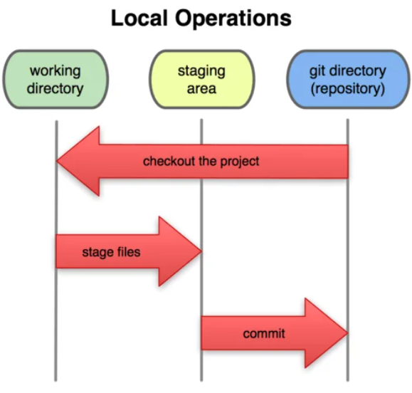
Git main flow

Slide 14
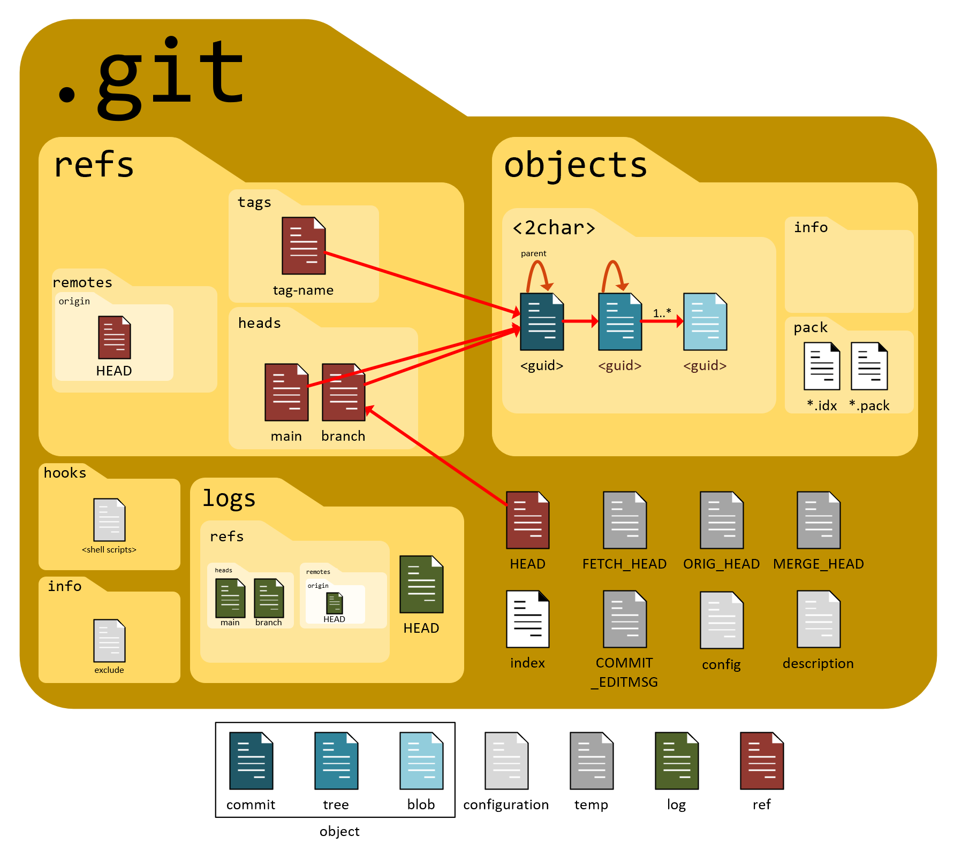
Inside .git folder

Slide 15
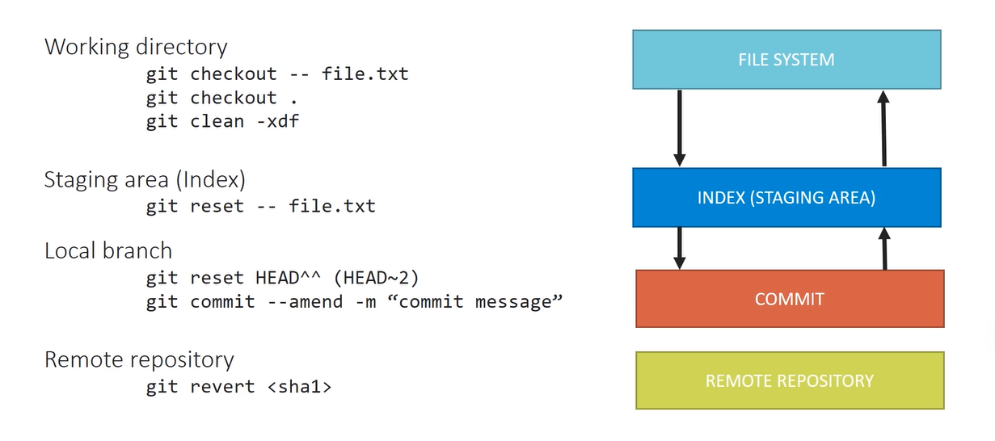
Undoing changes

Slide 16
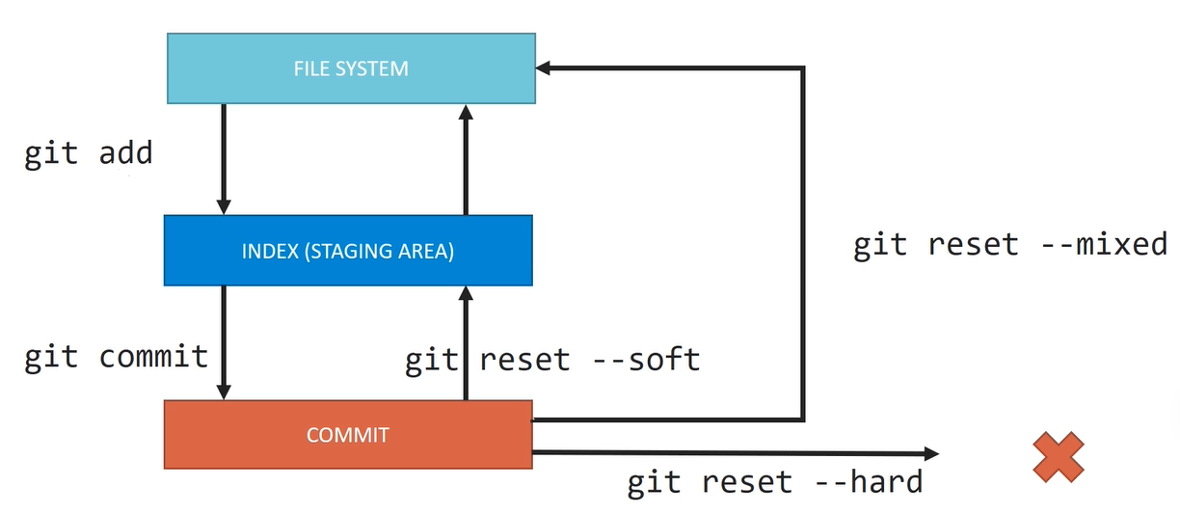
Git reset

Slide 17
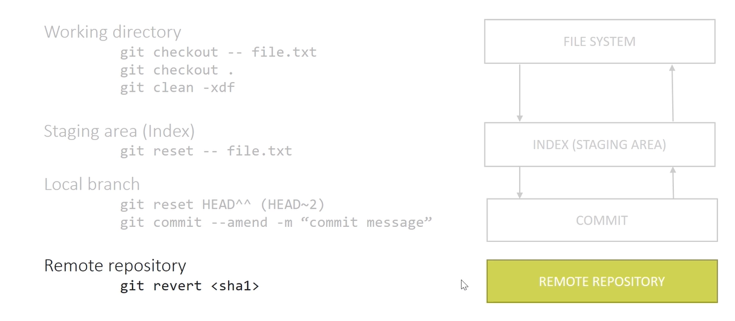
Git revert

Slide 18
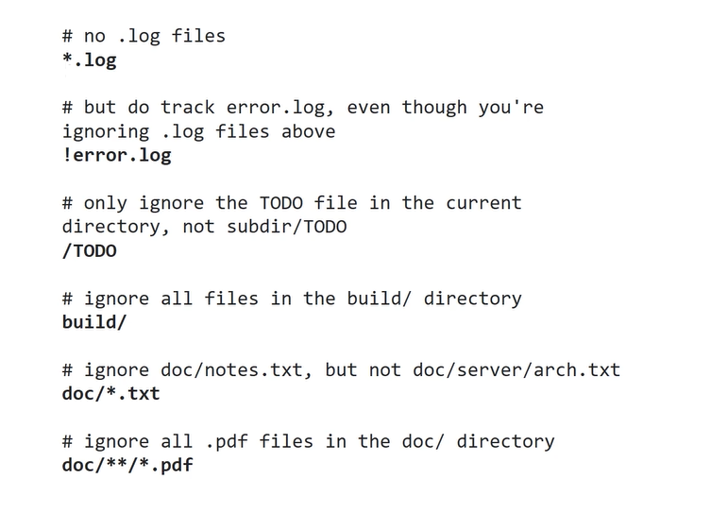
.gitignore

Slide 19
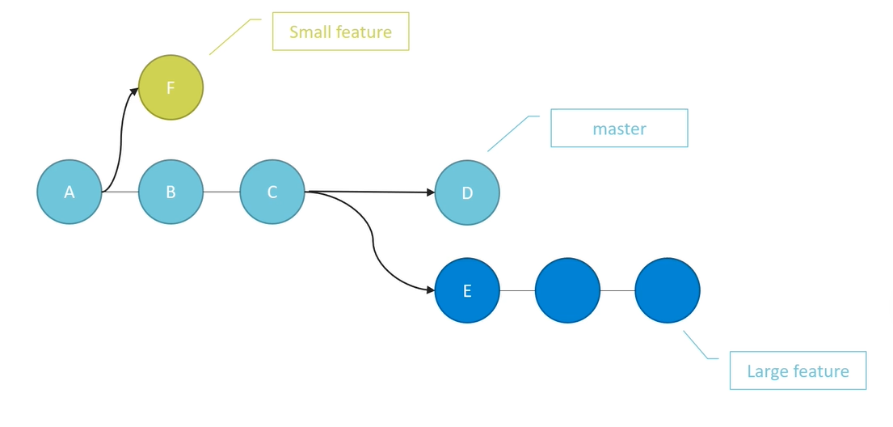
Branching and merge. Branch concept

Slide 20
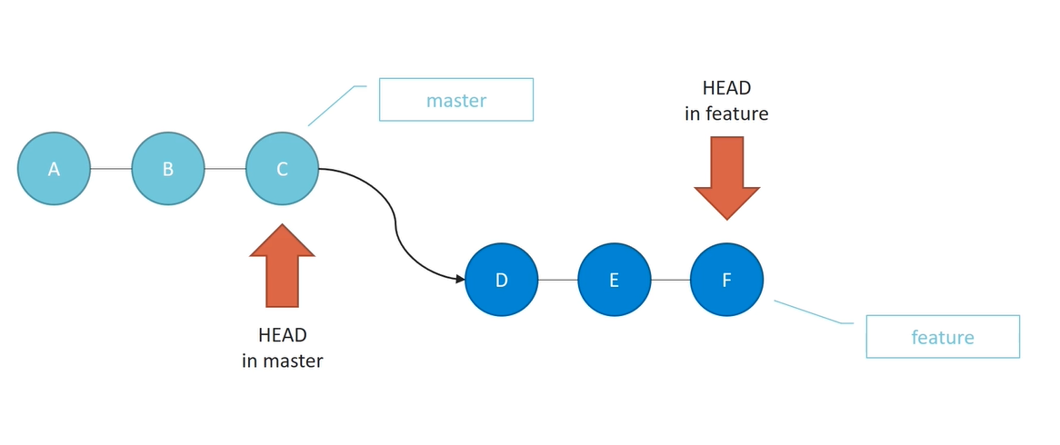
Fast-forward merge

Slide 21
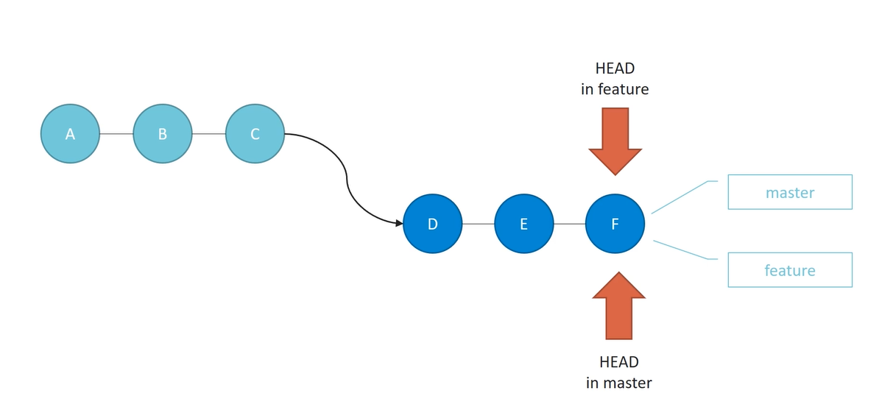
Fast-forward merge

Slide 22
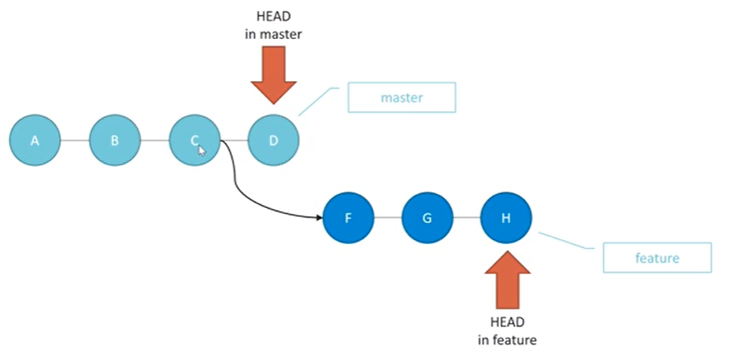
Non fast-forward merge
Non fast-forward merge
Non fast-forward merge

Slide 23
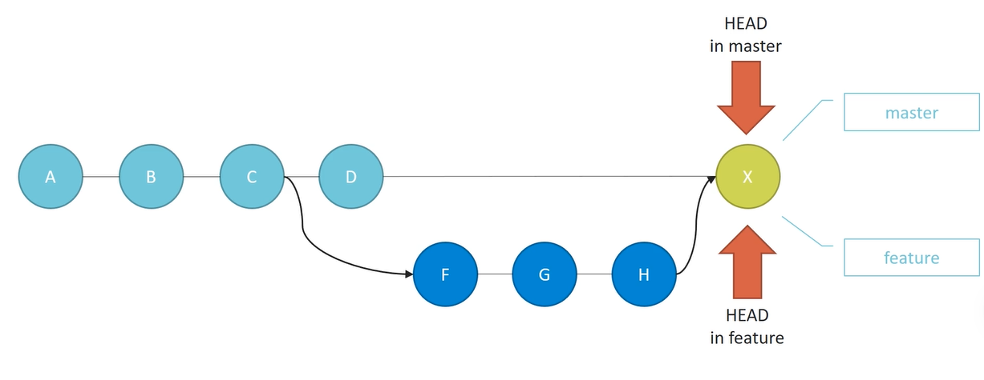
Non fast-forward merge

Slide 24
CONFLICTS
Abort merge
git merge –abort
Resolve by selecting version
git checkout --ours –theirs
Resolve manually git diff
Undo merge git revert 09fe472
Avoid conflicts
Short commits
No edits to whitespaces
Merge often

Slide 25
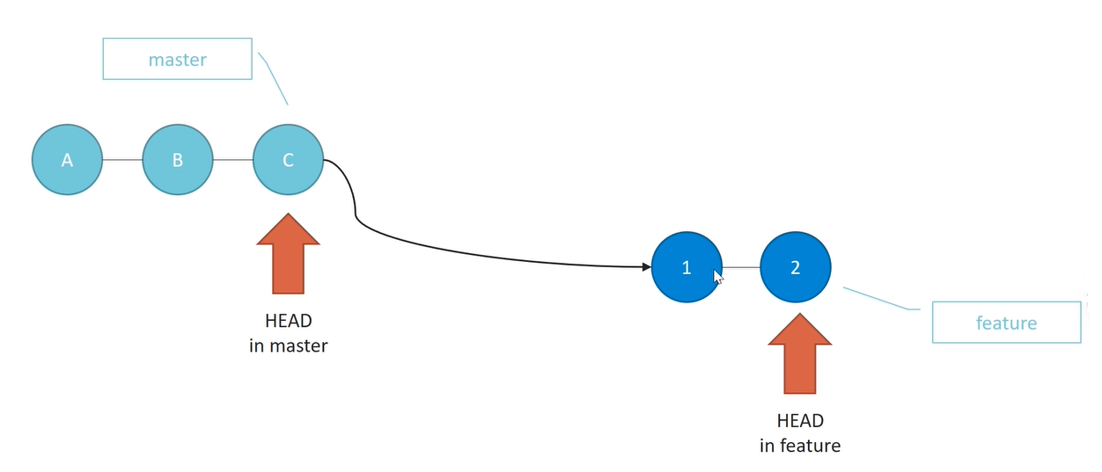
Rebase

Slide 26
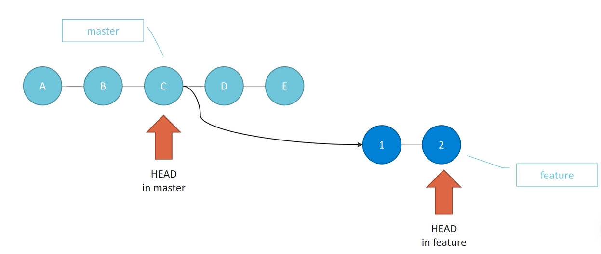
Rebase

Slide 27
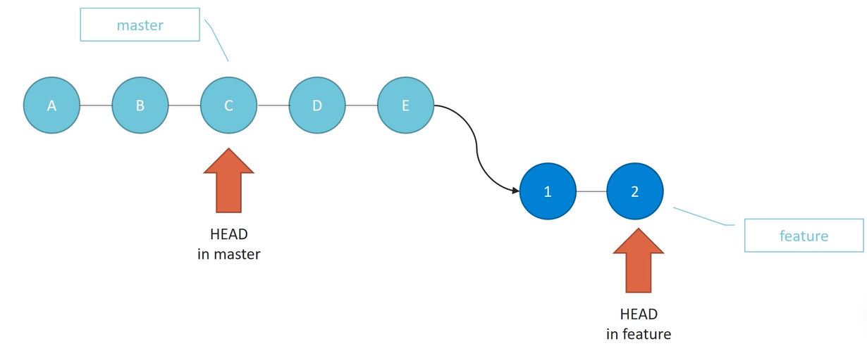
Rebase

Slide 28
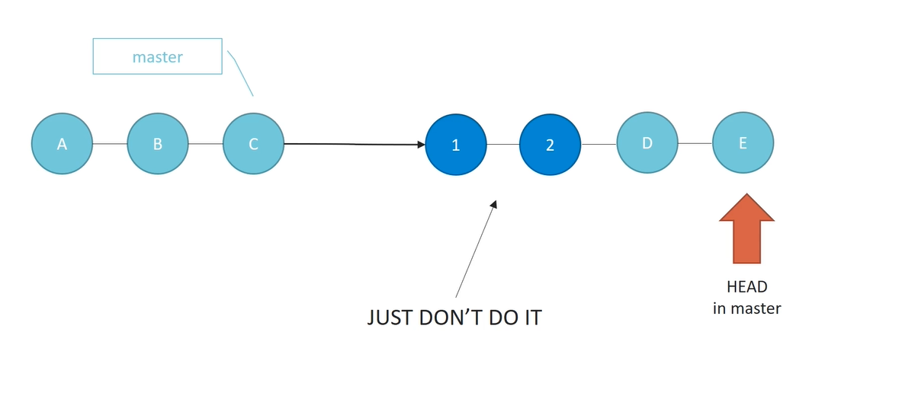
Golden rule of Rebase

Slide 29
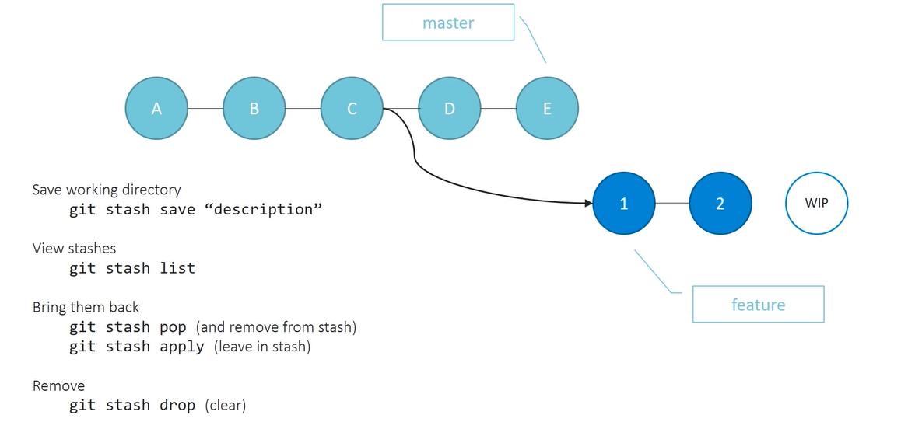
Stash

Slide 30


Q&A
Thank you!
Further reading:
Pro Git
Version Control with Git

Slide 31
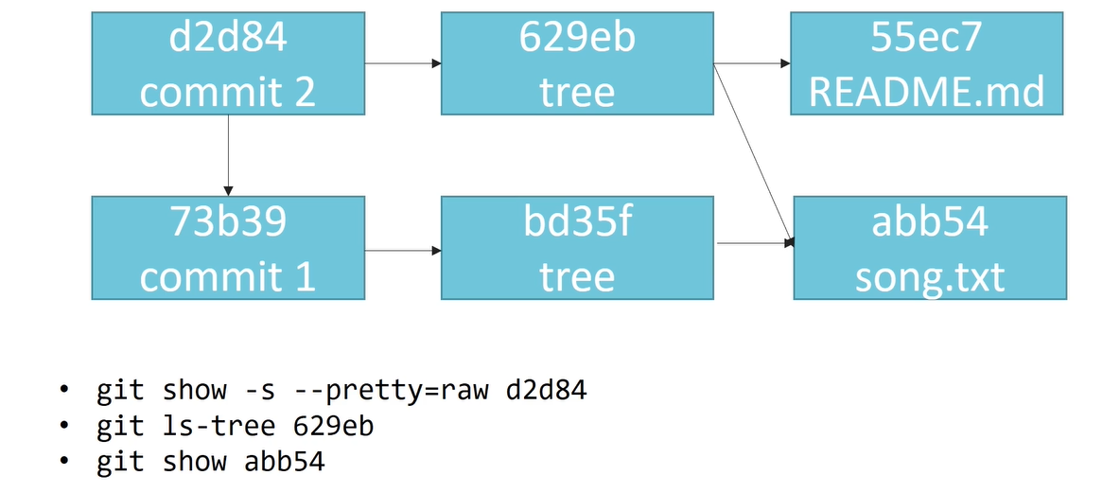
Commit, tree, blob

