Slide 1

Integration of Machine Learning Model for Auto-tagging Questions

Slide 2

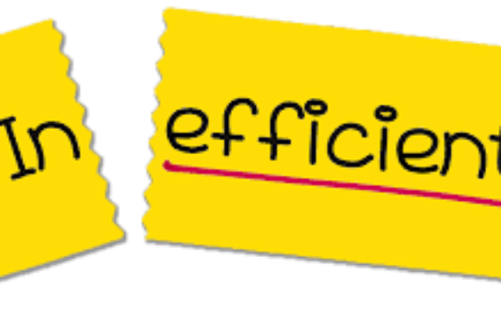
Problem Statement
The assessment platform lacks an automated tagging system for question difficulty and concepts. Manual tagging is slow and error-prone.
This project objective is to build accurate machine learning models that predict and assign tags. These models will integrate seamlessly with a local web page, making it user-friendly for question authors and test-takers.
Time-Consuming 🕑
Inefficient 🚫
Manual tagging is often slow and inaccurrate, leading to decreased productivity.
The process can be error-prone, which negatively impacts the performance of online question-and-answer websites.

Slide 3
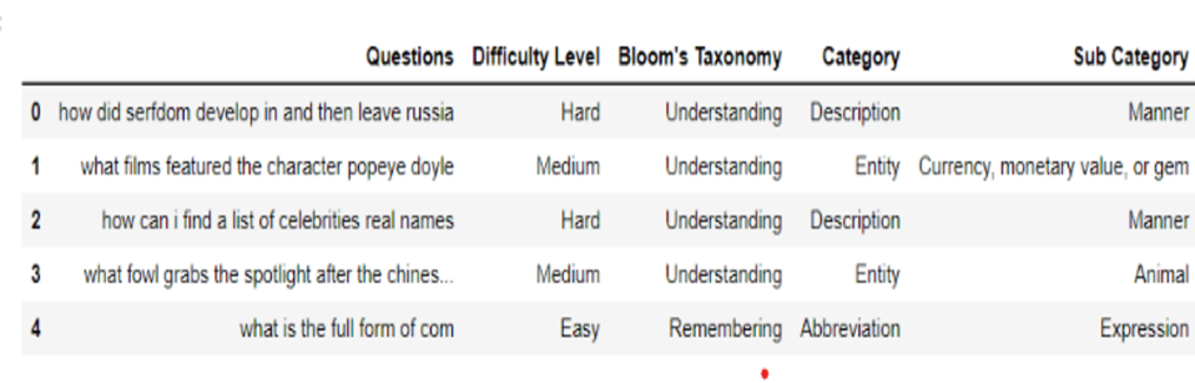
Dataset
The dataset consists of 5 attributes: Questions, Difficulty Level, Bloom's Taxonomy, Category, and Sub-Category, with 5452 instances.
Each question is associated with their respective tags: Difficulty Level, Bloom's Taxonomy, Category, and Sub-Category.

Slide 4
Data Insights
Difficulty Level: Three labels (Easy, Medium, Hard)
Bloom's Taxonomy: Six labels (Understanding, Remembering, Creating, Analyzing, Evaluating, Applying)
Category: Six labels (Entity, Human, Description, Numeric, Location, Abbreviation)
Sub-Category: Categorized sub-labels for each category

Slide 5
Approach
Feature Engineering
Hyperparameter Tuning
The TF-IDF vectorizer extracted essential text features, handling tokenization and lowercasing. Categorical features were one-hot encoded and combined with text features.
GridSearchCV optimized hyperparameters using cross-validation, ensuring robustness and generalization.
1
2
3
4
5
Data Preprocessing
Model Selection & Training
Model Integration with Web Page
The data was clean and well-organized, requiring minimal preprocessing. Raw text questions were directly fed into the pipeline.
Various algorithms were explored, including SVM, Random Forest, and Gradient Boosting, for multi-label classification. The chosen model was OneVsRest LinearSVC for each tag.
Flask, a Python web framework, was employed to create a user-friendly web application. Users can input questions, and the integrated models predict tags like Difficulty Level, Bloom's Taxonomy, Category, and Sub-Category.

Slide 6
Evaluation Metrics Used
Accuracy
Evaluation Metrics used:
F1-score
Accuracy is the ratio of correctly labeled questions to the total number of questions in the dataset.
The F1-score is the harmonic mean of precision and recall.

Slide 7
Results
The concluding machine learning models exhibited impressive accuracy and favorable F1 Scores for every tag, encompassing Difficulty Level, Bloom's Taxonomy, Category, and Sub-Category. The seamless integration with the local web page yielded a user-friendly interface, facilitating streamlined question tagging and categorization.

Slide 8
BERT’s Performance on Difficulty Level Tag
We also delved into the realm of BERT models, aiming to elevate our performance beyond the realms of machine learning. Our curiosity led us to experiment with these advanced language models, seeking to harness their potential. We eagerly dived into the results of this exploration to discern their impact on our project's performance.
The BERT model's performance beckoned, promising heightened impact. Yet, its outcomes closely mirrored our OneVsRest ML model. Amid this equilibrium, we made a practical choice, considering both models' similar prowess. This convergence highlights the art of balanced decision-making.

Slide 9
Project Impact
1
Transformative Upgrade through Integration:
Seamlessly integrating machine learning models with the local web page brings about a transformation.
2
Effortless Question Creation and Categorization:
Authors now have the ability to effortlessly create and categorize questions.
3
Enhanced Experience for Test-Takers:
The integration enhances the experience for test-takers.
4
Elimination of Manual Tagging:
The automated approach eliminates the need for manual tagging.
5
Time and Resource Savings:
The automated approach saves valuable time and resources.

Slide 10

Conclusion and Future Work
The integration of machine learning models with the local web page has made the assessment platform remarkably efficient. Accurate tagging of Bloom's Taxonomy, difficulty level, category, and sub-category offers a personalized learning experience.
This user-friendly web page, equipped with an auto-tagging system, signifies a pioneering and accessible tool for educational assessments, benefiting both educators and learners.
As we conclude, let's discuss our exploration of advanced language models, like BERT and LLMs, during the project. While they matched our machine learning models in accuracy and F1 score, their implementation complexity and resource demands were factors. Considering our dataset size and project scope, machine learning models found the right balance between performance and complexity. Notably, for future projects with extensive data, models like BERT and LLMs offer potential for an even more efficient solution. Thank you for your attention, and I'm ready for any questions.

Slide 11

TEAM
VETLA PAVAN KALYAN
MANUKONDA GOPALAKRISHNA REDDY
POTLA VANI
VARAPRASAD
DEVIKA

