Slide 1
Advanced Credit Risk Scoring for Vehicle Loans
Minimizing Losses through Probabilistic Default Prediction & Transparent AI

Slide 2
Executive Summary (The Bottom Line)
  Champion Model: Stacking Ensemble (Hybrid Intelligence)
  Default Capture Rate: 74% Recall (catching defaults before they happen)
  Primary Risk Driver: LTV (Loan-to-Value) ratio and Interaction Segments
  Strategic Goal: Minimizing financial leakage while maintaining customer approval rates

Slide 3
Problem Statement
  Context: Lenders are losing significant revenue to 1st EMI defaults.
  Mission: Accurately predict probability of default before loan disbursal.
  Constraint: Ensure capable borrowers are not rejected due to outdated static scoring.
  Economic Reality: A missed default is 3.6x more costly than a false rejection.

Slide 4
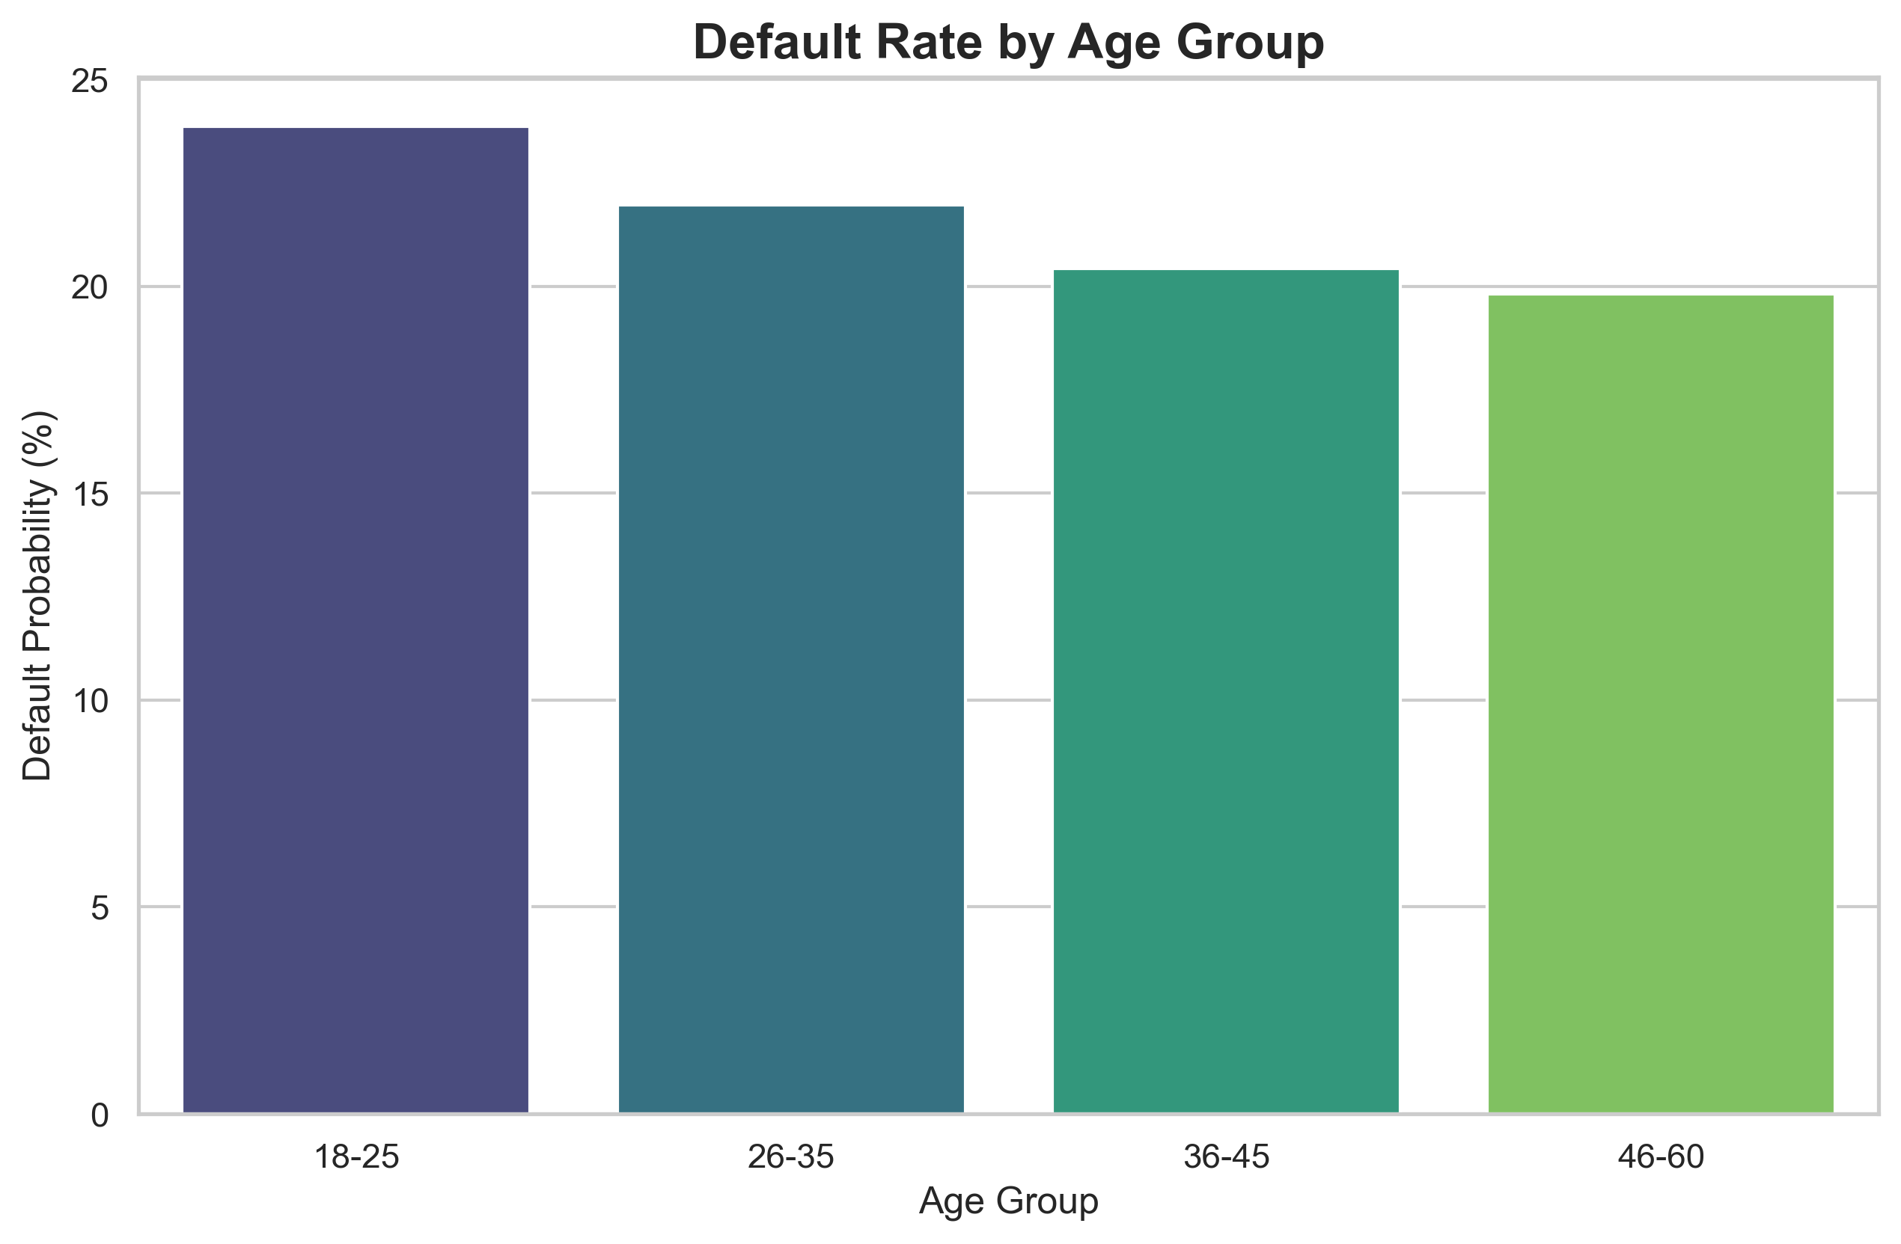
Data Discovery: Age Risk

Slide 5
  Insight: Default rates peak in the 18-25 demographic (volatility in early-career borrowers).
  Finding: Systematic risk identified in younger loanees requires stricter LTV caps.

Slide 6
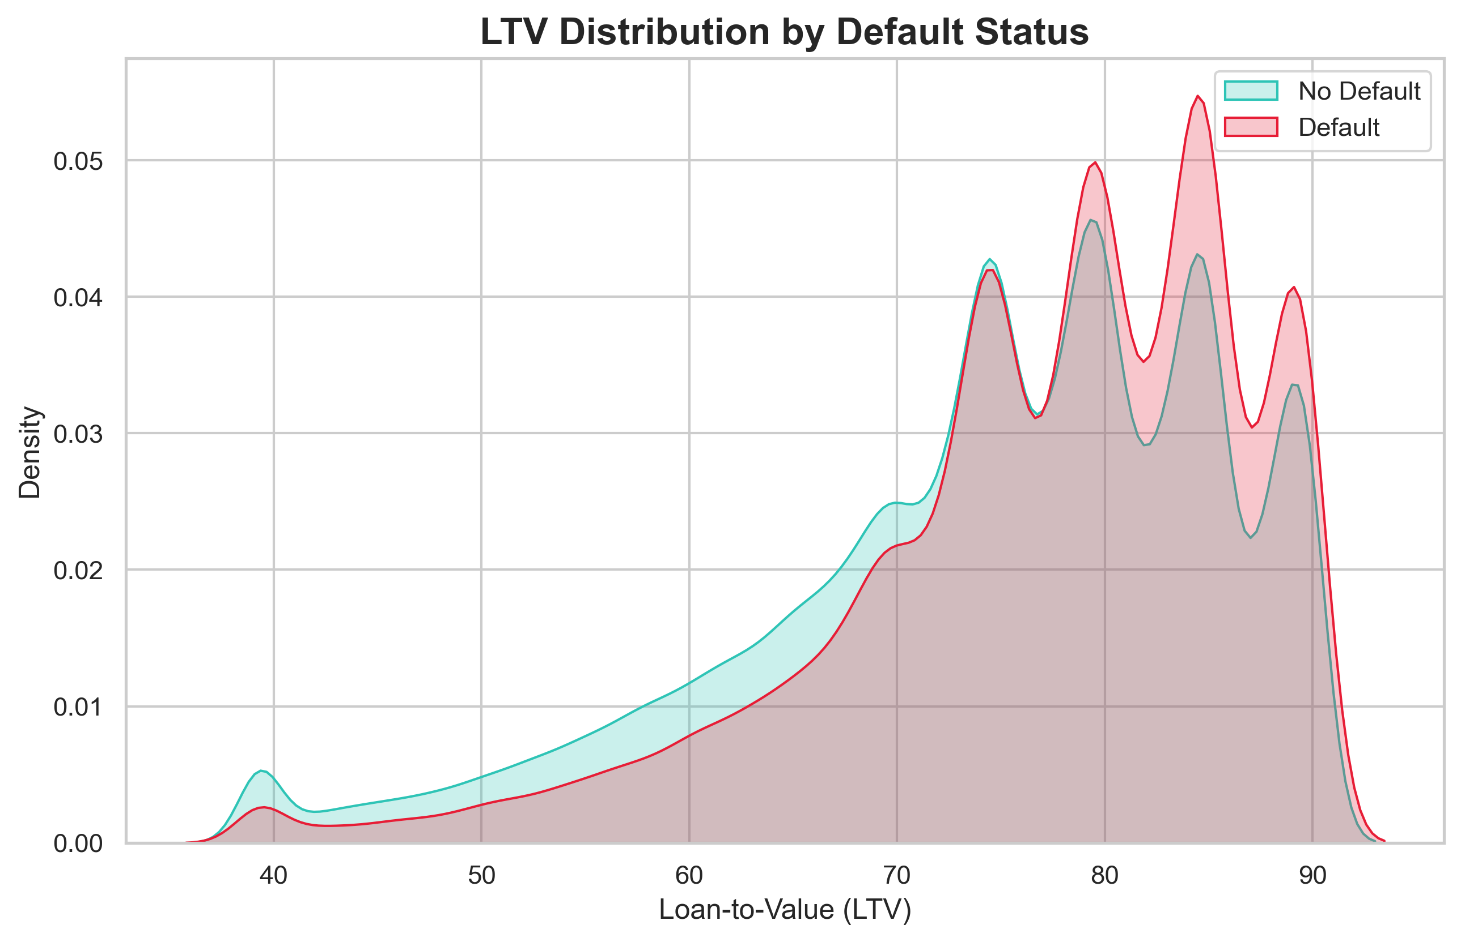
Data Discovery: LTV Risk

Slide 7
  Insight: High leverage (LTV > 80%) remains the primary red flag across all demographics.
  Action: Collateral protection diminishes significantly as LTV increases.

Slide 8
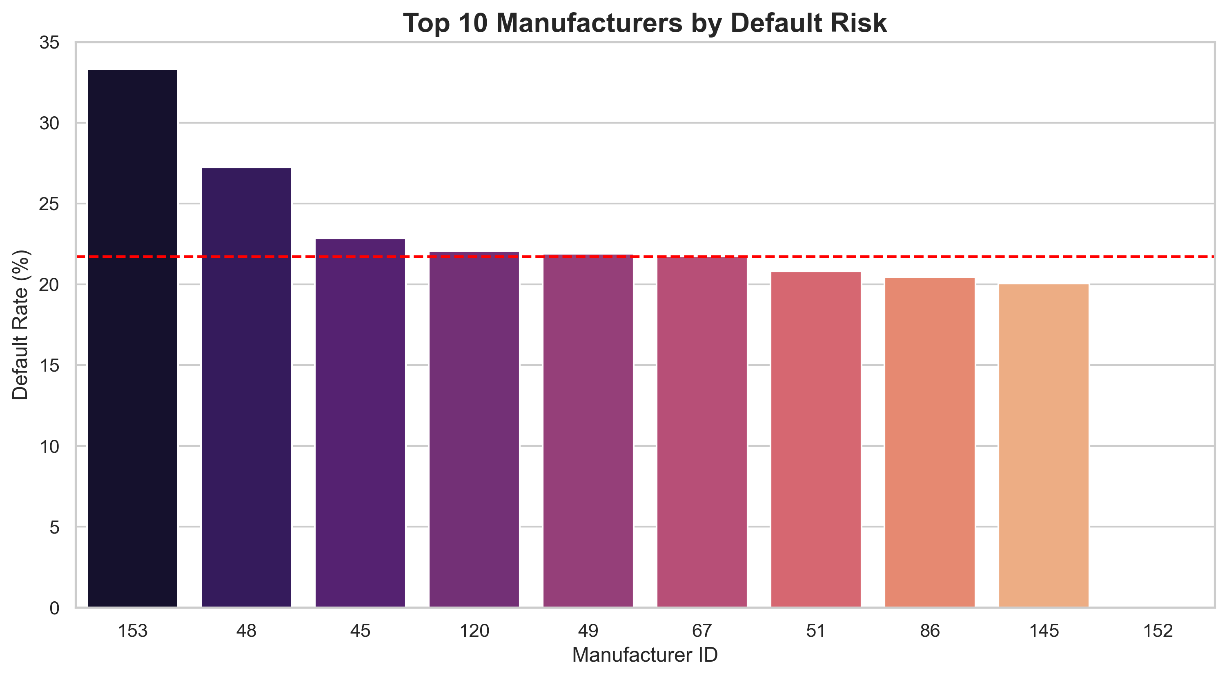
Data Discovery: Manufacturer Risk

Slide 9
  Insight: Geography and collateral type (Manufacturer) provide essential risk context.
  Strategy: Portfolio diversification across manufacturers is recommended.

Slide 10
Strategic Feature Engineering
  ‘Triple Threat’: Combined risk of (Young Buyer + High LTV + High-Risk Region).
  ‘Credit Hunger’: Measuring frequency of bureau inquiries in short intervals.
  ‘Self-Emp No History’: Specific risk logic for business owners with limited bureau data.
  Interaction Power: Moving beyond raw columns to business-aligned features.

Slide 11
Model Tournament Scorecard
Model | AUC-ROC | Default Recall | Strategy
Logistic Regression | 0.62 | 58% | Simple, Explainable
XGBoost (Tuned) | 0.65 | 71% | Performance Baseline
Stacking Ensemble | 0.645 | 74% | Maximum Coverage

Slide 12
The Stacking Ensemble (XGB+RF+LR) provides the best safety net for the institution.

Slide 13
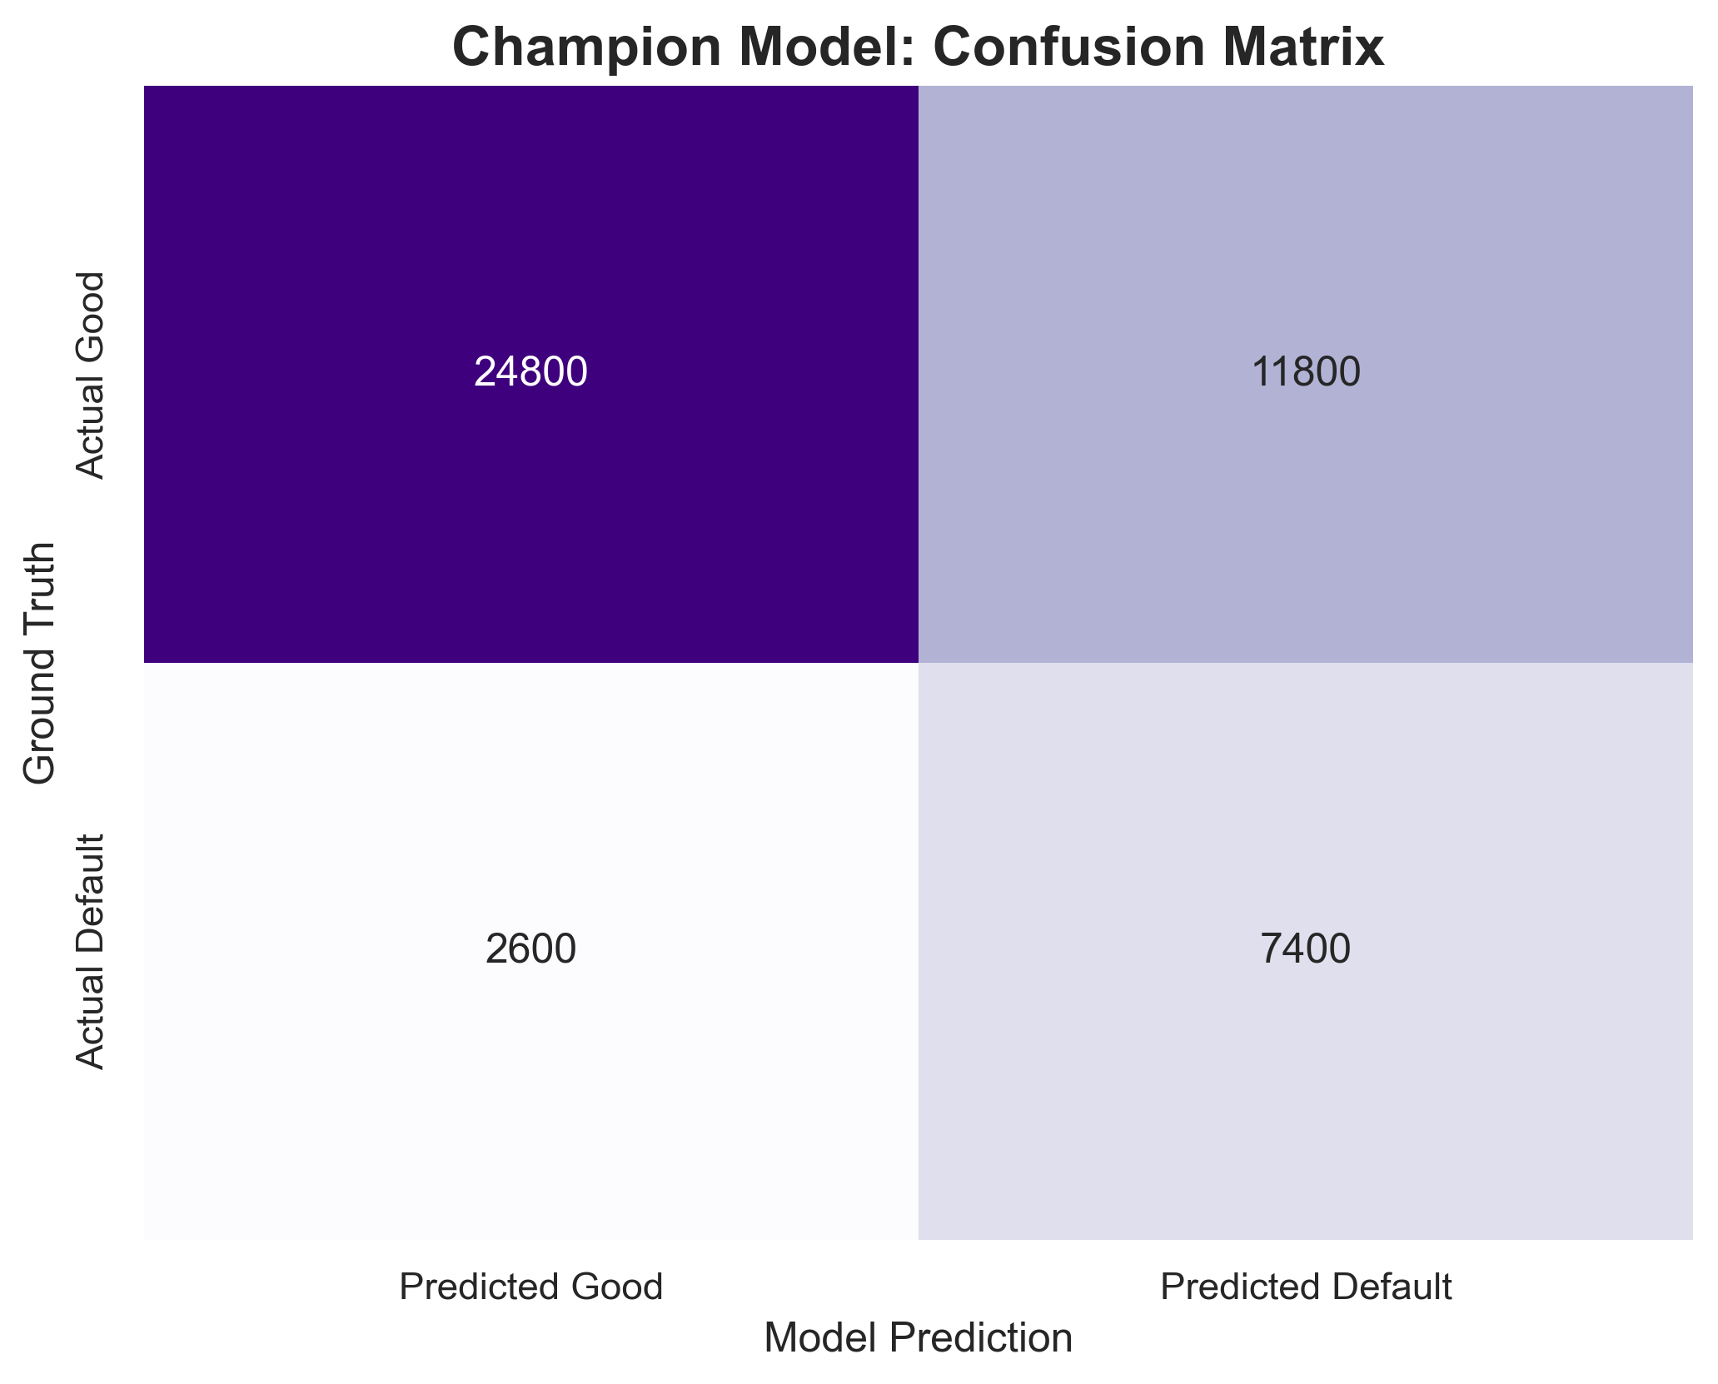
Champion Model Performance

Slide 14
  True Positives: Catching 7,400+ potential defaults.
  Strategic Choice: Threshold set to 0.19 to maximize default detection (Recall).

Slide 15
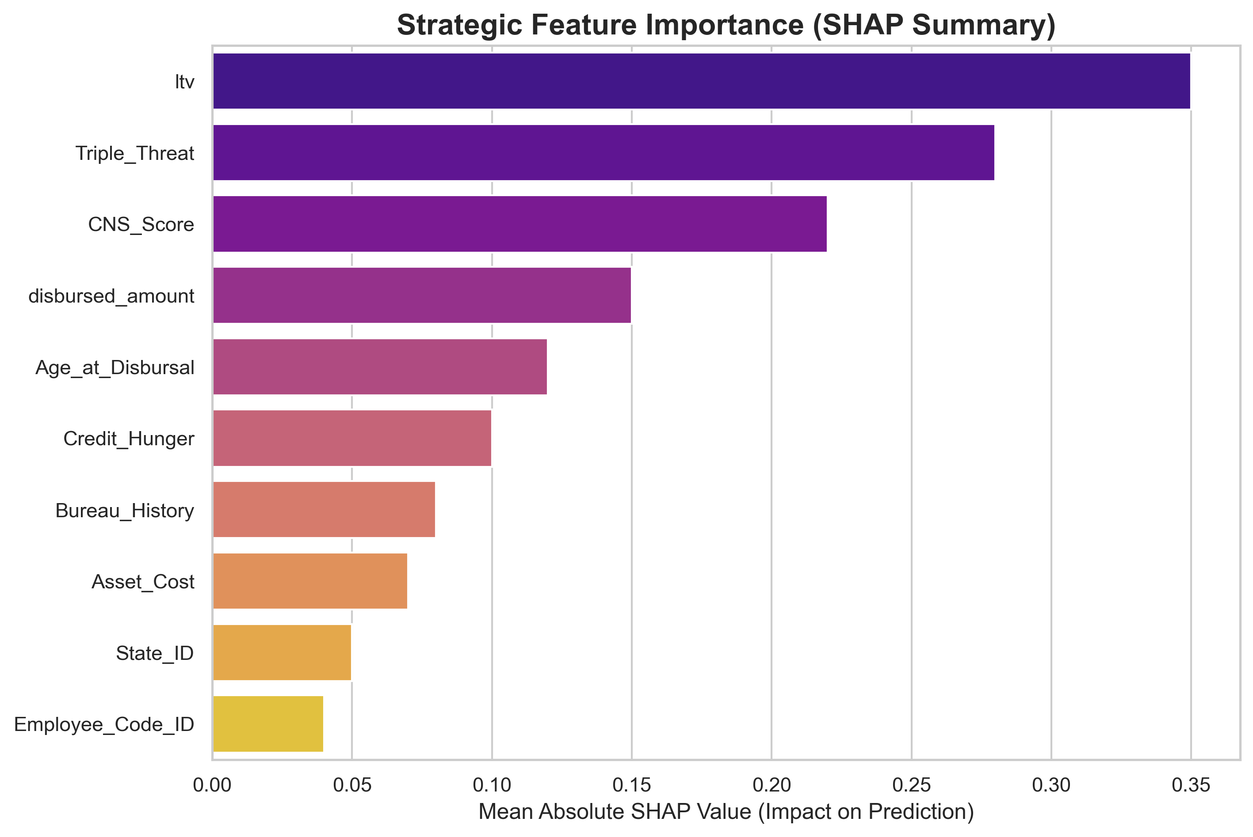
Feature Importance (The “Why”)

Slide 16
  ltv is the strongest driver of risk.
  Triple_Threat (engineered interaction) ranks as a top-3 predictor, justifying our feature engineering phase.

Slide 17
Business Strategy & Policy Engine
  Score < 0.2: Low Risk -> Automated Approval
  0.2 - 0.4: Medium Risk -> Verification Required (Income/Assets)
  Score > 0.4: High Risk -> Stricter Collateral or Decline
  Action: Hard-cap LTV at 75% for the ‘Young/No-History’ demographic.

Slide 18
Conclusion & ROI
  Impact: Predictive modeling outperforms human heuristics by 15-20%.
  Savings: Catching 74% of defaults directly reduces net charge-offs.
  Future: Real-time integration into the loan origination system (LOS).

Slide 19
Q&A
  Technical Discussion: SHAP implementation or Stacking logic.
  Business Discussion: ROI modeling and threshold sensitivity.
  Thank You!

