Slide 1
Intelligent Document Extraction,
Validation & API Platform
Invoices · Balance Sheets · Profit & Loss · Cash Flow Statements
OCR + layout-aware extraction · financial reconciliation · REST API · dashboard
AI Engineer Internship — Technical Case Study
Notes:
End-to-end document intelligence platform: upload a financial document, get back validated structured JSON, stored and browsable through a dashboard.

Slide 2
The problem
Financial teams receive the same numbers in inconsistent, often scanned, layouts
1
2
3
4
5
Validate
Read
Extract
Reconcile
Serve
Type, integrity and
page limit — before OCR
Native PDF text, or
rasterise + OCR
Fields and every
table row, grounded
Recompute the
financial relationships
Store, expose via API
and dashboard
Four document types in scope
Invoice — header fields, line items, tax, cash and change
Balance sheet — capital & liabilities and assets, per period
Profit & loss — income, expenditure, profit and appropriations
Cash flow — operating, investing, financing, opening/closing cash
Notes:
Scope is four document types. Document type is supplied by the caller — classification was explicitly out of scope.

Slide 3
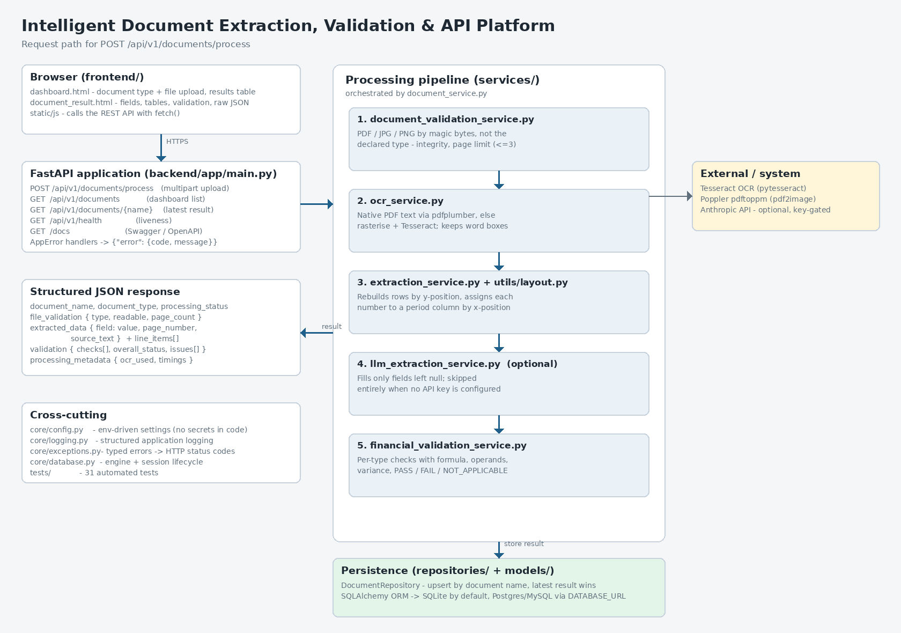
Architecture
One FastAPI application serves the API and the dashboard; services are separated by concern
Notes:
Validation, OCR, extraction, financial validation, persistence and API concerns are each their own module, orchestrated by document_service.

Slide 4
Why line-by-line OCR text is not enough
The insight that drove the design
Reading OCR text as lines
Reading the page as a table
Total 743,732,155
Total · x≈1540 → column 2 → 31-Mar-16
A row filled in for only one year gives no clue which year it belongs to — and OCR often emits all labels in one block and all numbers in another, so labels and values are separated entirely.
Word bounding boxes are kept from both PDF text and OCR. Rows are rebuilt by vertical position; each number is assigned to a period column by its right edge — so a lone value lands in the correct year and note references are ignored.
Measured, not assumed
Benchmarked all 30 dataset statements to find the first extractor was over-fitted to one year
Compared Tesseract page-segmentation modes and DPI settings — 300 DPI measured worse than 200
Found extraction and validation had drifted to two different field lookups, and unified them
Notes:
This is the heart of the solution: treating the page as a table rather than as lines of text, and choosing settings by measurement.

Slide 5
Financial validation
Every check reports formula, operands, calculated vs reported, variance and status
Invoice
qty × unit price ≈ line amount · Σ lines ≈ subtotal
subtotal + tax − discount ≈ total · cash − total ≈ change
Honest by design
Missing operand → NOT_APPLICABLE, never a failure
A partly-read section is not summed — an unread row would count as zero
Tolerance: max(1.0, 1% of the larger value)
Bracketed figures parse as negative
Every check runs once per reporting period
Missing values stay null — never guessed
Balance sheet
Total Capital & Liabilities ≈ Total Assets
Σ component rows ≈ each reported total
Profit & loss
Interest + Other Income ≈ Total Income · Expenses ≈ Total Expenditure
Income − Expenditure ≈ Net Profit · − Minority ≈ Attributable
Cash flow
Operating + Investing + Financing + FX ≈ Net Increase
Opening + Net Increase + Amalgamation ≈ Closing Cash
Notes:
The NOT_APPLICABLE rule matters: the system never claims a document fails to balance when the truth is that OCR could not read a row.

Slide 6
Measured results
All 50 documents in the provided dataset, 297 financial checks
228
checks reconcile exactly
2
genuine discrepancies, verified by hand
67
not applicable — nothing to reconcile
Every statement check reconciles. The two failures were read back against the source images and are real: a receipt whose items total $3,480 against a printed $5,257, and one whose change is RM 2.00 short. Not-applicable results concentrate in the 2020–2022 scans, where OCR cannot recover row labels.
Notes:
A check only passes if the numbers extracted from the document genuinely add up, so this doubles as an extraction-accuracy measure.

Slide 7
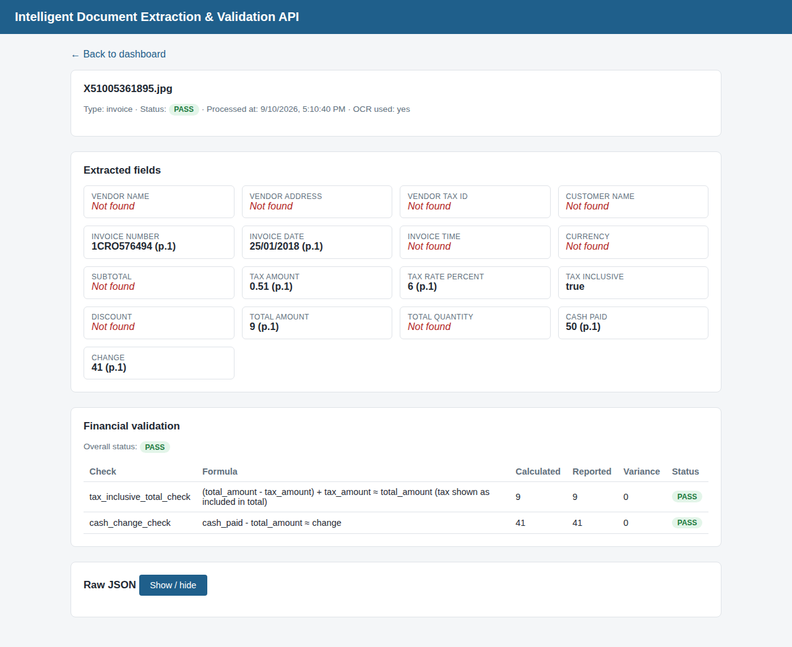
API and dashboard
One deployment serves both; Swagger is generated from the code
POST
/api/v1/documents/process
upload and process
GET
/api/v1/documents
dashboard list
GET
/api/v1/documents/{name}
latest result
GET
/api/v1/health
health check
GET
/docs
Swagger / OpenAPI
Errors return one envelope
{ "error": { "code": "UNSUPPORTED_FILE_TYPE",
"message": "Only PDF / JPG / PNG…" } }
415 · 400 · 404 · 422 · 500 — never a stack trace
Notes:
The dashboard highlights missing fields in red and shows each validation check with its formula; the raw JSON is one click away.

Slide 8
Limitations and what I'd change
Known today
For production
OCR quality is the binding constraint — 2020–2022 scans lose row labels entirely
Statement parsing is tuned to this dataset's banking format
Noisy receipts yield fewer line items
Synchronous processing, ~2–6 s per scanned page
No authentication — per case study scope
Queue the work, return a job id instead of holding the connection
Commercial OCR, with the LLM pass standard rather than opt-in
Golden-file regression suite over a labelled corpus
Object storage for source documents; Alembic migrations
Auth, rate limiting, metrics and alerting on the FAIL rate
Deterministic by default · every value traceable to its source row · nothing invented
Notes:
Closing: the system is honest about what it could not read, which is the property that matters most in a financial setting.

