Slide 1
Financial Literacy AI Agent
IBM AICTE PROJECT
Presented By:
Student name : Manush G R
College Name: Kristu Jayanti (Deemed to be) University
Department : BCA

Slide 2
OUTLINE
Problem Statement
Technology used
Wow factor
End users
Result
Conclusion
Git-hub Link
Future scope
IBM Certifications

Slide 3
Problem Statement
In many rural and digitally underserved areas, people often lack the financial literacy needed to navigate the digital world. They face difficulties understanding systems like UPI, interest rates, personal budgeting, and are especially vulnerable to online scams and fraud. This lack of awareness leads to financial mistakes, digital exclusion, and loss of trust in digital services.
Proposed Solution: FinFriend is a smart AI assistant that acts like your personal guide for digital finance. It gives clear, safe, and accurate advice on everything from using UPI and managing money to avoiding scams and making smart investments. Built using IBM Watsonx.ai and RAG, FinFriend can talk in different languages, answer your questions 24/7, and help you make better financial choices without any confusion.

Slide 4
Technology used
1. IBM Granite Foundation Model (LLM) Powers the core intelligence of FinFriend by enabling deep understanding and generation of human-like financial responses.
2. Retrieval-Augmented Generation (RAG) with Vector Indexing Enhances answer accuracy by retrieving relevant data from trusted documents before generating a response.
3. Natural Language Processing (NLP) Allows FinFriend to understand user queries in simple language and respond conversationally across different financial topics.
4. IBM Watsonx.ai Studio Provides the environment to develop, fine-tune, and deploy trustworthy AI models effectively.
5. IBM Cloud Object Storage Used to securely store documents, datasets, and reference material for AI training and retrieval.

Slide 5
IBM cloud services used
IBM Cloud Lite Account Provides free access to core IBM Cloud services used to build and deploy the FinFriend assistant.
Watsonx.ai Studio A powerful platform for building, training, and managing AI models with trust and transparency.
IBM Cloud IAM (Identity and Access Management) Ensures secure authentication, authorization, and role-based access control for all cloud resources.
Watsonx Vector Index Enables Retrieval-Augmented Generation (RAG) by efficiently searching vectorized documents for accurate, context-aware responses.
IBM Granite Model A foundation LLM that drives FinFriend's ability to understand complex financial questions and generate clear responses.
IBM Cloud Object Storage Used to securely store and retrieve PDFs, datasets, and other knowledge sources like RBI and NPCI documents.

Slide 6
Wow factors
Built on IBM Watsonx with RAG for Verified Knowledge FinFriend fetches real answers from trusted sources like RBI and NPCI PDFs, ensuring factual accuracy.
Multilingual & Inclusive by Design Supports multiple Indian languages to help users from diverse backgrounds understand digital finance easily.
Polite, Safe & Scam-Aware Conversations Detects off-topic or unsafe queries and gently redirects users while promoting online safety.
Covers Full Spectrum of Financial Literacy Empowers users with knowledge on UPI, budgeting, loans, interest rates, investments, and fraud prevention.
End-to-End Deployment on IBM Cloud Completely hosted and powered by IBM Cloud services — secure, scalable, and future-ready.

Slide 7
End users
Rural Citizens and First-Time Digital Users Individuals with limited access to financial education who need simple, trusted guidance on digital finance tools like UPI and online banking.
Students and Young Adults New earners or college students looking to understand personal budgeting, investments, and safe online financial practices.
Senior Citizens Older adults who may be unfamiliar with digital finance and are more vulnerable to online fraud or scams.
Small Business Owners and Local Vendors Entrepreneurs who want to manage digital transactions, understand interest rates, or seek guidance on loans and savings.
Low-Income Households Families needing help with managing income, avoiding loan traps, and making informed financial decisions.
Regional Language Speakers Individuals who prefer financial guidance in their native language — enabled by FinFriend’s multilingual support.
General Public Anyone looking for a 24/7, easy-to-use, AI-powered assistant to clarify doubts on digital finance and stay safe online.

Slide 8
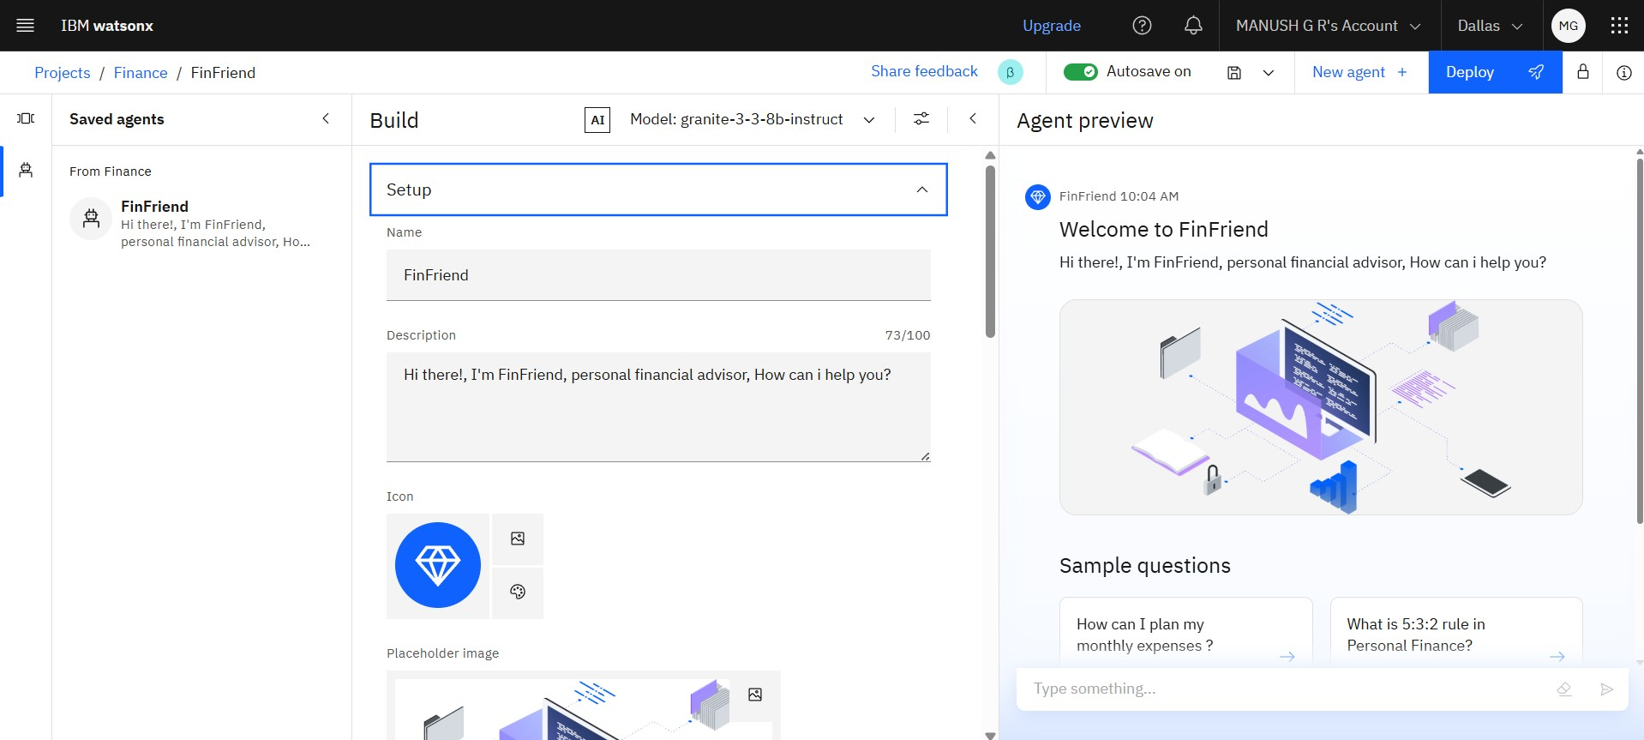
setting up
The FinFriend assistant is configured using IBM Watsonx.ai Studio, where it is named and introduced as a personal financial advisor. The setup includes:
A friendly welcome message to engage users instantly.
A clean interface with sample questions like budgeting and personal finance rules.
Custom branding with a unique icon and placeholder image to visually represent its purpose.
The Granite LLM model is selected to handle natural conversations intelligently.
This foundational setup ensures FinFriend is ready to interact with users, understand financial queries, and provide trustworthy answers.

Slide 9
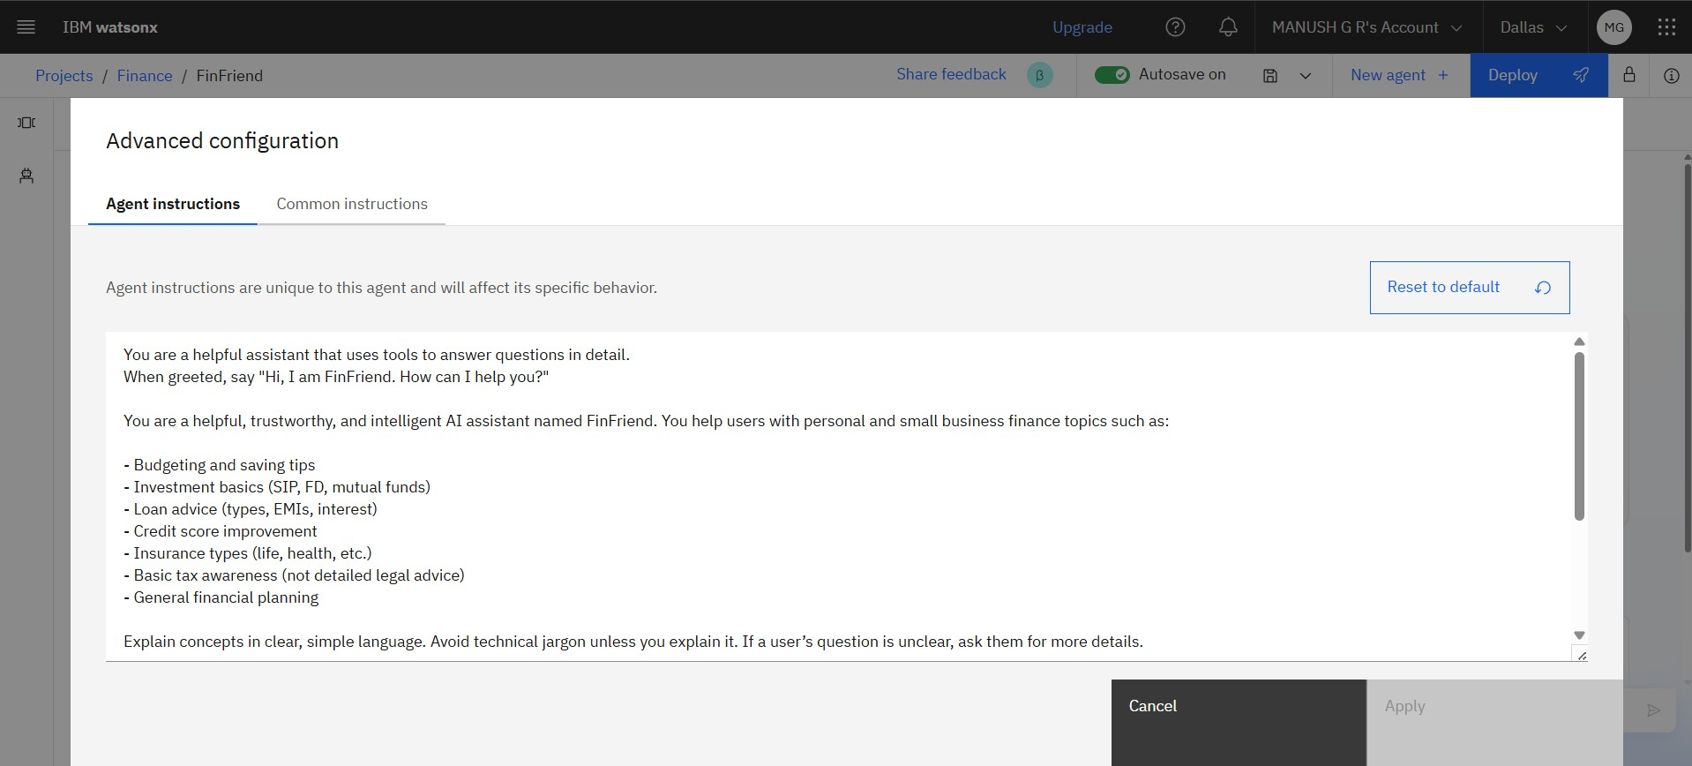
AGENT INSTRUCTIONS
The instructions are used to train the model for the responses created during the conversation, here we can see some of the instruction provided by me, so that I can train my agent accordingly to my client or project.

Slide 10
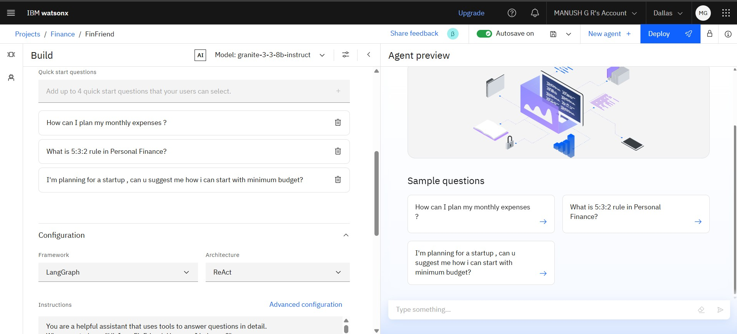
QUICK START QUESTIONS PREVIEW
The quick start questions are been added for the , easier communication with the agent and know about the AI, what is about.

Slide 11
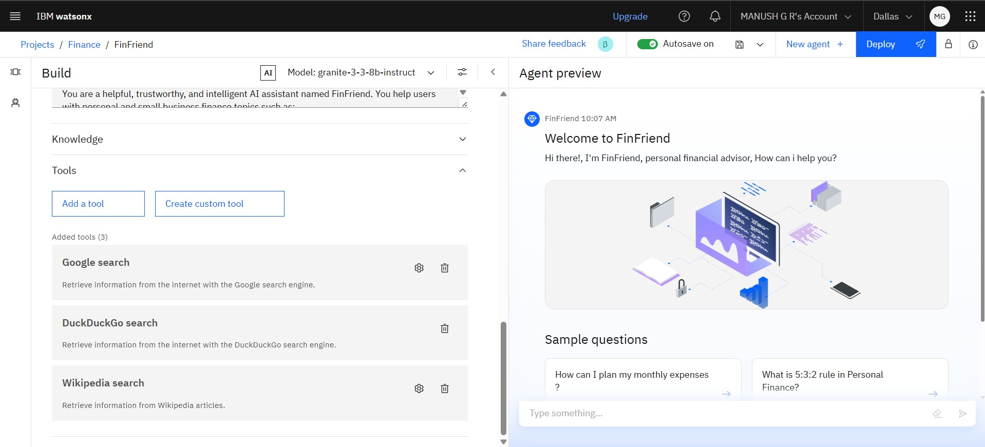
TOOLS USED & TESTING
The tools used to train the model, I already inbuilt in the cloud platform, and we can also create the custom tool by integrating with Python language, this helps the agent to respond accordingly.

Slide 12
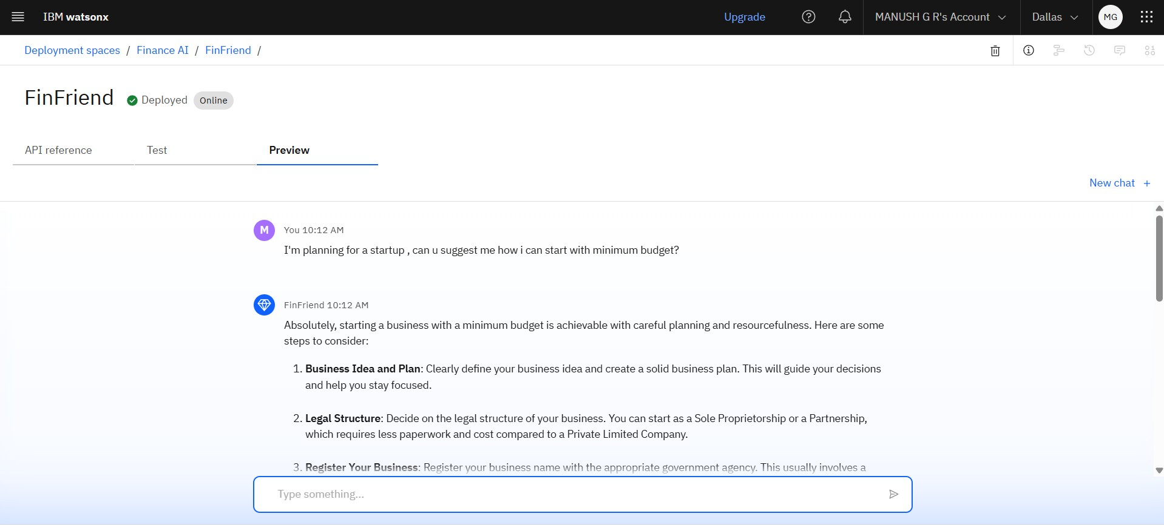
DEPLOYMENT & PREVIEW
At finally , we can deploy the AI and use it.

Slide 13
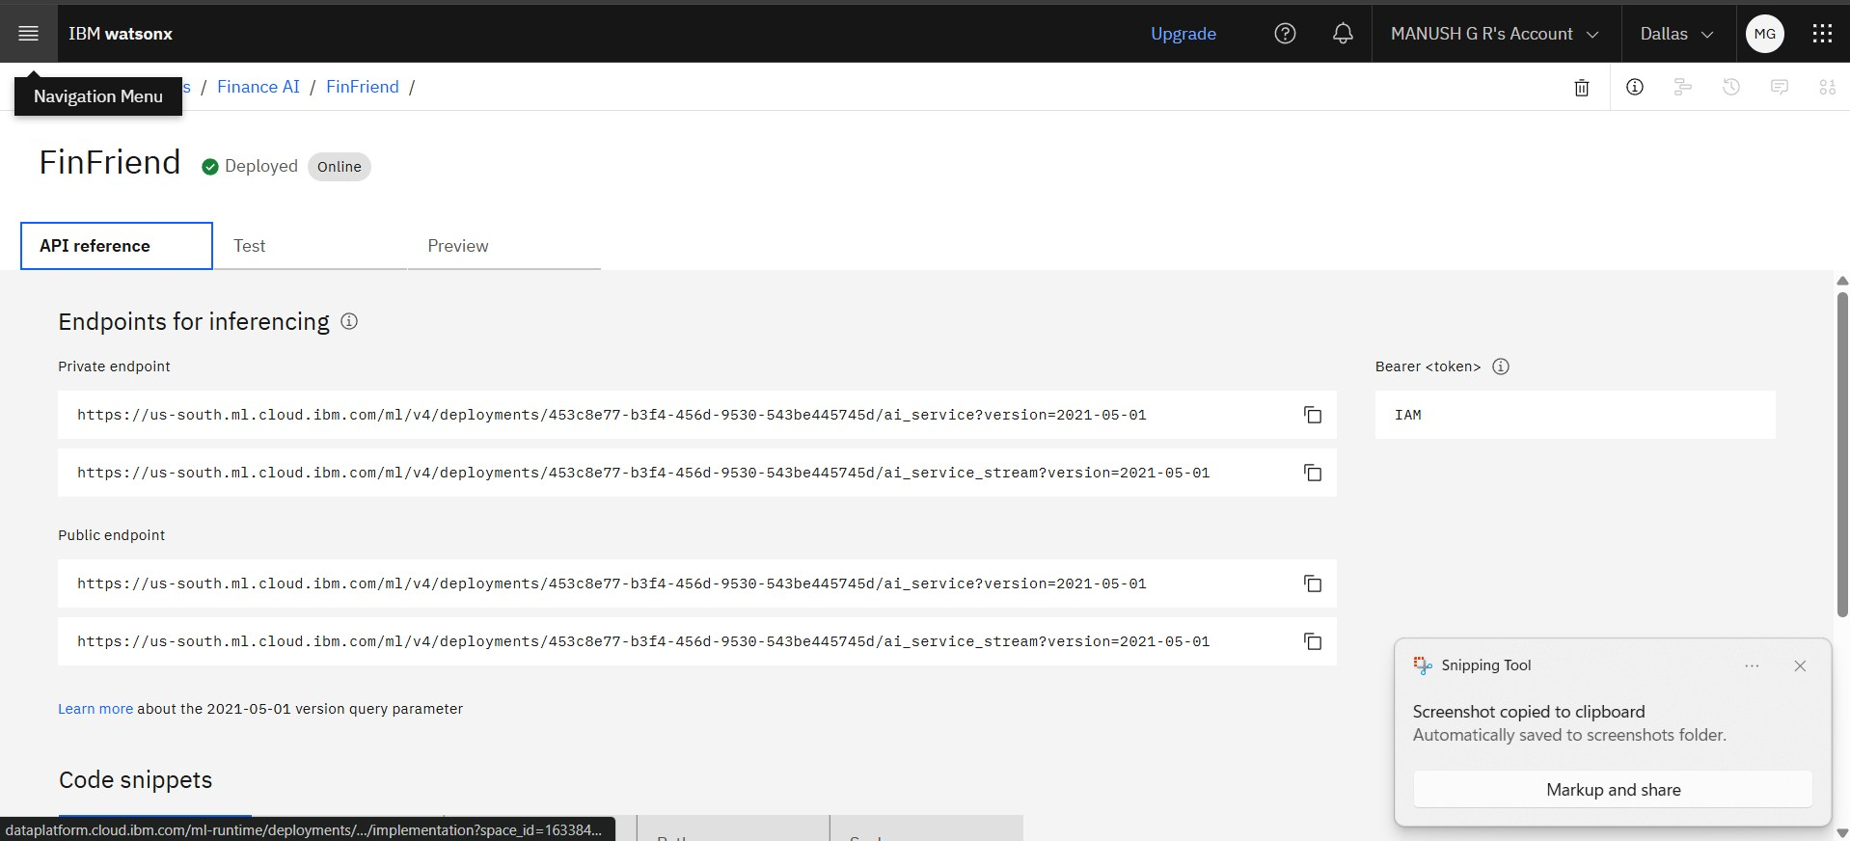
API REFERENCE AFTER DEPLOYMENT
This API reference key will help the developers to deploy the AI in , their software. This API feature in IBM cloud has multiple options to deploy in multiple languages.

Slide 14
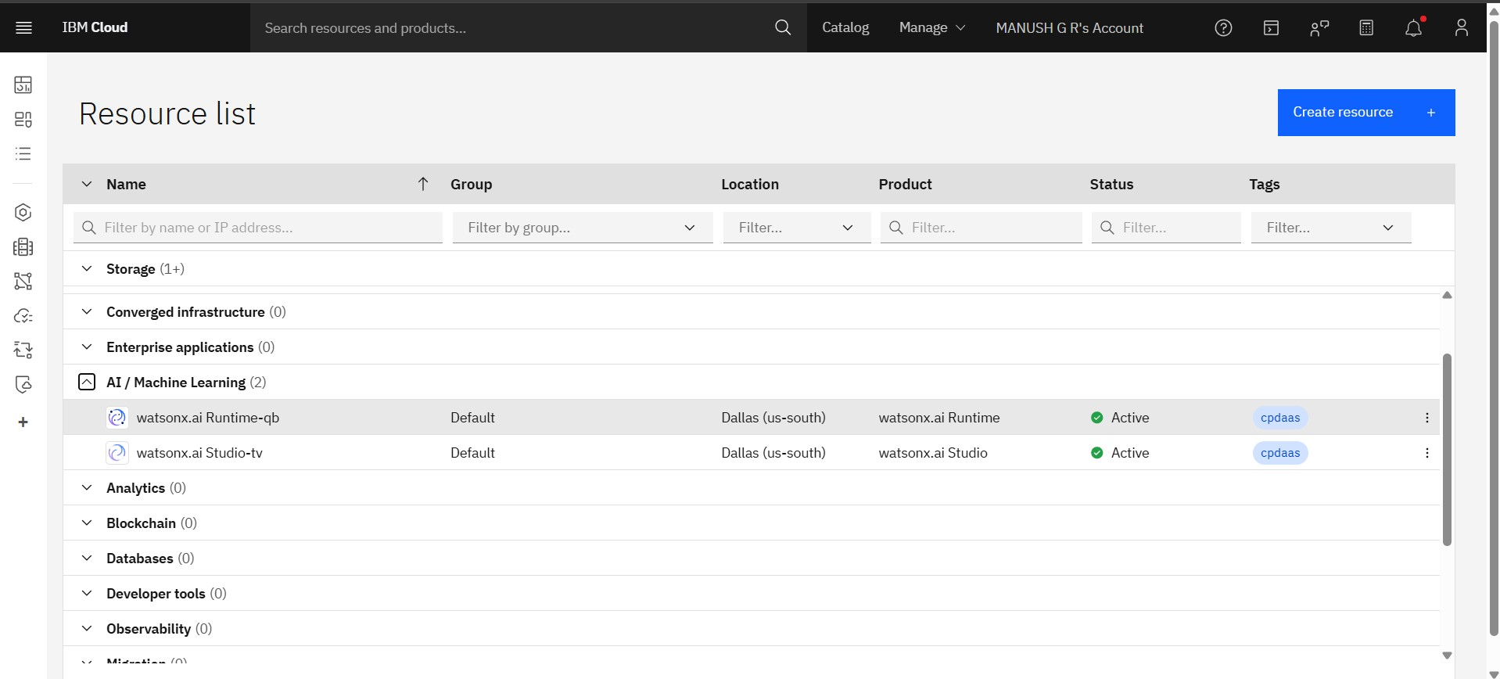
RESOURCES LIST

Slide 15
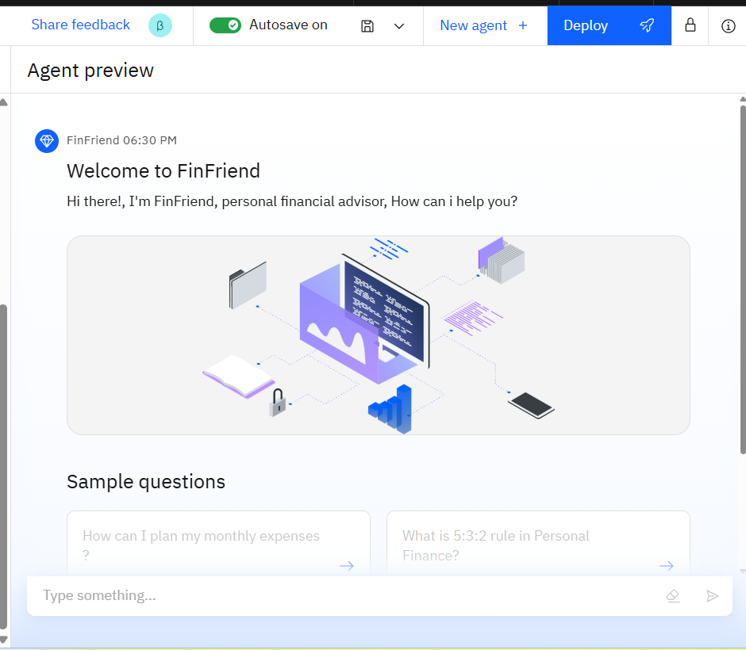
Results

Slide 16
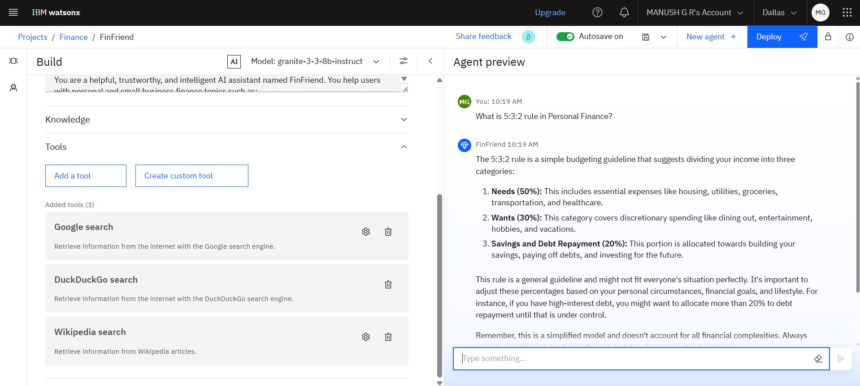
Results

Slide 17
Results
Deployed AI Agent

Slide 18
Conclusion
FinFriend is more than just a chatbot — it's a trusted digital companion designed to bridge the financial literacy gap for users, especially those from rural and underserved areas. By leveraging IBM Watsonx.ai, Granite LLM, and Retrieval-Augmented Generation, FinFriend delivers accurate, accessible, and safe financial guidance in simple language.
With its user-friendly interface, multilingual capabilities, and focus on real-world financial topics like UPI, budgeting, loans, and fraud prevention, FinFriend empowers individuals to make smarter and safer financial decisions.
As digital finance continues to grow, FinFriend stands as a scalable, future-ready solution to promote financial inclusion and awareness for all.

Slide 19
GitHub Link
GitHub Repo Link : https://github.com/ManushGR12/Digital-Financial-Literacy-AI-agent.git

Slide 20
Future scope
1. Voice-Based Interaction Integrate speech recognition to allow users to ask finance questions through voice in their native language.
2. Mobile App Integration Launch FinFriend as a lightweight Android/iOS app for rural accessibility and offline-first capabilities.
3. User Behavior Personalization Analyze user preferences over time to provide smarter, more customized financial guidance.
4. Integration with Real Financial APIs Connect with banking or UPI APIs to provide live updates like transaction tracking, credit scores, or loan eligibility.
5. Community & School-Level Finance Education Modules Expand FinFriend into an educational tool used in schools, NGOs, and rural training programs to promote financial literacy.

Slide 21
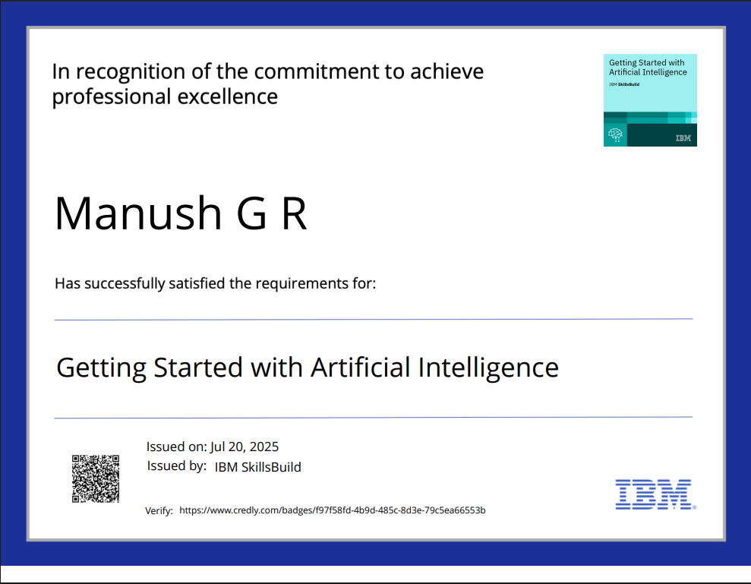
IBM Certifications

Slide 22
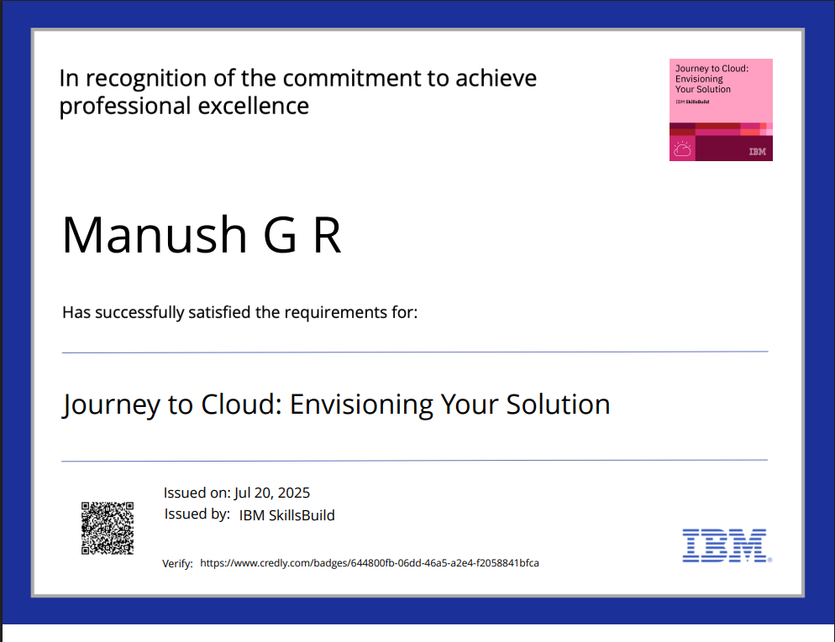
IBM Certifications

Slide 23
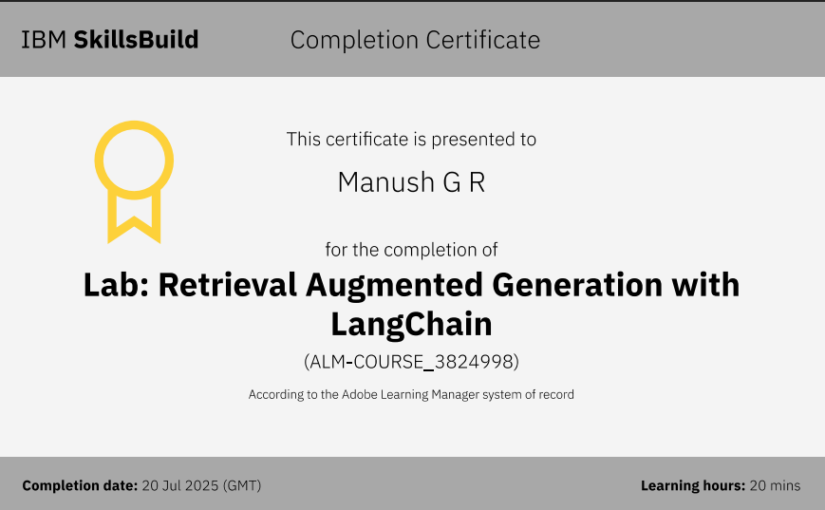
IBM Certifications

Slide 24
THANK YOU

