Slide 1
OPTICAL CHARACTER DETECTION
Mentor : Submitted By:
Dr. Vinod Pankajakshan Ishaan Bains 11116026
Abhishek Kumar Singh 11116001
Manush Gupta 11116031
IIT ROORKEE

Slide 2
OBJECTIVE
Implement text detection on Computer generated images as well as natural images
Development package used: Python 2.7.3

Slide 3
FIRST APPROACH
True color RGB image contains 256x256x256 colors(~16million colors)
Processing time for working in true color is very high
Converting such an image into binary image may result in loss of text which is similar in color to background
Best way to deal with the issue is to reduce the number of colors in the image

Slide 4
Conversion to grayscale and reducing the colors
Grayscale image will contain 256 colors as compared to 16million
The 256 colors are basically different shades of gray
Rescaled the 256 colors to 20 colors. Takes care of the various shades of similar color in the same component
Rejected colors which occupy less than 100*{[x]*[y]}/300000 pixels where x and y are the horizontal and vertical resolution of the image.

Slide 5
Flag matrix
Initialize flag matrix of 20 colors
Records number of pixels of each color
Traverse all pixels
Nested loop on x and y
Populating flag matrix
Populate flag matrix by incrementing by 1 whenever a particular color is encountered
Linearly rescale colors from 256 to 20
Rejecting noise
Reject if flag matrix count is less than 100
The value of rejected pixel is set to 255

Slide 6
Generate binary sub-images
Binary images were generated
Each image has one of the colors as ON and the rest as OFF
Binary images have same height and width as the original image

Slide 7
^{Traverse all pixels}
Nested loop on x and y
Hence all pixels traversed
check
Check if pixel value is 255
If not, assign 255 to image sequence matrix(frames)
Image sequence
Initialize binary image sequence(frames)

Slide 8
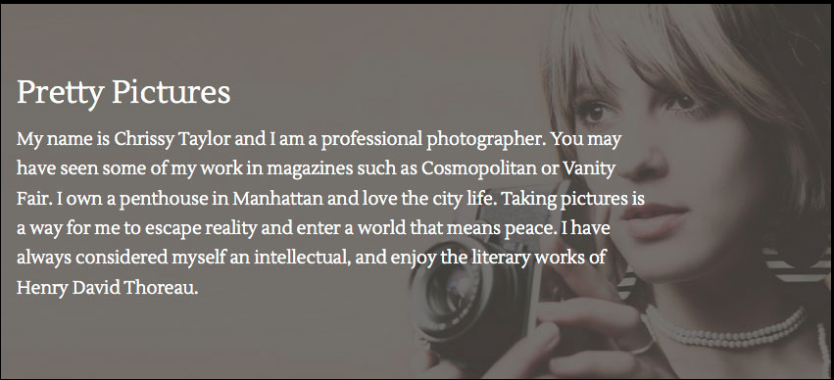
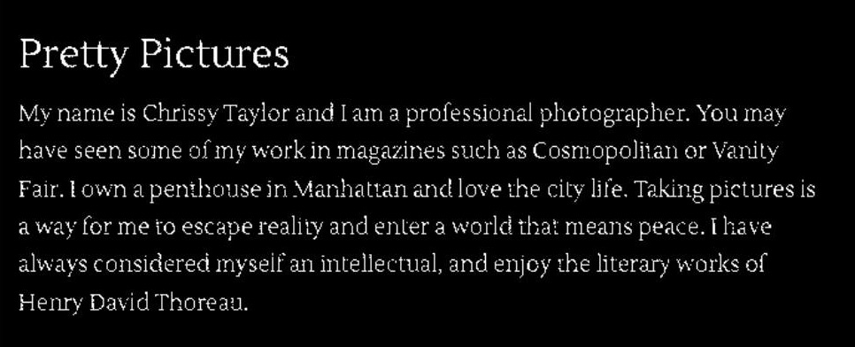
OUTCOME
Works well on uniform colored text in computer generated image
Fig. True color image
Fig. Detected binary image

Slide 9


Poor results in natural image
Fig. True color image
Fig. Detected binary image

Slide 10
SECOND APPROACH
Based on the concept of Stroke Width Transform
A stroke in the image is a continuous band of a nearly constant width
Finding the stroke width of each image pixel
Grouping pixels into letter candidates using their stroke width value
Grouping letters into bigger constructs of words and lines

Slide 11
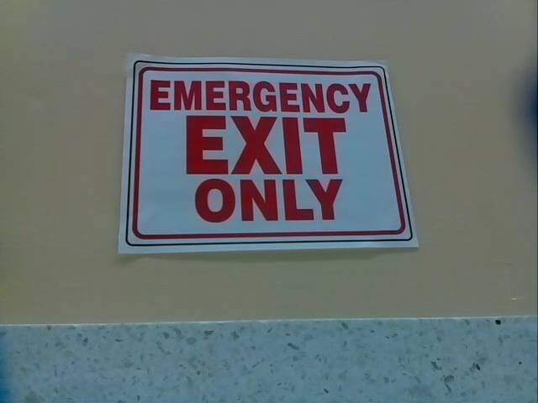
PRE-PROCESSING OF THE IMAGE
Reducing the colors in the image using K-means clustering
Converting the reduced color image to grayscale image
Fig. Original True Color Image

Slide 12
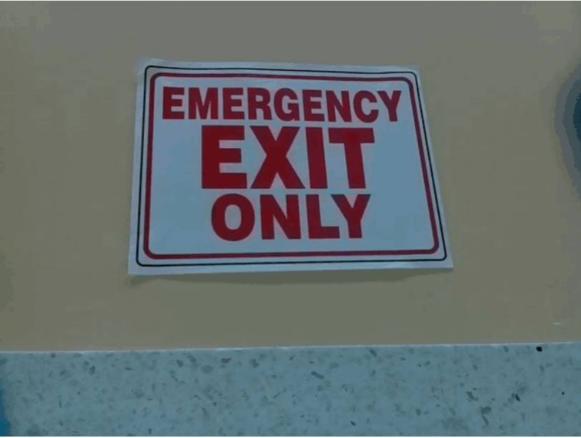
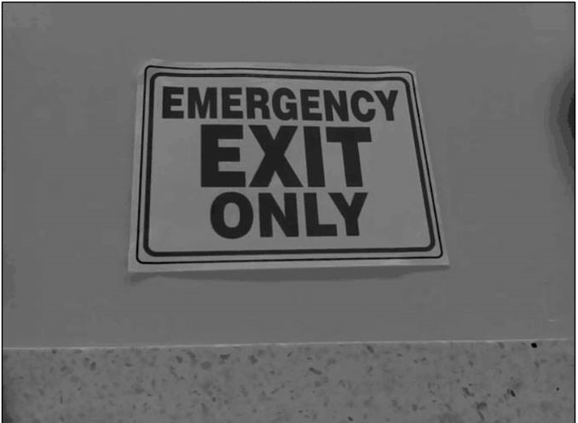
Fig. Output of K-means clustering
Fig. Grayscale converted image

Slide 13
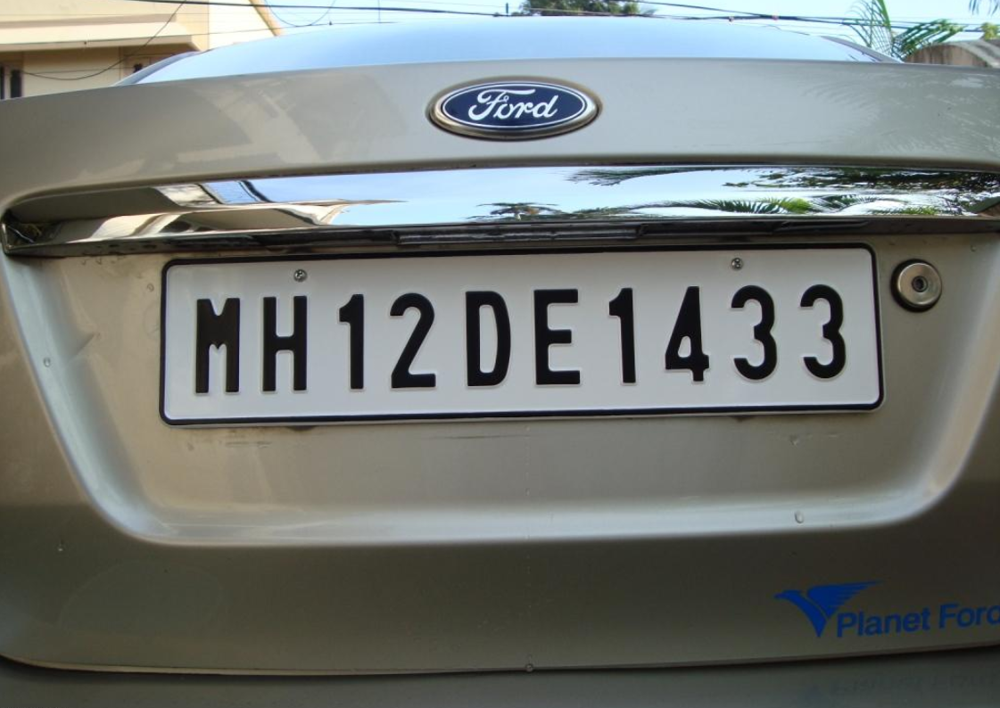
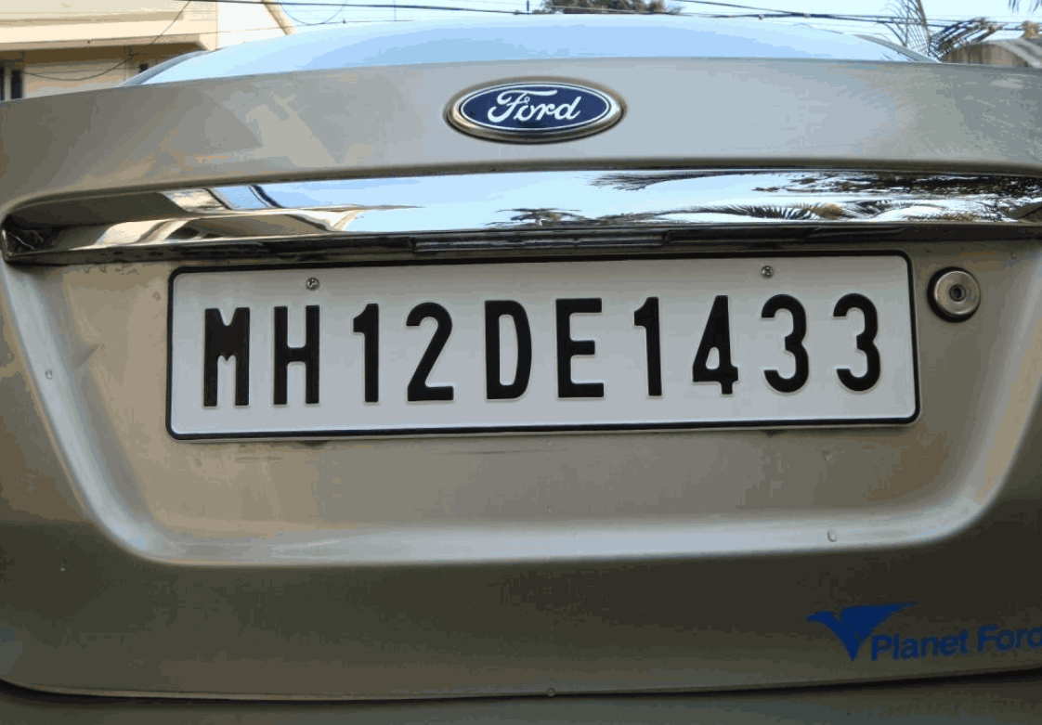
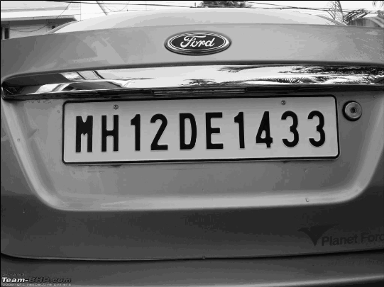
Fig. True color image
Fig. Output of K-means clustering
Fig. Grayscale converted image

Slide 14
Calculating Stroke Width Transform
First, all pixels are initialized with 255 as their stroke width in a separate SWT matrix
Then, we calculate the edge map of the image by using the Canny edge detector

Slide 15
CANNY EDGE DETECTOR
Filter out any noise in the original image using Gaussian filter
Find the intensity gradients of the image using Sobel Operator
Apply non-maximum suppression to get rid of spurious response to edge detection
Apply double threshold to determine potential edges
Track edge by hysteresis: Finalize the detection of edges by suppressing all the other edges that are weak and not connected to strong edges

Slide 16
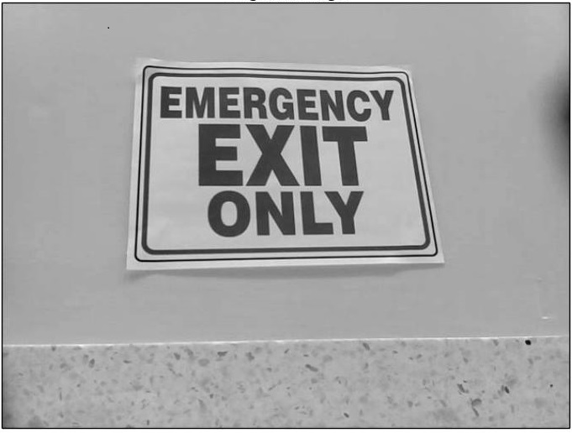
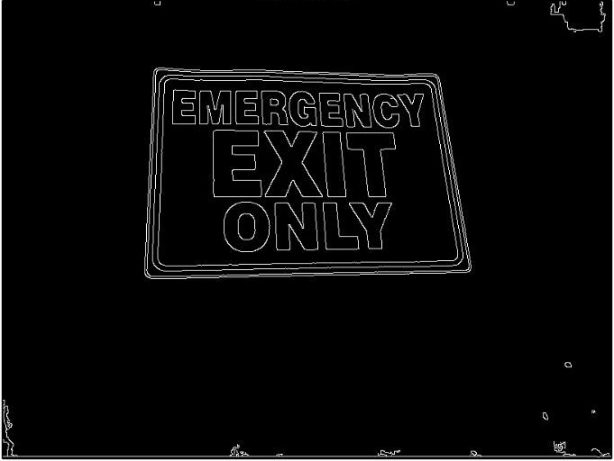
Fig. Grayscale image
Fig. Corresponding edge image

Slide 17
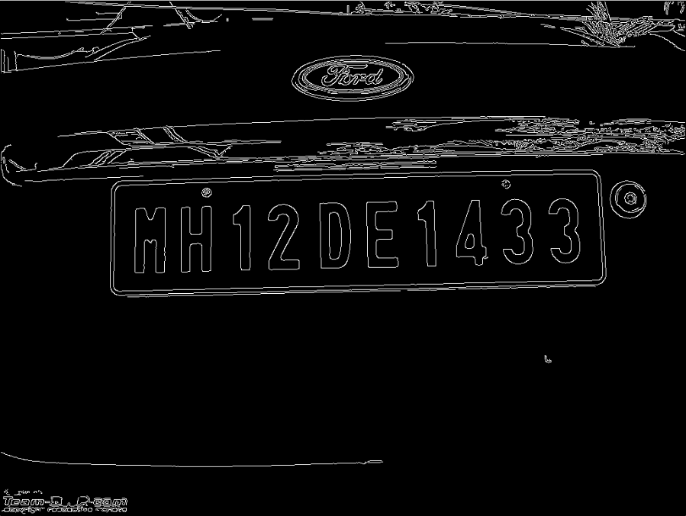
Fig. Original Image
Fig. Corresponding Edge Image

Slide 18
Using Sobel Operator, we calculate gradient direction(angle) for the edge pixels
We start from an edge pixel and move in its gradient direction till we reach some other edge pixel.
If the gradient direction at the second edge pixel is same as the first edge pixel, then we assign each pixel in the ray, the distance between the two edge pixels as the stroke width, unless it already has a lower value
If other pixel with same gradient direction is not found, then the whole ray is discarded.

Slide 19
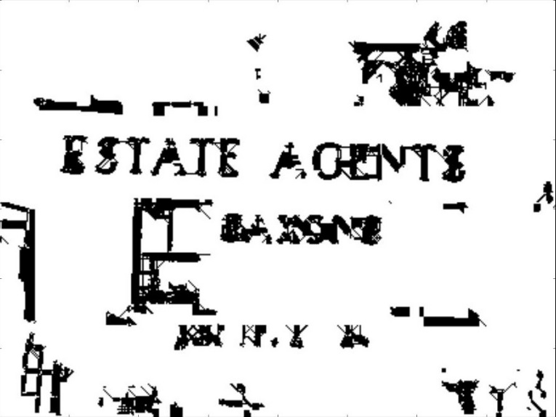
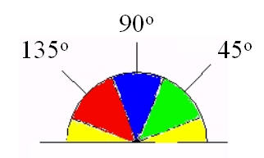
After getting the gradient direction, since we could only move in one of the eight adjacent pixels, we were mapping each gradient direction to four angles i.e. 0 , 45 , 90 ,135
Did not work well with large text size

Slide 20
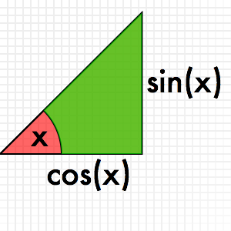
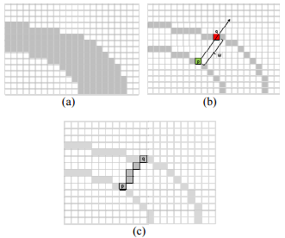
Alternate traversal method was used
Start from an edge pixel with ray length ‘r’ set as 1
First move in horizontal direction as r*cos(x) and then in vertical direction as r*sin(x) and increment ray length ‘r’.
‘x’ is the gradient direction

Slide 21
Number of pixels in a valid stroke, is assigned as the stroke width to each pixel in that ray in the SWT matrix
Valid stroke width is the one in which the end edge pixel has a gradient difference between –pi/2 and +pi/2 from start edge pixel
The output of the previous steps is another image of the same size as the input image where each element contains the width of the stroke associated with the pixel.

Slide 22
ISSUES ADDRESSED
Detects only dark text on light background
For light text on dark background, gradient direction is outwards, wrong stroke width is assigned
We ran the algorithm twice, once in +ve gradient direction, then in –ve gradient direction

Slide 23
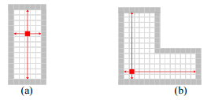
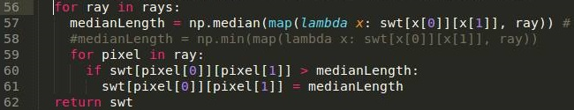
Pixels in complex locations might not hold the true stroke width value
For that reason, we pass along each non-discarded ray, where each pixel in the ray receives the minimal value between its current value, and the median value along that ray

Slide 24
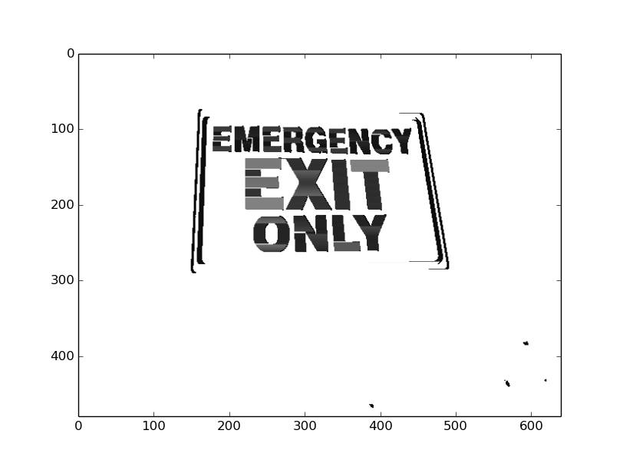
Fig. SWT image

Slide 25
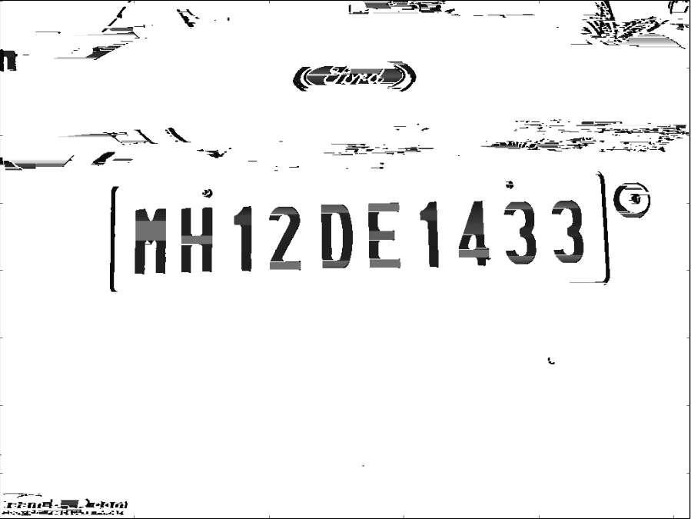
Fig. SWT image

Slide 26


Morphology: Dilation
After calculation of SWT values and normalizing them to be between 0-255
Gaps were found between the single letters of the text
Prevented them from being recognized as a single connected component
Applied dilation to fill those gaps

Slide 27

Fig. Output of the dilation

Slide 28
FINDING THE CONNECTED COMPONENTS
4 connectivity is used
Two neighboring pixels may be grouped together if they have similar stroke width.
The criteria for similarity is that the SWT ratio lies between 0.33 and 3.

Slide 29
A queue was used to implement the above steps
We used Breadth First Search algorithm to access the pixels.

Slide 30
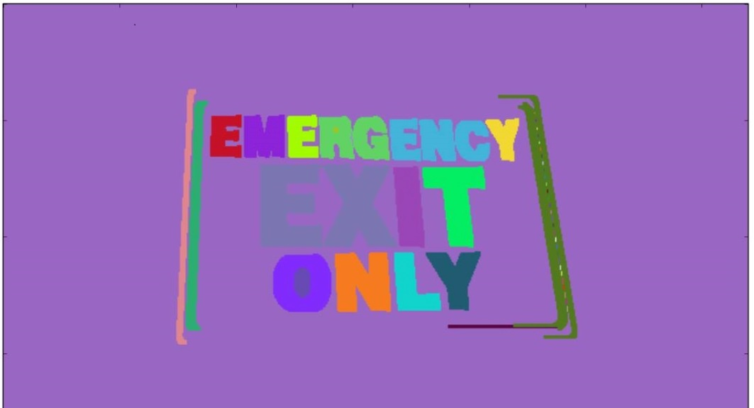
Fig. Connected component image

Slide 31
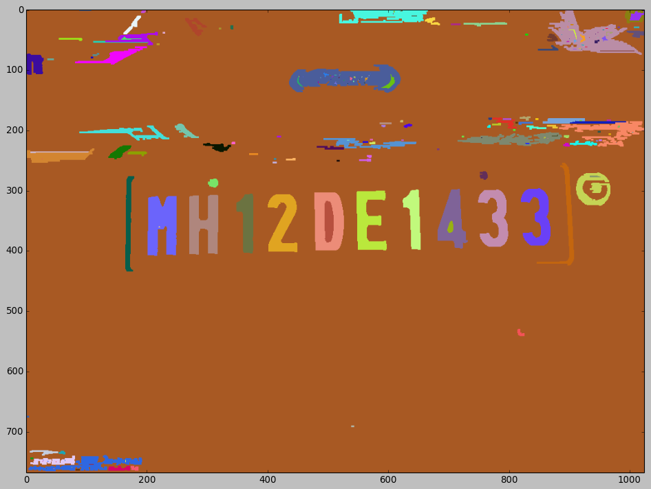
Fig. Connected component image

Slide 32
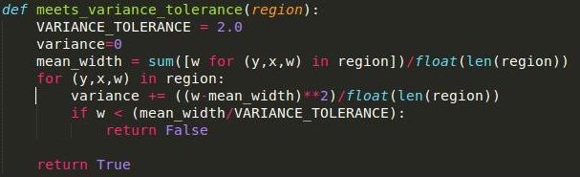
FINDING POSSIBLE LETTER CANDIDATES
Identify components that may contain text. For this we employ a small set of flexible rules like:
The variance(σ²) of the stroke-width within a component must not be too big. Helps rejecting foliage.
The threshold value for stroke width is obtained as:
Stroke width< 0.5*mean stroke width

Slide 33
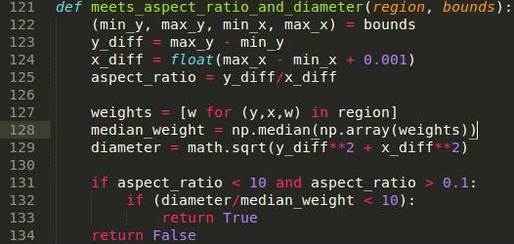
The aspect ratio of a component must be within a small range of values, in order to reject long and narrow components:
0.1< Aspect Ratio < 10

Slide 34
Often times, text is surrounded by other components like frames of a sign board, number plate etc.
To eliminate these frames, we restrict that the bounding box of obtained components should not contain more than two other components.
We restrict the size of our text within a range of values and hence reject very large or very small components.
All the remaining connected components were considered as potential letter candidates

Slide 35
GROUPING LETTER CANDIDATES INTO TEXT REGIONS
Since single letters are not expected to appear in images, group closely positioned letter candidates into regions of text
A set of rules to group letters together into regions of text:
Two letter candidates should have similar stroke width with ratio of median stroke width being less than 2
Height and width of the neighboring characters should be in ratios 2 and 3 respectively.
The candidate pairs determined above are clustered together into chains

Slide 36

Fig. Grouping of letter candidates

Slide 37
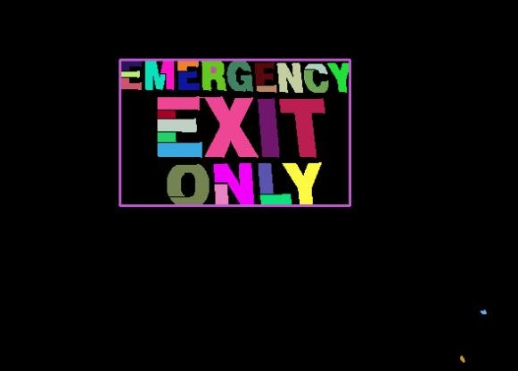
The final step is to cluster together, all the candidate pairs determined above into chains. Multiple chains can be grouped together if they share a common end. Each hence produced chain is taken to be a text line.
Fig. Detected text box in connected component image

Slide 38

PROBLEMS FACED
In canny edge, we had to change min max threshold according to image and not some arbitrary value
Canny edge works on the principle of intensity gradient
a difference in intensity is always assumed from the implementation side
In Otsu's method we exhaustively search for the threshold that minimizes the intra-class variance (the variance within the class)
we were able to dynamically adjust edges by using his algorithm

Slide 39
Often times, two texts of different colors are detected in the same line and given the same bounding box if they follow the width and height ratios.
However, these two boxes may not form a continuous line of text and can just be two separate sentences . Eg: in a newspaper color page
To remove this problem, we compare mean component color of the two detected regions and if they differ by a ratio greater than 2, they are put in two different bounding boxes and are not merged

Slide 40
Detected region still include components which have unusual orientation because algorithm detects stroke independent of language
To remove these components, the diameter to median stroke width ratio is changed to have a lower bound of 1.414
1.414
1

Slide 41
Morphological dilation:
After performing dilation on the image with a normal rectangular kernel[2x2] with all values as 1, many times two letter candidates are grouped into one component
This poses a problem for the aspect ratio conditions in many images
The proposed solution is to use a 3x3 kernel of the form:
1 0
0 1 0
0 1 1

Slide 42
Size of font:
When the bounding box of each letter is less than 0.0025% of the area of the image, such letters maybe recognized in SWT but will not be grouped into letter candidates because of the limiting condition

Slide 43
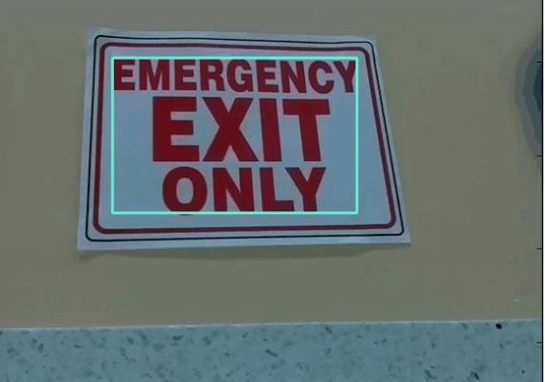
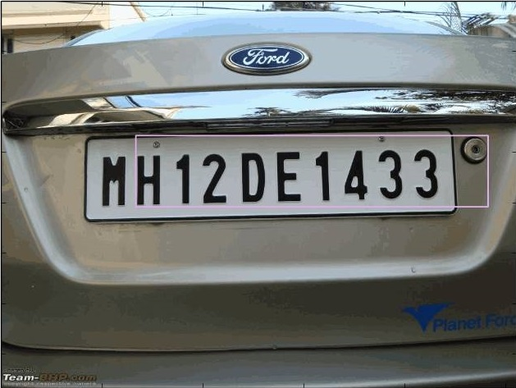
FINAL RESULTS
Fig. Final image with detected text box

Slide 44
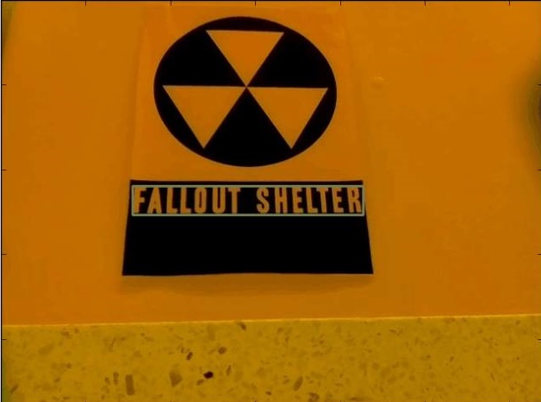
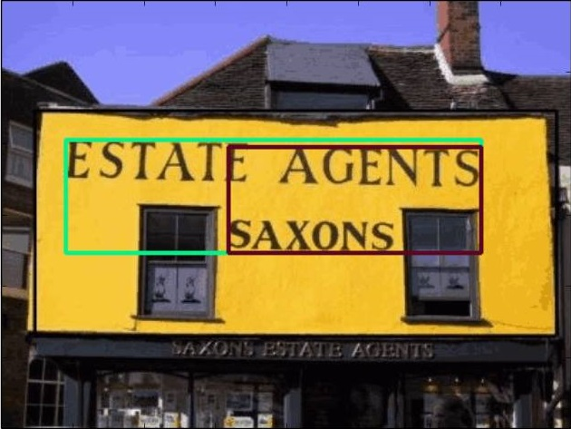
RESULTS WITH OTHER SAMPLES

Slide 45
THANK YOU

