Slide 1

STUDY OF GENDER DISTRIBUTION ACROSS JOBS IN NEW YORK CITY - Manushi Majumdar

Slide 2


BACKGROUND
New York City – Financial Capital of the world
3.9 Million employees as recorded in the year 2013
1.97M employees
1.95M employees
A paper ‘Occupational gender segregation Trends and Explanations’, written by Jo Anne Preston *
How are these segregations done?
*Preston, Jo Anne. "Occupational gender segregation trends and explanations." The Quarterly Review of Economics and Finance 39.5 (1999): 611-624.

Slide 3

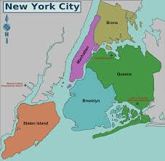
RESEARCH QUESTION
Does New York City exhibit patterns in gender distribution across jobs?
Do some of these gender dominated jobs, also predominate in certain neighborhoods?

Slide 4
DATA
LODES data – LEHD Origin Destination Employment Statistics for the year 2013
Longitudinal Employer Household Dynamics
Workforce Area Characteristics (WAC) provides Number of Employees based on
Age
Gender
Race
Income bracket
Education Background
Industry Type, Size, Age
Per Workplace Census Block Code
New York State Geographical Crosswalk File (xwalk)
State
County
Block Grop Name
FIPS Code
ZIP Code
Other Geographical Details
Per Workplace Census Block Code

Slide 5
DATA PROCESSING
STATE xwalk
NYC
xwalk
WAC for State
Reduced to
Inner Join
NYC
WAC
Group based on zip code
NYC
WAC per ZIP Code
Retained only necessary attributes
NYC
WAC
OF USE

Slide 6
ANALYSIS
For each zip code, calculated → RatioMF = number of men / number of women
Correlation Matrix of final table.
FINDINGS
Much larger number of women in ‘Health Care and Social Assistance’.
Also large number of women in ‘Accommodation and Food Services’, and ‘Public Administration’.
Large number of men in ‘Professional, Scientific and Technical Services’.

Slide 7
FURTHER ANALYSIS
Normalize the data
KMeans Clustering – 6 Clusters
Merged results with ZIP Code shapefile of NYC
Plotted results on a map

Slide 8
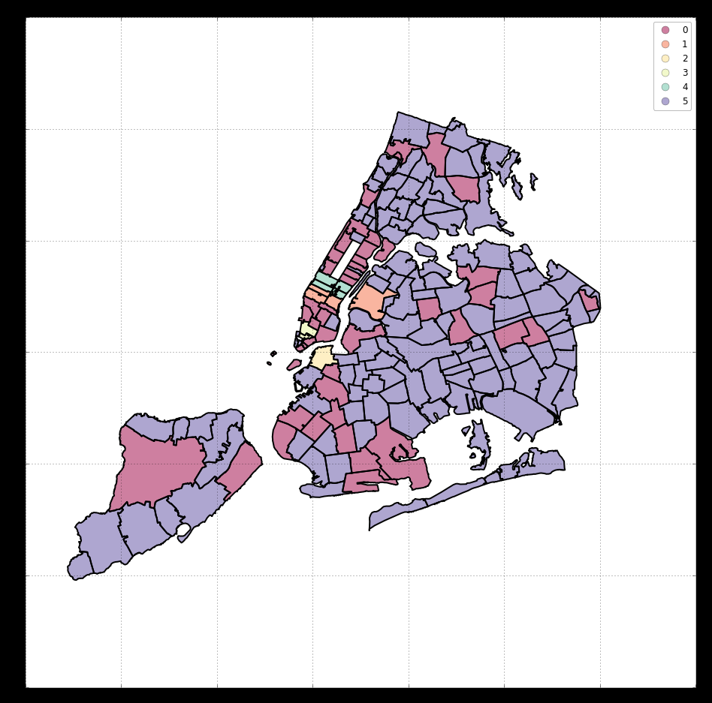
RESULTS
CLUSTER COLOR | OCCUPATION | GENDER MAJORITY
Purple | Public Administration | Female
Pink | Health Care and Social Assistance | Female
Green | Finance and Insurance | Male
Pale Yellow | Finance and Insurance + Professional, Scientific and Technical(PST) Services | Male
Orange (Manhattan) | Education Services | Male
Peach (Queens) | PST, Public Administration | About equal

Slide 9
CONCLUSION
Gender distribution across jobs observed in NYC
Other Clustering Algorithms,
Older data of WAC
RAC, Data about Salary across genders, Education across genders
Project on - https://github.com/ManushiM/GenderDistributionAcrossJobs

