Slide 1

Introduction to Dapr
a runtime for building microservices on cloud and edge
Carlos Mendible
Azure Evangelist @everis
Azure & Developer Technologies MVP
@cmendibl3

Slide 2
GOALS
Understand What is Dapr
Understand how Dapr works
Understand basic Dapr samples
Notes:
QUE QUIERO QUE CONSIGAMOS HOY?

Slide 3
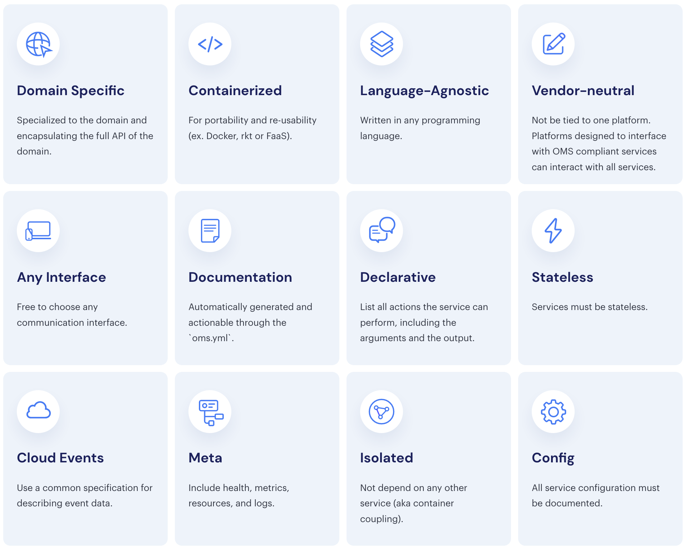
The Twelve-Factor Microservice
Notes:
AHORA VAMOS A VER LO QUE SUCEDE EN EL MUNDILLO DE LOS PALABROS COMO MICROSERVICIOS Y CONTENEDORES.
LAS SOLUCIONES BASADAS DIRECTAMENTE EN EL KEYVAULT SECRET MANAGER ACOPLAN DIRECTAMENTE NUESTAR APLICACION CON ESA SOLUCION Y CON AZURE
LO QUE IMPLICA QUE NO CUMPLIMOS CON UNOS DE LOS FACTORES DE APOSTAR POR LA NEUTRALIDAD RESPECTO AL VENDOR.
Y CREEDME MUCHOS DE MIS CLIENTES SE PREOCUPAN POR ESTO.
https://openmicroservices.org/

Slide 4
Dapr
An event-driven, portable runtime for building microservices on cloud and edge.
Powerful Building Blocks
Open API
Works with any programming language
Open Source

Slide 5
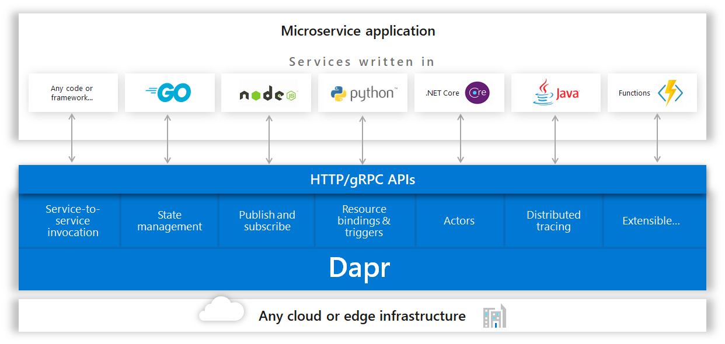
Dapr
Notes:
https://github.com/dapr/docs/blob/master/overview.md#running-dapr-on-a-local-developer-machine-in-standalone-mode

Slide 6
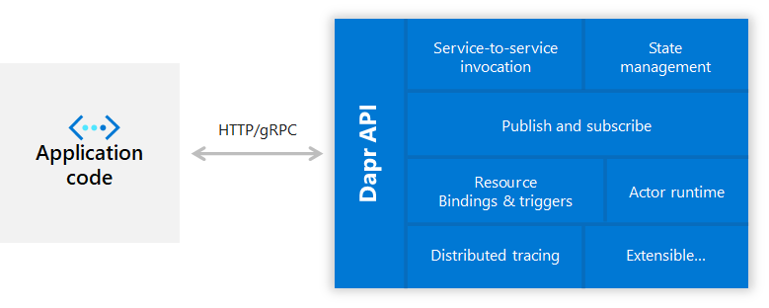
Sidecar architecture
Notes:
https://github.com/dapr/docs/blob/master/overview.md#running-dapr-on-a-local-developer-machine-in-standalone-mode

Slide 7
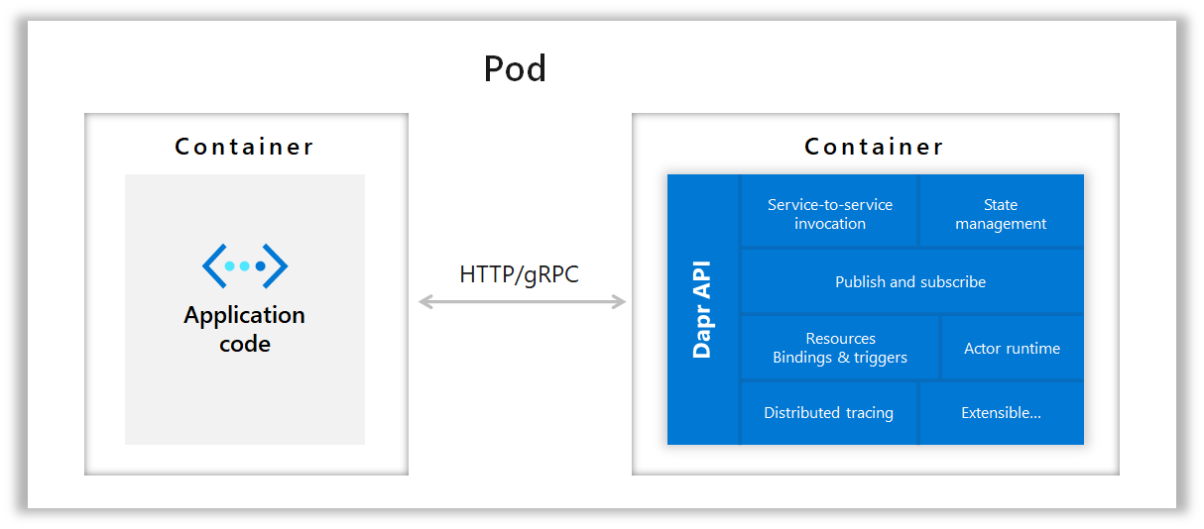
Sidecar architecture
Notes:
https://github.com/dapr/docs/blob/master/overview.md#running-dapr-on-a-local-developer-machine-in-standalone-mode

Slide 8
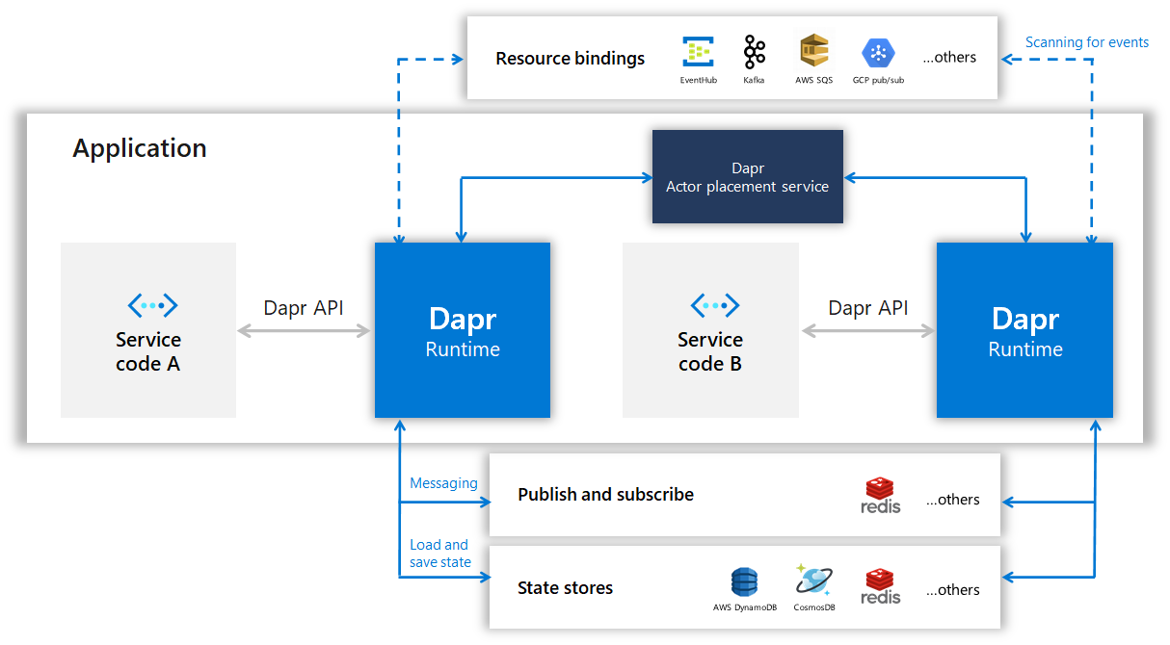
Dapr on a local developer machine in Standalone mode
Notes:
https://github.com/dapr/docs/blob/master/overview.md#running-dapr-on-a-local-developer-machine-in-standalone-mode

Slide 9
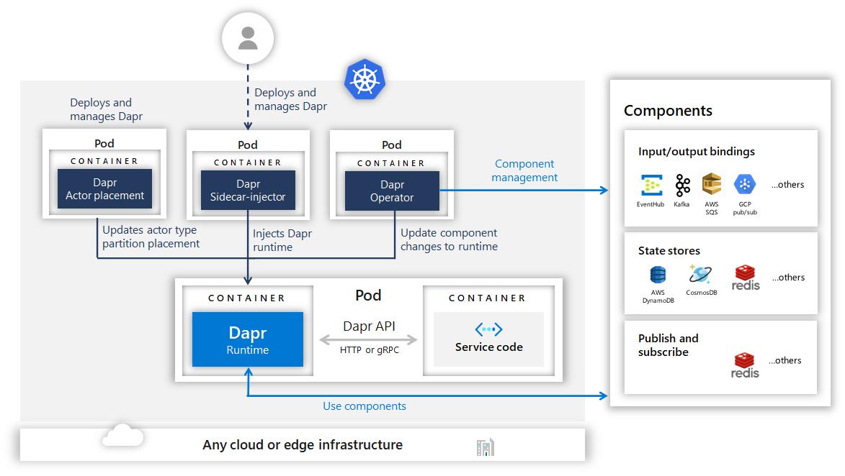
Dapr in Kubernetes mode
Notes:
https://github.com/dapr/docs/blob/master/overview.md#running-dapr-on-a-local-developer-machine-in-standalone-mode

Slide 10
Dapr Core Concepts
Building blocks are a collection of components that implement distributed system capabilities, such as pub/sub, state management, resource bindings, and distributed tracing.
Components encapsulate the implementation for a building block API. Example implementations for the state building block may include Redis, Azure Storage, Azure Cosmos DB, and AWS DynamoDB. Many of the components are pluggable so that one implementation can be swapped out for another.
Notes:
https://github.com/dapr/docs/blob/master/concepts/README.md

Slide 11
Dapr Building Blocks
Resource Bindings: a binding provides a bi-directional connection to an external cloud/on-premise service or system.
Distributed Tracing: distributed tracing collects and aggregates trace events, metrics and performance numbers between
Publish/Subscribe MessagingService Invocation
Service invocation: http or gRPC
State Management: key/value-based state API
Actors: virtual Actor pattern
Notes:
https://github.com/dapr/docs/blob/master/concepts/README.md

Slide 12
Dapr Components
Bindings
Tracing exporters
Middleware
Pub/sub
Secret store
Service discovery
State
Notes:
https://github.com/dapr/docs/blob/master/concepts/README.md

Slide 13
Installing Dapr
Prerequisites
Docker
Install CLI
Powershell -Command "iwr -useb https://raw.githubusercontent.com/dapr/cli/master/install/install.ps1 | iex“
Installing Dapr in standalone mode
dapr init
docker ps
Installing Dapr on a Kubernetes cluster
dapr init –Kubernetes
kubectl get pods -n dapr-system -w
Notes:
https://github.com/dapr/docs/blob/master/getting-started/environment-setup.md#prerequisites

Slide 14
Demo Time!
@cmendibl3

Slide 15
Thanks!
@cmendibl3

