Slide 1
Android Healthcare App
COMPETATIVE PROGRAMMING LAB
WIN SEM 2022-2023

Slide 2
TABLE OF CONTENTS Introduction Features of healthcare app Design

Slide 3
Abstract
Android healthcare is a revolutionary project that utilizes the latest mobile technology to provide healthcare services to individuals. This project is designed to make healthcare more accessible and efficient for everyone.
The Android healthcare project is a comprehensive system that includes a mobile application, cloud computing, and a secure database. This project will allow users to access their medical records/lab tests, find a doctor, manage their appointments, and receive health advice from medical professionals.

Slide 4
Features of healthcare app
Find doctors and hospitals
Lab test and packages
Buy medicines
Health articles
Order details

Slide 5
Design

Slide 6
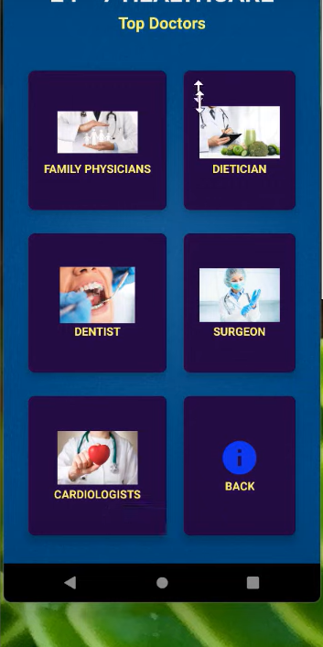
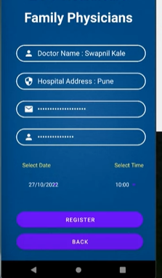


Find doctors and hospitals
This will give you the grid
view of specific departments
of doctors you want
to concern with.
Further you can select one
and find the top doctors along
with their hospitals and book
appointment.

Slide 7
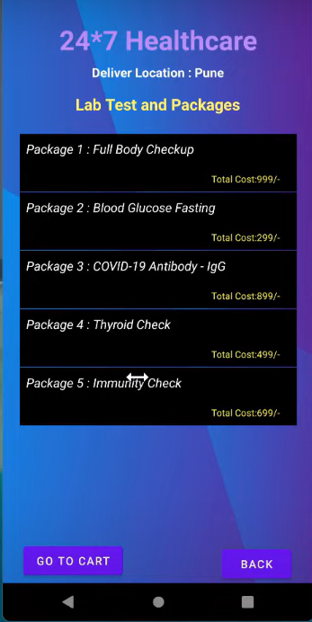
Lab Test and Packages
It includes the available tests and its costs,
you can select as many lab test you want to do
on specific dates and book for labs which are
convenient for your location.

Slide 8
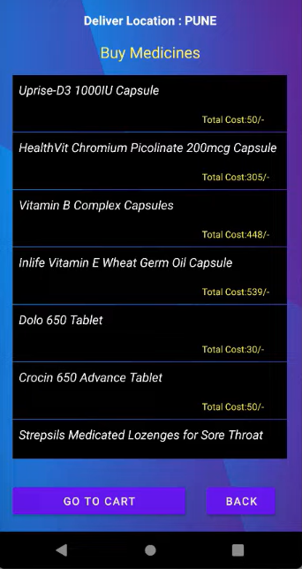
Buy medicines
This feature helps to buy
medicines online and deliver
it to your location .
Once the order has been placed
one can keep the track of the delivery.

Slide 9
Health articles
This is an additional feature .
Health articles can be a great source
of information for individual. They
provide up-to-date information
about medical conditions, treatments.
They can also provide tips for maintaining
a healthy lifestyle and preventing illnesses.
By reading health articles, people can
learn about different diseases,
treatments, and lifestyle changes that
can help them stay healthy.

Slide 10
THANK YOU

