Slide 1

GROWTH PATH
A Learning Platform
Team 11
Nitya N Hegde
Manuvidya S

Slide 2
Growth Path: A Personalized Learning Journey
Project Overview
Key Features
Goal
Growth Path is a digital learning platform designed to provide learners with a personalized journey of growth by assigning them relevant courses based on their needs and progress.
Course Assignment
Empower learners to develop new skills at their own pace while providing valuable insights into their progress.
Progress Calculating based on modules completed
Feedback

Slide 3
System Technologies Used
Backend
Frontend
ASP.NET Core provides a robust and scalable foundation for our API. It ensures reliable communication between the frontend and database.
Angular enables a dynamic and responsive user interface. It allows for interactive components and a seamless user experience.
Database
Security
SQL Server, paired with Entity Framework Core, efficiently manages data. It ensures secure and organized storage for user information and learning progress.
Role-based access control ensures that only authorized users have access to specific features and data. It prioritizes user privacy and data protection.

Slide 4
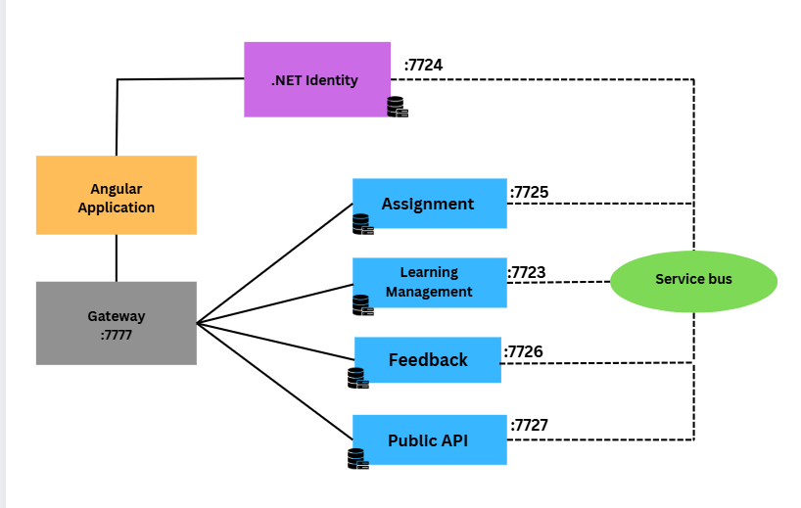
Architectural Diagram

Slide 5
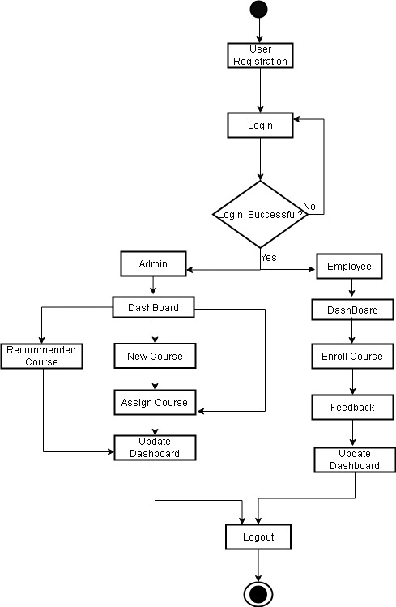
Workflow

Slide 6
Microservices in the Architecture
Auth API
Learning API
Handles user login, generates JWT tokens, and manages user roles
Manages courses , calculates progress based on modules completed, and retrieves course data
Assignment API
Feedback API
Assigning courses to users based on their learning path
Collects user feedback, evaluates performance, and provides better solution
Public API
Lists the recommended courses
Email notifications

Slide 7
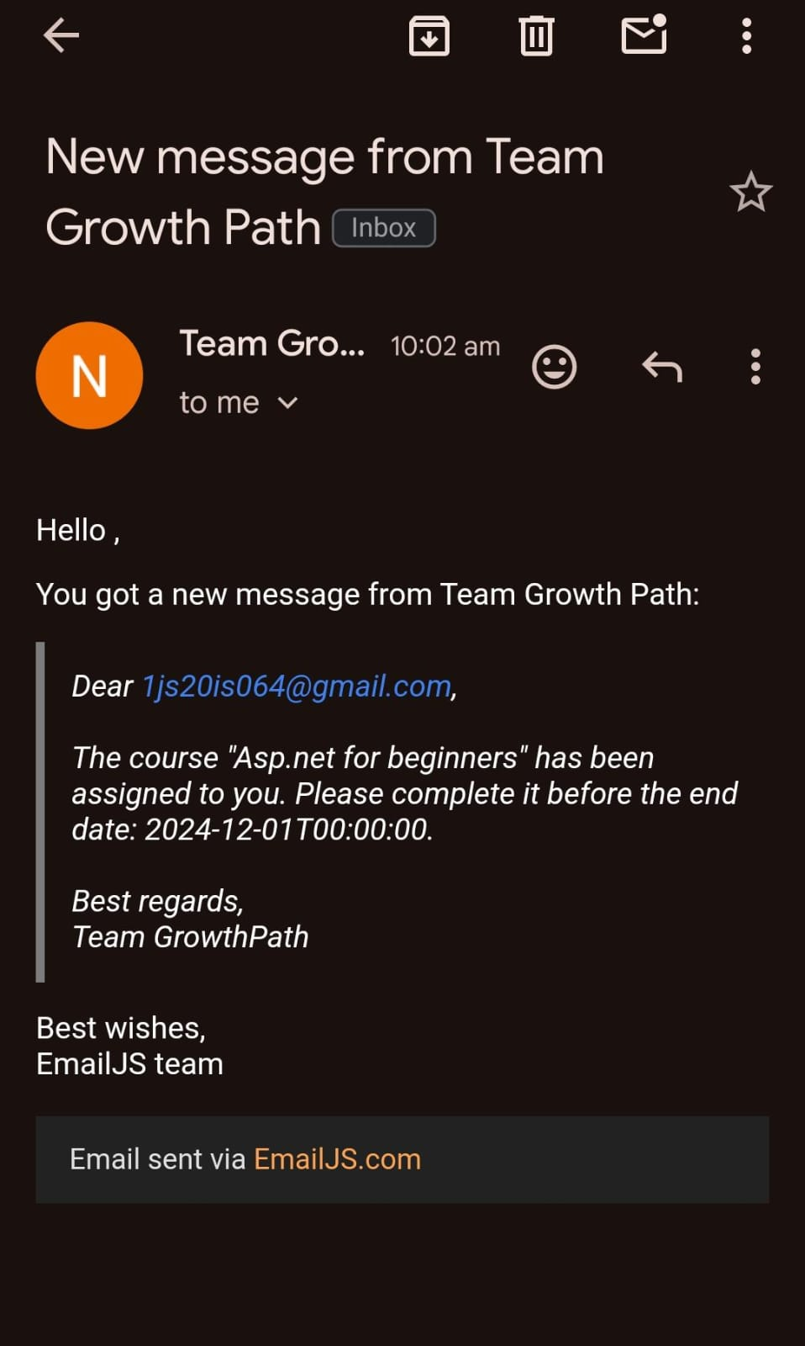
Real-Time API - Email

Slide 8





System Workflow
Login Process
Users (learners or admins) log into the system using the Auth API. Secure JWTs are generated to grant access based on roles.
Learner Dashboard
Users are directed to their personalized dashboards, displaying course assignments and progress, fetched via the Learning API.
Assignment
The Assignment API assigns courses with the end date and modules.
Admin Dashboard
Admins manage courses, view feedback through the Learner Management System.
Feedback
Learners' feedback is collected and stored by the Feedback API.

Slide 9



Conclusion
Key Technologies
Microservices Architecture
Future Improvements
The platform leverages ASP.NET Core, Angular, Entity Framework, and SQL Server for a robust and scalable solution.
The system's modularity and scalability are enhanced by a microservices architecture.
We plan to scale the system, introduce new features, and enhance security measures for improved performance and user experience.

Slide 10

THANK
YOU

