Slide 1
UE20CS302 – Machine Intelligence
Mini Project
SPEECH EMOTION RECOGNITION
Project Title : SPEECH EMOTION RECOGNITION
Team No:
Project Guide : LIKITHA MAM
Project Team with SRNs : MANVANTH GS -PES1UG20CS247
NEHA MADHUSUDHAN -PES1UG20CS263
PRATEEK VA -PES1UG20CS304

Slide 2
PROBLEM STATEMENT
Speech Emotion Recognition (SER) is the task of recognizing the emotional aspects of speech irrespective of the semantic contents.
Emotional cues in speech are conveyed through vocal inflections known as prosody. Key attributes of prosody include the relative pitch, duration, and intensity of the speech signal. Together, these features encode stress, intonation, and rhythm, all of which impact emotion perception.
In the process of solitary problem solving, emotions have a significant role in self-regulation, focusing attention and biasing cognitive processes. In social context, additional functions of emotions become apparent, such as interpersonal relations and social coordination of collaborative action.

Slide 3
APPLICATION AND USES
Both feature extraction and feature selection are capable of improving learning performance, lowering computational complexity, building better generalizable models, and decreasing required storage.
Our understanding of emotions and moods can affect many aspects of organizational behavior including the selection process, decision making, creativity, motivation, leadership, negotiation, customer service, job attitudes, deviant workplace behavior, and safety.
Emotions – even those that feel unpleasant or seem negative – have a few important uses: Emotions drive our actions – for example, a fight, flight or freeze response. Emotions tell others that we're dealing with stressors and may need support. Emotions have wisdom.
Speech recognition applications include voice user interfaces such as voice dialing (e.g. "call home"), call routing (e.g. "I would like to make a collect call"), domotic appliance control, search key words (e.g. find a podcast where particular words were spoken), simple data entry (e.g., entering a credit card number) ...

Slide 4
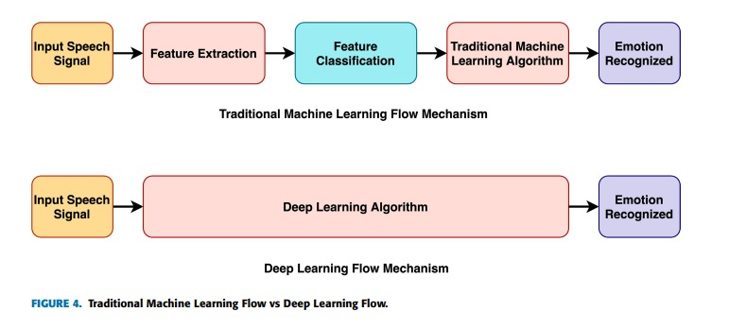
HIGH LEVEL ARCHITECTURE

Slide 5
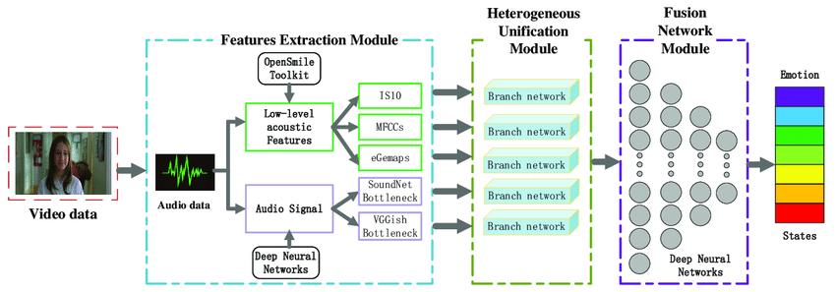
HIGH LEVEL ARCHITECTURE
The proposed human emotion recognition system is of five components: input speech signal, pre-processing, feature extraction and selection, classification and finally emotions recognition. The Architecture of Emotional speech recognition system is as shown in above figure.

Slide 6
LITERATURE SURVEY
PES1UG20CS247
TITLE OF THE PAPER | YEAR OF PUBLICATION | JOURNAL / CONFERENCE NAME | ADVANTAGES | LIMITATIONS
SPEECH EMOTION RECOGNITION USING DEEP LEARNING TECHNIQUES: A REVIEW | 2019 | Rahul Amin Khalil, Edward Jones, Mohammad Inayatullah Babar,Tariqullah Jan, Mohammad Haseeb Zafar, Thamer Alhussain | Deep Learning Produces better Accuracy than Traditional Machine Learning Models | Detailed overview of Deep Learning Techinques for SER.
FAST AND ACCURATE SEQUENTIAL FLOATING FEATURE SELECTION WITH THE BAYES CLASSIFIER APPLIED TO SPEECH EMOTION RECOGNITION | 2008 | DimitriosVerveridis, ConstantineKotropoulos | The Proposed technique can handle as many features as one wishes to extract from the data execution time and the accuracy of SFFS method are optimized by exploiting statistical tests instead of comparing just average CCRs. | It is found that the proposed method A reduces the executional time of SFFS by 50% without deteriorating its performance. Method B improves the accuracy of SFFS by exploiting confidence intervals of MCCR for the compartison of features.
HIDDEN MARKOV MODEL BASED SPEECH EMOTION RECOGNITION | 2003 | B. Schuller, G. Rigoll, M. Lang | One reason for the better performance can be seen in the loss of information of durations of voiced sounds by eliminating these in the contours. | we aim at a hybrid approach combining neural networks and hidden Markov models for the automatic recognition

Slide 7
LITERATURE SURVEY
PES1UG20CS263
TITLE OF THE PAPER | YEAR OF PUBLICATION | JOURNAL / CONFERENCE NAME | ADVANTAGES | LIMITATIONS
SPEECH EMOTION RECOGNITION METHODS | 2017 | Badak Basharirad and Mohammadreza Moradhaseli | In this paper, HMM with short time LFPC as a feature exhibits good accuracy at various chart levels. | HMM with short time LFPC adopted as a feature in this survey exhibits good accuracy on several levels in the chart.
A CROSS CORPUS STUDY ON SPEECH EMOTION RECOGNITION | 2019 | Rosanna Milner, Md Asif Jalal, Raymond W. M. Ng, Thomas Hain | OOD models show that learning from multiple discordant datasets is more useful than training from a single dataset Mismatched datasets, and reconciliation yields significant improvement shows the importance of training on adjusted data | Investigation of performance degradation during movement from traded to more natural datasets.
CLUSTERING BASED SPEECH EMOTION RECOGNITION BY INCORPORATING LEARNED FEATURES AND DEEP BILSTM | 2020 | Mustaqeem, Muhammad Sajjad, Soonil Kwon | We improved the detection accuracy for the IEMOCAP dataset to 72.25%, reaching 85.57% for the EMO-DB dataset and 77.02% for the RAVDESS dataset. | The experimental results of the proposed system proved the robustness and significance for SER to correctly recognize the emotional state of the speaker using spectrograms of speech signals

Slide 8
LITERATURE SURVEY
PES1UG20CS304
TITLE OF THE PAPER | YEAR OF PUBLICATION | JOURNAL / CONFERENCE NAME | ADVANTAGES | LIMITATIONS
IMPACT OF FEATURE SELECTION ALGORITHM ON SPEECH | 2020 | Misbah Farooq, Fawad Hussain, Naveed Khan Baloch, Fawad Riasat Raja, Heejung Yu, and Yousaf Bin Zikria | AlexNet (Conv4).-91.11%, SVM (79.08%) RAVDESS dataset- calm (85.26%) and neutral (98.96%) | The model created can only predict the emotion of the speaker on the basis of speech. It doesn’t guaranee the emotion is correct. Just the prediction is shown.
SPEECH EMOTION RECOGNITION | 2012 | Ashish B. Ingale, D. S. Chaudhari | For the best features a maximum accuracy of 78.77% could be achieved using GMM. speaker independent r (75%), speaker dependent (89.12%) | All the training and testing equations are based on the supposition that all vectors are independent therefore GMM cannot form temporal structure of the training data.
MULTIMODAL SPEECH EMOTION RECOGNITION AND AMBIGUITY RESOLUTION | 2019 | Gaurav Sahu David R. Cheriton School of computer Science University of Waterloo Ontario, Canada | Audio+Text results gives us a boost of ∼ 14% for all the metrics. | Extracted handful of time-domain features from audio signals. The audio feature-space could be richer using frequency domain features.

Slide 9
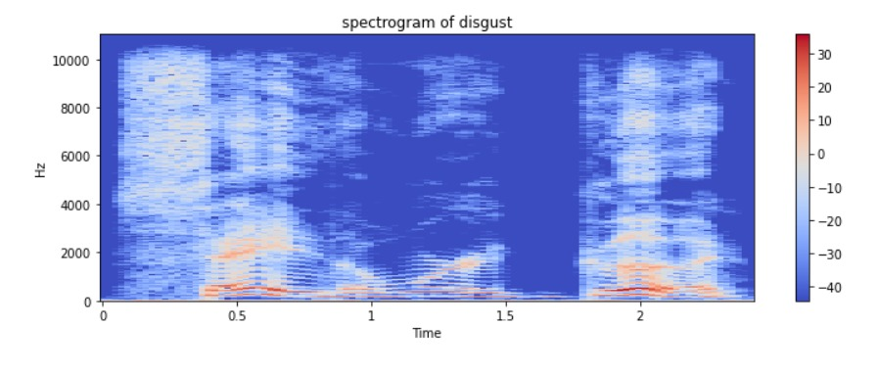
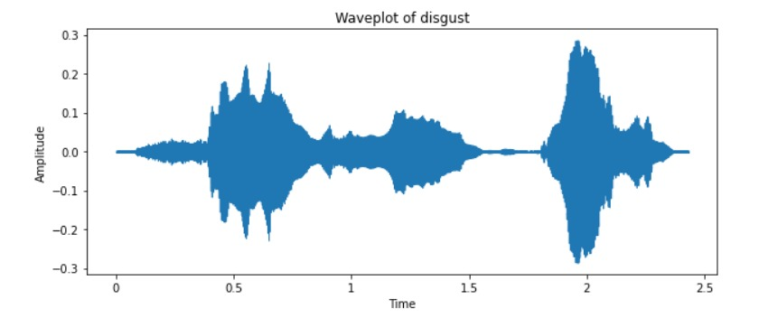
PROPOSED APPROACH
EXPLORATORY DATA ANALYSIS
CHOOSING THE APPROPRIATE DATASET.
ELIMINATING THE NOISE.
PLOTTING WAVE PLOTS AND SPECTROGRAM.

Slide 10
FEATURE EXTRACTION
FEARURE EXTRACTION IS DONE USING MFCC
MFCC IS USED FOR FEATURE EXTRACTION BECAUSE IT IS A REPRESENTATION OF THE SHORT TERM POWER SPECTRUM OF A SOUND, BASED ON SOME TRANSFORMATION IN A MEL-SCALE.
IN MEL-SCALE EQUAL DISTANCES IN PITCH SOUNDED EQUALLY DISTANT TO THE LISTENER.

Slide 11
EMOTION PREDICTION
MODEL TYPE :- SEQUENTIAL LSTM
ACTIVATION FUNCTION :- RELU
OUTPUT ACTIVATION FUNCTION :- SOFTMAX
LOSS FUNCTION :- CATEGORICAL CROSS ENTROPY.
OPTIMIZER :- ADAM
EPOCHS :- 100 WITH SHUFFLE
VALIDATION SPLIT :- 0.2

Slide 12
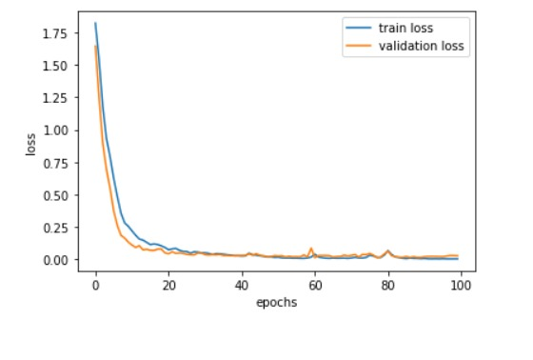
RESULTS AND DISCUSSION

Slide 13
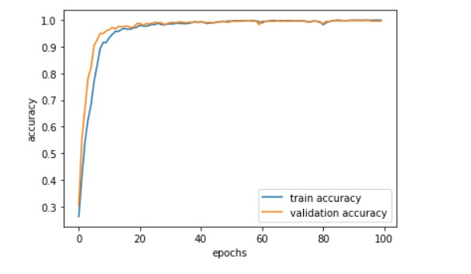
RESULTS AND DISCUSSION

Slide 14
REFERENCES
https://citeseerx.ist.psu.edu/viewdoc/download?doi=10.1.1.457.2825&rep=rep1&type= pdf
https://ieeexplore.ieee.org/abstract/document/1202279
https://ieeexplore.ieee.org/abstract/document/1527805
https://ieeexplore.ieee.org/abstract/document/9078789

Slide 15
THANK YOU

