Slide 1

Maths and Brain Assessment Toolset UNDER Mr. Kishor Chaturani (OSS Enterprise Architect, TCS Ltd.) and Surabhi Baoker (Solution Architect, TCS Ltd.)

Slide 2
Project Team
Name College
Aditya NK NIT, Silchar
Manveer Singh GNDU, Amritsar
Mayank Arya IIT, Patna
Nandan Sukthankar COEP, Pune
Saurav Kumar ISM, Dhanbad
Shefali Gupta MNIT, Jaipur
Shubham Shah VNIT, Nagpur
Srinidhi Bhat IIT, Kharagpur
Sunny Mazumder NIT, Silchar
Utkarsh Jain NIT, Silchar

Slide 3
Key Challenges in Teaching
Education in India – Theoretical in nature.
Lacking practical aspects.
Teaching methodology – one way communication.
Places students in passive role.

Slide 4
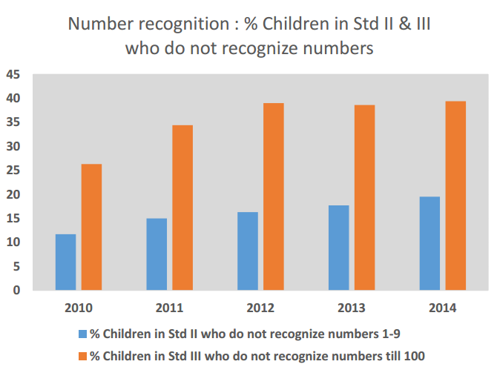
Do children recognize numbers in early grades?
Source: ASER (Annual status of education report)

Slide 5
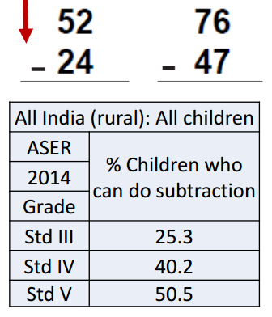
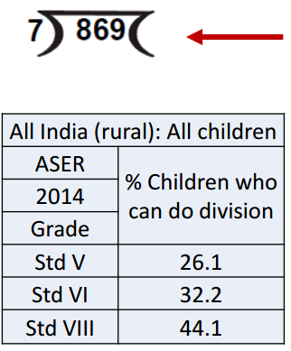
What about basic operations in Standard III and above?
Source: ASER (Annual status of education report)

Slide 6
Objective
To provide an interactive learning platform for kids
Targeted age group : 4-9 years
To assess fundamental concepts of Math and logical subjects
All targeted through interactive fun filled games

Slide 7
About Target Audience
Fun seeking
No prior knowledge of math
Very small attention span

Slide 8
DEMO

Slide 9
System Design Characteristics
Configurable
Scalable
Interoperability
Open Source (github.io/moovon/IITBProject)
Portable
Randomness

Slide 10
Features of Platform
Sign up individual User
Batch Registration
Mail verification
View/ Edit profile
Forgot password
Record User Activity
Leader board
Dashboard
Admin Page

Slide 11
Metrics of Deliverables
Subjects : 50
Themes : 7
Total 65 games
Lines of code : Only 8 KLOC
Number of Config. Files for games: 160
Notes:
Interactive Learning through multiple attractive themes

Slide 12
Challenges Faced
In Front End
Making it configurable
Making generic functions
Mapping correct answer in the form at random position
In Backend
In configuring Mongo Engine for database with django
In configuring external email server
Configuring edx platform with our platform.
Notes:
Making functions generic for any theme-subject combination
Mapping correct answer in the form at random position
To stop and start the animation again

Slide 13
What have we learnt?
Technical knowledge
Web Development
Database design
Django framework
Three.js library
Social skills
Team work
Time management
Problem solving skills
Respecting other’s work

Slide 14
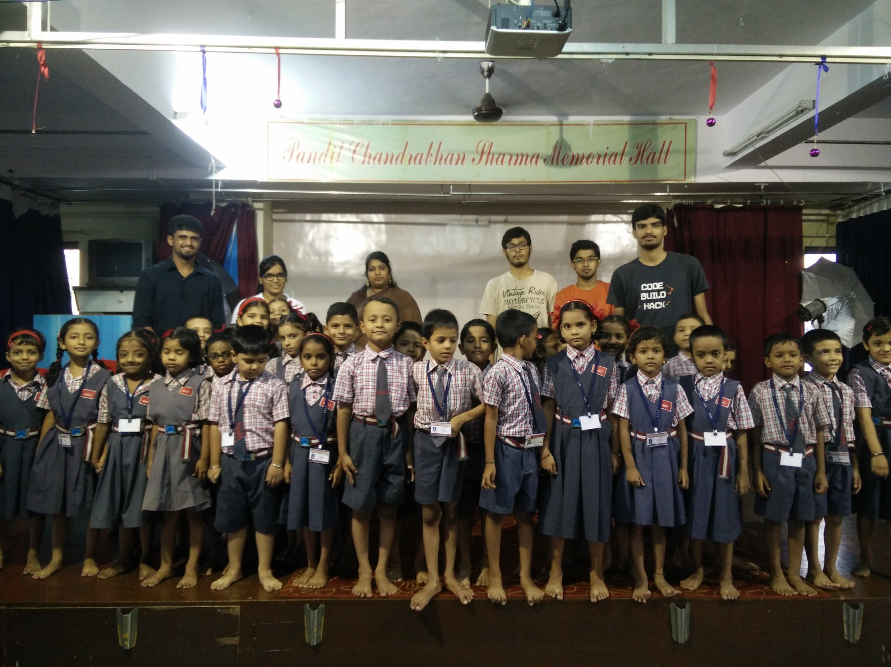
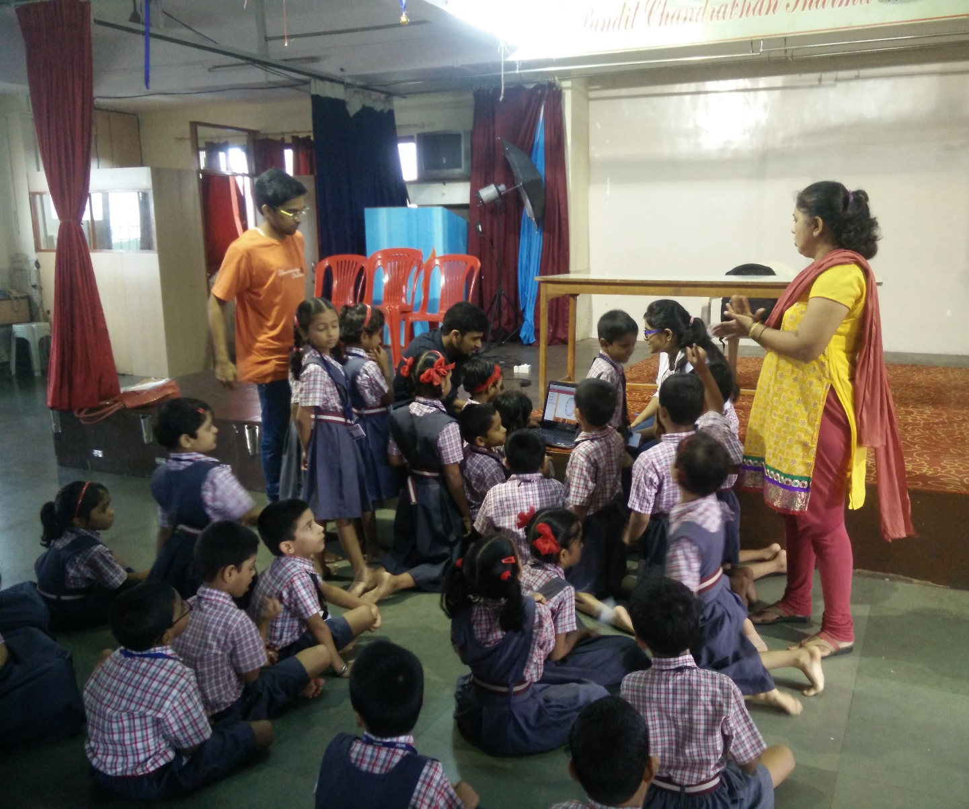
Visit to Powai English High School, Powai

Slide 15
Future Scope
Expansion of platform
User profile based system response (A.I.)
Desktop App

Slide 16
Thank You!

