Slide 1
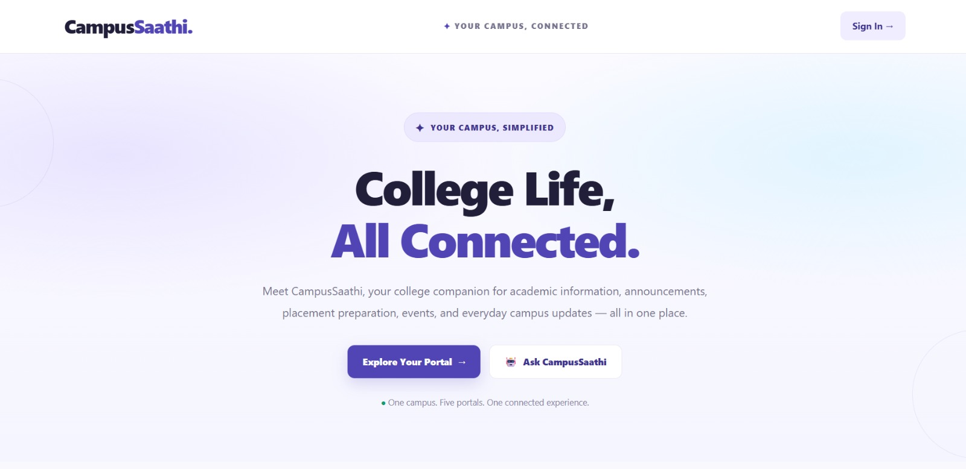
FINAL PROJECT PRESENTATION
CampusSaathi
Your Campus, Connected
A unified campus portal for academic updates, announcements, complaints and student support.
Team: Manvi, Mausam, Nikita Rathore, Kusum, Nikita

Slide 2
Problem Statement and Our Solution
The problem
Our solution
Scattered updates: students look in many places for announcements, assignments and college information.
Different roles: students, teachers, HODs, club leaders and administrators all need different actions.
Communication gaps: notices and complaints have no clear route between campus stakeholders.
One entry point for all campus services.
Separate dashboards for each role.
Easy access to announcements and academic information.
Assignment and complaint workflows where available.
A campus assistant for quick questions.
Goal: bring key campus interactions together in one role-based web portal.

Slide 3
Homepage: CampusSaathi at a Glance
What the homepage offers
Campus identity: brand and name at the top.
Sign-in entry point for all users.
Explore Your Portal button leads to role selection.
Ask CampusSaathi: a built-in assistant for quick help.
A short value statement explains the idea at once.
Actual screenshot of the CampusSaathi homepage.

Slide 4
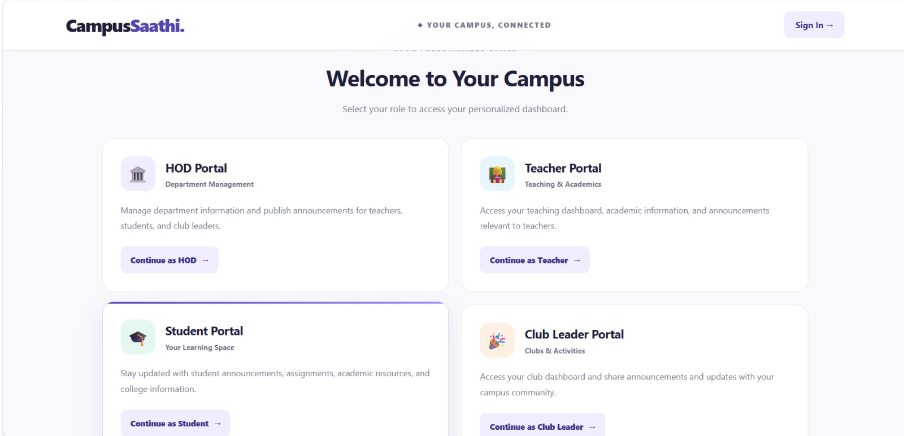
Role Selection: Separate Portals
Five portals
Student: assignments, marks and complaints.
Teacher: classes, assignments and notices.
HOD: department announcements and complaint review.
Club Leader: club announcements and issues.
Administrator: opens from a separate screen.
Every user picks the portal built for their role.

Slide 5
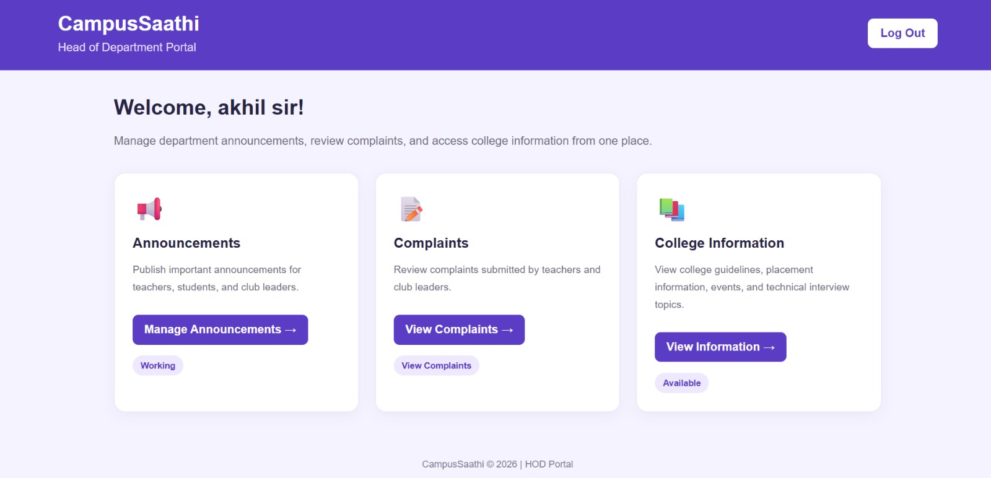
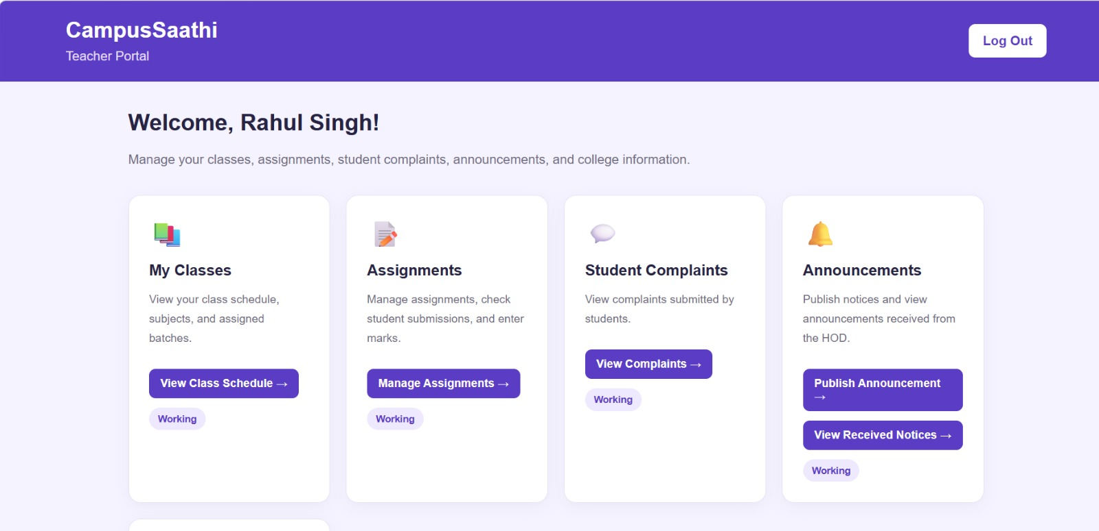
Modules 1-2: HOD and Teacher
HOD Portal
Teacher Portal
Announcements: manage department notices.
Complaints: review those from teachers and club leaders.
College information: open it from the dashboard.
My Classes: schedules, subjects and batches.
Assignments: manage submissions and marks.
Complaints: view student complaints.
Announcements: publish and view HOD notices.

Slide 6
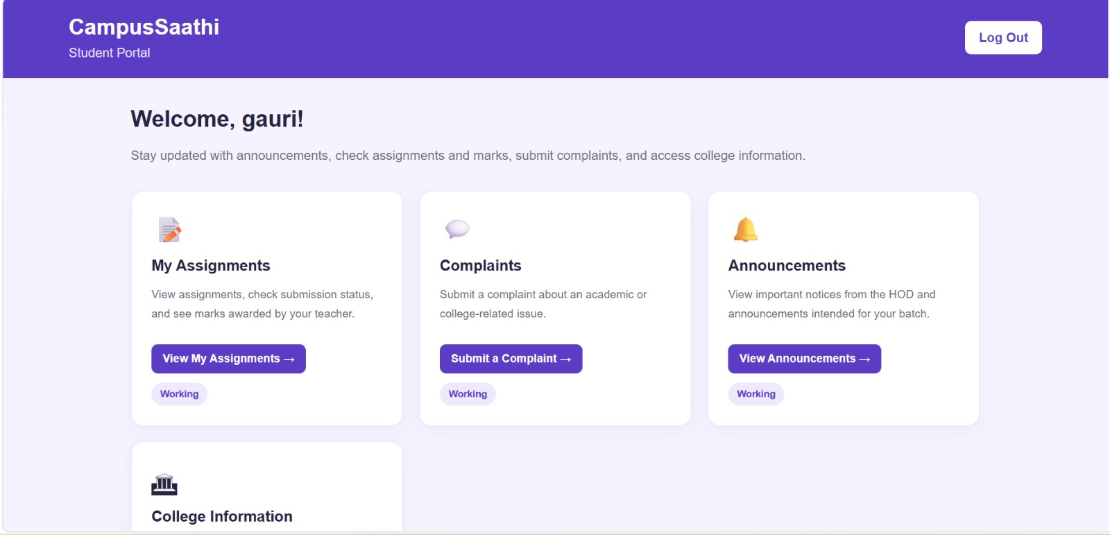
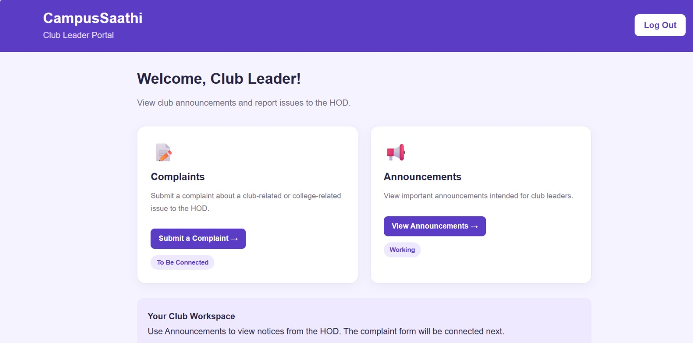
Modules 3-4: Student and Club Leader
Student Portal
Club Leader Portal
Assignments: see work and submission status.
Marks: view marks given by teachers.
Complaints: submit academic or college issues.
Updates: read announcements and college info.
Announcements: view updates meant for club leaders.
Issues: submit club or college related problems.
Status: complaint form is marked To Be Connected.

Slide 7
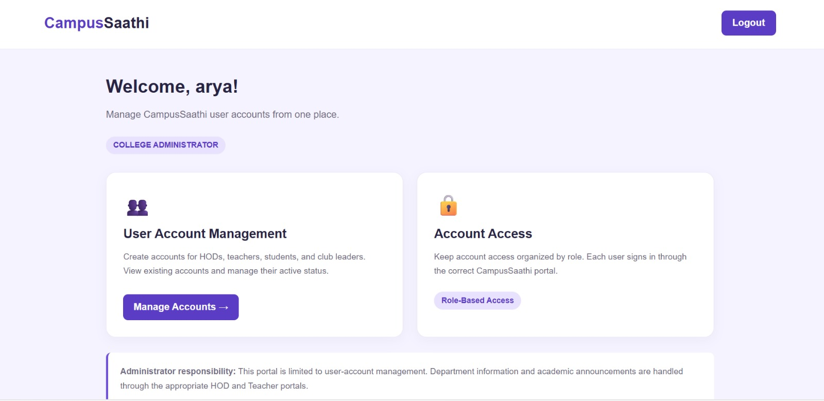
Module 5: Administrator Portal
Control for the whole campus
Create accounts for HODs, teachers, students and club leaders.
View accounts already registered.
Manage status: keep accounts active or inactive.
Role-based access so each user sees the right portal.
Account management screen for the administrator.

Slide 8
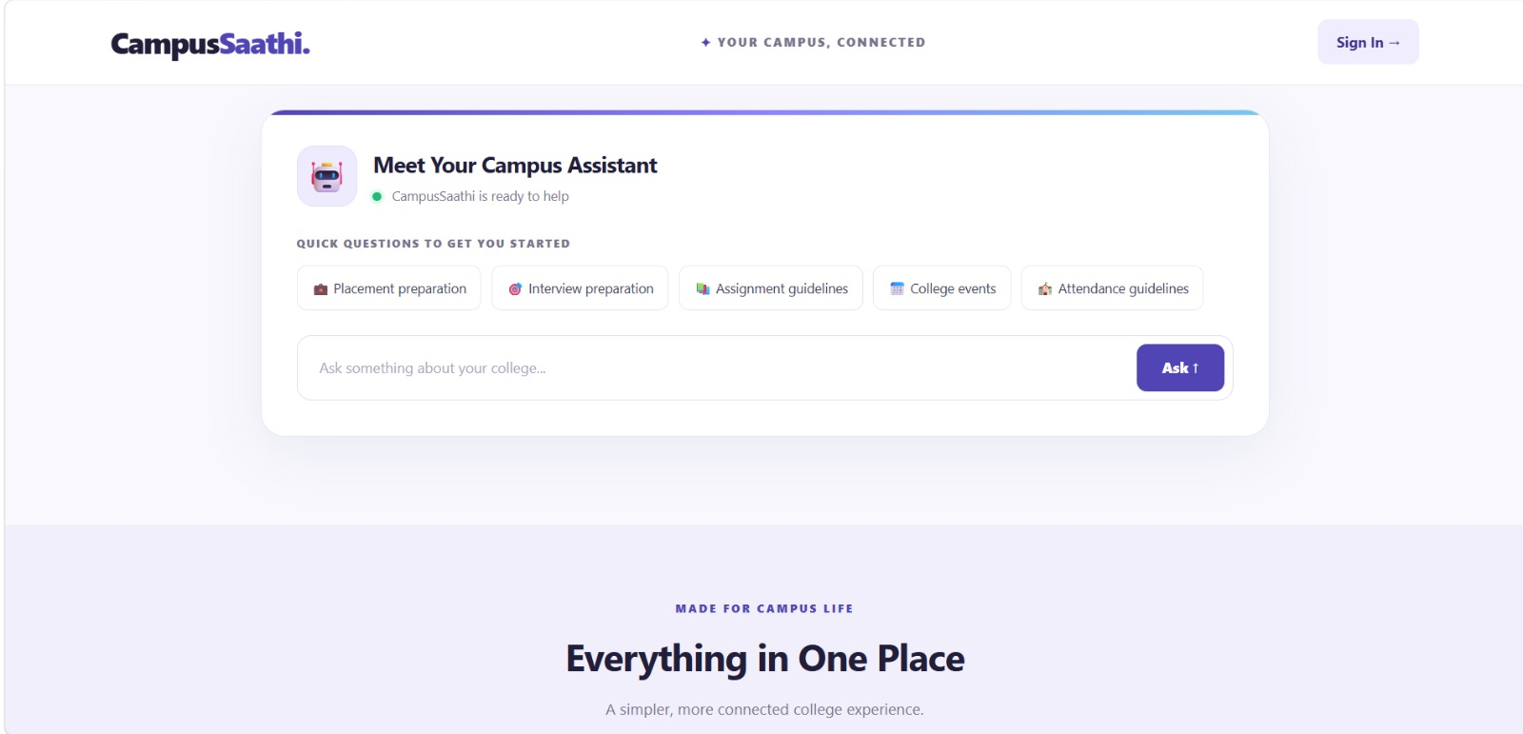
Campus Assistant: Ask CampusSaathi
Ask about
Placement preparation.
Interview preparation.
Assignment guidelines.
College events and activities.
Attendance guidelines.
Quick prompts make the assistant easy to start.

Slide 9
Status and Future Scope
Working now
Still pending
Future scope
Student assignments, complaints and announcements
Teacher classes, assignments and notices
HOD and club leader announcements
Club Leader complaint form is marked To Be Connected
Assistant answers need live validation
Notifications and searchable announcements
Stronger validation, access checks and logs
A smarter assistant with feedback handling

Slide 10
Thank You
Questions and Answers
CampusSaathi: one campus, connected services.
Team: Manvi, Mausam, Nikita Rathore, Kusum, Nikita

