Slide 1
Project Based Seminar Indoor Navigation System Guide :- Prof. Rachna Chhajed
Group members :-
1.Neha Jaju (33224)
2.Komal Parmar (33144)
3.Manvi Pandya (33235)

Slide 2
Abstract
Indoor navigation system is mobile based application focusing on providing easy navigation facilities to the users for locating a specific location in any building considering all aspects including different floors of the building.
The platform is modularized and provided access according to the primary users and their responsibilities:
Users (online/offline)
Owner of the building/campus (Admin)
Mediator(may exists or not)

Slide 3

Domain :
Machine Learning (algorithms to find shortest path if optimisation doesn’t work).
IOT (for beacons)/ Augmented Reality / Other (depending on the technology used to find position).
GIS and Geofencing
Data analysis

Slide 4





Positioning Technologies
We classify Indoor Positioning technologies using several criteria, one of which is the kind of signal used for location. We can have the following kinds of signals :
Radio Frequency Signals (RF)
Wi-Fi
Bluetooth
ZigBee
RFID (Radio Frequency Identification)
Ultrawideband
Light
Infrared technology (IR)
Visible Light Communication (VLC)
Sound
Ultra sound
Audible sound
Magnetic Fields
Inertial Technology
Computer Vision

Slide 5
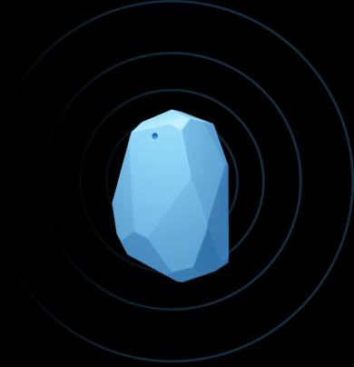
What are beacons?
Beacons are small, often inexpensive devices that enable more accurate location within a narrow range than GPS, cell tower triangulation and Wi-Fi proximity.
Beacons transmit small amounts of data via Bluetooth Low Energy (BLE) up to 50 meters, and as a result are often used for indoor location technology, although beacons can be used outside as well.
It’s transmitting a unique ID number that tells a listening device which beacon it’s next to.

Slide 6
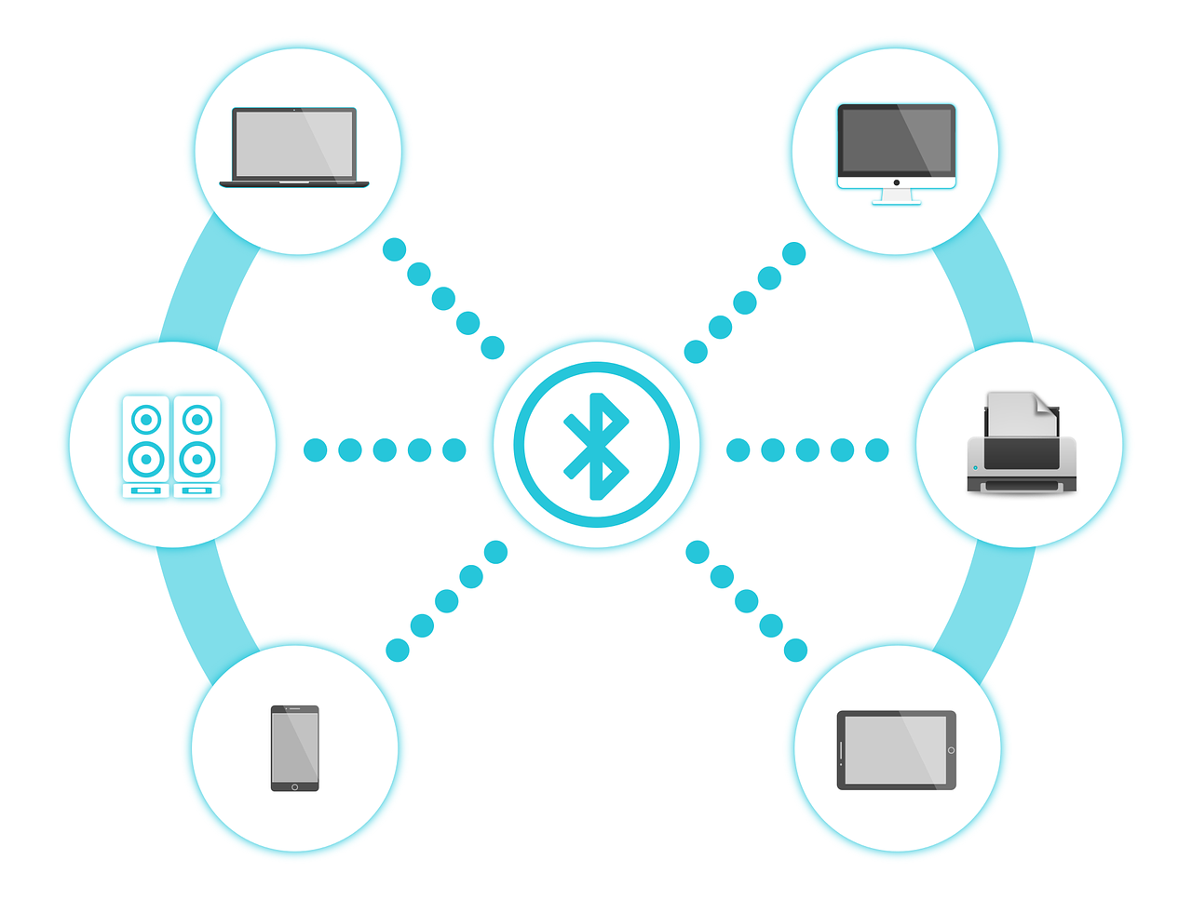
What is BLE?
BLE stands for Bluetooth Low Energy.
The beacon’s working is based upon BLE.
BLE’s low energy needs are vital to beacons, as it allows them to run for years on tiny coin-cell batteries.
It also consumes far less energy than the old and clunky Bluetooth.
In fact, BLE is a major driver in the IoT, allowing technology to last longer with smaller parts.

Slide 7
What is i-Beacon?
In 2013, iBeacon was brought to market by Apple, and became the first communication protocol for proximity beacons.
iBeacon software is their proprietary technology, and cannot be accessed by outside parties.
Although iBeacon can interact with Android as well as iOS, there are some limitations for owners of Android devices, for example, iBeacon can't wake up an Android app that is deactivated.
An Android app must be running (in the background at least) for iBeacon to trigger activation.
Due to such reasons, Google developed beacons called as Eddy stone which was developed for Android with no limitations.

Slide 8
Difference between beacons and i-beacons
Beacons (Eddy stone) | i-Beacons
1. Manufactured by Google | 1. Manufactured by Apple
2. It is open-source | 2. It cannot be accessed by outside party
3. Not simple to implement | 3. Simple to implement
4. It provides flexibility | 4. Not very flexible
5. No limitations for android users | 5. Limitations for android users

Slide 9
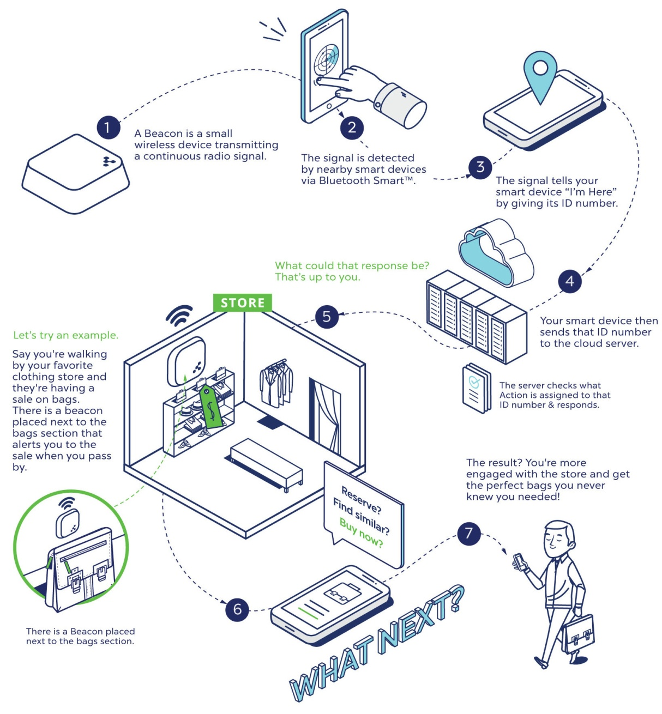
Working of beacons
The beacon sends out its ID numbers about ten times every second (sometimes more, sometimes less, depending on its settings).
A nearby Bluetooth-enabled device, like your phone, picks up that signal.
When a dedicated app recognizes it, it links it to an action or piece of content stored in the cloud and displays it to the user.

Slide 10

Advantages and Disadvantages of beacons
Advantages
Improved offline attribution
Effective Advertising Tool
Increases App Engagement and Retention
Provides Insightful Data
Cheap and Easy to Adopt
Disadvantages
Beacons Do Not Work on Their Own
Tracking Movement is Not Simple
Bluetooth is Not Battery-Friendly
iOS users must have a relevant app

Slide 11
Introduction to various possible algorithms to find optimal path:
Due to complex structure of buildings and infrastructure like areas, to get the exact location of any entity has become difficult. Therefore, Indoor positioning and navigation system, plays vital role for obtaining position for indoor areas.
Various algorithms includes:
Dijkstra’s
A*
Location Aware and Remembering Navigation (LARN)
Flexible Path Planning(FPP)
HCT NAV

Slide 12
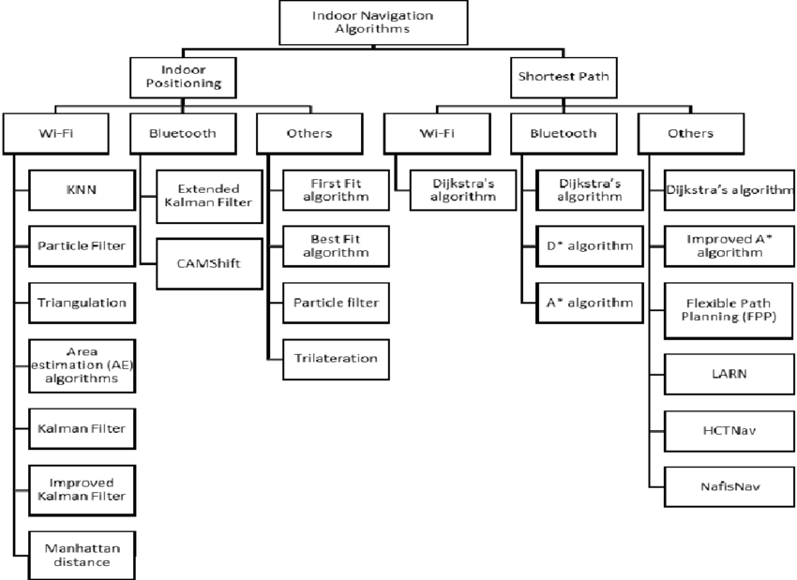

Slide 13
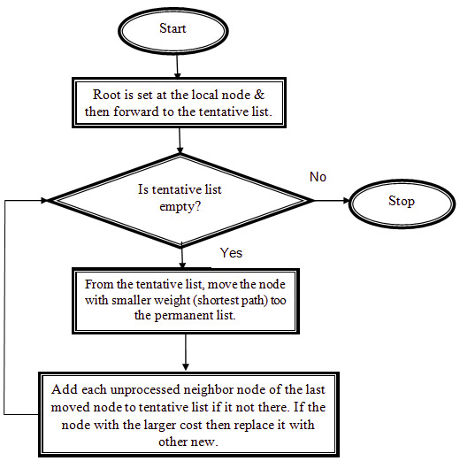
Dijkstra’s Algorithm
Dijkstra's algorithm is an algorithm for finding a graph geodesic, i.e., the shortest path between two graph vertices in a graph. It functions by constructing a shortest-path tree from the initial vertex to every other vertex in the graph.

Slide 14
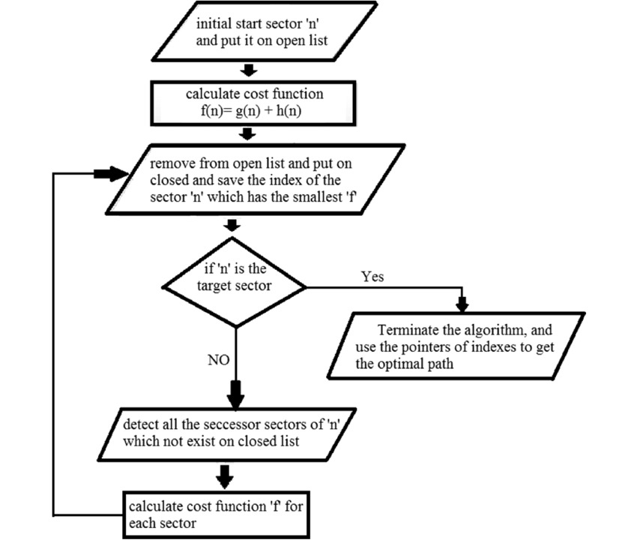
A* Algorithm
A* Search algorithms, unlike other traversal techniques, it has “brains”, which separates it from the other conventional algorithms.
A* selects the route that minimizes G(n)=a(n)+h(n) Where , n is the last node on the path , a(n)is the cost of the path from the start node to n, and h(n) is a heuristic that estimates the cost of the cheapest route from n to the goal.

Slide 15
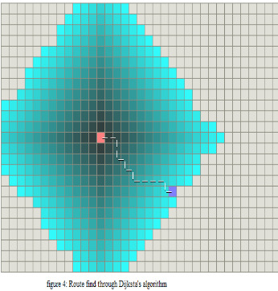
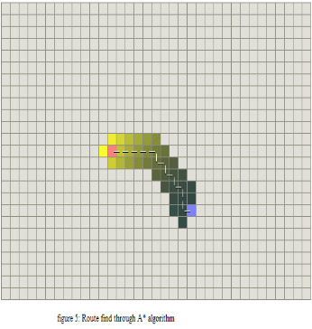
Comparison
Dijkstra’s
A*
A* search algorithm is an extension of the Dijkstra’s algorithm. A* algorithm is Dijkstra’s algorithm without heuristic. Both the algorithm gives the shortest path but the A* gives more faster and efficient result.

Slide 16
Conclusion(Navigation)
However, most of indoor positioning systems lack accuracy due to complex structure of areas, mobility of people and indoor obstacles.
In order to increase the accuracy of positioning system using wireless communications , we suggests A* algorithm to be implemented for finding the route due to its performance and accuracy.

Slide 17
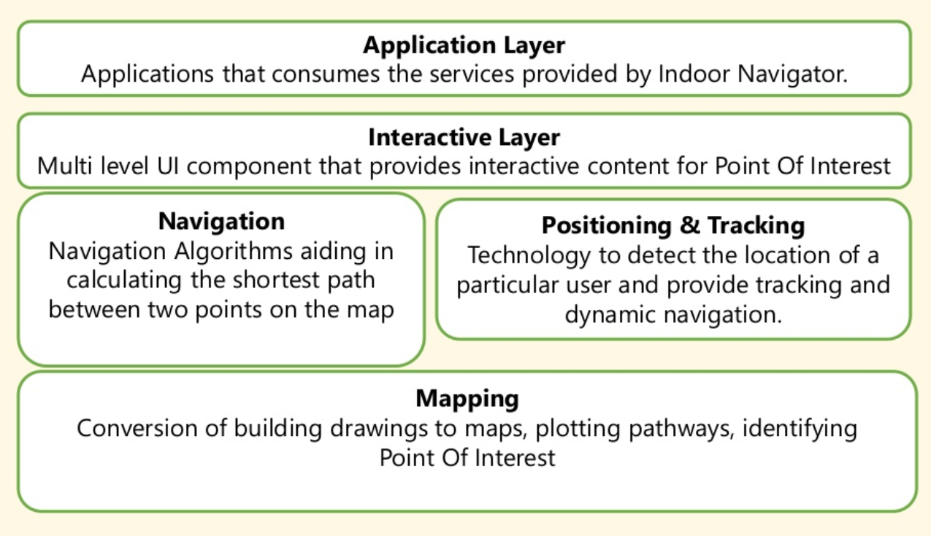
Technology Stack

Slide 18

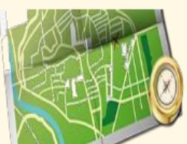

Mapping Mapping tools provides 3 Features including:
Map Creation
Allowable Path
Point of Interest
Converts the floor plan image into suitable format and Identify details at different levels.
Allow admin to mark the paths.
Provides Flexibility to user to choose among different paths
It includes conference rooms , elevators and other amenities like water-coolers.

Slide 19
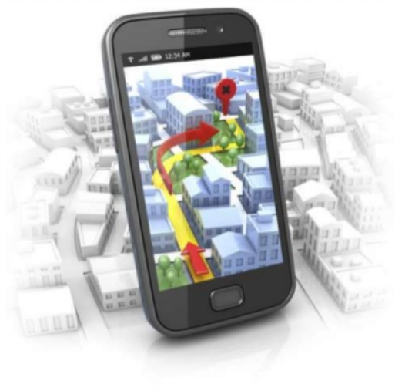
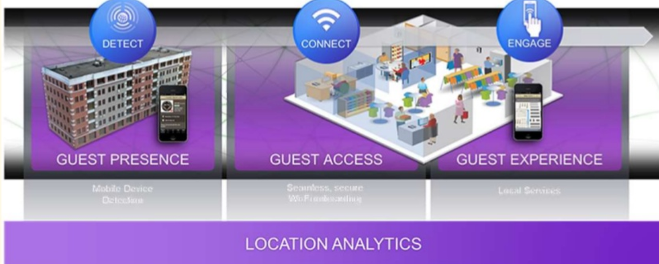
Positioning and Navigation
Positioning
Navigation

Slide 20

Interactive Layer
This layer helps user to interact with Point-of-Interest(presented as overlay above the map at specific location.)
Custom Interactive definitions are possible where another applications can be launched within the map.
Example: To book a movie ticket.

Slide 21
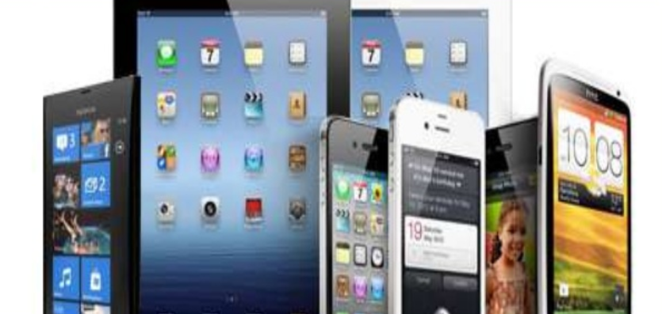
Application Layer
All the services of Indoor-Navigation – Mapping, Navigation , Positioning and Interaction are exposed as Web-App Service that can be consumed by Application Layer.
This helps in having one common SDK for all platforms – iOS , Android , Laptop ,Desktop etc.

Slide 22
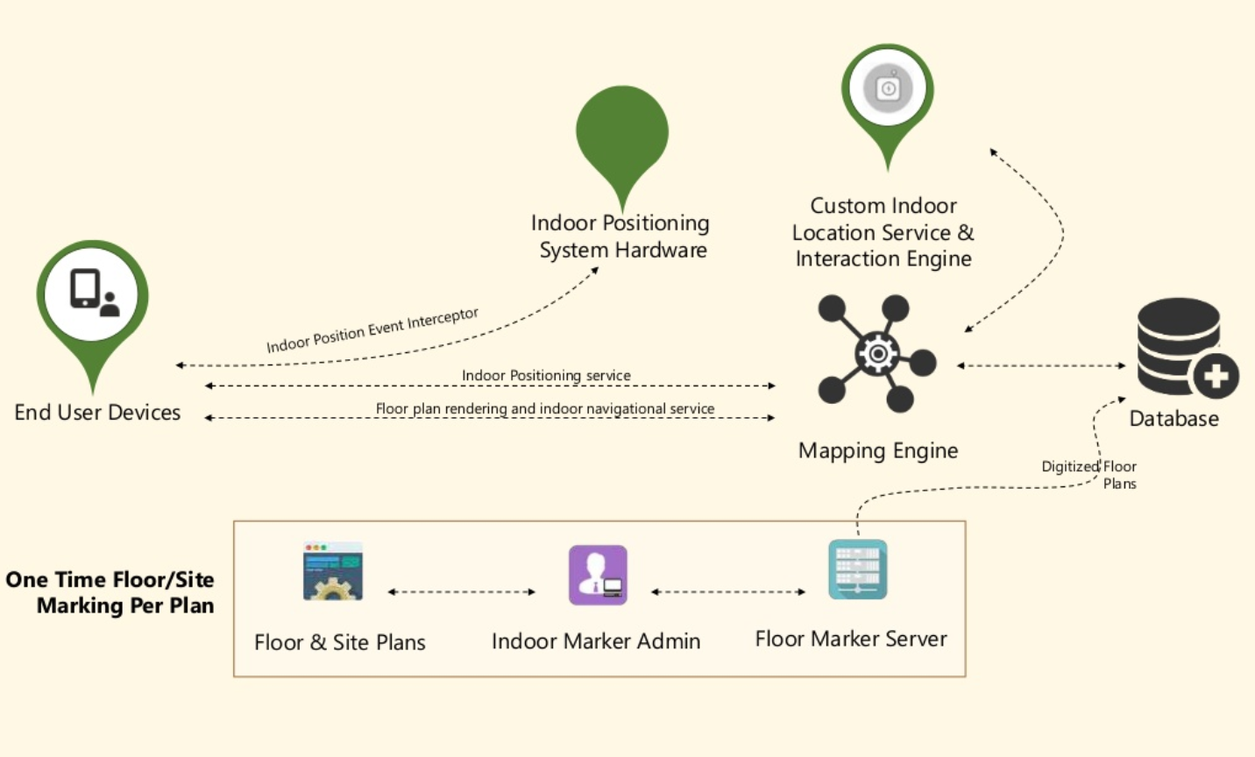
Work-Flow

Slide 23




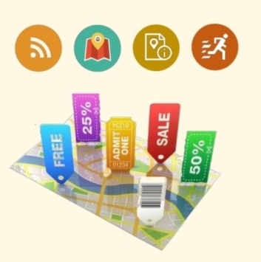
Features
Indoor Marker Admin
Allows Admin to Locate paths and points of interest.
Share Location
This feature will share your current location in building to other contact
Emergency Evacuation
It finds the closest Emergency exit during crisis.
Find a Friend
A friend gets a notification if other is in same locality
(If connected via any social networking ).
Location Based Features
Provides Indoor Local Information

Slide 24
Topic |  | Advantages | Disadvantages
Time-Efﬁcient Indoor Navigation and Evacuation With Fastest Path Planning Based on Internet of Things Technologies | 2019 IEEE TRANSACTIONS ON SYSTEMS, MAN, AND CYBERNETICS: SYSTEMS | Finds the fastest path and shortest path based on congestion In case of emergency, provides closest exit without congestion Friend’s location can be detected. | No admin panel
Mobile Indoor Navigation System in iOS Platform Using Augmented Reality |  | Augmented reality is more accurate | Starting point should be entered manually Not feasible in new places For accuracy purpose, gender and height is required of user (user specific)
Indoor Navigation System using BLE Beacons | 2019 International Conference on Nascent Technologies in Engineering (ICNTE 2019) | Uses web app rather than traditional apps Has admin panel Dynamic interaction and adaptability to changes | Need internet connection Fastest path is not provided

Slide 25
Topic |  | Advantages | Disadvantages
An Indoor Positioning and Navigation Application for Visually Impaired People using Public Transport | 2018 International Conference on Indoor Positioning and Indoor Navigation (IPIN), 24-27 September 2018, Nantes, France | Both outdoor(GPS) and indoor(PDR) navigation system Different modes are also shown including railway (Graz main railway station) to reach target point | Uses PDR algorithm which is very complex PDR is not accurate as beacons Uses tactile paths which is difficult to follow Useful only for visually impaired people
Smart Indoor Navigation System over BLE | 2019 8th International Conference on Modern Circuits and Systems Technologies (MOCAST) | A* algorithm Beacon (accuracy upto 1m) | Need internet connection No admin panel (Blueprint is a pre-requisite)
Indoor pedestrian navigation algorithm based on smartphone mode recognition | 2019 IEEE 3rd Information Technology,Networking,Electronic and Automation Control Conference (ITNEC 2019) | Neural networks are used (accuracy 99.45%) Heading correction method is used Step length method is used to improve accuracy | Inertial sensors are required for positioning which is not practically possible (first aspect)

Slide 26
References
BSB Navigator
Proximi.io
https://www.doc.ic.ac.uk/teaching/distinguished-projects/2013/a.chandgadkar.pdf
“Indoor Navigation System using BLE Beacons”, International Conference on Nascent Technologies in Engineering, 2019.
“Time-Efﬁcient Indoor Navigation and Evacuation with Fastest Path Planning Based on Internet of Things Technologies”, IEEE Transactions On Systems, Man, And Cybernectics : Systems, 2019.
“A Smart Indoor Navigation System over BLE”, 8th International Conference on Modern Circuits and Systems Technologies, 2019.
“Indoor pedestrian navigation algorithm based on smartphone mode recognition”, IEEE 3rd Information Technology, Networking, Electronic and Automation Control Conference, 2019.
“Indoor Positioning Method Using Augmented Audio Reality Navigation Systems Using iBeacons”, IEEE 4th Global Conference on Consumer Electronics, 2019.
“Sim-Real Joint Reinforcement Transfer for 3D Indoor Navigation” , IEEE/CVF Conference on Computer Vision and Pattern Recognition, 2019.

Slide 27
Thank You!!

