Slide 1

ENHANCING LEGAL ASSISTANCE WITH DATA ENRICHMENT USING HPCC SYSTEMS

Slide 2

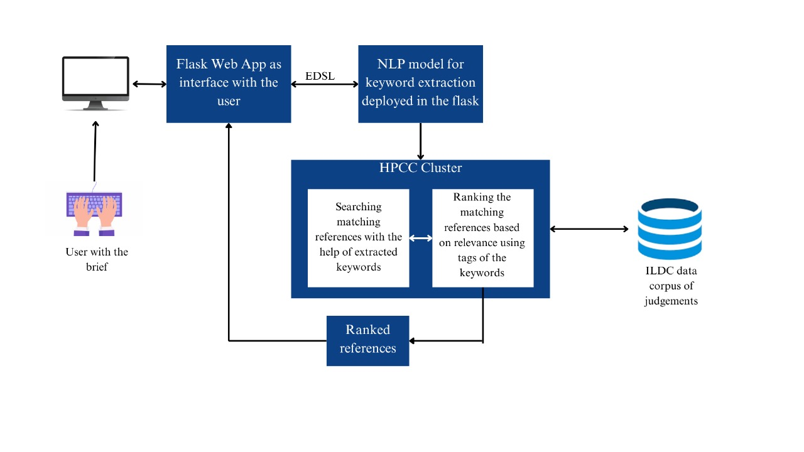

Slide 3
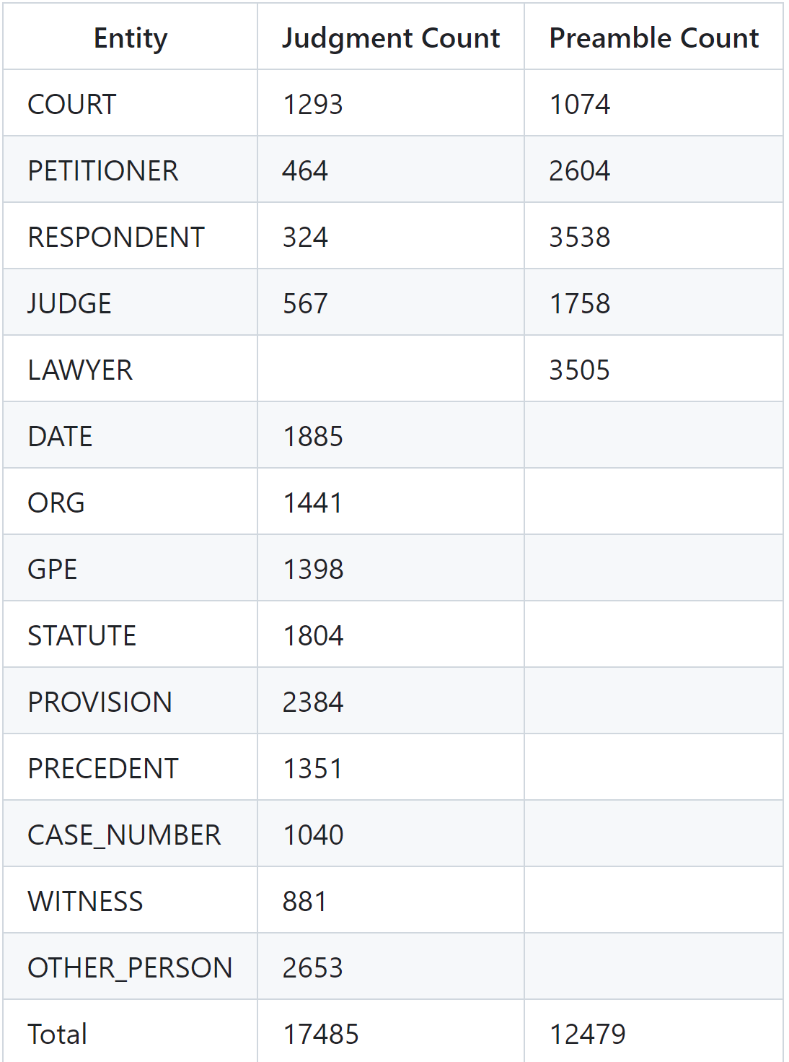
NLP Model
The main application of NLP in our project is to extract keywords from the user input.
For that we are using a pre-trained model that is built using Named Entity Recognition(NER) support in spacy library. The model is built and trained on a data corpus of 9500 judgments.
It is a free to use model that could be found on hugging face community.
https://huggingface.co/opennyaiorg/en_legal_ner_sm

Slide 4
Input Example and expected set of keywords
In the Karnataka High Court, the Sharma vs. Rao land dispute unfolds under Sections 79 of the Karnataka Land Revenue Act, 1964, Section 3 of the Limitation Act, 1963, and Section 101 of the Indian Evidence Act, 1872. Sharma, claiming ancestral ownership, cites oral evidence and old records, shifting the burden of proof to the Rao family. Rao presents recent documentation, invoking Section 79, challenging Sharma's claim. Justice Patel orders a halt on land activities, directing a court-ordered survey and document scrutiny.
The keywords relevant are:
Karnataka High Court
Land dispute Act
Section 3,Section 101,Section 79
Justice Patel
Karnataka Land Revenue Act, 1964
Evidence Act, 1872

Slide 5
DATA CORPUS
The ILDC dataset (Indian Legal Documents Corpus) is a large corpus of 35k Indian Supreme Court cases annotated with original court decisions. A portion of the corpus (a separate test set) is annotated with gold standard explanations by legal experts.
This data was originally used by the students to build a ML model that predicts the possible judgment of a case.
Reference:
https://github.com/Exploration-Lab/CJPE/tree/main/Data

Slide 6
Searching the data corpus for relevant references
After getting the set of keywords from the NLP model ,these keywords are searched in the data corpus.
The data corpus in the cluster is searched using the existing ECL functions like JOIN() and ITERATE().
Any entry in the dataset that contains these keywords will be shortlisted for further ranking.
This ranking will be done on the basis of importance of the word.

Slide 7
What all has been completed in the project?
NLP model for keyword extraction
Data corpus(ILDC) and district court judgements
Searching the corpus for shortlisting

Slide 8
What lies ahead in the timeline?
Developing a ranking algorithm:
Once the shortlisting is done we will have to rank the cases from most relevant to lest relevant cases.
This will be a rule based ranking that is based on the structure of the Indian Penal Code.
Web Interface for showcasing the ranked references:
API Integration: Connect website to HPCC cluster via API for real-time access to ranked legal references and transfer of relevant keywords.

Slide 9


Any Questions?

Slide 10


